Slide 1
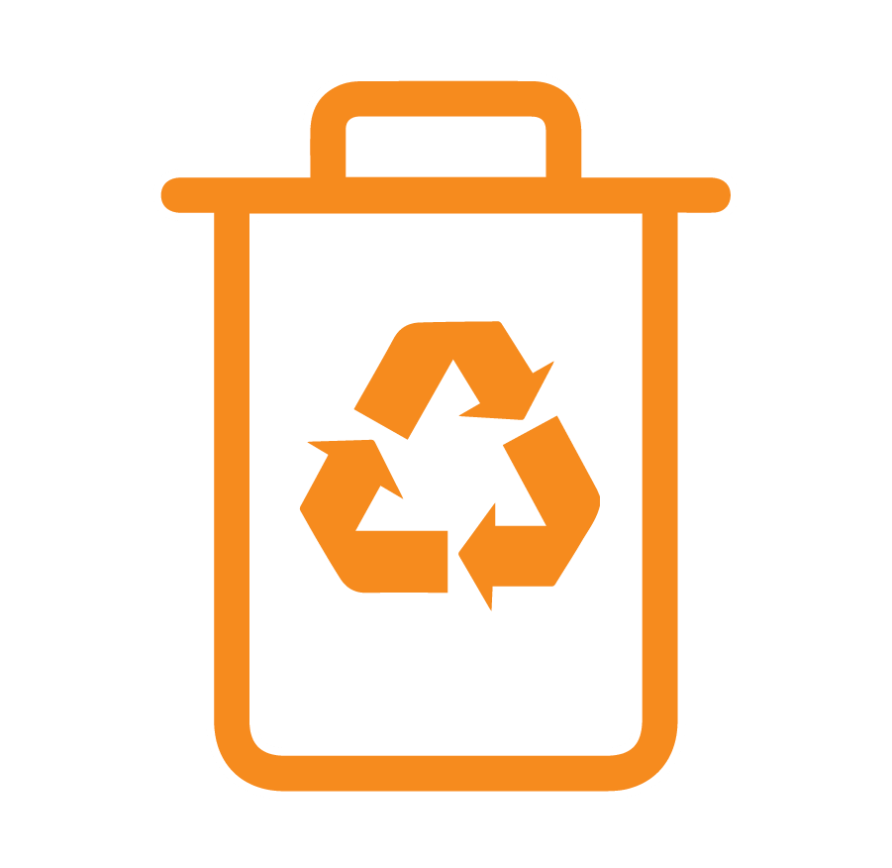
MODULE 9
Reusing, recycling and disposing of waste
For copyright details see last slide of this PowerPoint presentation
Notes:
Narration: Welcome to Module 9: Reusing, recycling and disposing of waste.
This module explains what you need to do with waste to keep everyone safe and well, and to look after the environment.
Image by: © World Bank

Slide 2
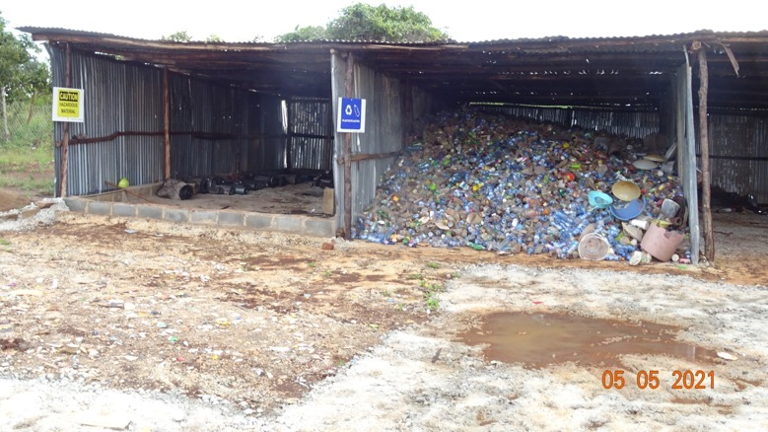
Reduce waste
Put waste in right place
Handle waste safely
Notes:
Narration: By the end of this module you will be able to:
reduce waste
put waste in the right place for reuse, recycling or disposal and
handle waste in a way that is safe for you and others and protects the environment.
Photo by: © Jean Damascene Ntivunwa, RRFHP/NELSAP / World Bank

Slide 3
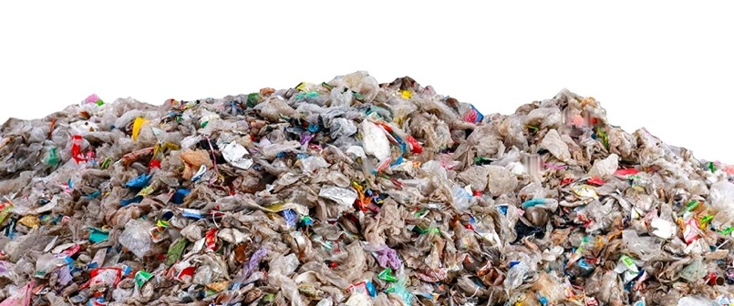
Why reducing, reusing and recycling waste is important
3
Notes:
Narration: Let’s begin by looking at why reducing, reusing and recycling waste is important.
Photo by: Shutterstock.com

Slide 4
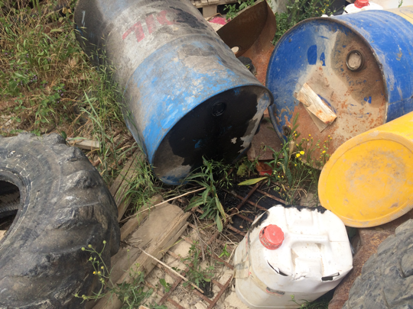
Hazardous to health Pollution
Notes:
Narration: Waste can be hazardous to people’s health and pollute the environment.
Here you can see that this waste oil drum has just been dumped and oil is leaking into the ground, causing pollution.
Photo by: © Michael Hall / World Bank

Slide 5
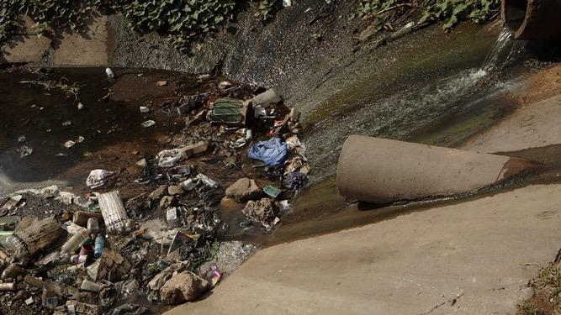
Pollute rivers and oceans
Notes:
Narration: Our rivers and oceans are choked up with waste, like plastic, which is getting into our food and can harm our health as well as kill wildlife.
Photo by: © John Hogg / World Bank

Slide 6
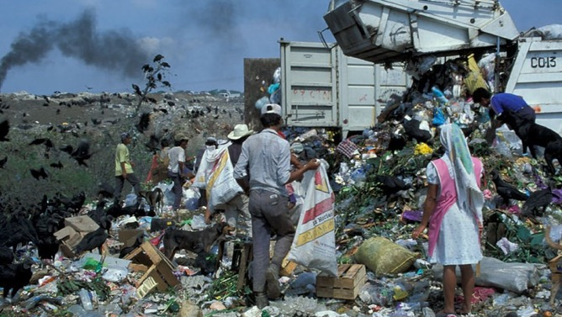
Use natural resources efficiently
Notes:
Narration: Waste causes pollution when it is incinerated or buried in landfill sites like this one.
Everyone on the planet creates over 2 billion tonnes of waste every year.
If all this waste was put on trucks they would go around the world 24 times.
We need to create less waste and use the earth’s limited resources more efficiently.
Rather than bury or burn waste, we should reuse it or recycle it into something new.
Data source: 2.01 billion tonnes from https://datatopics.worldbank.org/what-a-waste/trends_in_solid_waste_management.html
https://www.theworldcounts.com/challenges/planet-earth/state-of-the-planet/world-waste-facts/story
Photo by: © Curt Carnemark / World Bank. Further permission required for reuse.

Slide 7
Avoid generating waste
Reduce
Reuse
Recycle
Notes:
Narration: The first thing you can do is to avoid generating waste in the first place by storing and using fuels, oils, chemicals and materials properly.
You can also help by reusing materials - provided it is safe to do so - for instance using off-cuts from one job for another task.
Materials that can’t be reused need to be recycled.
For instance, materials from a building can be salvaged during demolition for reuse.
Here’s an example of timber being recycled into wood chips.
Photo by: © Dohwa Engineering Co Ltd / World Bank

Slide 8
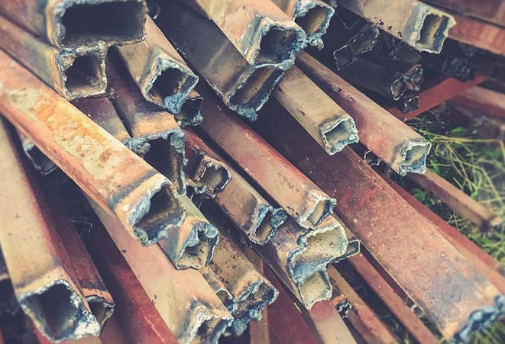
Where to put waste
8
Notes:
Narration: Next we’ll find out where to put waste on site.
When you have anything that you no longer want, you need to put it in the right place so that it can be reused or recycled.
Photo by: Shutterstock.com

Slide 9
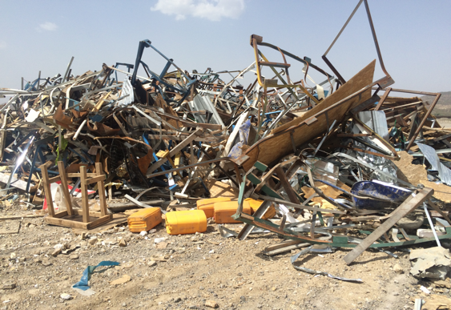
Keep different types of waste separate
Notes:
Narration: You will have things like metal, wood, packaging, glass and plastic.
Keep these different types of waste separate.
Do not mix them together like in this photo.
It makes it difficult to recycle waste if it's mixed.
Photo by: © Michael Hall / World Bank

Slide 10
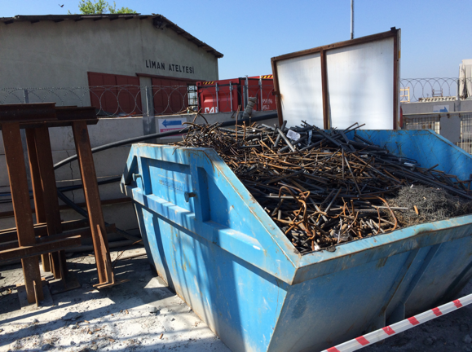
Keep different types of waste separate
Notes:
Narration: Keep them separate like the metal in this skip.
Photo by: © Michael Hall / World Bank

Slide 11
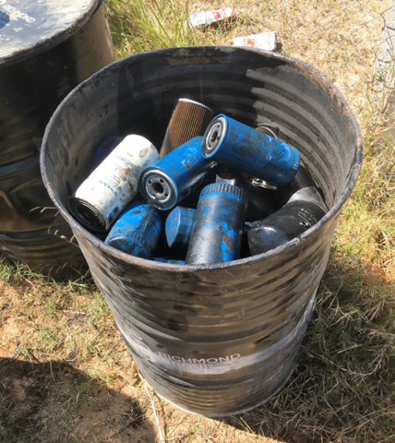
Keep different types of waste separate
Notes:
Narration: And the filters in this bin.
Photo by: © Michael Hall / World Bank

Slide 12
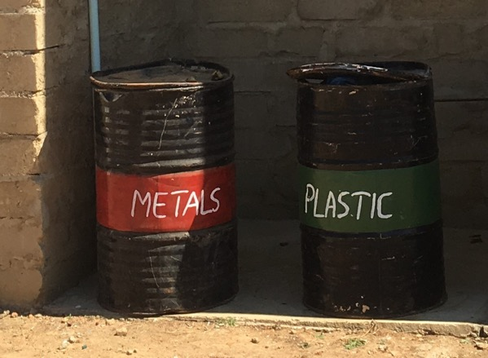
Put waste in right area
Put covers back on
Never burn waste
Notes:
Narration: Place each kind of waste in the right area – bins should be labelled, like these bins for metals and plastic.
Put any lids or covers back on containers to stop the wind blowing waste away.
And never burn waste.
Photo by: © Michael Hall / World Bank

Slide 13
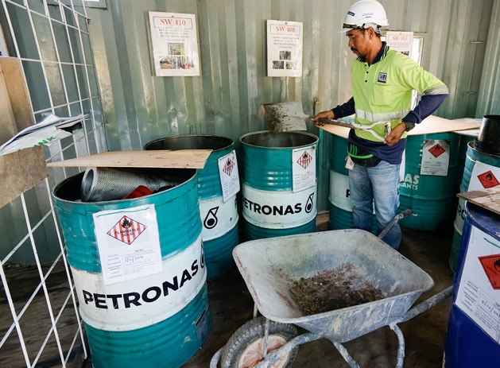
Handling hazardous waste
Photo: Sallehudin Ahmad / Shutterstock.com
13
Notes:
Narration: Now we’ll explore how to handle hazardous waste.
Some types of waste are hazardous to people’s health or the environment and are known as Hazardous Waste.
It can have the same type of effects as the hazardous substances we looked at in Module 8.
Photo by: Sallehudin Ahmad / Shutterstock.com. Further permission required for reuse.

Slide 14
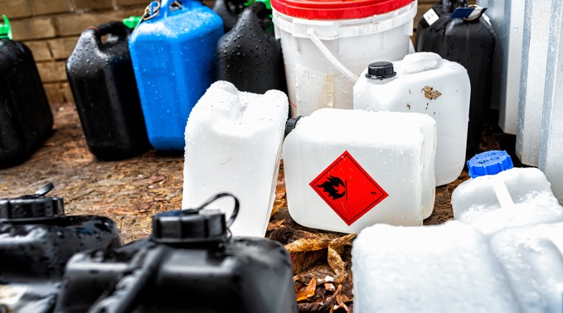
Hazardous waste
empty chemical containers
used solvents
Notes:
Narration: It includes: empty chemical containers – like these, used solvents.
Note to trainer: To make the training more interactive, before this slide, ask the workers: “What types of waste are hazardous?” The answer is: given in the narration.
Photo by: Shutterstock.com

Slide 15
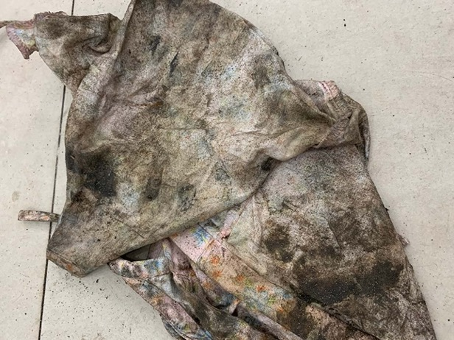
Hazardous waste
oily rags
waste oil
used batteries
some lighting
medical waste
contaminated soil
Notes:
Narration: Oily rags, cement bags, waste oil, used batteries, some types of lighting, medical waste and contaminated soil – that is soil that has been polluted by fuel, oil or chemicals.
Photo by: Shutterstock.com

Slide 16
Keep hazardous waste and non-hazardous waste separate Keep different types of hazardous waste separate
Notes:
Narration: Keep hazardous waste separate from non-hazardous waste in a proper hazardous waste storage area, like this one.
The person looking after this area must have special training on how to handle these wastes carefully.
Keep each different type of hazardous waste apart from other types.
This is because some types of waste can be very dangerous when mixed, and even explode.
Photo by: © Dohwa Engineering Co Ltd / World Bank
(Korean translates to: ‘designated waste storage’ and the logo on the left says ‘safety first’ and the logo on the right says ‘zero disaster’ or zero hazard.)

Slide 17
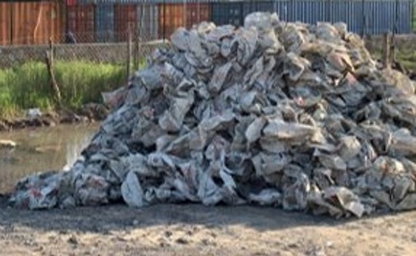
Bad waste storage
17
Notes:
Narration: Here’s an example of bad practice.
This pile of used cement bags is not contained or covered.
The local community collect water for drinking and washing on the other side of the fence.
Cement left in the bags will wash out when it rains and run into their water supply polluting it.
Used cement bags should be in a covered area or bin.
Photo by: © Michael Hall / World Bank

Slide 18
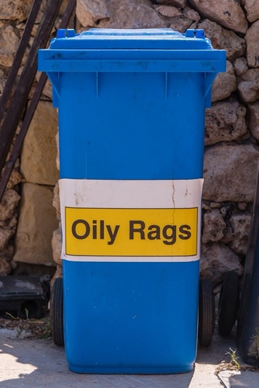
Label waste containers
Put waste in the right place
Notes:
Narration: Label hazardous waste containers so that everyone knows what it is.
Put waste in the right place – like this oily rags bin.
Photo by: Shutterstock.com

Slide 19
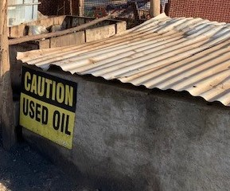
Put waste in the right place
Notes:
Narration: And this store for used oil.
Photo by: © Michael Hall / World Bank

Slide 20
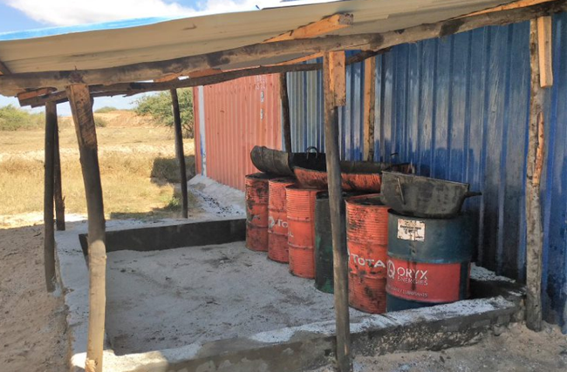
Put waste in the right place
Notes:
Narration: And this area for waste oil drums.
Photo by: © Michael Hall / World Bank

Slide 21
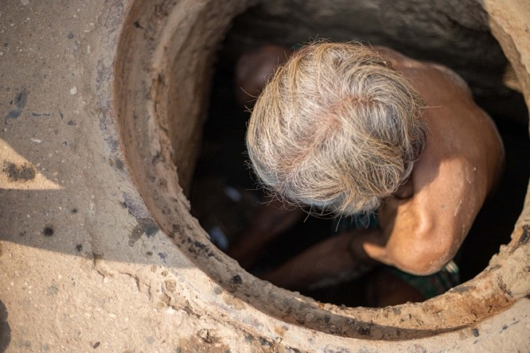
Working with hazardous waste
Special training
Extra PPE
Emptying toilet pits
Photo: Im_rohitbhakar / Shutterstock.com
Notes:
Narration: If you are working with hazardous waste you will need special training and extra Personal Protective Equipment PPE.
For example, if you do some cleaning up tasks, like emptying toilet pits.
Photo by: Im_rohitbhakar / Shutterstock.com

Slide 22
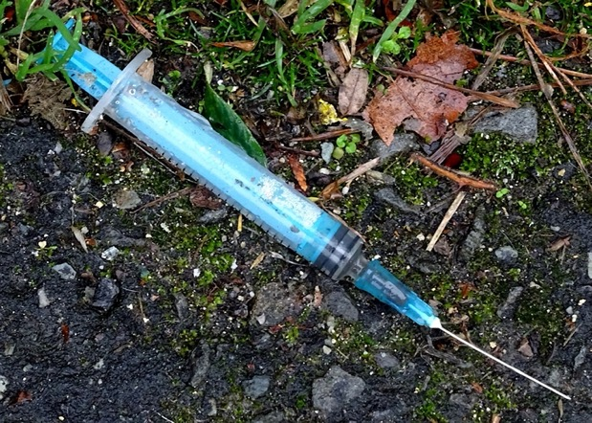
Clearing used needles
Notes:
Narration: Clearing used needles and syringes.
Photo by: Public Domain Pictures, Creative Commons CCO https://www.publicdomainpictures.net/en/view-image.php?image=372718&picture=drug-addicts-discarded-syringe

Slide 23
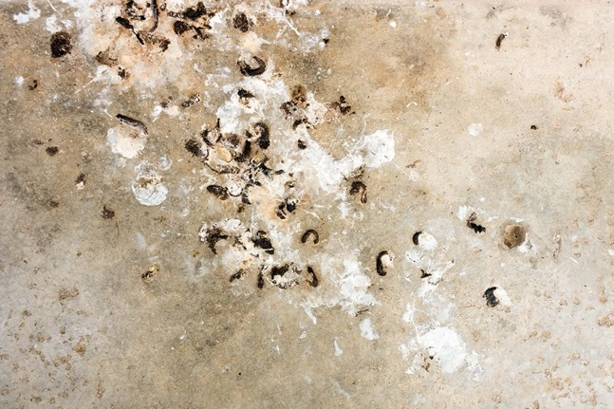
Clearing bird or animal droppings
Notes:
Narration: Or cleaning up bird or animal droppings.
This is because these wastes can transmit serious diseases to humans.
Do not do these jobs without extra training and PPE.
Photo by: Shutterstock.com

Slide 24
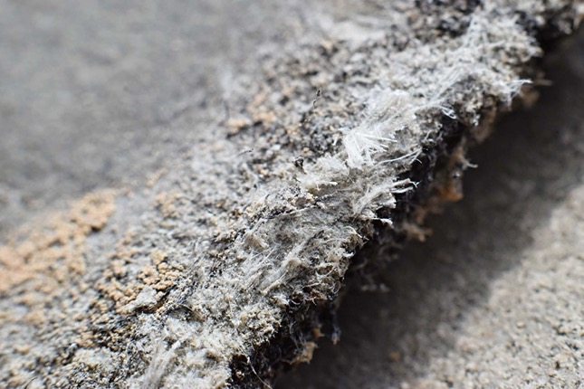
Stop work and tell Supervisor if you find:
Asbestos
Notes:
Narration: If you are demolishing a building or refurbishing an existing one you are likely to come across hazardous waste.
Stop work and tell your Supervisor if you find:
- Asbestos for instance, in boarding, lagging, cement, insulation, or flooring – it can cause lung disease and cancer.
Photo by: Shutterstock.com

Slide 25
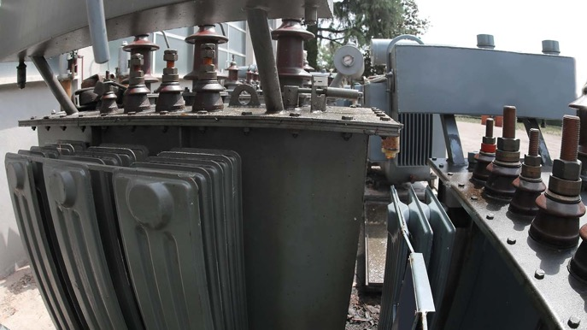
Old electrical equipment
Notes:
Narration: - Or old electrical equipment – it may contain toxic chemicals.
Photo by: Shutterstock.com

Slide 26
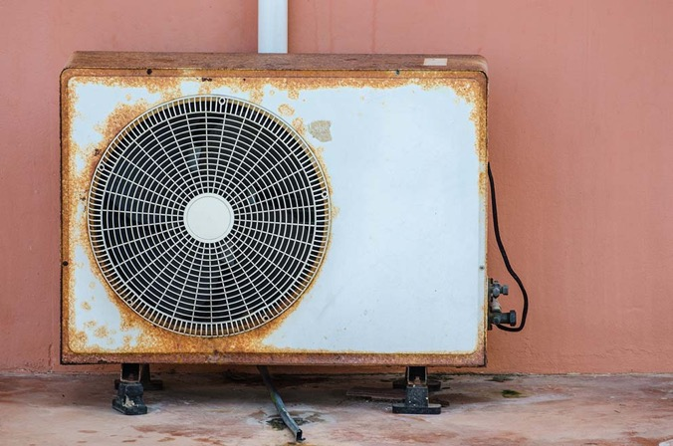
Old refrigeration or air conditioning equipment
Notes:
Narration: - Or old refrigeration or air conditioning equipment which also may contain toxic and flammable substances
Photo by: Shutterstock.com

Slide 27
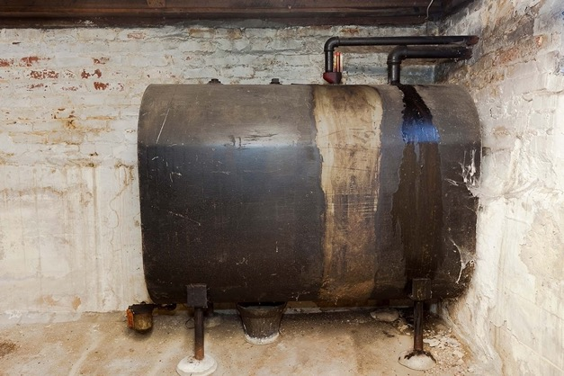
Old tanks, drums or containers
Notes:
Narration: - Old tanks, drums or containers – may still contain hazardous fuels, oils or chemicals.
All of these need to be dealt with by specially trained workers so you should not touch them unless you have had special training and have the right Personal Protective Equipment.
Photo by: Shutterstock.com

Slide 28
28
Notes:
Narration: We’ll finish this module with four key things to remember.
Image by: © World Bank

Slide 29
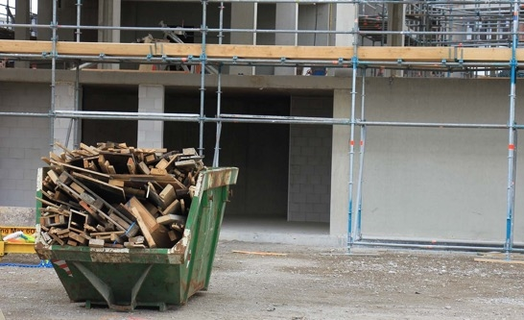
Reduce, reuse, recycle
Keep different types of waste separate
Put waste in storage area
Only work with hazardous waste if you are specially trained and have the right Personal Protective Equipment PPE
Notes:
Narration: 1. Reduce, reuse, recycle waste. 2. Keep different types of waste separate. 3. Put waste in the proper storage area.
4. Only work with hazardous waste if you have had special training and have the right Personal Protective Equipment PPE.
Now that you know about reducing, reusing and recycling waste, we’ll explore the safe way to lift loads by hand in Module 10.
Photo by: Shutterstock.com

Slide 30
Copyright
© 2022 International Bank for Reconstruction and Development / The World Bank
1818 H Street NW
Washington DC 20433
Telephone: 202-473-1000
Internet: www.worldbank.org
This work is a product of the staff of The World Bank with external contributions. The findings, interpretations, and conclusions expressed in this work do not necessarily reflect the views of The World Bank, its Board of Executive Directors, or the governments they represent.
The World Bank does not guarantee the accuracy, completeness, or currency of the data included in this work and does not assume responsibility for any errors, omissions, or discrepancies in the information, or liability with respect to the use of or failure to use the information, methods, processes, or conclusions set forth. The boundaries, colors, denominations, and other information shown on any map in this work do not imply any judgment on the part of The World Bank concerning the legal status of any territory or the endorsement or acceptance of such boundaries.
Nothing herein shall constitute or be construed or considered to be a limitation upon or waiver of the privileges and immunities of The World Bank, all of which are specifically reserved.
Rights and Permissions
The material in this work is subject to copyright. Because The World Bank encourages dissemination of its knowledge, this work may be reproduced, in whole or in part, for noncommercial purposes as long as full attribution to this work is given.
Any queries on rights and licenses, including subsidiary rights, should be addressed to World Bank Publications, The World Bank Group, 1818 H Street NW, Washington, DC 20433, USA; fax: 202-522-2625; e-mail: pubrights@worldbank.org.

