Slide 1
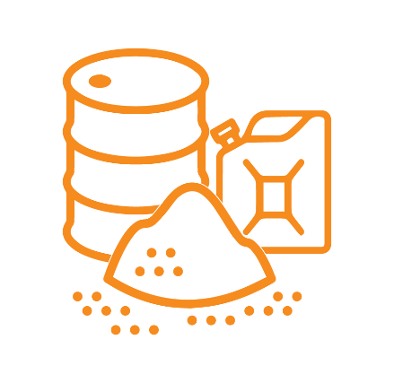
MODULE 8
Using fuels, oils, chemicals and materials
For copyright details see last slide of this PowerPoint presentation
Notes:
Narration: Welcome to Module 8 Using fuels, oils, chemicals and materials.
This module explains how to handle these substances on site safely and in a way that looks after the environment.
Image by: © World Bank

Slide 2
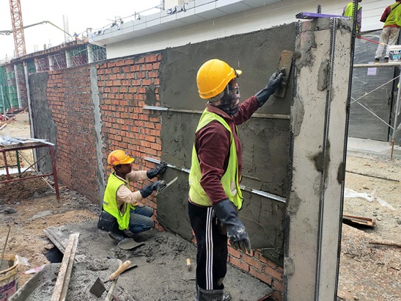
Identify hazards and risks from fuels, oils, chemicals and materials
Recognize hazardous substances
Use fuels, oils, chemicals and materials safely and to protect environment
Photo: Aisyaqilumaranas / Shutterstock.com
Notes:
Narration: By the end of this module you will be able to:
identify the hazards and risks from using fuels, oils, chemicals and materials
recognize hazardous substances and
use all these in a way that is safe for you and others and avoids damaging the environment.
Photo by: Aisyaqilumaranas / Shutterstock.com. Further permission required for reuse.

Slide 3
Hazards and risks from using fuels, oils, chemicals and materials
3
Notes:
Narration: Let’s begin by explaining the hazards and risks from using fuels, oils, chemicals and materials.
Photo by: Pxhere, Creative Commons CC0, https://pxhere.com/en/photo/1205180 ​

Slide 4
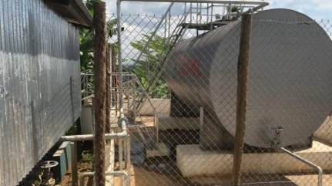
Fuels
Notes:
Narration: There are hazards and risks from most of the substances you use on site, including
Fuels for fueling generators and machines
Photo by: © Michael Hall / World Bank

Slide 5
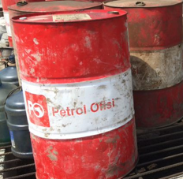
Oils
Notes:
Narration: - Oils like lubricating oils, shuttering oil, and tar
Photo by: © Michael Hall / World Bank

Slide 6
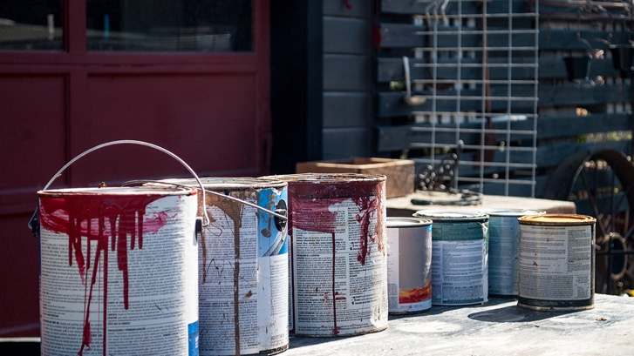
Chemicals
Notes:
Narration: - Chemicals including paints, degreasers, pesticides, detergents, glue and concrete additives.
Fuels, oils and chemicals may be in small containers, tins, gas cannisters, Intermediate Bulk Containers (IBCs), drums or tanks.
Photo by: Shutterstock.com

Slide 7
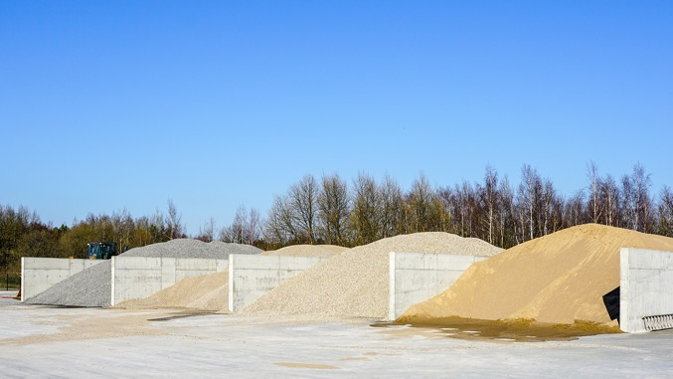
Materials
Notes:
Narration: Materials such as stone and sand will be in stockpiles, bays, silos or hoppers.
Others like cement will be in bags or sacks.
Photo by: Shutterstock.com

Slide 8
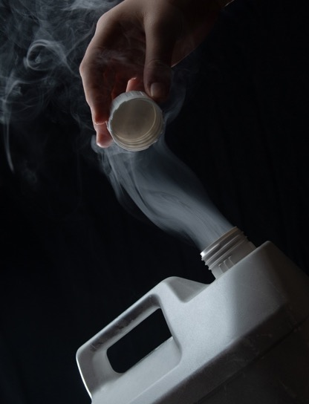
Catch fire or explode
Burn skin or cause skin problems
Irritate eyes
Cause breathing diseases
Cause cancer
Notes:
Narration: Most of these substances can harm your health and the environment if you do not handle them correctly.
Some, like fuel, can catch fire or explode.
Others, such as concrete and cement, can burn your skin or cause skin problems.
Dust and fumes can irritate your eyes, and if you breathe them in they can make you feel dizzy, give you a headache and lead to breathing diseases.
Some substances can cause cancer.
All of this can affect the health of you, anyone working on site, and also the community if they are exposed to these substances.
Photos by: Shutterstock.com

Slide 9
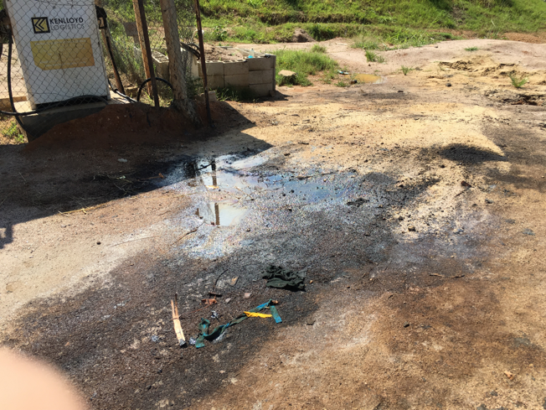
Pollute air, soil and water Waste
Notes:
Narration: Fuels, oils, chemicals and materials also pollute the environment.
Liquids can spill or leak, like this fuel and get into the soil and water.
If it contaminates drinking water, it can make people or livestock ill.
If pollutants get into rivers or lakes, they can kill plants, animals and fish.
Harmful dusts and fumes can pollute the air.
In addition everything needs to be stored and handled to avoid waste.
Note to trainer: To make the training more interactive, at the beginning of this slide, before the text appears, ask the workers: “What’s happened in this photo? And what’s the risk?” The answer is: given in the beginning of the narration.
Photo by: © Michael Hall / World Bank

Slide 10
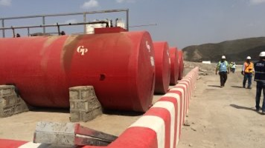
Handling fuels, oils, chemicals and materials
10
Notes:
Narration: Next we’ll find out how to handle fuels, oils, chemicals and materials correctly.
Photo by: © Michael Hall / World Bank
​

Slide 11
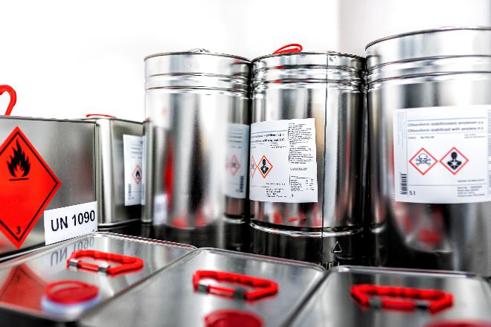
Never get any substance on your skin
Never put any substance in your mouth or swallow it
Do not breathe in dust or fumes
Do not put any substance onto soil, into water or onto plants or trees
Notes:
Narration: Never get any substance on your skin.
Don't use chemicals, like solvents, to clean your skin - use soap and water or special hand cleaner.
Never put any substance or in your mouth or swallow it.
Do not breathe in dust or fumes.
Do not put any substance onto soil, into water or onto plants or trees.
Photo by: Shutterstock.com

Slide 12
Look out for hazardous substance labels – easily set on fire
Notes:
Narration: Some substances on site are hazardous.
To help you identify them, look out for the international symbols on labels that tell you it is hazardous.
They are red diamonds with a black and white picture inside.
For example, this one means that the substance is flammable so it is easily set on fire.
Image by: Globally Harmonized System of Classification and Labelling of Chemicals (GHS), https://unece.org/transportdangerous-goods/ghs-pictograms, public domain

Slide 13
Look out for hazardous substance labels - burns
Notes:
Narration: And this one means that the substance is corrosive so will burn your skin and your lungs.
Image by: Globally Harmonized System of Classification and Labelling of Chemicals (GHS), https://unece.org/transportdangerous-goods/ghs-pictograms, public domain

Slide 14
Look out for hazardous substance labels - kills plants, animals and fish
Notes:
Narration: This one means that the substance is toxic to the environment so it can kill plants, animals and fish.
Image by: Globally Harmonized System of Classification and Labelling of Chemicals (GHS), https://unece.org/transportdangerous-goods/ghs-pictograms, public domain

Slide 15
Do not smoke in storage areas or when handling hazardous substances
Notes:
Narration: You must not smoke in or near storage areas or when handling hazardous substances – they might explode or catch fire.
Image by: ISO 7010 https://en.wikipedia.org/wiki/ISO_7010, public domain

Slide 16
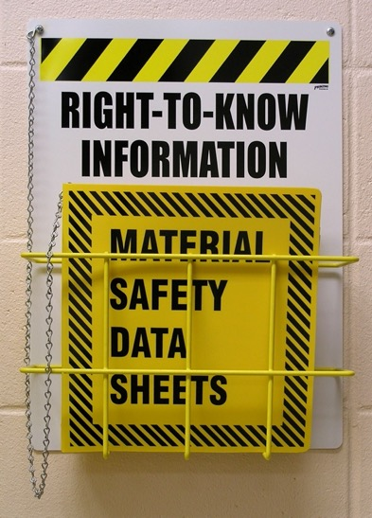
Material Safety Data Sheets tell you
how to handle substances safely
Notes:
Narration: Material Safety Data Sheets should be available on site for you to find out how to handle every hazardous substance safely.
This includes telling you what Personal Protective Equipment (PPE) you need to wear and what to do if there is an incident with this substance, like a spill or if it splashes in your face.
They should be written in your language, and you need to read and understand it before working with a substance.
Photo by: Shutterstock.com

Slide 17
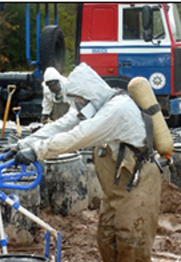
Wear Personal Protective Equipment:
Rubber gloves and chemical-rated goggles
Respirator
Face shield
Apron/ splash suit
Special boots
Notes:
Narration: When you work with hazardous substances you need to wear extra protective clothing as well as your normal PPE of hard hat, boots and high visibility vest.
And don’t wear clothes next to your skin if they are dirty with oils, fuels or chemicals.
The extra PPE you might need to wear includes long trousers and long-sleeved tops, rubber gloves, and if you are working with liquids that could splash into your eyes, wear chemical-rated goggles too.
If you wear glasses, you still need to wear safety googles as well.
Depending on the task you are doing you may also need to wear a respirator, a face shield, an apron/ splash suit, or special boots.
Images by: https://en.wikipedia.org/wiki/ISO_7010, public domain
Photo by: © World Bank

Slide 18
Do not handle or use:
Welding rods
Acetylene or oxygen
Notes:
Narration: Do not handle or use:
welding rods
acetylene or oxygen
Photo by: Shutterstock.com. Further permission required for reuse.

Slide 19
Radioactive substances
Do not handle or use
Explosives
Notes:
Narration: Also do not handle or use:
radioactive substances or
explosives, for example to blast rock.
This sign on the left tells you there are radioactive substances nearby and this sign on the right tells you that there are explosives.
Images by:​ https://en.wikipedia.org/wiki/ISO_7010, public domain.

Slide 20
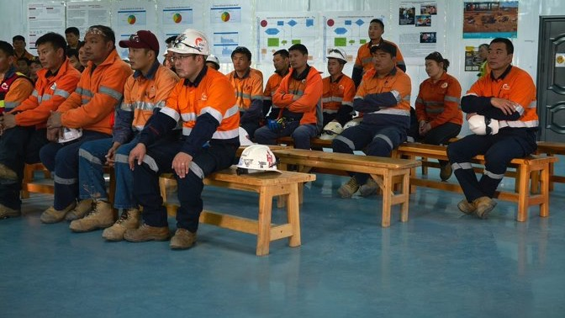
Have special training
20
Notes:
Narration: You must have special training before you use them on how to handle them properly.
Extra training is also required for looking after storage areas, and refilling tanks and silos.
Do not do these tasks if you have not been given special training.
Photo by: © World Bank. Further permission required for reuse.

Slide 21
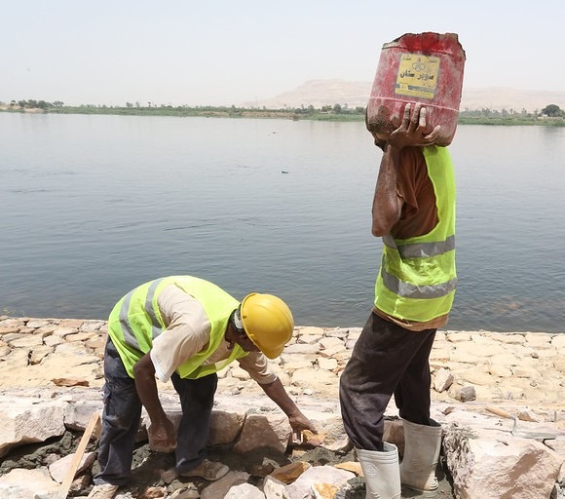
Using fuels, oils, chemicals and materials
21
Notes:
Narration: Now we’ll look at how to use fuels, oils, chemicals and materials safely and in a way that protects the environment.
Photo by: © Dominic Chavez ​/ World Bank

Slide 22
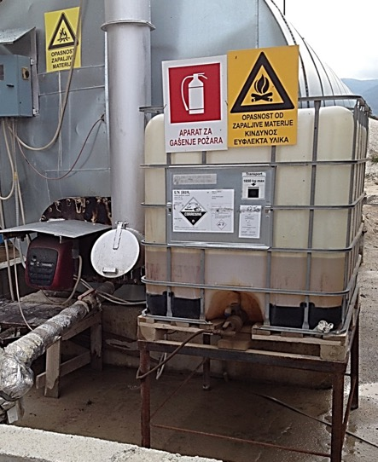
Keep fuels, oils, chemicals and materials in storage areas – IBCs inside bunds
Notes:
Narration: Keep fuels, oils, chemicals and materials in the proper storage areas until you need them. The Storesperson will tell you where to store them to ensure they don’t mix and cause a danger.
Intermediate Bulk Containers (IBCs) like this one should be inside bunds to catch any leaks or spills.
Photo by: © Michael Hall / World Bank

Slide 23
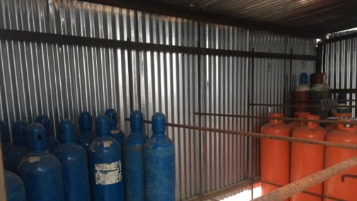
Keep gas bottles upright and locked
Notes:
Narration: Gas bottles should be upright and locked securely.
Photo by: © Michael Hall / World Bank

Slide 24
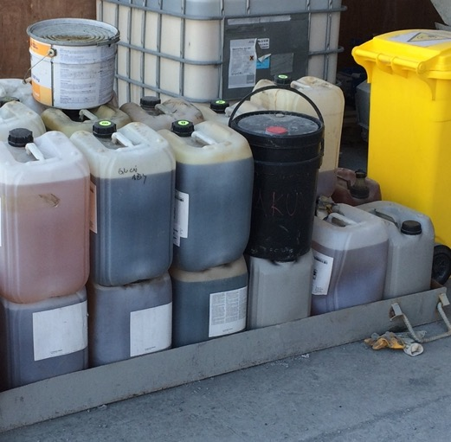
Use proper containers and label them
Notes:
Narration: When you take substances from the stores, always use proper containers with lids so that liquids cannot spill out.
Label containers so that everyone knows what is in them.
Photo by: © Michael Hall / World Bank

Slide 25
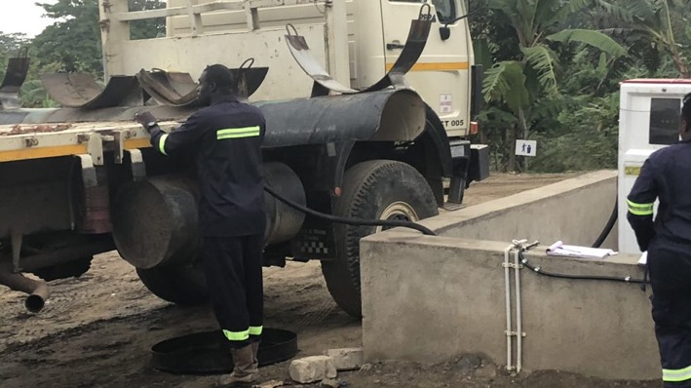
Put the hose in bund when finished refueling
Notes:
Narration: When getting fuel from a tank always put the hose inside the bund when you’ve finished using it.
Photo by: © Jack Mozingo / World Bank. Further permission required for reuse.

Slide 26
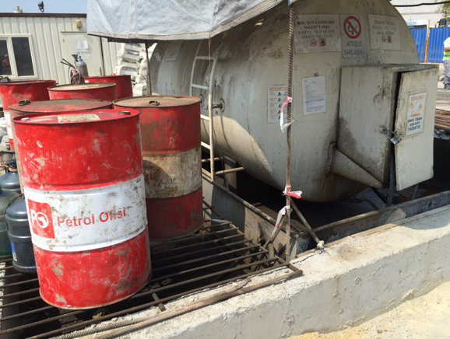
Put the hose in cabinet and lock it
Notes:
Narration: If the tank has a lockable cabinet to put the hose in - like the cabinet on the right of this photo - then put the hose in there and lock the cabinet.
You can also see here that the drums are kept inside the bund so that if there are any leaks or spills they are caught.
Photo by: © Michael Hall / World Bank

Slide 27
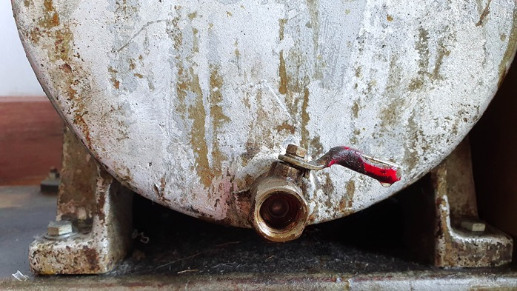
Close tap
Notes:
Narration: With drums always close the tap - like this tap here - after use.
Photo by: Shutterstock.com

Slide 28
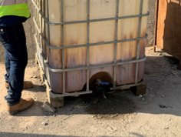
Close tap
Notes:
Narration: Here’s an example of bad practice.
You can see that the chemicals have polluted the ground because of spills and the tap not being properly closed after use.
Photo by: © Michael Hall / World Bank

Slide 29
When refueling do not put drum in excavator bucket or suck on hose
Notes:
Narration: When refueling machines from drums, do not put the drum in an excavator bucket or suck the hose to get fuel out, like in this photo.
This is unsafe.
Note to trainer: To make the training more interactive, at the beginning of this slide, before the text appears, ask the workers: “What is happening in this photo? And what are the hazards and risks?” The answer is: given in the narration above.
Photo by: © Michael Hall / World Bank. Further permission required for reuse.

Slide 30
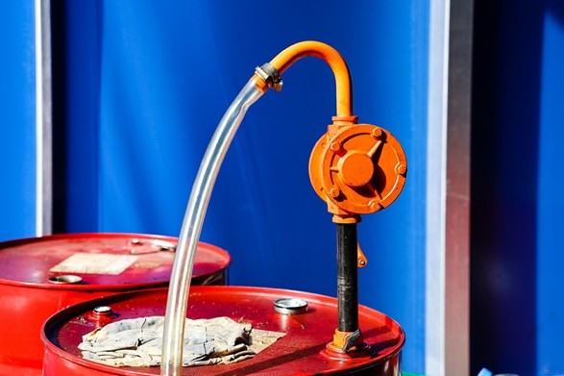
When refueling use a transfer pump
Notes:
Narration: Always use a transfer pump like this one.
Photo by: ​ Shutterstock.com
​

Slide 31
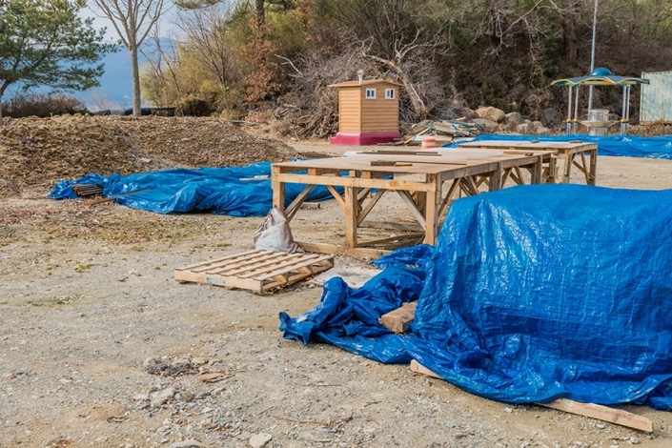
Take materials from the bottom of stockpiles
Put covers back on
Take only as much as you need
Notes:
Narration: Take materials from the bottom of stockpiles - this creates less dust than if you remove them from the top.
Always put covers back over materials to protect them from damage.
And only take as much as you need to avoid waste.
Photo by: Shutterstock.com

Slide 32
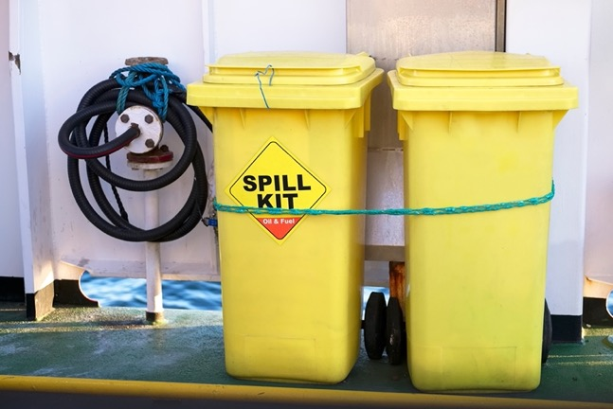
Keep fuels, oils and chemicals:
away from where they could be knocked over
in drip trays
have spill kit nearby
Notes:
Narration: Put fuels, oils and chemicals you are using: - away from where they might get knocked over by people, vehicles and machines, and
- in drip trays to catch leaks and spills.
Check there is a spill kit nearby.
Always use it to mop up anything you accidentally spill.
Photo by: Shutterstock.com

Slide 33
Wet concrete and cement Wear protective boots
Notes:
Narration: ​When working with concrete and cement wear proper boots, like this worker here.
Image by: https://en.wikipedia.org/wiki/ISO_7010, public domain.
Photo by: © Dominic Chavez / World Bank. Further permission required for reuse.

Slide 34
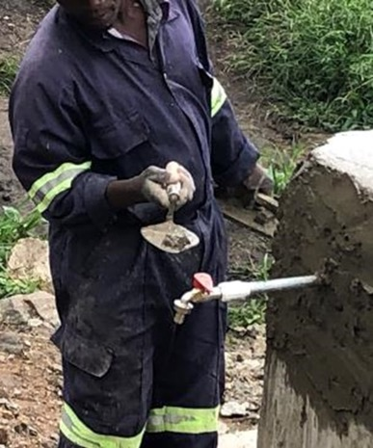
Wet concrete and cement Wear rubber gloves
Notes:
Narration: ​And this worker is not wearing gloves so his hands might get burnt by the cement.
Always wear rubber gloves …
​
Image by: https://en.wikipedia.org/wiki/ISO_7010, public domain.
Photo by: © Michael Hall / World Bank

Slide 35
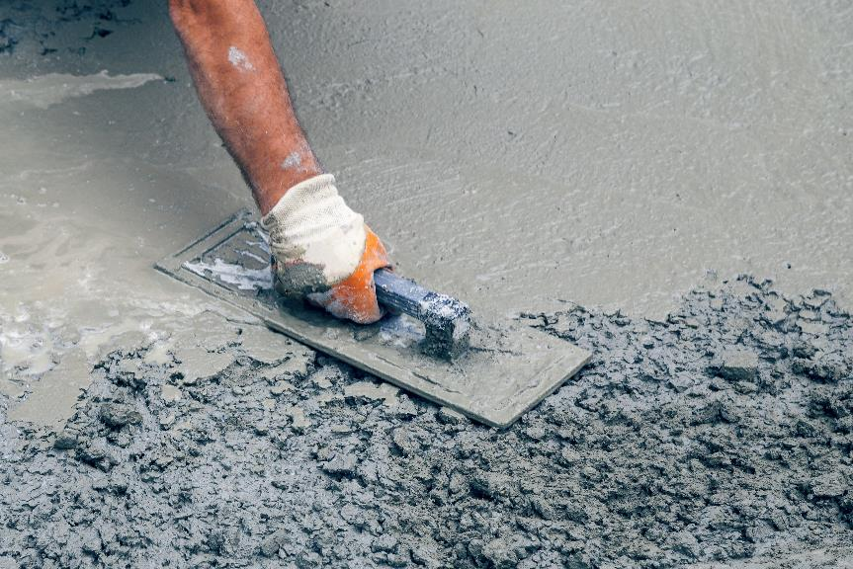
Wet concrete and cement:
Keep it in containers
Don’t put it into water
If spill, clean up
Notes:
Narration: ​… like this worker here.
Wet concrete and cement can also pollute water so - Keep it in containers and
- Don’t put it into water - If it spills, clean it up.
​
Photo by: Shutterstock.com

Slide 36
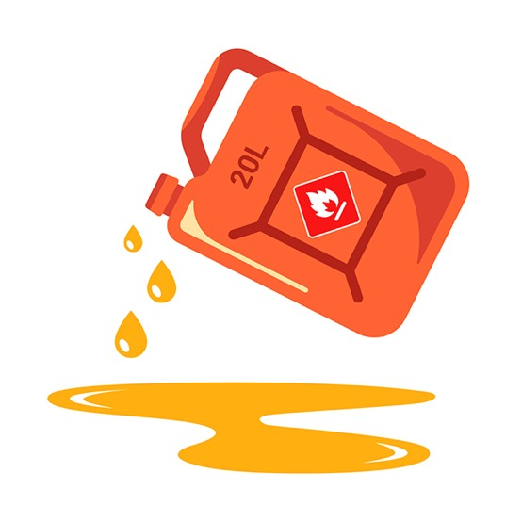
Never pour liquids or dirty water:
onto ground
into ditches or drains
Notes:
Narration: The job you are doing might create dirty water such as oily water from a fuel bund or drip tray.
Or concrete and cement wash out water from cleaning chutes on a concrete wagon, or cement buckets and tools you’ve used.
Never pour liquids or dirty water:
onto the ground
into a ditch or drain
Image by: Shutterstock.com

Slide 37
Into water
Notes:
Narration: - or into water like rivers, streams, lakes, ponds, wetlands, marshlands and the sea.
Photo by: 19eli14 on Pixabay, https://pixabay.com/photos/oil-pollution-colors-purple-blue-5996460/

Slide 38
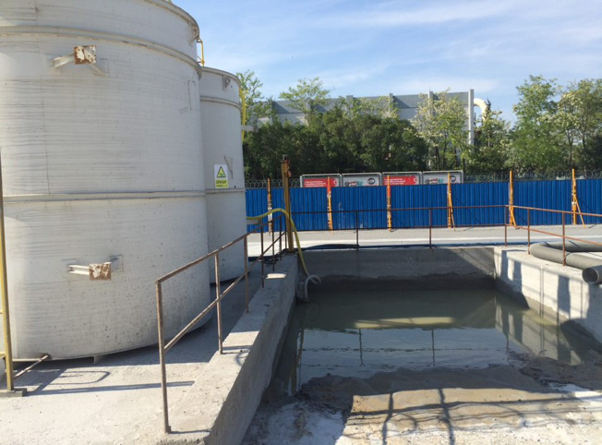
Put it in the proper disposal place
Notes:
Narration: Put liquids and dirty water into the proper disposal place – this might be a waste tank or an oil water separator or a concrete wash-out pit like this.
If you see a drip tray on site with oily water in it, use an absorbent pad to soak up the oil from on top of the water and put the oily pad in the right hazardous waste bin.
Use a hand-pump to put the oily water into a small container then put it in the right waste tank or oil interceptor.
Photo by: © Michael Hall / World Bank

Slide 39
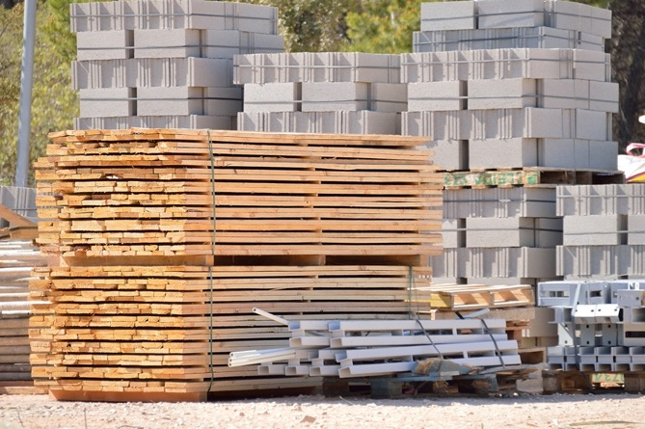
Take anything not used back to storage areas
Notes:
Narration: At the end of the day, take anything you haven't used back to the storage area where it can be re-used – and so that it is not littering the site.
Photo by: Shutterstock.com

Slide 40
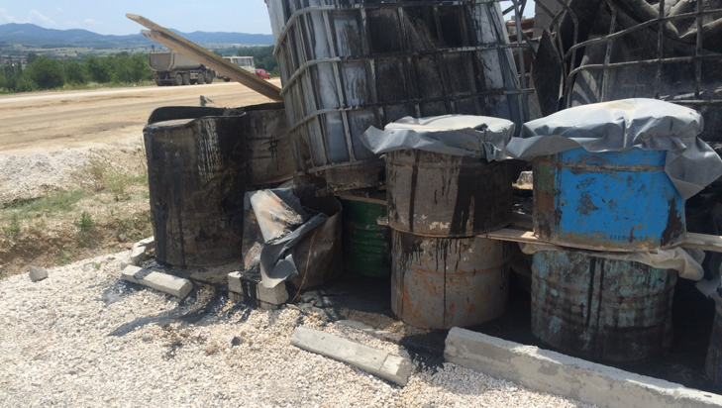
Bad
storage
Notes:
Narration: Put things away tidily to help keep the storage areas safe and non-polluting. Here is an example of a poor storage area.
The drums are leaking, the concrete bund is broken so spills aren’t caught but are polluting the ground.
And the Intermediate Bulk Containers (IBCs) are stacked badly and too high.
They could easily fall and hurt someone.
Photo by: © Michael Hall / World Bank

Slide 41
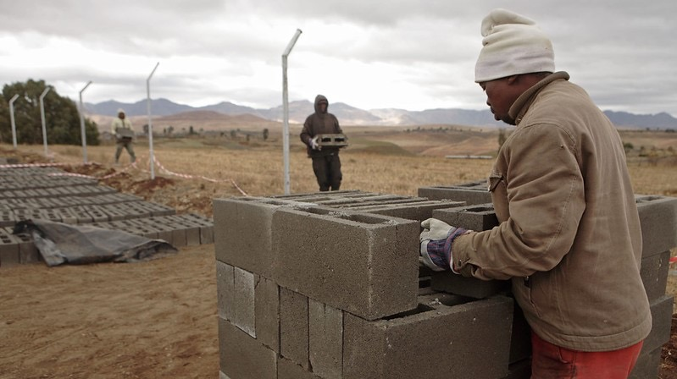
Stack materials so they are stable
41
Notes:
Narration: Always stack materials so that they are stable, like this worker is doing.
Photo by: © John Hogg / World Bank. Further permission required for reuse.

Slide 42
Keep bags of cement and plaster out of rain
Notes:
Narration: Also keep bags of cement and plaster out of the rain - they go hard when they get wet and cannot be used, creating unnecessary waste.
You can see here that they are stacked off the ground on pallets and under cover of a tarpaulin.
Photo by: Wikimedia Commons, Creative Commons CC0, https://commons.wikimedia.org/wiki/File:9730Bolintaguen,_San_Quintin,_Pangasinan_35.jpg

Slide 43
43
Notes:
Narration: We'll finish this module with three key things to remember.
Image by: © World Bank
​

Slide 44
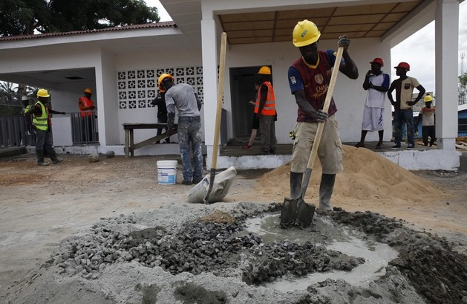
Handle fuels, oils, chemicals and materials carefully
Wear extra Personal Protective Equipment
Don’t spill or pour liquids onto ground or into water or drains
Notes:
Narration:
Handle fuels, oils, chemicals and materials carefully
Wear extra Personal Protective Equipment (PPE) when using hazardous substances, like cement, concrete and fuels
Don’t spill or pour liquids onto the ground or into water or drains.
Now that you know how to handle fuels, oils, chemicals and materials in the right way, let’s look at how you need to reuse, recycle and dispose of waste in Module 9.
Photo by: ​ © Dominic Chavez / World Bank. Further permission required for reuse.

Slide 45
Copyright
© 2022 International Bank for Reconstruction and Development / The World Bank
1818 H Street NW
Washington DC 20433
Telephone: 202-473-1000
Internet: www.worldbank.org
This work is a product of the staff of The World Bank with external contributions. The findings, interpretations, and conclusions expressed in this work do not necessarily reflect the views of The World Bank, its Board of Executive Directors, or the governments they represent.
The World Bank does not guarantee the accuracy, completeness, or currency of the data included in this work and does not assume responsibility for any errors, omissions, or discrepancies in the information, or liability with respect to the use of or failure to use the information, methods, processes, or conclusions set forth. The boundaries, colors, denominations, and other information shown on any map in this work do not imply any judgment on the part of The World Bank concerning the legal status of any territory or the endorsement or acceptance of such boundaries.
Nothing herein shall constitute or be construed or considered to be a limitation upon or waiver of the privileges and immunities of The World Bank, all of which are specifically reserved.
Rights and Permissions
The material in this work is subject to copyright. Because The World Bank encourages dissemination of its knowledge, this work may be reproduced, in whole or in part, for noncommercial purposes as long as full attribution to this work is given.
Any queries on rights and licenses, including subsidiary rights, should be addressed to World Bank Publications, The World Bank Group, 1818 H Street NW, Washington, DC 20433, USA; fax: 202-522-2625; e-mail: pubrights@worldbank.org.

