Slide 1
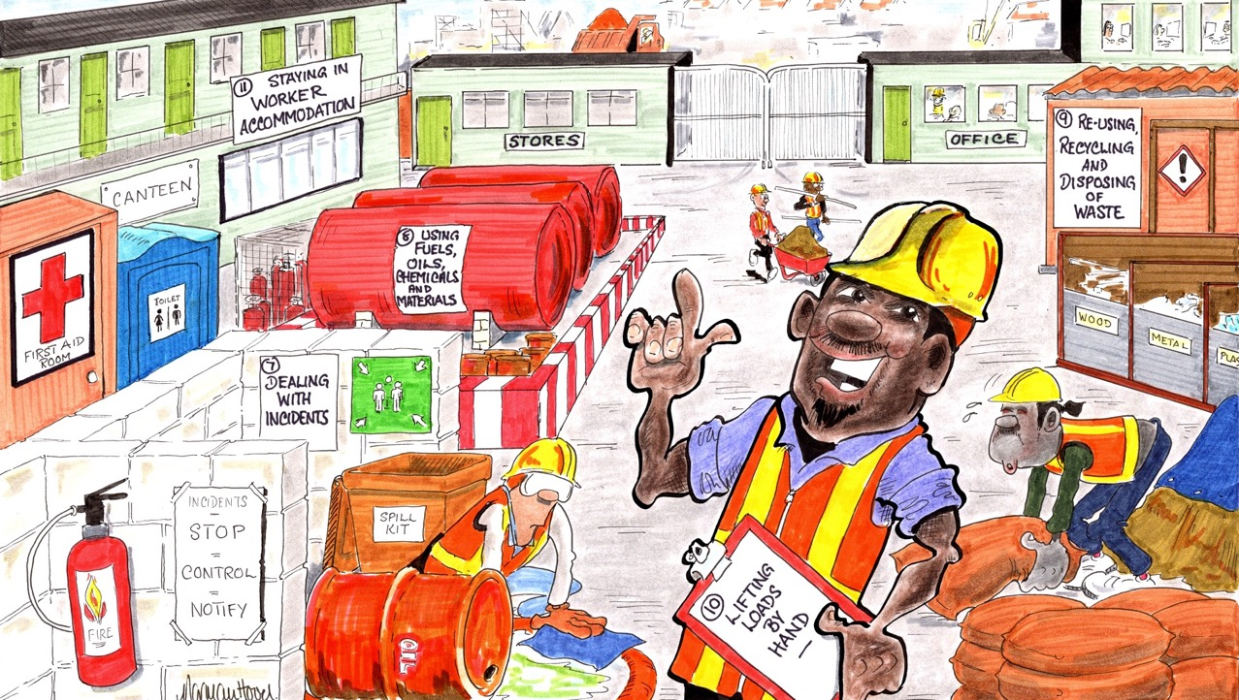
MODULES 7-11 • EVERYDAY TASKS
Notes:
Narration: Welcome to the second section of the general induction which covers how to do everyday tasks. We’ll look at:
Dealing with incidents
Using fuels, oils, chemicals and materials
Reusing, recycling and disposing of waste
Lifting loads by hand and
Staying in worker accommodation.
Image by: © Norman Hood / World Bank

Slide 2
MODULE 7
Dealing with incidents
For copyright details see last slide of this PowerPoint presentation
Notes:
Narration: Let’s begin with Module 7 Dealing with Incidents.
This module explains what you need to do when someone gets injured because of the work being done or the environment is harmed.
Image by: © World Bank.

Slide 3
Be prepared for incidents
Respond to the incident
Report the incident
Help learn the lessons
Notes:
Narration: By the end of this module you will:
Know how to be prepared for incidents
Be able to respond to an incident in the right way
Report it and then
Help with learning lessons so that it doesn’t happen again.
Photo by: Shutterstock.com. Further permission required for reuse.

Slide 4
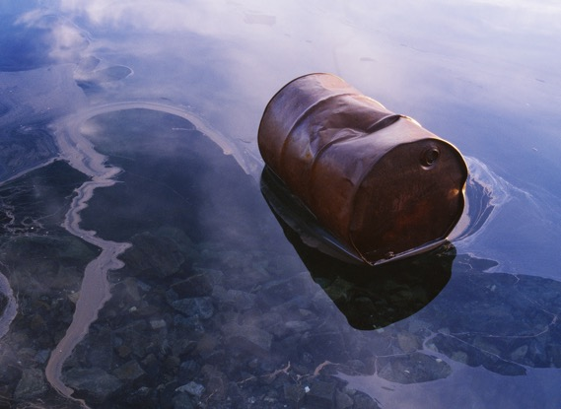
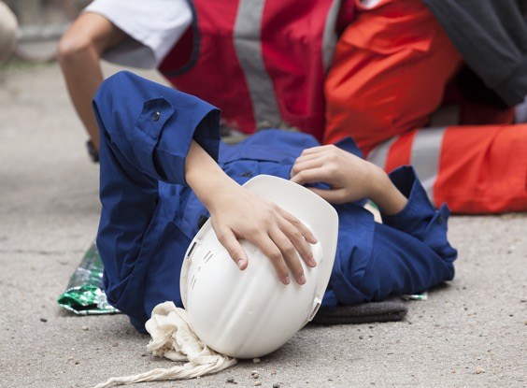
What is an incident?
4
Notes:
Narration: First we’ll answer the question: what is an incident?.
Note to trainers: To make the training more interactive, before you show the next slide, ask the workers “What do you think an incident is?”. The answer is given on the next slides.
Photos by: 1. Worker lying on ground: Shutterstock.com
2. Oil drum in polluted water: Shutterstock.com

Slide 5
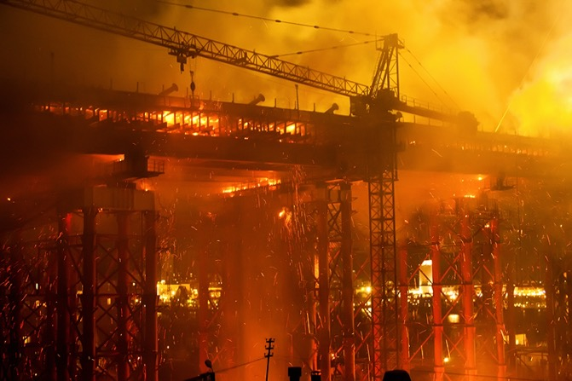
Emergency
Notes:
Narration: An incident is:
- an emergency like a flood, earthquake or fire.
Photo by: Shutterstock.com

Slide 6
Someone killed,
injured or
seriously ill
Notes:
Narration: It is
- when someone is killed, injured or seriously ill, so this might be a broken leg or someone being run over by a vehicle or falling into water.
Photo by: Shutterstock.com. Further permission required for reuse.

Slide 7
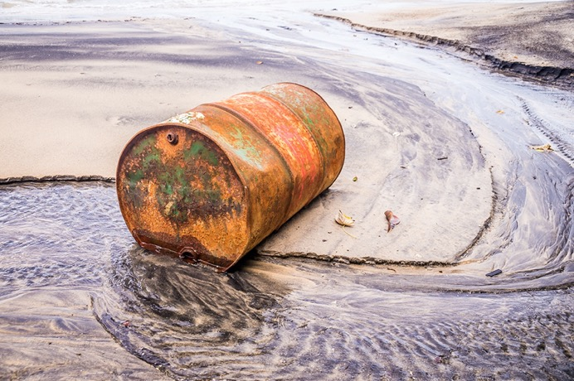
Environment harmed
7
Notes:
Narration: An incident is
when the environment is harmed, for example by an oil or chemical spill, which can pollute soil and water.
Photo by: Shutterstock.com

Slide 8
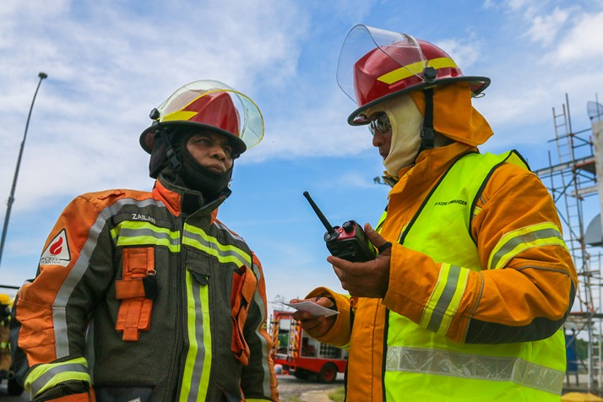
Why dealing with incidents is important
Photo: zulkamalober / Shutterstock.com
8
Notes:
Narration: Now we’ll explain why dealing with incidents is important.
Photo by: zulkamalober / Shutterstock.com. Further permission required for reuse.

Slide 9
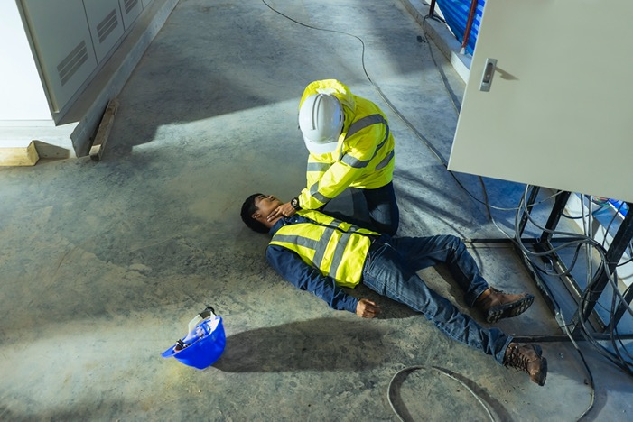
Save someone’s life
Make injury less serious
Minimize harm to environment
Notes:
Narration: Unfortunately, sometimes things go wrong.
When they do you need to respond quickly and in the right way.
This can save someone’s life or mean that their injury will be less serious.
If the environment is damaged or polluted then dealing with it straight away will minimize the harm done.
Photo by: Shutterstock.com. Further permission required for reuse.

Slide 10
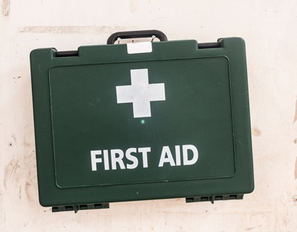
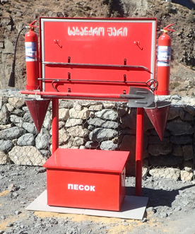
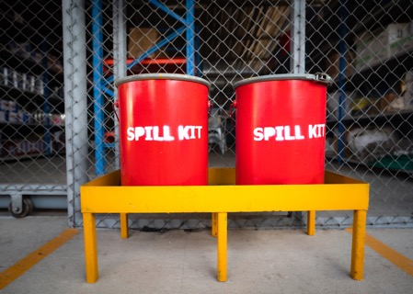
Being prepared for incidents
10
Notes:
Narration: In a moment we’ll look at what you need to do when an incident happens.
But first we’ll go through how to be prepared in advance so that if and when an incident happens you are ready.
You need to know where everything is that you might need.
Photo by: 1. Fire fighting station: © Jack Mozingo / World Bank
2. First aid kit: Shutterstock.com
3. Spill kit: Shutterstock.com

Slide 11
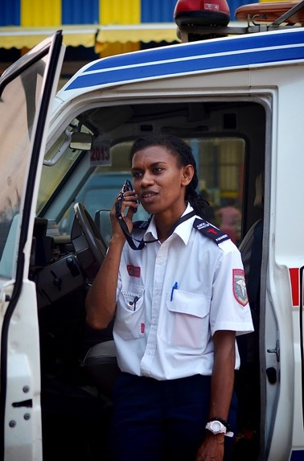
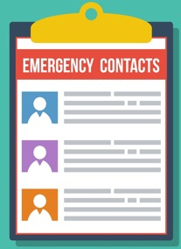
Know where the Emergency Contacts List is and who can help:
first aiders
fire wardens
emergency responders
Notes:
Narration: Make sure you know where the Emergency Contacts List is – it’s usually on site noticeboards.
This tells you who to contact and how if you need help dealing with an incident.
It includes people like:
First aiders
Fire wardens and
Emergency responders.
Image by: Emergency Contacts List https: Shutterstock.com
Photo by: Emergency worker: © Tom Perry / World Bank. Further permission required for reuse.

Slide 12
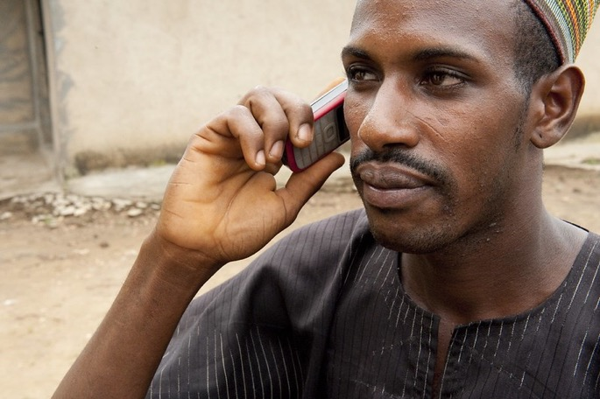
Don’t rely on your mobile phone
Notes:
Narration: Remember, your mobile phone may not always have a signal.
There might be another way to communicate quickly on site, like radios.
You need to know where the nearest radio is or who in your team has one.
Photo by: © Arne Hoel / World Bank. Further permission required for reuse.

Slide 13
Know where the emergency exits are and how to get to them
Keep them clear
Notes:
Narration: Make sure you know where the emergency exits are and how to get to them – this sign shows the way to an emergency exit.
Keep access to emergency exits clear so there is nothing in the way and people can get out quickly.
Image by: ISO 7010 https://en.wikipedia.org/wiki/ISO_7010, public domain

Slide 14
Know where the assembly point is
Notes:
Narration: You also need to know where the assembly point is - this sign shows the assembly point.
Make sure you know how to get there from the emergency exits.
Go there when you need to evacuate the work area such as when a fire alarm goes off.
Image by: ISO 7010 https://en.wikipedia.org/wiki/ISO_7010 public domain

Slide 15
Know where the first aid/ medical room is
Notes:
Narration: You should know where the first aid or medical room is so you can go there if you are hurt or you need to get medical help for someone else - this sign shows where you can find medical help.
Image by: ISO 7010 https://en.wikipedia.org/wiki/ISO_7010 public domain
Photo by: © World Bank. Further permission required for reuse.

Slide 16
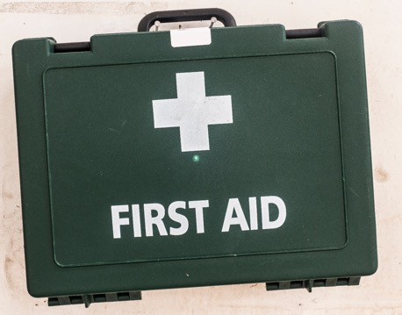
Know where the first aid kits are
Notes:
Narration: You also need to know where the first aid kits are kept.
This sign shows where they are.
Images by: 1. Sign: ISO 7010 https://en.wikipedia.org/wiki/ISO_7010, public domain.
2. First aid kit: Shutterstock.com

Slide 17
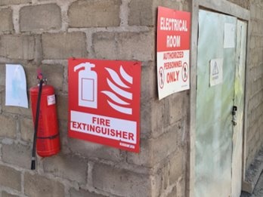
Know where the fire extinguishers are
Notes:
Narration: Make sure you know where to get a fire extinguisher and fire fighting equipment – this sign shows where they are kept.
Images by: 1. Sign: ISO 7010 https://en.wikipedia.org/wiki/ISO_7010, public domain
2: Fire extinguisher: © Michael Hall / World Bank

Slide 18
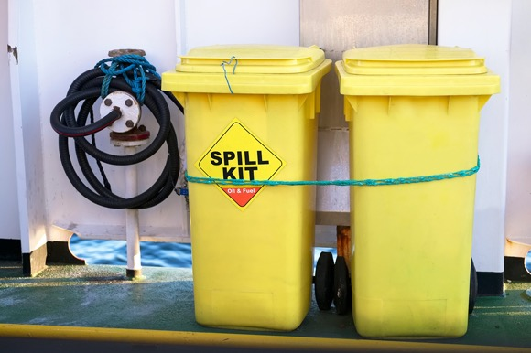
Know where the spill kits are
Notes:
Narration: And you need to know where the spill kits are.
If you use anything from the first aid kit, spill kit or fire fighting equipment, or notice that stocks are running low tell your Supervisor so it can be refilled.
Photo by: Shutterstock.com

Slide 19
What to do in an incident
19
Notes:
Narration: Now you know how to be prepared for an incident we’ll go through what to do when an incident happens.
Note to trainer: To make the training more interactive, before you show the next slide, ask the workers “What is the first thing you should do when there is an incident?”. The answer is stop work.
Photo by: Shutterstock.com

Slide 20
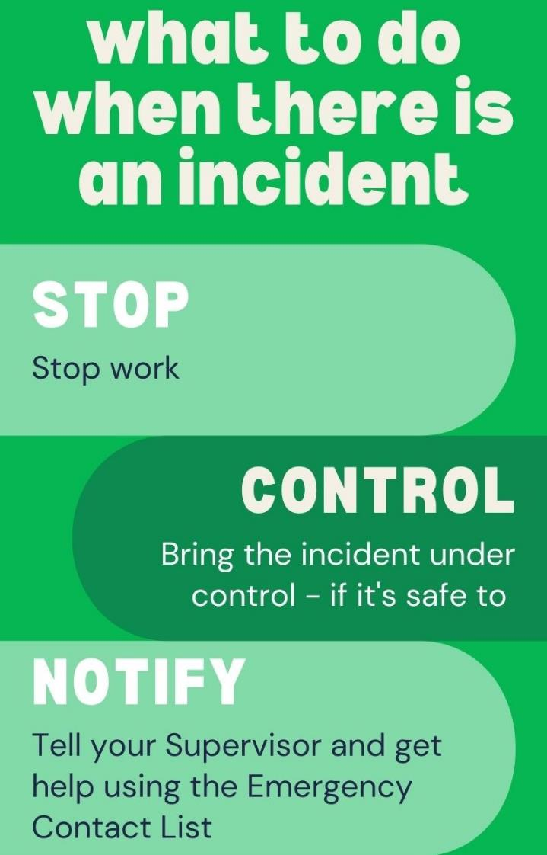
Notes:
Narration: You need to Stop, Control and Notify.
Let's go through each of these in turn.
STOP means to stop work.
Stop whatever you are doing.
Turn off all tools and machines using the emergency stop button or switch.
And you might need to get out of the work area to stay safe.
CONTROL means to bring the incident under control.
Only do this if it is safe for you to, without getting yourself injured.
NOTIFY means to tell your Supervisor and get help by contacting people on the Emergency Contacts List.
Now we'll look at what to do with different types of incidents.
Image by: © World Bank

Slide 21
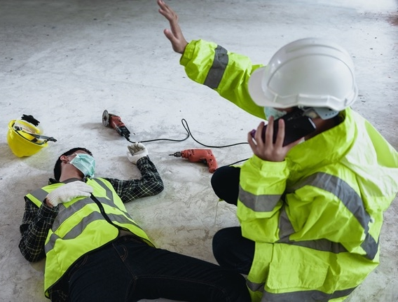
Serious injury Before you help an injured person, check it's safe Call for medical help using the Emergency Contacts List Unless the casualty is in danger never move them – wait for the first aider or emergency services
Notes:
Narration: If there is a serious injury to someone on site or a member of the community: - Before you go to help the injured person, check it's safe to do so
- Call for medical help from the Emergency Contacts List and - Unless the casualty is in a dangerous place never move them because it can make their injuries worse.
Wait for the first aider or emergency services.
Photo by: Shutterstock.com

Slide 22
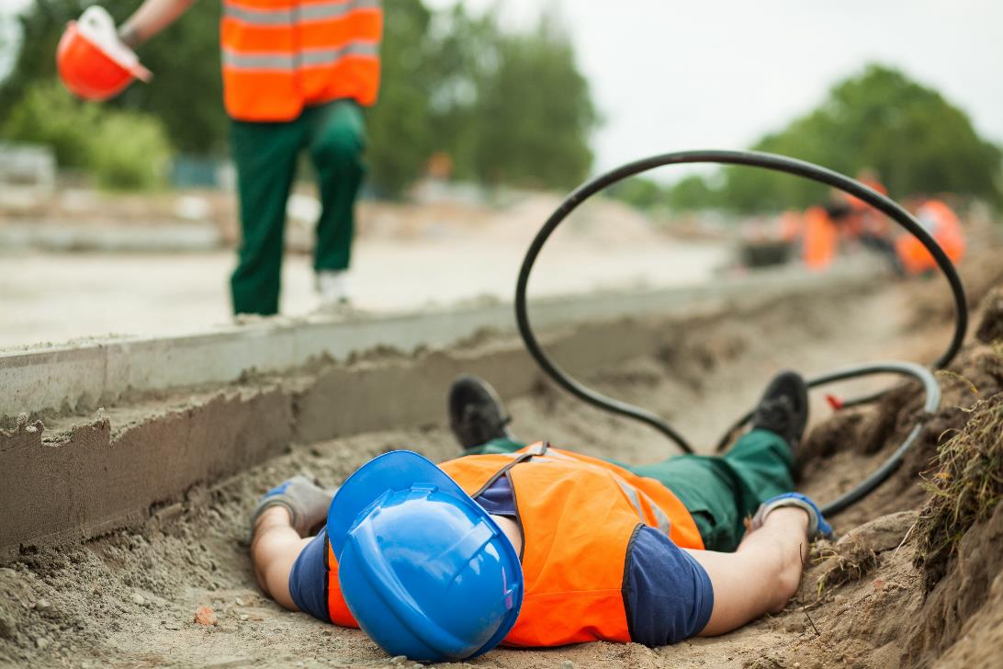
Contact with live electricity cable Do not touch them Turn off the power or call electricity company to turn it off Get medical help from the Emergency Contacts List
Notes:
Narration: If someone is in contact with a live electricity cable: - Do not touch them - if you do you could also be electrocuted
- Turn off the power or call the electricity company to turn it off
- Get medical help from the Emergency Contacts List.
Photo by: Shutterstock.com

Slide 23
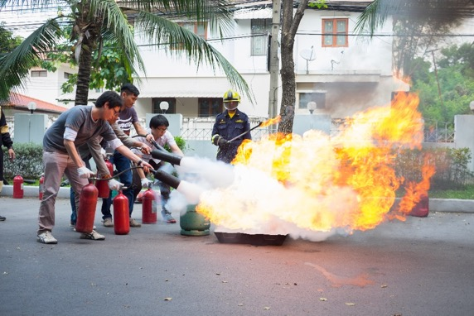
Fire
If you discover a fire, raise alarm by shouting "Fire" and set off the fire alarm
Only use a fire extinguisher if the fire is very small
Photo: mantinov / Shutterstock.com
Notes:
Narration: - If you discover a fire, raise the alarm shout "Fire" and set off the fire alarm if there is one.
Fighting fires is specialist operation and should be done only by those specially trained to do it.
Only use a fire extinguisher if you have been trained how to use it.
And if the fire is very small - fire extinguishers cannot put out larger fires.
Photo by: 1: Fire: Shutterstock.com
2: Fire extinguisher training: mantinov / Shutterstock.com. Further permission required for reuse.

Slide 24
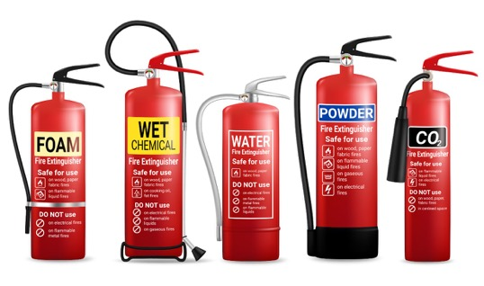
Water – RED LABEL wood, paper, fabric and solid material
Powder – BLUE LABEL liquid and electrical fires
Carbon dioxide – BLACK LABEL
liquid and electrical fires
Foam – CREAM LABEL liquid fires
Wet chemical - YELLOW LABEL
cooking oil, wood, paper or fabric
If you use a fire extinguisher
on small fire,
use the right type
24
Notes:
Narration: If you use a fire extinguisher on a small fire, make sure you use the right type.
They have different color labels: - Water has a RED LABEL and is for fires of wood, paper, fabric and solid material - Powder has a BLUE LABEL and is for liquid and electrical fires - Carbon dioxide has a BLACK LABEL and is also for liquid and electrical fires - Foam has a CREAM LABEL and is for liquid fires - Wet chemical has a YELLOW LABEL and is for cooking oil, wood, paper or fabric.
Photo by: Shutterstock.com

Slide 25
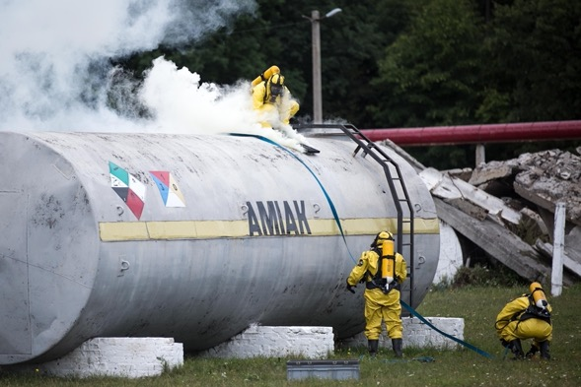
Fire
Evacuate
Call for fire-fighting help from Emergency Contacts List
Photo: home for heroes / Shutterstock.com
Notes:
Narration: Evacuate the area around the fire.
And call for fire-fighting help from the Emergency Contacts List.
Photo by: home for heroes / Shutterstock.com

Slide 26
Evacuation
Go to the assembly point immediately
Do not go back to work until the person in charge tells you it is safe
Notes:
Narration: If the site needs to be evacuated, for example, in a fire:
go the assembly point immediately – and help others to evacuate quickly if you can
evacuate the local community too if they are at risk of being hurt
do not go back to work until the person in charge of the emergency tells you it is safe to do so.
Image by: ISO 7010 https://en.wikipedia.org/wiki/ISO_7010, public domain

Slide 27
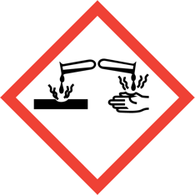
Hazardous substances If you get it on your skin, swallow some or feel unwell after breathing it in, get medical help straight away
Notes:
Narration: If you get a hazardous substance on your skin, swallow some or feel unwell after breathing in fumes get medical help straight away.
It will help if you can tell them exactly what substance it was.
The Material Safety Data Sheet will also give advice on what to do.
Images by: Globally Harmonized System of Classification and Labelling of Chemicals (GHS), https://unece.org/transportdangerous-goods/ghs-pictograms, public domain.

Slide 28
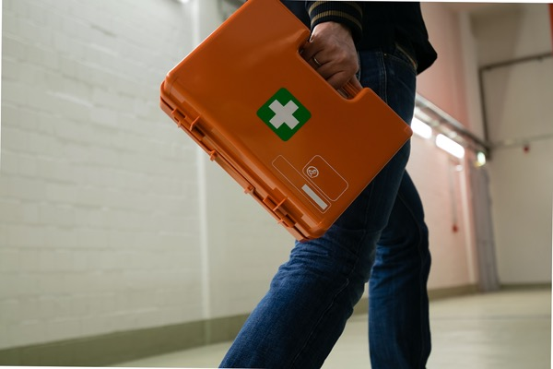
Minor Injury
Stop work, tell Supervisor, clean wound and put dressing on
Get help from a First Aider or Medical Center
Notes:
Narration: If you have a minor injury like a small cut, stop work, tell your Supervisor, clean it and put a dressing on – get help from the First Aider or visit the medical center if you need to.
Even small cuts and grazes can get infected so it’s important to do this.
Image sources: Shutterstock.com

Slide 29
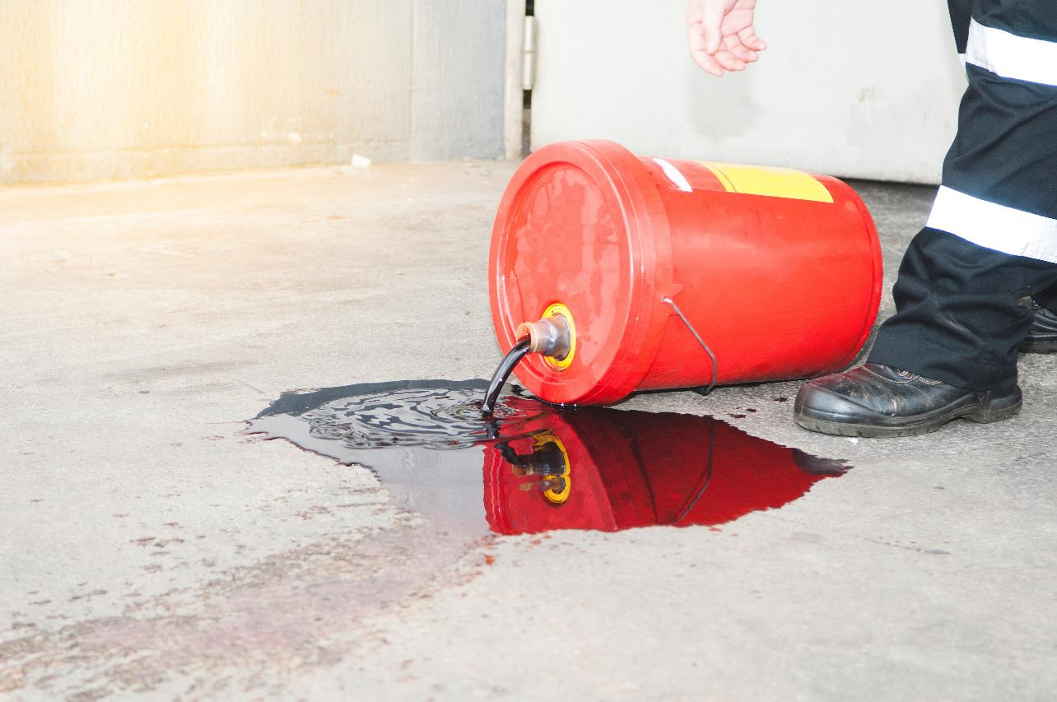
Spill of fuels, oils or chemicals The 3Cs Control Contain Clean up
Notes:
Narration: It is crucial to clean up any spill of fuels, oils or chemicals before they cause pollution of the ground or water.
Drinking polluted water can make people and livestock ill.
And pollution in rivers and lakes can kill plants, animals and fish.
To help you remember what to do follow the “3 Cs": control, contain, clean up.
Photo by: Shutterstock.com

Slide 30
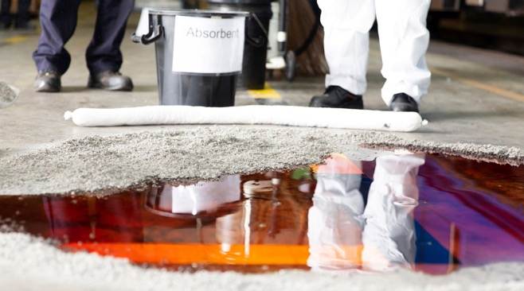
Spill of fuels, oils or chemicals Control stop source of spill Contain use spill kit and stop it going down drains or into water – wear PPE
Notes:
Narration: First
- Control the spill by stopping it at source, for example, by turning off a tap or valve or putting a drum upright.
Contain the spill using spill kit and stop it going down drains, by covering the drains. Also stop it getting into water like streams, rivers, ponds, lakes, wetlands and marshlands or the sea.
Call for help from the Emergency Contacts List if you need it.
Photo by: Shutterstock.com

Slide 31
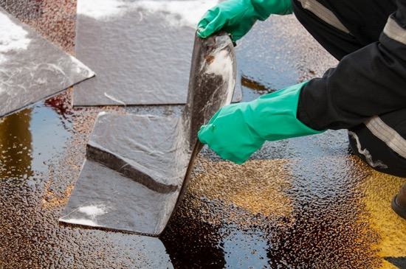
Spill of fuels, oils or chemicals Clean up use a spill kit, dig out contaminated soil. Put the used spill kit and contaminated soil in the right Hazardous Waste bin
Notes:
Narration: Clean it up using spill kit and dig out any contaminated soil. Put used spill kit and contaminated soil in the right Hazardous Waste bin.
That's the “3 Cs" - control, contain, clean up.
Photo by: Shutterstock.com

Slide 32
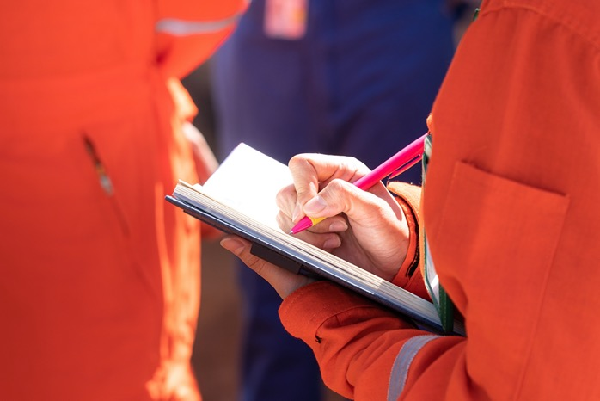
After an incident
32
Notes:
Narration: Let’s explore what happens after an incident has been brought under control.
Photo by: Shutterstock.com

Slide 33
Help with investigations, to stop it happening again
Notes:
Narration: There will be an investigation to work out what happened and why.
This is not to find out who to blame but to work out what went wrong and stop it happening again.
If you are asked, always help with this and say what you saw and what you did.
You can also make suggestions about what you think could be done better.
This can result in improvements on site, making it a safer place for you and everyone else.
Photo by: Shutterstock.com. Further permission required for reuse.

Slide 34
34
Notes:
Narration: We’ll finish this module with four key things to remember.
Image by: © World Bank

Slide 35
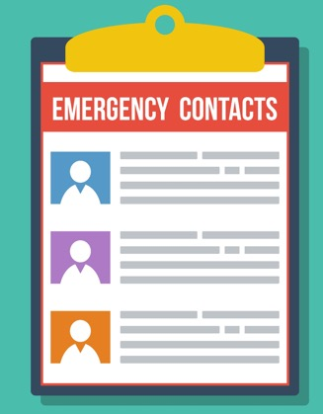
1. Know where the Emergency Contacts List is
Notes:
Narration:
Know where the Emergency Contacts List is so you can call for help
Image by:​ Shutterstock.com

Slide 36
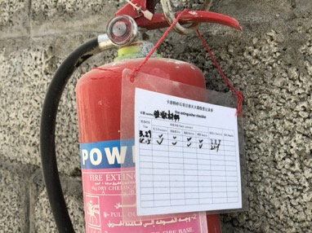
2. Know where the incident response equipment is
Notes:
Narration: 2. Know where fire extinguishers, first aid and spill kits are kept
Photos by: :​ 1. Fire extinguisher: © Jack Mozingo / World Bank
2. First aid kit: Shutterstock.com
3. Spill kit: Shutterstock.com

Slide 37
3. Know where the assembly point is
Notes:
Narration: 3. Know where the assembly point is if you need to evacuate.
Image by:​ https://en.wikipedia.org/wiki/ISO_7010, public domain

Slide 38
4. Stop
Control
Notify
Notes:
Narration: 4. Remember Stop Control Notify.
Now that you know how to deal with incidents, we’ll find out how to handle fuels, oils, chemicals and materials in Module 8.
Image by:​ © World Bank

Slide 39
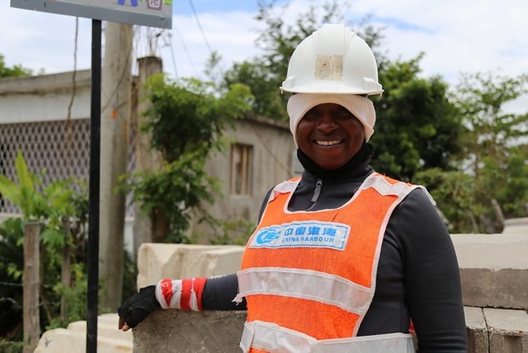
Prevention is better than cure
Notes:
Narration: And finally, remember that the best way to deal with incidents is to stop them happening in the first place.
You can do this by following the good practice in all the other modules in this training.
Prevention is always better than cure.
Photo by: © Mariana Kaipper Ceratti / World Bank. Further permission required for reuse.

Slide 40
Copyright
© 2022 International Bank for Reconstruction and Development / The World Bank
1818 H Street NW
Washington DC 20433
Telephone: 202-473-1000
Internet: www.worldbank.org
This work is a product of the staff of The World Bank with external contributions. The findings, interpretations, and conclusions expressed in this work do not necessarily reflect the views of The World Bank, its Board of Executive Directors, or the governments they represent.
The World Bank does not guarantee the accuracy, completeness, or currency of the data included in this work and does not assume responsibility for any errors, omissions, or discrepancies in the information, or liability with respect to the use of or failure to use the information, methods, processes, or conclusions set forth. The boundaries, colors, denominations, and other information shown on any map in this work do not imply any judgment on the part of The World Bank concerning the legal status of any territory or the endorsement or acceptance of such boundaries.
Nothing herein shall constitute or be construed or considered to be a limitation upon or waiver of the privileges and immunities of The World Bank, all of which are specifically reserved.
Rights and Permissions
The material in this work is subject to copyright. Because The World Bank encourages dissemination of its knowledge, this work may be reproduced, in whole or in part, for noncommercial purposes as long as full attribution to this work is given.
Any queries on rights and licenses, including subsidiary rights, should be addressed to World Bank Publications, The World Bank Group, 1818 H Street NW, Washington, DC 20433, USA; fax: 202-522-2625; e-mail: pubrights@worldbank.org.

