Slide 1
MODULE 6
Respecting yourself and others
For copyright details see last slide of this PowerPoint presentation
Notes:
Narration: Welcome to Module 6: Respecting yourself and others.
Image by: © World Bank

Slide 2
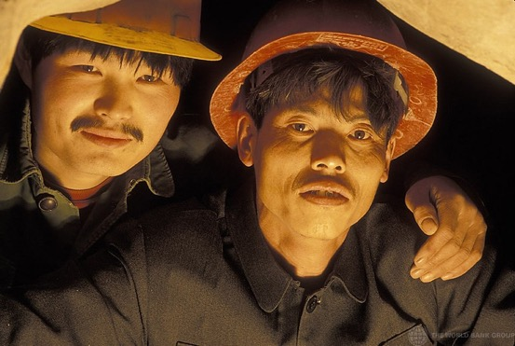
Why treating people well is important
Behave in an acceptable way
How you can expect to be treated
Recognize unacceptable behavior
How to report it
Notes:
Narration: By the end of this module you will :
know why treating people well is important
be able to behave in an acceptable way
understand how you can expect to be treated at work
recognize unacceptable behavior and
know how to report it if it happens to you or other people.
Photo by: © Curt Carnemark / World Bank. Further permission required for reuse.

Slide 3
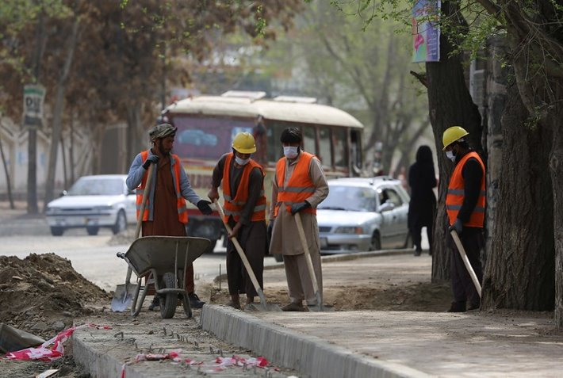
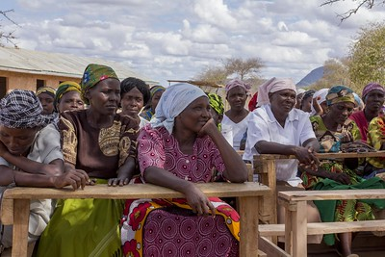
Why treating people well is important
3
Notes:
Narration: Let’s begin by explaining why treating people well is important.
Photos by: 1. Workers in street: © ABBAS Farzami / Rumi Consultancy / World Bank​. Further permission required for reuse.
2: Group of people: © Flore de Preneuf / World Bank. Further permission required for reuse.

Slide 4
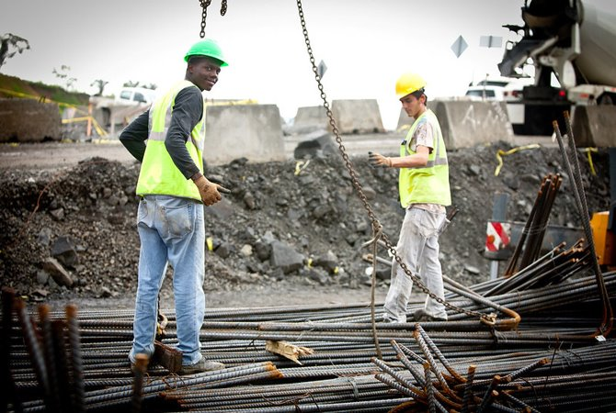
Workplace needs to be safe environment for everyone
4
Notes:
Narration: The workplace needs to be safe environment for everyone so how you behave towards others matters.
Treating people badly can make them feel uncomfortable, cause severe stress and seriously affect their health and wellbeing.
Treating people well creates a happier workplace where everyone feels safe and comfortable.
Photo by: © Gerardo Pesantez / World Bank.​ ​Further permission required for reuse.

Slide 5
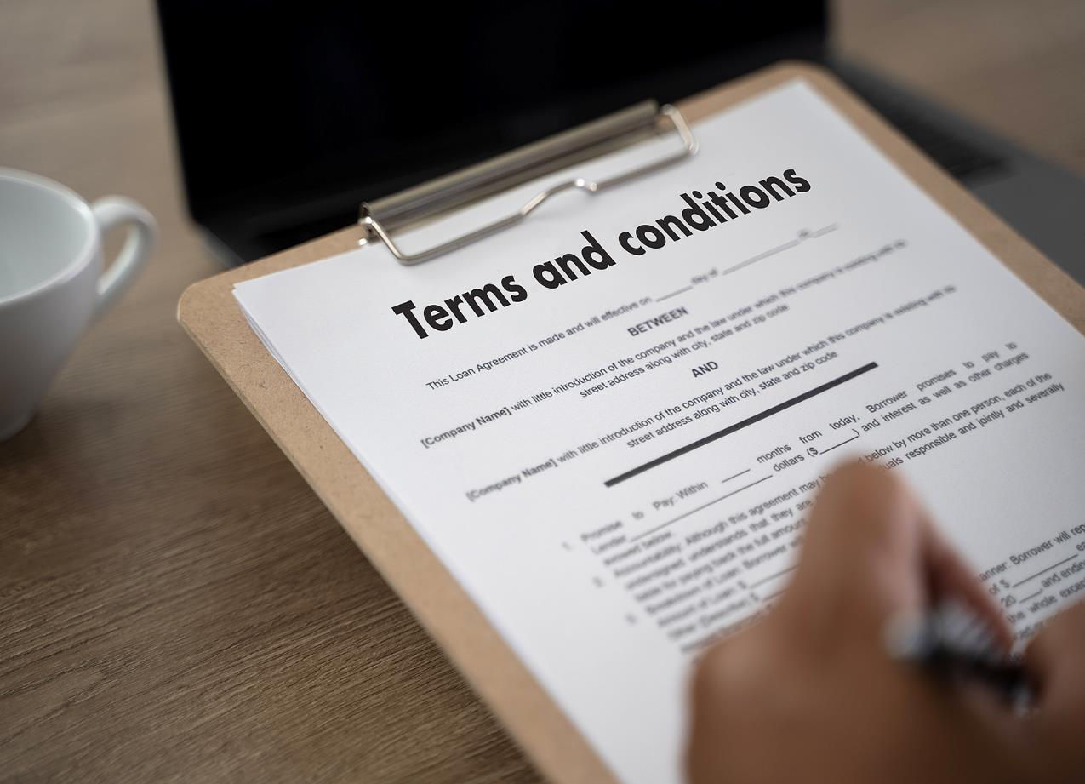
Important you know rules for acceptable behavior
Written in your work terms and conditions or worker’s handbook or a Code of Conduct
5
Notes:
Narration: So it's really important that you know the rules for acceptable behavior.
This may be covered in your work contract, workers handbook or a Code of Conduct.
Photo by: Shutterstock.com

Slide 6
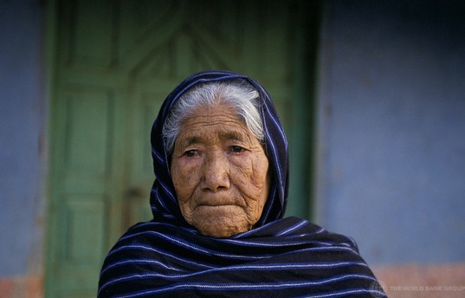
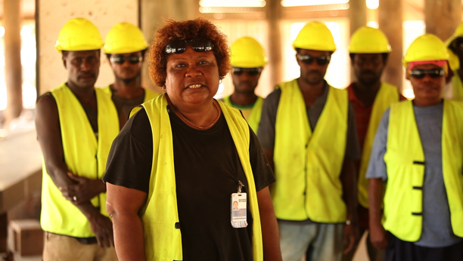
How to behave at work
6
Notes:
Narration: Now we’ll explain how you need to behave towards other people at work so that you know the things you should and should not do.
Photos by: 1. Woman: © Curt Carnemark/ World Bank. Further permission required for reuse.
2. Workers: © World Bank. Further permission required for reuse.

Slide 7
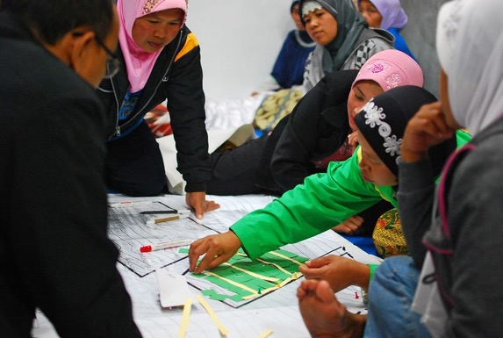
You should treat people:
Equally
Fairly
Respectfully
7
Notes:
Narration: You should treat people equally, fairly and respectfully.
Photo by: © Nugroho Nurdikiawan Sunjoyo / World Bank. Further permission required for reuse.

Slide 8
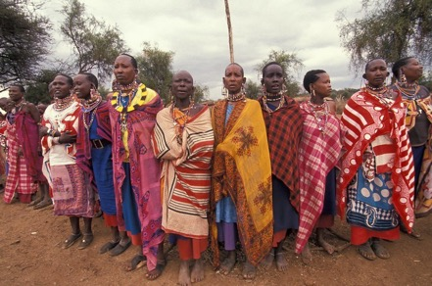
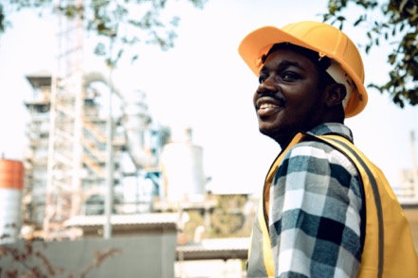
Everyone
8
Notes:
Narration: This applies to everyone you come across at work – everybody on site and the community.
It includes, for example, women, the elderly, people with disabilities, migrant workers and children.
And it covers people’s culture and traditions too.
Note to trainer: To make the training more interactive, before you show this slide, ask the workers: “Who do you need to treat with respect at work?” The answer is: everyone – everybody on site, the community and any other people you come across at work.
Photos by: 1. Worker: Shutterstock.com. Further permission required for reuse.
2. Women: © Curt Carnemark / World Bank. Further permission required for reuse.

Slide 9
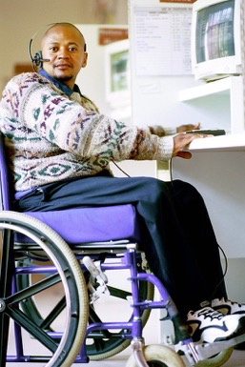
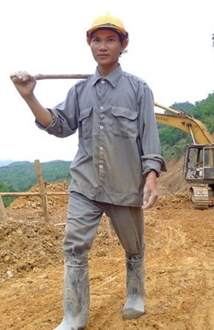
Do not pick on anyone, exclude anyone or put them at disadvantage
Do not treat people badly
9
Notes:
Narration: Do not pick on anyone, exclude anyone or put them at a disadvantage.
Do not treat people badly for any reason, such as their appearance, gender, age, marital status, ethnic group, religion, political opinions or the language they speak.
For example, do not tell someone that they cannot do a task because they are a woman or refuse to work with someone because they are a different religion to you.
Photos by: 1. Worker: © Mai Ky/ World Bank. Further permission required for reuse.
2. Wheelchair user: © Trevor Samson / World Bank. Further permission required for reuse.

Slide 10
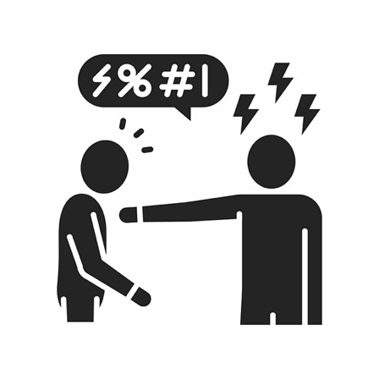
Non-violent
Do not use force to hurt or harm anyone – talking to people aggressively or shouting or physical force
10
Notes:
Narration: Always behave in a non-violent way and do not use force to hurt or harm anyone.
This includes talking to people aggressively or shouting at them, as well as using physical force.
And never threaten anyone with violence.
Image by: Shutterstock.com

Slide 11
Respect women
Non-sexual
Do not make sexual advances
Never persuade or force anyone to do anything sexual
11
Notes:
Narration: It is important to ​respect women ​so you must act in a non-sexual way at work.
Do not make sexual advances to anyone.
This includes whistling, making comments or gestures or physical contact, which would be sexual harassment.
And don’t threaten to do sexual acts to someone.
Never persuade or force anyone to do anything sexual with you. This would be sexual abuse.
Don't offer any benefits, like money or work, in return for sexual favors.
A couple of examples of unacceptable sexual behavior that is not allowed are:
A worker sending sexually explicit texts to another person working on site.
Or a worker telling a member of the community that they can get them a job on site in exchange for sex.
Sexual abuse or harassment will be reported to the police.
Image by: Shutterstock.com

Slide 12
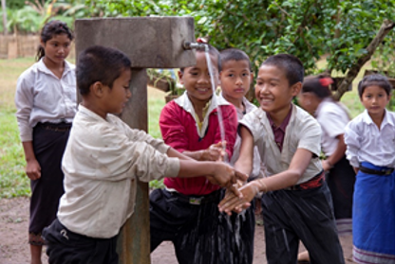
Protecting children
12
Notes:
Narration: Next we’ll look at protecting children.
Generally around the world, a child is anyone under the age of 18.
Photo by: © Bart Verweij / World Bank. Further permission required for reuse.

Slide 13
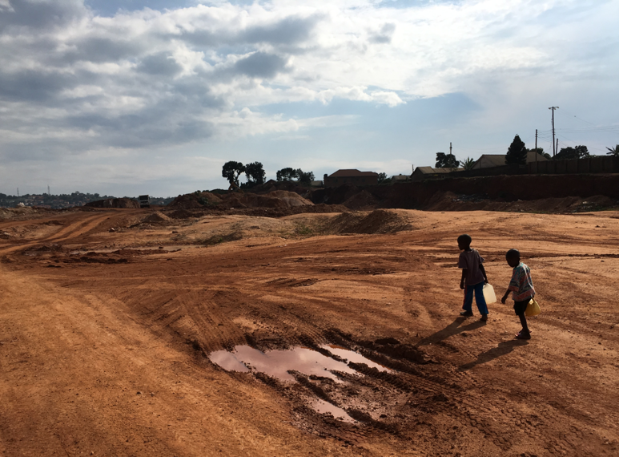
MODULE 5 • KEEPING THE COMMUNITY SAFE
Construction sites are not safe for children
13
Notes:
Narration: Children like to go exploring but construction sites are not safe places to do that.
Photo by: © Michael Hall / World Bank. Further permission required for reuse.

Slide 14
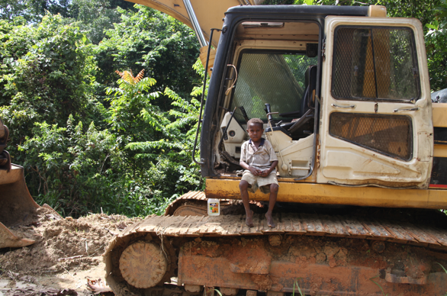
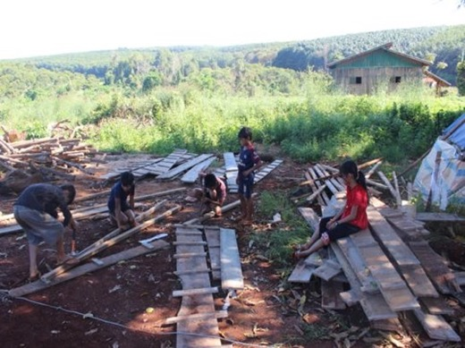
Keep children off site
Do not give work to children
14
Notes:
Narration: Children should not be on construction sites so keep them off site.
Children must not work on construction sites.
They should be at school as this will help them get good jobs in future.
Don't give work to children.
Photos by: 1. Child on excavator: © World Bank. Further permission required for reuse.
2. Children taking nails out of timber: © World Bank. Further permission required for reuse.

Slide 15
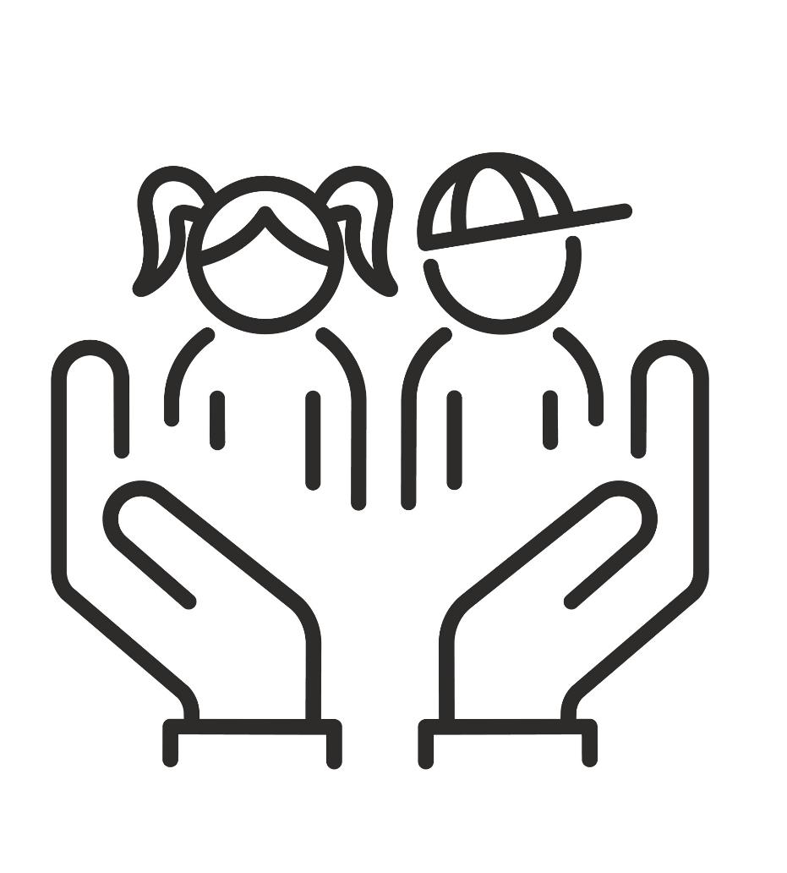
Do not do anything sexual with a child
Do not hurt or harm children
15
Notes:
Narration: Children also need to be kept safe from bad treatment by anyone – including people working on site.
Do not do anything sexual with a child.
And do not hurt or harm children for example through violence, physical force or behaving aggressively.
Image by: Shutterstock.com

Slide 16
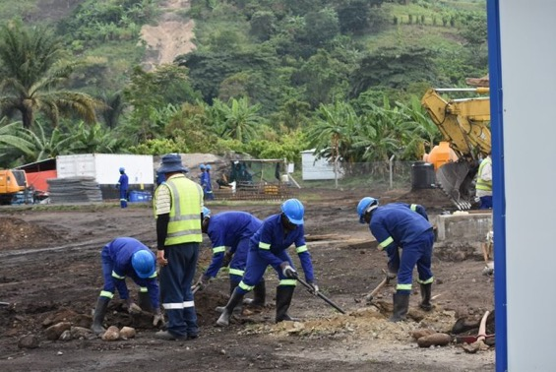
How you should be treated
at work
16
Notes:
Narration: Now we’ll explain how you can expect to be treated by other people at work.
So that you understand what is unacceptable and know that you should not put up with it.
Photo by: 1. Group of workers: © Jack Mozingo / World Bank. Further permission required for reuse.
2. Two workers talking: Shutterstock.com. Further permission required for reuse.

Slide 17
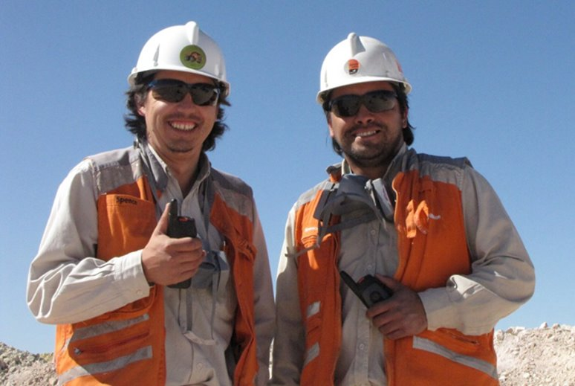
You should be treated:
Equally
Fairly
Respectfully
17
Notes:
Narration: You should be treated equally, fairly and respectfully.
And not be picked on, excluded or disadvantaged in any way.
Photo by: Pxhere, Creative Commons CC0, https://pxhere.com/en/photo/683029. Further permission required for reuse.

Slide 18
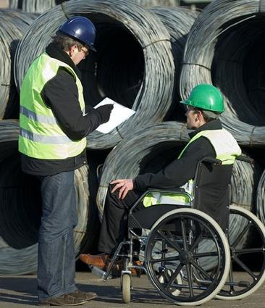
If you are disabled, reasonable measures should be put in place to meet your needs
18
Notes:
Narration: If you are disabled, reasonable measures should be put in place to meet your needs, including being able to access the parts of site you need to.
And also to help you evacuate in an emergency, for example if you cannot hear a fire alarm.
Photo by: Shutterstock.com. Further permission required for reuse.

Slide 19
You should NOT be treated violently
19
Notes:
Narration: You should not be treated violently - either with physical force or spoken to aggressively or threatened.
Image by: Shutterstock.com

Slide 20
You should NOT receive sexual attention
20
Notes:
Narration: You should not receive sexual attention or be persuaded or forced into sexual acts. This could be sexual abuse, or sexual harassment and subject to police action.
Image by: Shutterstock.com

Slide 21
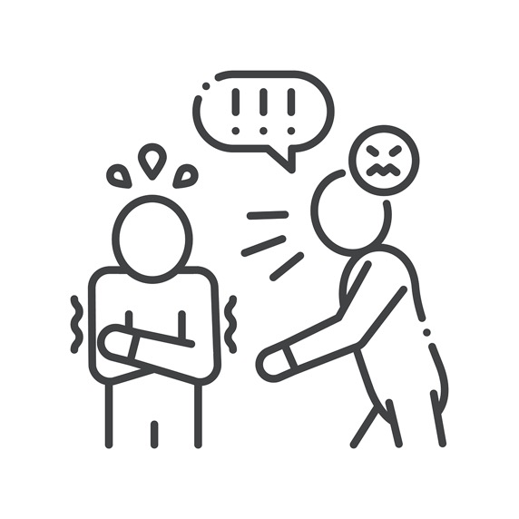
You should NOT be:
Forced to work by someone threatening you
Denied benefits you are entitled to
21
Notes:
Narration: You should not be forced to work by someone who is threatening you.
For example, to pay off a debt or because someone is keeping your identity papers.
You should not be denied any benefits that you are entitled to as part of your job - by law or in your work contract.
Image by: Shutterstock.com

Slide 22
Reporting unacceptable behavior and seeking help
22
Notes:
Narration: Now let’s see how unacceptable behavior should be dealt with.
Unfair, unequal or disrespectful behavior is not to be tolerated – people thinking it is okay because it is part of their culture or tradition is not an excuse.
Image by: Shutterstock.com

Slide 23
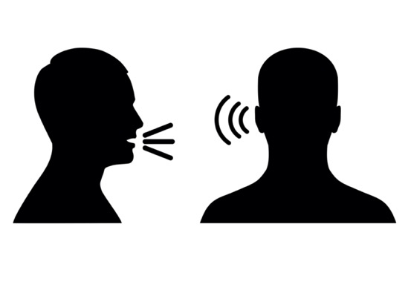
If you experience or see unfair, unequal or disrespectful behavior report it
Should not be retaliation against you for reporting
23
Notes:
Narration: If you experience unacceptable behavior yourself or see it happening to someone on site or being done by someone on site to someone in the community, then report it.
You can do this through the system for raising issues with site management - this might be a grievance process.
There should not be any retaliation against you for reporting a concern. It should be taken seriously, investigated, and appropriate action taken.
Note to trainer: To make the training more interactive, change, “If you experience unacceptable behavior yourself or see it …..” into a question. Ask the workers: “What should you do If you experience unacceptable behavior yourself or see it happening to someone on site or being done by someone on site to someone in the community?” The answer is: report it.
Image by: Shutterstock.com

Slide 24
If you are treated unacceptably, seek specialist support – there are organizations that help victims and survivors
24
Notes:
Narration: If you are treated unacceptably seek specialist support to help you recover from what happened.
This might be medical care or counselling or legal advice.
There may be support available from your employer’s workplace health team, human resources or any organization that helps victims and survivors, such as a specialist Service Provider in the project area.
Image by: Shutterstock.com

Slide 25
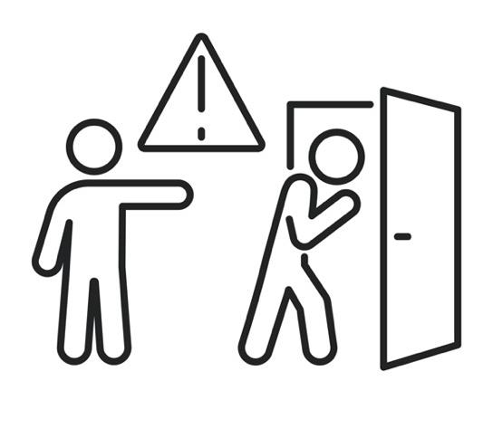
If you treat people unequally, disrespectfully or unfairly there will be serious consequences for you
25
Notes:
Narration: If you treat people unequally, disrespectfully or unfairly then there may be serious consequences for you, including losing your job or being reported to the police.
Image by: Shutterstock.com

Slide 26
26
Notes:
Narration: We’ll finish this module with three key things to remember.
Image by: © World Bank

Slide 27
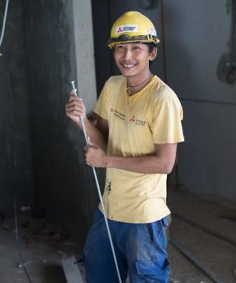
Treat everyone equally, fairly and respectfully
Violent, sexual or forceful behavior is not tolerated
Report concerns without fear of retaliation
27
Notes:
Narration:
Treat everyone equally, fairly and respectfully
Violent, sexual or forceful behavior is not tolerated
Report concerns without fear of retaliation.
You have now completed the first section of the general induction about essential things you need to do when on site and how to behave at work – well done!
Next we’ll start the second section on how to do everyday tasks.
Photo by: © World Bank. Further permission required for reuse.
​

Slide 28
Copyright
© 2022 International Bank for Reconstruction and Development / The World Bank
1818 H Street NW
Washington DC 20433
Telephone: 202-473-1000
Internet: www.worldbank.org
This work is a product of the staff of The World Bank with external contributions. The findings, interpretations, and conclusions expressed in this work do not necessarily reflect the views of The World Bank, its Board of Executive Directors, or the governments they represent.
The World Bank does not guarantee the accuracy, completeness, or currency of the data included in this work and does not assume responsibility for any errors, omissions, or discrepancies in the information, or liability with respect to the use of or failure to use the information, methods, processes, or conclusions set forth. The boundaries, colors, denominations, and other information shown on any map in this work do not imply any judgment on the part of The World Bank concerning the legal status of any territory or the endorsement or acceptance of such boundaries.
Nothing herein shall constitute or be construed or considered to be a limitation upon or waiver of the privileges and immunities of The World Bank, all of which are specifically reserved.
Rights and Permissions
The material in this work is subject to copyright. Because The World Bank encourages dissemination of its knowledge, this work may be reproduced, in whole or in part, for noncommercial purposes as long as full attribution to this work is given.
Any queries on rights and licenses, including subsidiary rights, should be addressed to World Bank Publications, The World Bank Group, 1818 H Street NW, Washington, DC 20433, USA; fax: 202-522-2625; e-mail: pubrights@worldbank.org.

