Slide 1
MODULE 5
Keeping the community safe
For copyright details see last slide of this PowerPoint presentation
Notes:
Narration: Welcome to Module 5: Keeping the community safe.
This module explains the things that you need to do on site to make sure the community is not harmed by the construction work.
When we say “community” we mean everyone who lives and works near the site, and people passing by.
Image by: © World Bank.

Slide 2
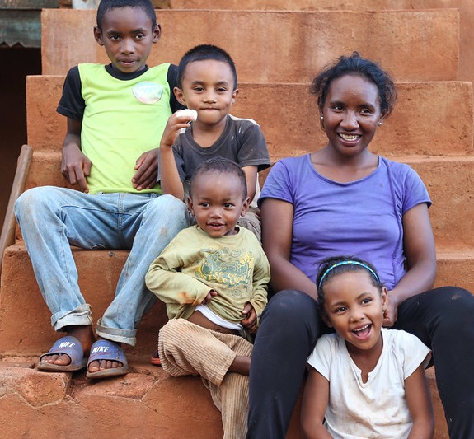
MODULE 5 • KEEPING THE COMMUNITY SAFE
Keeping the community safe is important
Keep community off site
Protect community from hazards
What to do if community has query or complaint
2
Notes:
Narration: By the end of this module you will: - Know why keeping the community safe is important
- Be able to keep the community off site - Protect the community from hazards and - Know what to do if a member of the community has a query or complaint.
Photo by: © Sarah Farhat/ World Bank. Further permission required for reuse.

Slide 3
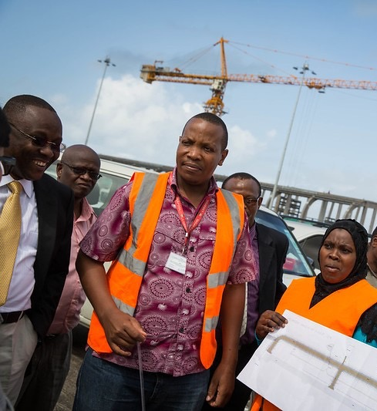
Why keeping the community safe is important
MODULE 5 • KEEPING THE COMMUNITY SAFE
Why keeping the community safe is important
3
Notes:
Narration: First let’s look at why keeping the community safe is important.
Photo by: © Rob Beechey / World Bank. Further permission required for reuse.

Slide 4
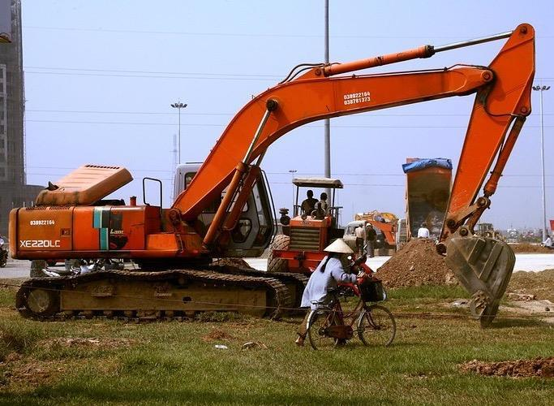
MODULE 5 • KEEPING THE COMMUNITY SAFE
Members of the community can die or be injured
4
Notes:
Narration: Construction sites can be dangerous to the local community - members of the community have died, or been injured, because of construction work – for example by falling into excavations or getting run over by vehicles.
For example, the person in this photo is too close to the excavator.
If the driver hasn’t seen them, the excavator could swing round and knock them over.
Photo by: © D. McCourtie / World Bank.

Slide 5
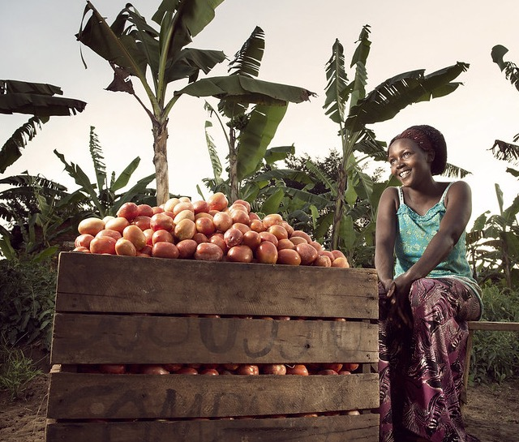
MODULE 5 • KEEPING THE COMMUNITY SAFE
Damage to community property and crops
Pollute land, air and water
Disrupt business, schooling and health
5
Notes:
Narration: If construction work is not done properly it can damage the community’s property or crops.
They can also be affected by pollution of the air, water and soil.
And construction traffic, noise and vibration can all be disruptive to people in the community.
Photo by: © Stephan Gladieu / World Bank. Further permission required for reuse.

Slide 6
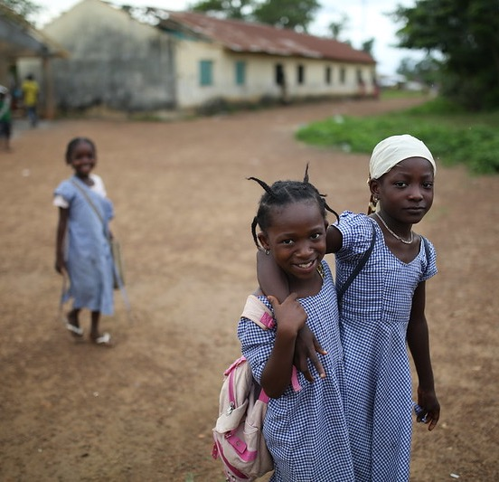
MODULE 5 • KEEPING THE COMMUNITY SAFE
Keeping the community safe
6
6
Notes:
Narration: Next we’ll explore the best ways to keep the community safe.
Photo by: © Dominic Chavez / World Bank. Further permission required for reuse.

Slide 7
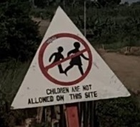
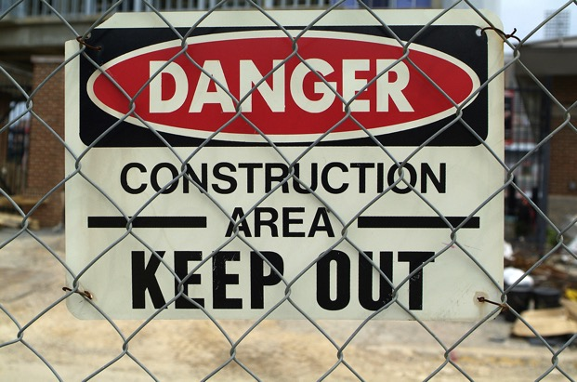
MODULE 5 • KEEPING THE COMMUNITY SAFE
Keep the community out of working areas
If you see a member of community on site, politely ask them to leave
Tell Supervisor
7
Notes:
Narration: Keep the community, including children, out of working areas – signs and fences like these can help.
If you see a member of the community on site, politely ask them to leave, explaining that the site is dangerous. Tell your Supervisor so that they can do something more to stop people getting onto site.
Note to trainer: To make the training more interactive, change “If you see a member of the community on site……..” into a question. Ask the workers: “What should you do if you see a member of the community on site?” The answer is: politely ask them to leave, explaining that the site is dangerous.
Photos by: ​ 1. Sign – children are not allowed on this site: © Michael Hall / World Bank
2. Keep out sign: Shutterstock.com

Slide 8
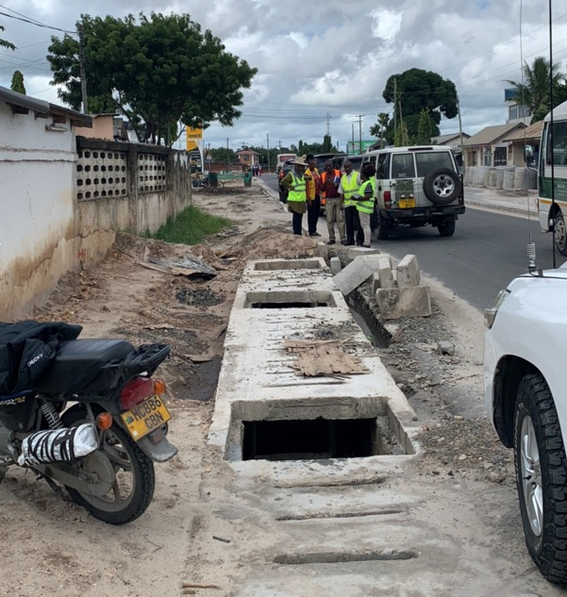
MODULE 5 • KEEPING THE COMMUNITY SAFE
Protect community from hazards
8
Notes:
Narration: Always make sure you protect the community from hazards.
Keep the site safe so that people cannot get injured even if they do get onto site.
For instance, a member of the community could easily fall into the drains here because the drain covers have not been replaced and there are no barriers to keep people out.
Photo by: © Michael Hall / World Bank. Further permission required for reuse.

Slide 9
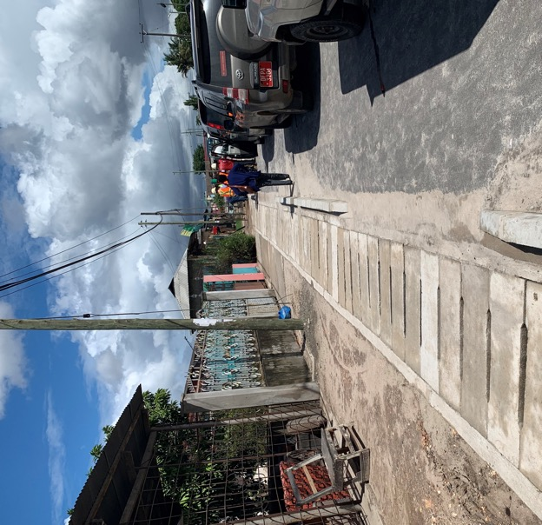
MODULE 5 • KEEPING THE COMMUNITY SAFE
Cover drains and holes
9
Notes:
Narration: Cover drains like this or put up barriers around holes so people cannot fall in.
Photo by: © Michael Hall / World Bank

Slide 10
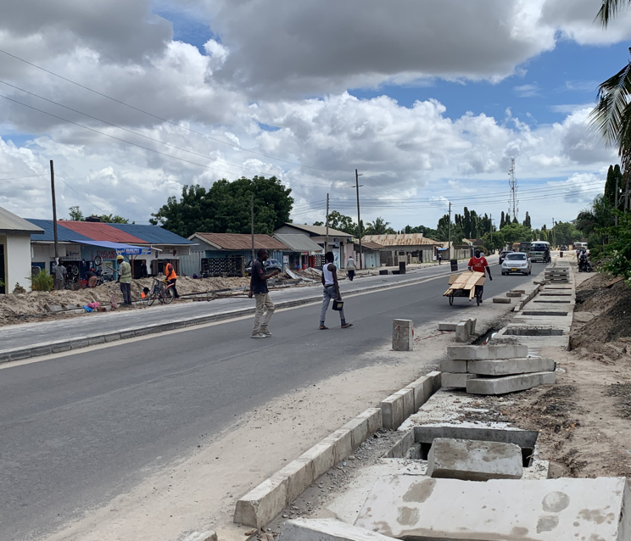
MODULE 5 • KEEPING THE COMMUNITY SAFE
10
Notes:
Narration: In this photo you can see people have had to walk in the road because the footway is unsafe.
This puts them at risk of getting run over.
Photo by:​ © Michael Hall / World Bank. Further permission required for reuse.

Slide 11
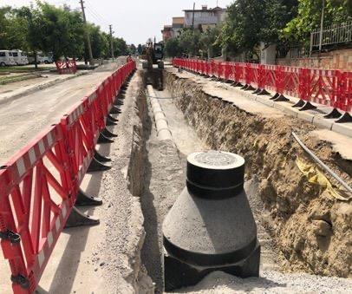
MODULE 5 • KEEPING THE COMMUNITY SAFE
Temporary footpath for community
Put up barriers
11
Notes:
Narration: If the work affects footpaths, make sure there is a temporary footpath for the community to use that is separate from the working area and any other hazards, like a road, like the one on the right here.
And put up barriers around the work areas – like these.
Photo by: © Canan Yildiz / World Bank

Slide 12
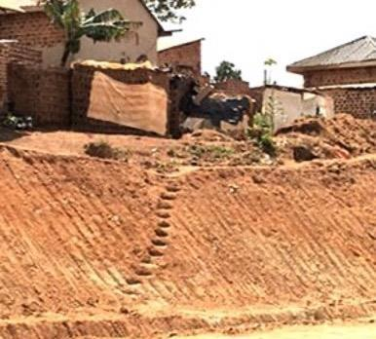
MODULE 5 • KEEPING THE COMMUNITY SAFE
Keep footpaths and accesses clear
12
Notes:
Narration: Remember to keep accesses clear to schools, hospitals, other community facilities and road crossings so people can get where they need to go safely.
For example, you can see here that no proper access has been provided for the people who live in these houses.
There should be temporary stairs in place.
Photo by: © Michael Hall / World Bank

Slide 13
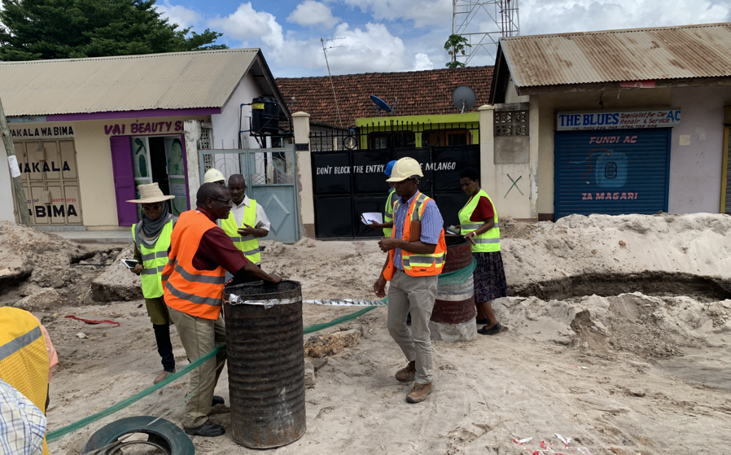
MODULE 5 • KEEPING THE COMMUNITY SAFE
Keep footpaths and accesses clear
13
Notes:
Narration: And keep gates clear.
Here this gate says on it "Do not block entry" but the entrance has been blocked by the work.
And there is no way for customers to get across the works to the shops safely.
Photo by: © Michael Hall / World Bank. Further permission required for reuse.

Slide 14
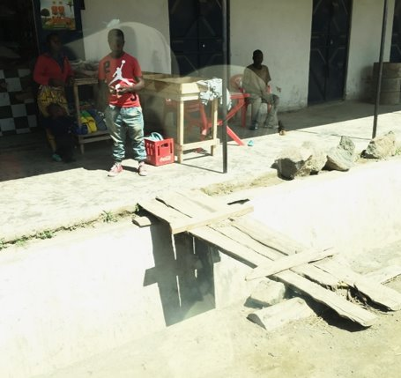
MODULE 5 • KEEPING THE COMMUNITY SAFE
Keep footpaths and accesses clear
14
Notes:
Narration: And in this photo you can see some wood has been put across this trench but it is not strong or secure.
Photo by: © Michael Hall / World Bank. Further permission required for reuse.

Slide 15
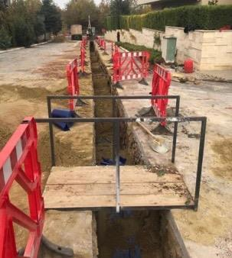
MODULE 5 • KEEPING THE COMMUNITY SAFE
Keep footpaths and accesses clear
15
Notes:
Narration: It should have a fixed floor and guard rails, like this one.
Photo by: © Canan Yildiz / World Bank

Slide 16
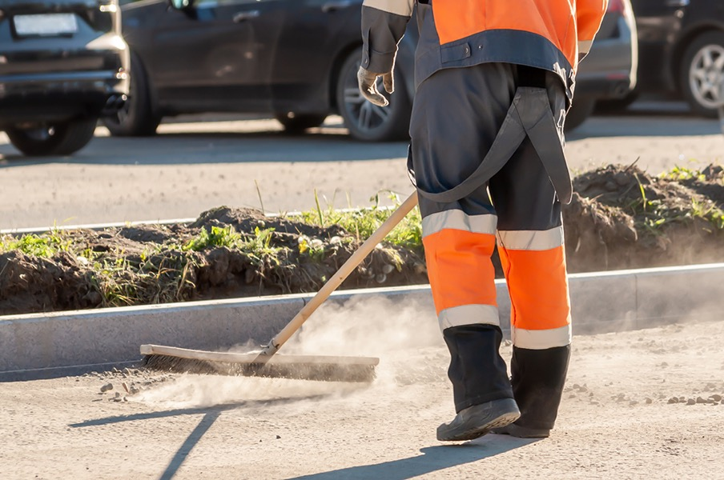
MODULE 5 • KEEPING THE COMMUNITY SAFE
Keep site access and roads clean
16
Notes:
Narration: Keep site access and roads clean of mud and dust.
In wet weather, mud on the roads can get slippery and cause accidents.
During dry weather, dust can make it difficult for drivers to see properly and is unhealthy to breathe in.
Photo by: Shutterstock.com

Slide 17
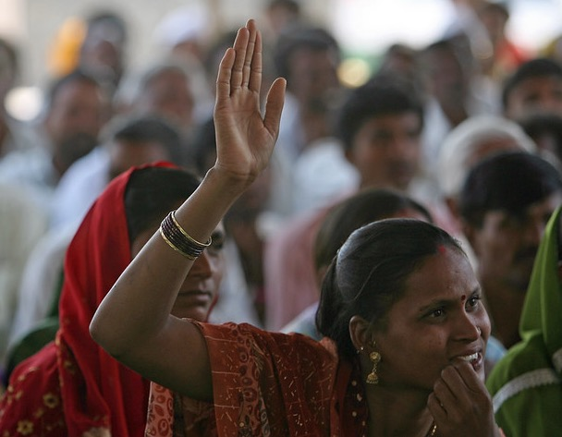
MODULE 5 • KEEPING THE COMMUNITY SAFE
If a member of the community has a query or complaint
Politely ask them to wait safely away from work area
Get Supervisor or manager to talk to them
17
Notes:
Narration: If a member of the community has a query or complaint, politely ask them to wait safely away from the work area.
Get your Supervisor or a manager to come and talk to them.
Be sure to deal with it so that any problems can be fixed.
Photo by: ​© Simone D. McCourtie / World Bank. Further permission required for reuse.

Slide 18
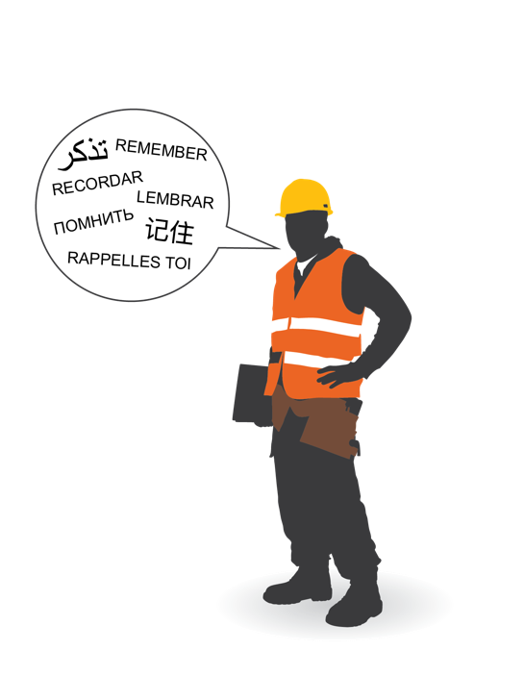
MODULE 5 • KEEPING THE COMMUNITY SAFE
Key things to remember
18
Notes:
Narration: Finally here are three key things for you to remember.
Image by: © World Bank

Slide 19
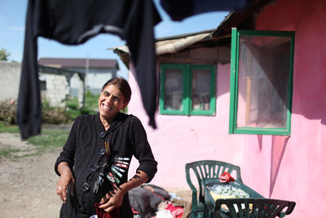
MODULE 5 • KEEPING THE COMMUNITY SAFE
Keep community off site
Protect community from hazards
Tell your Supervisor about queries or complaints from community
19
Notes:
Narration:
Keep the community off site
Protect the community from hazards
Tell your Supervisor about queries or complaints from the community.
Now that you know how to keep the community safe, let’s see what you need to do at work to respect yourself and others in Module 6.
Photo by: © Dominic Chavez / World Bank. Further permission required for reuse.

Slide 20
Copyright
© 2022 International Bank for Reconstruction and Development / The World Bank
1818 H Street NW
Washington DC 20433
Telephone: 202-473-1000
Internet: www.worldbank.org
This work is a product of the staff of The World Bank with external contributions. The findings, interpretations, and conclusions expressed in this work do not necessarily reflect the views of The World Bank, its Board of Executive Directors, or the governments they represent.
The World Bank does not guarantee the accuracy, completeness, or currency of the data included in this work and does not assume responsibility for any errors, omissions, or discrepancies in the information, or liability with respect to the use of or failure to use the information, methods, processes, or conclusions set forth. The boundaries, colors, denominations, and other information shown on any map in this work do not imply any judgment on the part of The World Bank concerning the legal status of any territory or the endorsement or acceptance of such boundaries.
Nothing herein shall constitute or be construed or considered to be a limitation upon or waiver of the privileges and immunities of The World Bank, all of which are specifically reserved.
Rights and Permissions
The material in this work is subject to copyright. Because The World Bank encourages dissemination of its knowledge, this work may be reproduced, in whole or in part, for noncommercial purposes as long as full attribution to this work is given.
Any queries on rights and licenses, including subsidiary rights, should be addressed to World Bank Publications, The World Bank Group, 1818 H Street NW, Washington, DC 20433, USA; fax: 202-522-2625; e-mail: pubrights@worldbank.org.

