Slide 1
MODULE 4
Staying healthy
For copyright details see last slide of this PowerPoint presentation
Notes:
Narration: Welcome to Module 4: staying healthy.
This module explains the things that you need to do on site to keep yourself and others well.
This will stop you from getting ill and prevent diseases from spreading to other people on site, or even to the local community.
Image by: © World Bank

Slide 2
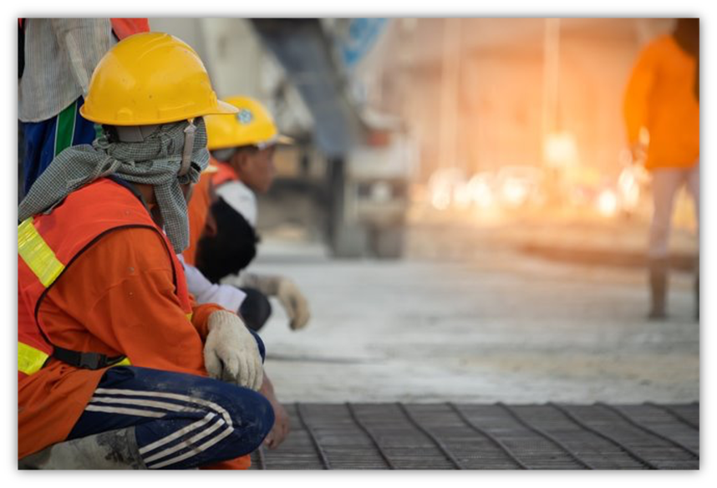
Stay healthy
rdc
Look after other people’s health
Prevent pests and diseases
2
Notes:
Narration: By the end of this module you will be able to:
take steps to stay healthy
look after other people’s health and
help prevent pests and diseases from spreading.
Photo by: Pixabay https://pixabay.com/photos/construction-worker-industry-4241847/

Slide 3
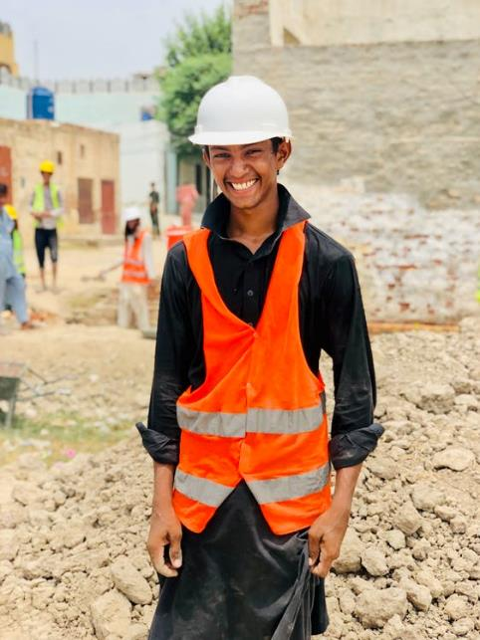
Keeping yourself well
Notes:
Narration: Let’s begin with finding out about keeping yourself well.
Photo by: Mutahir Jamil on Pexels https://www.pexels.com/photo/a-young-man-working-in-construction-8990557/

Slide 4
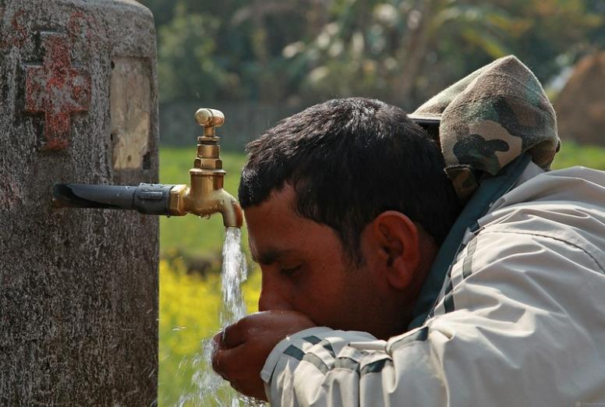
Drink lots water Only drink from drinking water tap or bottled water
Notes:
Narration: Drink lots of water to stay hydrated especially in the sun and heat.
This helps you avoid heatstroke, stay focused and keep your muscles strong making it less likely you'll have an accident.
Only drink water from the drinking water tap which should be labelled something like this blue sign - or bottled water.
Don't drink water from elsewhere as it may not be clean and could make you ill.
Turn off the tap when you've finished to save water.
Image by: Pixabay, https://pixabay.com/illustrations/water-tap-icon-drinking-water-3597526/
Photo by: © Simone D. McCourtie / World Bank. Further permission required for reuse.

Slide 5
Take regular rest breaks Eat and drink away from work areas
Notes:
Narration: It’s important that you take regular rest breaks to stop you from getting tired.
When you are tired you are more likely to have an accident.
Eat and drink away from the work areas.
There should be proper places for eating and resting.
Photo by: © Michael Hall / World Bank

Slide 6
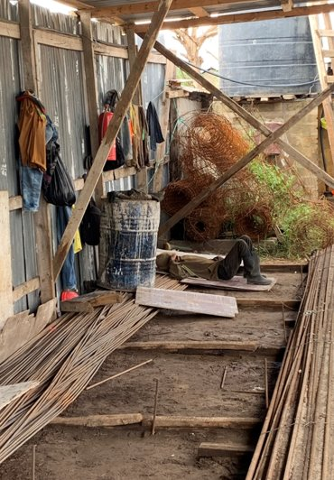
Smoke in smoking areas Use waste bins
Notes:
Narration: Not like this site, where the worker is just lying on the ground.
Smoking is very bad for your health, but if you must smoke do so only in the smoking areas.
And use the waste bins provided to keep the site clean.
Photo by: © Michael Hall / World Bank

Slide 7
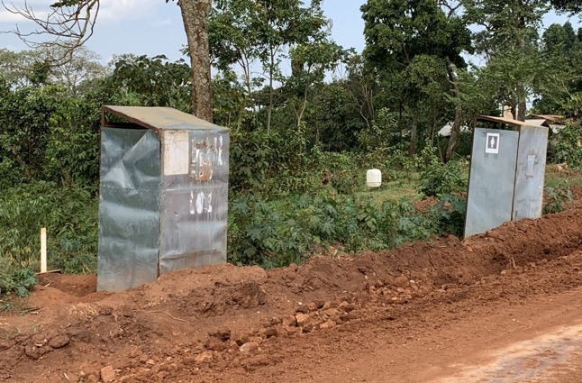
Use toilets and washing areas
Notes:
Narration: Always use the toilets and washing areas, not other areas.
The toilets and washing areas have been designed not to cause pollution.
And there should be separate toilets and washing areas for men and women.
Photos by: 1. Four toilets: © Dohwa Engineering Co Ltd /World Bank
2. Two toilets: © Michael Hall / World Bank

Slide 8
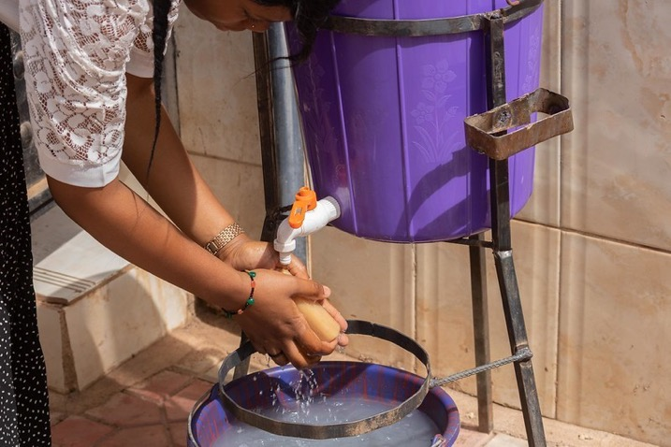
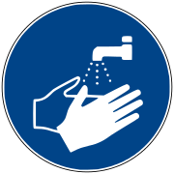
Wash hands after using toilet and hands and face before eat or drink
Remember: Save water by turning off taps
Notes:
Narration: Always wash your hands after using the toilet and wash your hands and face before you eat or drink.
Keeping clean reduces the risk of getting an infection and helps avoid health problems caused by handling hazardous substances, like fuel and cement.
There should be running water, soap and hand towels or driers.
If these run out or are not working tell your Supervisor.
Turn off the tap when you've finished to save water.
Image by: ISO 7010 https://en.wikipedia.org/wiki/ISO_7010 In public domain.
Photo by: © Ousmane Traore (MAKAVELI) / World Bank

Slide 9
Keep cuts and wounds covered and check for infection
Notes:
Narration: Diseases and chemicals can enter your body through cuts and wounds, making you ill.
So keep cuts and wounds covered with a dressing and check for infection every day.
Photo by: Shutterstock.com.

Slide 10
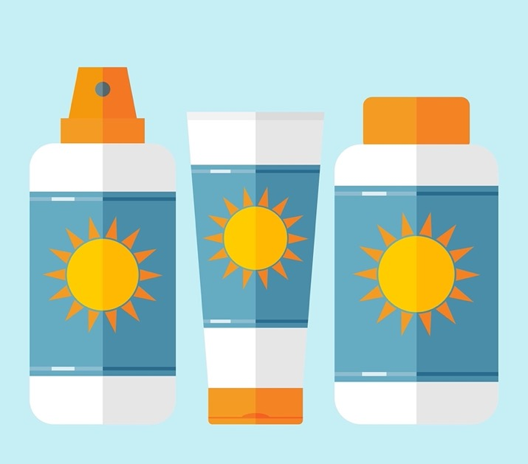
If in sun, keep skin covered or wear sunscreen
Notes:
Narration: If you are working in the sun, keep your skin covered with long clothes or wear sunscreen.
Note for trainer: To make the training more interactive, change, “If you are working in the sun…. “ into a question. Ask the workers: “What should you do if you are working in the sun?” The answer is: keep your skin covered with long clothes or wear sunscreen.
Images by: 1. Suncream: Shutterstock.com.
2. Top: by Biju Toha from Pixabay https://pixabay.com/illustrations/t-shirt-shirt-isolated-product-image-2068353/

Slide 11
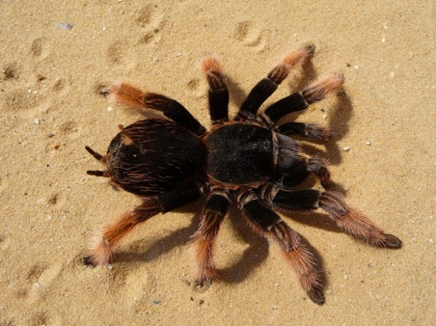
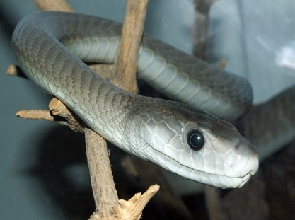
Watch out for animals that bite
Notes:
Narration: Watch out for animals that can bite, like scorpions and some snakes and spiders.
They might hide away in dark places so be careful where you put your hands.
And shake out clothes and Protective Personal Equipment before you put them on.
Photos by: 1. Scorpion: Pxhere, Creative Commons CC0, https://pxhere.com/en/photo/1624839
2. Spider: Pxhere, Creative Commons CC0, https://pxhere.com/en/photo/1356724
3. Snake: Wikimedia, public domain, https://commons.wikimedia.org/wiki/File:Dendroaspis_polylepis_(14).jpg

Slide 12
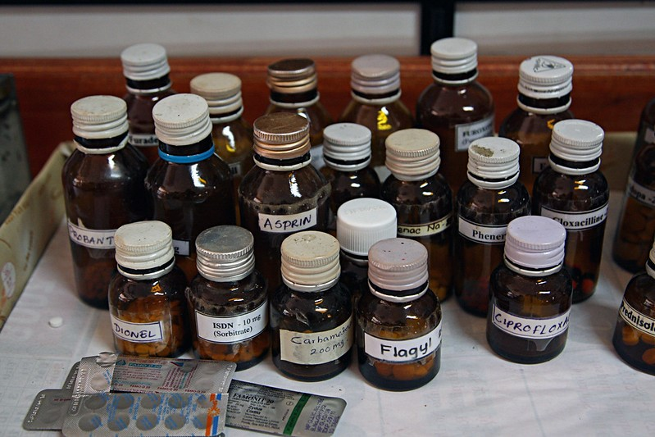
Avoid alcohol and drugs
If you are taking medication that makes drowsy tell Supervisor
Notes:
Narration: Drugs and alcohol can make you drowsy and slow your reactions making you more likely to have an accident.
So it's best to avoid alcohol and drugs, whether they are legal or not.
If you are taking medication from a doctor that could make you drowsy tell your Supervisor.
Photo by: © Simone D. McCourtie/ World Bank

Slide 13
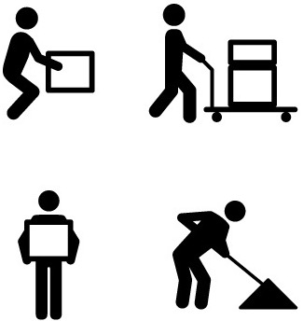
Move to not strain your body
Do not:
do same movement repeatedly
put body in awkward positions
Notes:
Narration: When you are working, move in a way that does not strain your body:
Do not do the same movement repeatedly – repetitive tasks need to be shared amongst several workers so that no one is doing it for too long
Do not put your body in awkward positions – like reaching up or behind you, twisting, bending, or kneeling – the task needs to be set up so your body can stay in a natural position
If you can feel too much strain on your body, talk to your Supervisor about improving the way the task is done.
Image by: Shutterstock.com.

Slide 14
If mental health issues affect you at work, tell Supervisor
Notes:
Narration: Your mental health is as important as your physical health so if you have any mental health issues, like anxiety, that affect you at work, tell your Supervisor.
Image by: Shutterstock.com.

Slide 15
Tell Supervisor about disease that could be caused,
or made worse, by work
15
Notes:
Narration: Also tell your Supervisor if you have a disease that could be caused, or made worse, by your work.
Image by: Shutterstock.com.

Slide 16
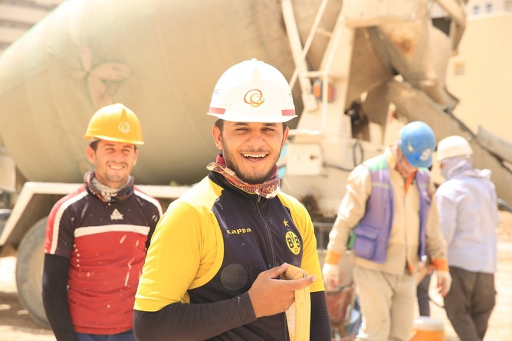
Stopping pests and diseases
Notes:
Narration: Let’s look at stopping pests and diseases from spreading.
These steps reduce the chance of diseases being passed on to someone else on site or in the local community.
Photo by: Pixabay. https://pixabay.com/photos/construction-worker-3384691/

Slide 17
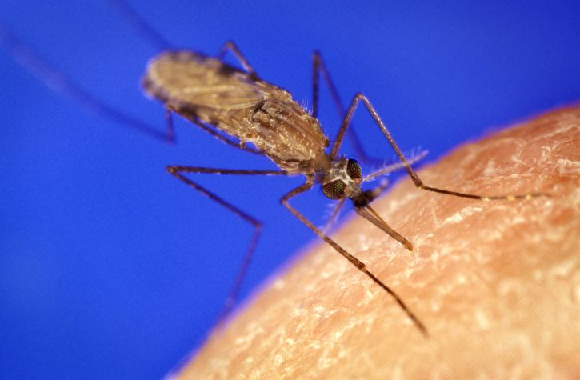
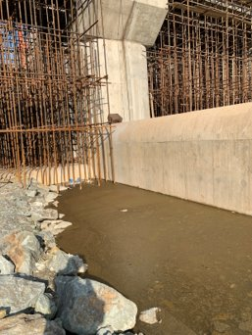
Pest control
Get rid of standing water
Notes:
Narration: Pests need to be kept under control because they can spread diseases, like malaria.
To do this get rid of standing water where insects, like mosquitos, can breed.
Report any stagnant water, like in this photo to your Supervisor
Photos by: 1. Stagnant water: © Michael Hall / World Bank
2. Mosquito: James D. Gathany on Pixnioi, Creative Commons CC0. https://pixnio.com/fauna-animals/insects-and-bugs/mosquito/blood-feeding-anopheles-gambiae-mosquito-this-mosquito-is-one-of-the-leading-malaria-vectors-in-the-world

Slide 18
Pest control
Cover water tanks
If water kept, stir often
Notes:
Narration: Cover water tanks to keep insects out – the one in this photo isn’t covered but it should be.
Photo by: © Michael Hall / World Bank

Slide 19
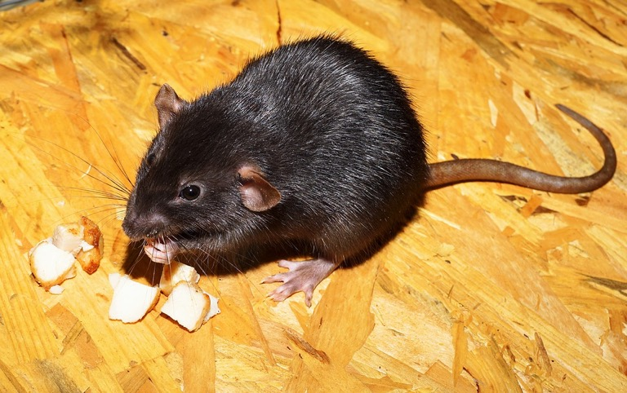
Pest control
Keep your skin covered
If you see vermin like rats or cockroaches, tell Supervisor
Notes:
Narration: Keep your skin covered with clothing to help prevent insect bites and if you see vermin like rats or cockroaches, tell your Supervisor.
Photo by: Kapa65 on Pixabay, https://pixabay.com/photos/rat-color-rat-black-dear-wolf-down-2804058/

Slide 20
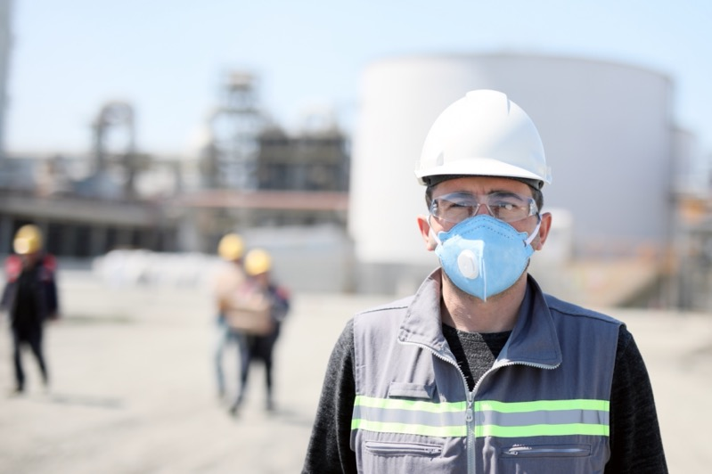
Follow the rules about communicable diseases Cough and sneeze into crook of elbow or tissue and throw in waste bin
If you are ill stay away from people
Notes:
Narration: Follow the rules on your site about communicable diseases, like covid.
These usually include keeping at least 3 paces away from people, washing your hands often, and wearing a face mask.
Cough and sneeze into the crook of your elbow or a tissue and throw it into a waste bin. If you are ill, for example with diarrhoea or vomiting, tell your Supervisor and stay away from other people.
Photo by: Shutterstock.com. Further permission required for reuse.

Slide 21
Notes:
Narration: Now we’ll finish this module with three key things for you to remember.
Image by: © World Bank.

Slide 22
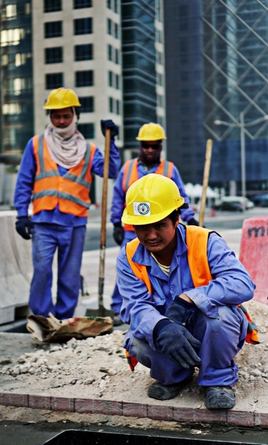
Drink water, eat, rest and wash regularly
Protect yourself from things that can make you ill
Stop pests and diseases from spreading
Notes:
Narration: 1. Drink water, eat, rest and wash regularly
2. Protect yourself from things that can make you ill and
3. Stop pests and diseases from spreading.
Now that you know how to stay healthy, we’ll explain what you can do to keep the community safe in Module 5.
Photo by: Pxhere, Creative Commons CC0, https://pxhere.com/en/photo/1610984. Further permission required for reuse.

Slide 23
Copyright
© 2022 International Bank for Reconstruction and Development / The World Bank
1818 H Street NW
Washington DC 20433
Telephone: 202-473-1000
Internet: www.worldbank.org
This work is a product of the staff of The World Bank with external contributions. The findings, interpretations, and conclusions expressed in this work do not necessarily reflect the views of The World Bank, its Board of Executive Directors, or the governments they represent.
The World Bank does not guarantee the accuracy, completeness, or currency of the data included in this work and does not assume responsibility for any errors, omissions, or discrepancies in the information, or liability with respect to the use of or failure to use the information, methods, processes, or conclusions set forth. The boundaries, colors, denominations, and other information shown on any map in this work do not imply any judgment on the part of The World Bank concerning the legal status of any territory or the endorsement or acceptance of such boundaries.
Nothing herein shall constitute or be construed or considered to be a limitation upon or waiver of the privileges and immunities of The World Bank, all of which are specifically reserved.
Rights and Permissions
The material in this work is subject to copyright. Because The World Bank encourages dissemination of its knowledge, this work may be reproduced, in whole or in part, for noncommercial purposes as long as full attribution to this work is given.
Any queries on rights and licenses, including subsidiary rights, should be addressed to World Bank Publications, The World Bank Group, 1818 H Street NW, Washington, DC 20433, USA; fax: 202-522-2625; e-mail: pubrights@worldbank.org.

