Slide 1
MODULE 3
Avoiding hazards and risks
For copyright details see last slide of this PowerPoint presentation
Notes:
Narration: Welcome to Module 3: Avoiding hazards and risks.
This module explains some of the common hazards and risks you will come across on site.
Hazards and risks are the many and various things on site that can cause accidents, harm people’s health or the environment.
We’ll look at what you need to do to avoid them to stay safe and protect the environment.
Image by: © World Bank

Slide 2
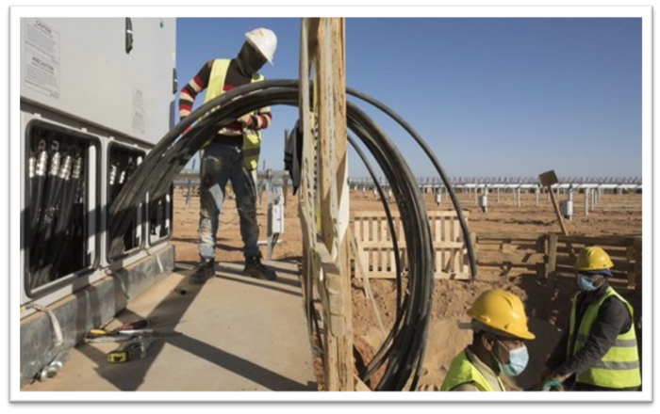
Identify hazards and risks
Protect yourself from common hazards and risks
Minimize noise
Keep the air clean
Protect wildlife
Notes:
Narration: By the end of this module you will be able to:
Identify everyday hazards and risks on site
protect yourself and others from common hazards and risks
minimize noise
keep the air clean and pollution-free and
protect wildlife.
Photo by: © World Bank. Further permission required for reuse.

Slide 3
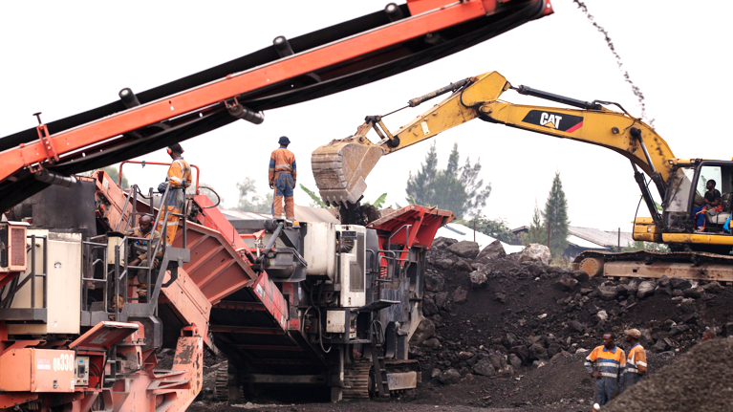
Common hazards and risks
3
Notes:
Narration: We’ll begin by looking at common hazards and risks.
They can be minimized, or even avoided, when you know what to look out for and what to do.
Let’s go through some ways you can do that.
Photo by: © World Bank

Slide 4
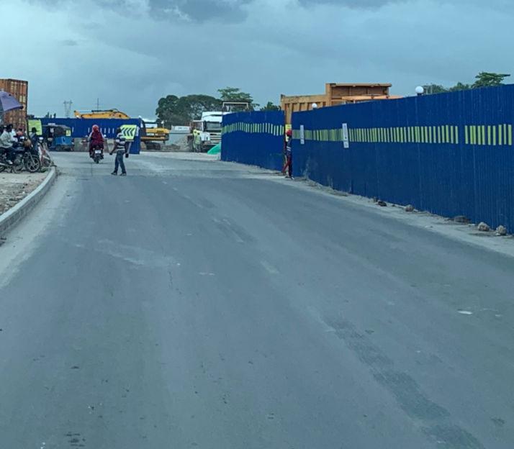
Stay within site boundary
Notes:
Narration: Always stay within the site boundary.
It should be marked with tape, a barrier or fence.
Photo by: © Michael Hall/ World Bank

Slide 5
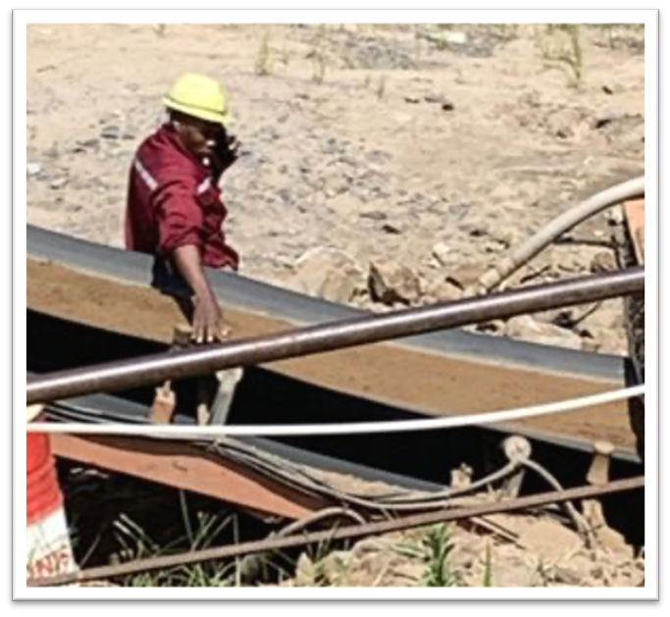
​Look out for hazards around you and what you are doing​
Keep your focus​
Only use your phone in a safe place away from working areas​ ​
Notes:
Narration: Look out for hazards from what’s going on around you AND from what you are doing.
Keep your focus on the task you are working on.
Only use your phone in a safe place away from working areas - not like in this photo where the worker is on the phone in the working area.
Photo by: © Michael Hall/ World Bank. Further permission required for reuse.

Slide 6
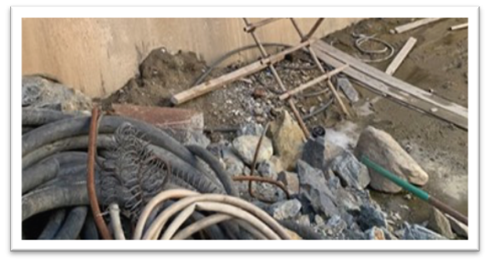
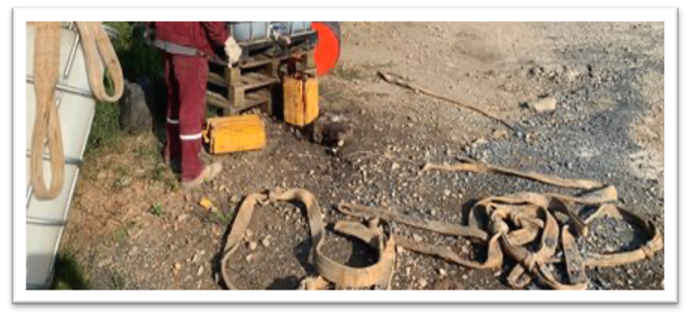
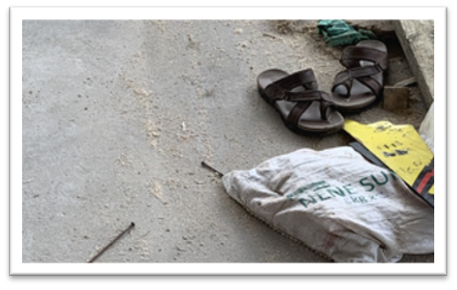
Keep site clean and tidy
Notes:
Narration: Untidy sites like these create hazards that people can slip, trip or fall over as well as increasing the risk of a fire.
Note to trainer: To make the training more interactive, ask the workers: “What is one of the best ways to keep site safe and look after the environment? The answer is: to keep it clean and tidy.
Photos by: © Michael Hall/ World Bank

Slide 7
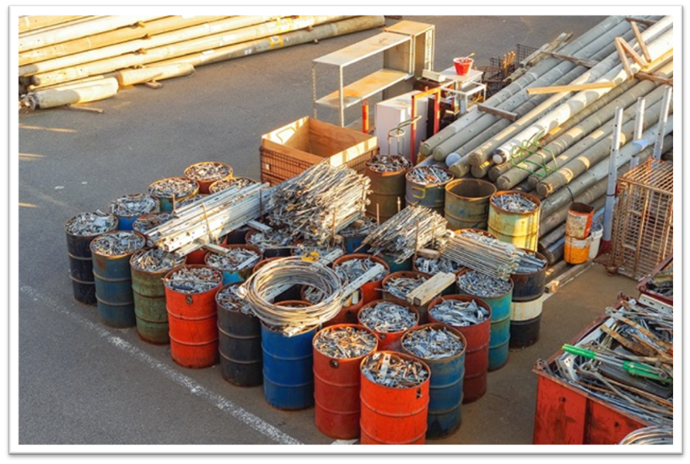
Tidy site is safer site
Notes:
Narration: A tidy site is a safer site.
So keep your work areas and the walkways clear of tools, materials and waste. ​
Photo by: Shutterstock.com.

Slide 8
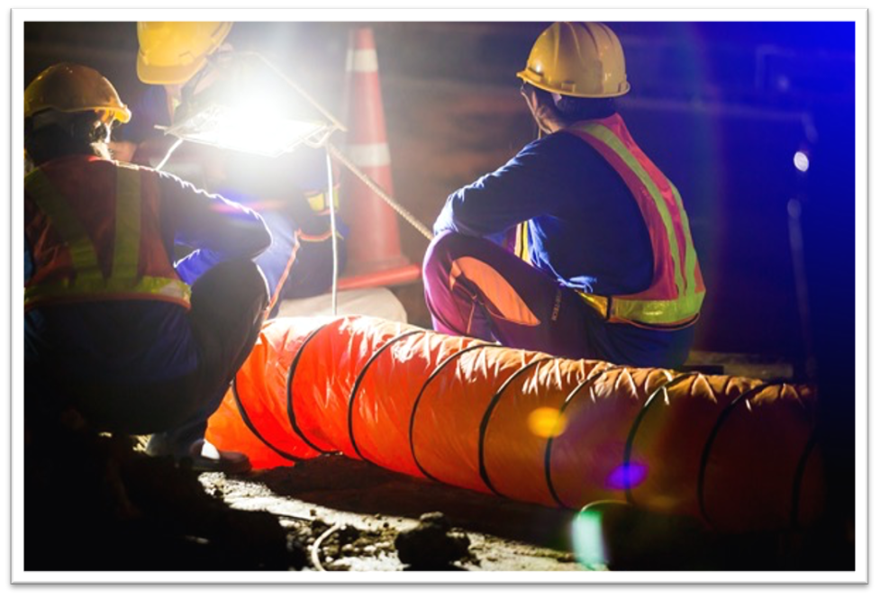
Use lights so you can see
Notes:
Narration: Always use proper lights so you can see clearly what you're doing - in bad weather as well as at night.
Don’t use headlights from a truck or machine – they are too dazzling – the light needs to come from above.
Photo by: Shutterstock.com.

Slide 9
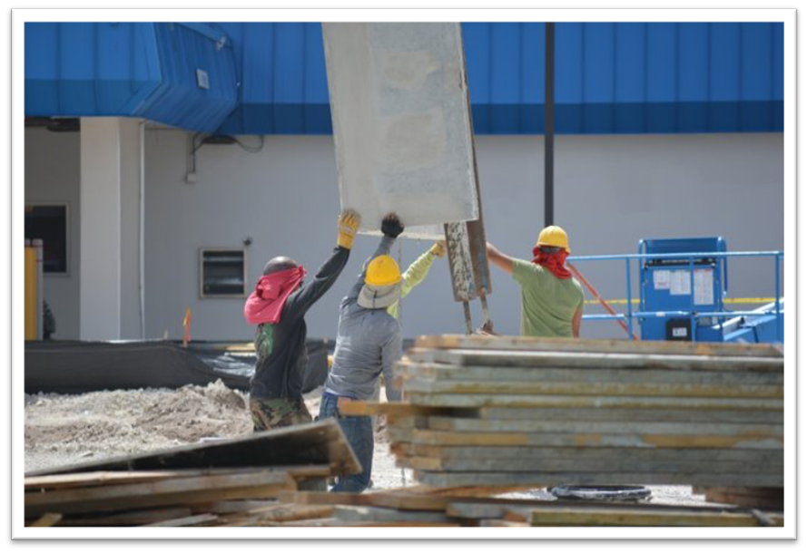
Keeping away from hazards
9
Notes:
Narration: The best way to avoid hazards and risks on site is to keep away from certain areas and activities.
Let’s have a look at some of these.
Photo by: Pxhere, Creative Commons CC0, https://pxhere.com/en/photo/824644

Slide 10
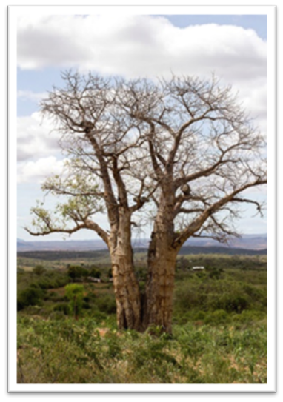
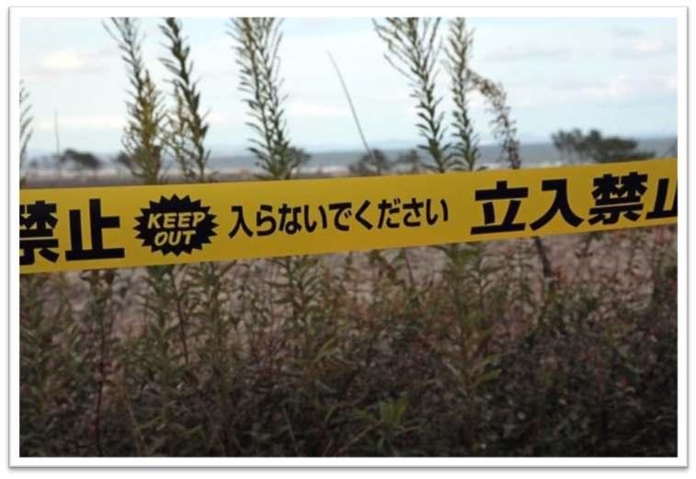
Keep out of fenced-off or no-go areas
Notes:
Narration: You need to keep out of some areas on site that are fenced-off or no-go areas.
For example, it might be unsafe because workers are working above.
Or it could be a special tree that needs protecting.
Photo by: 1. Keep out photo: © Simone D. McCourtie / World Bank
2. Tree: © World Bank

Slide 11
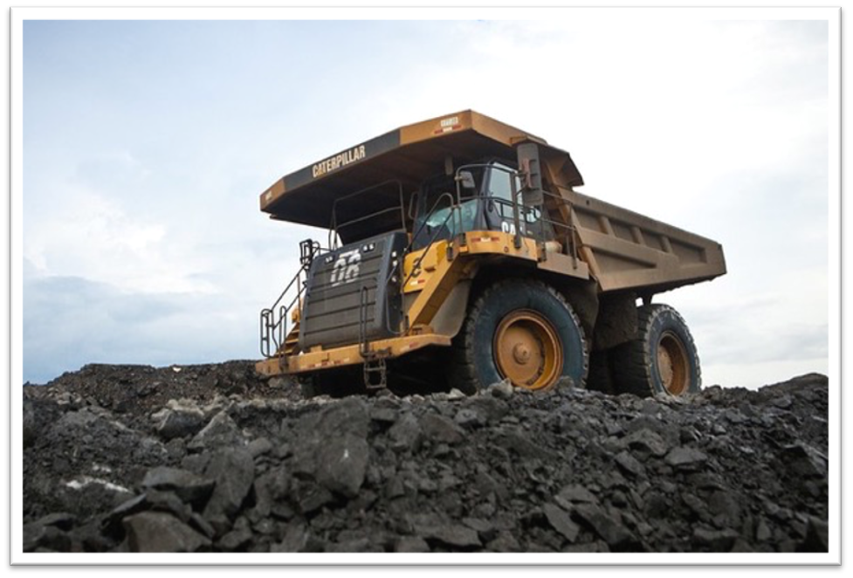
Keep off piles of soil, rock, loose material
Notes:
Narration: Keep off piles of soil, rock or other loose material, like stockpiles.
They are unstable and can move and bury you.
Photo by: © Gerardo Pesantez / World Bank

Slide 12
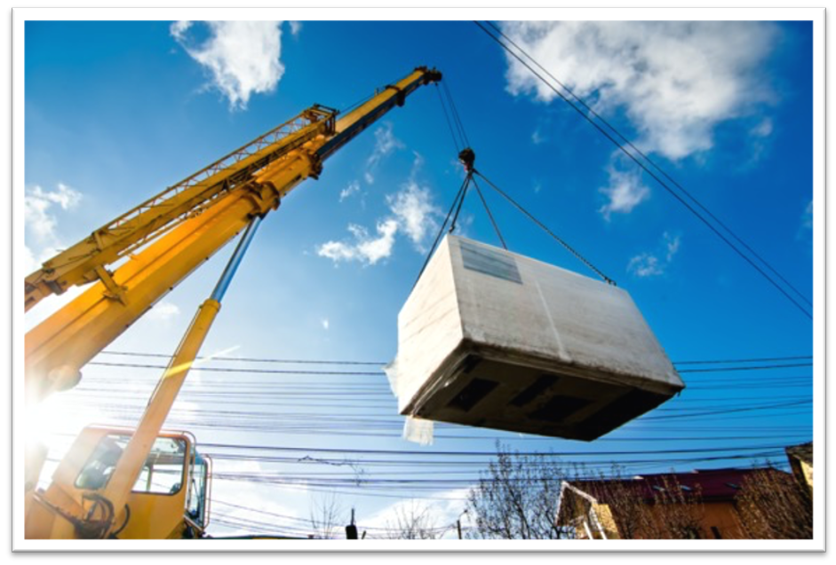
Do not walk or work underneath people working above, or under loads being lifted
Notes:
Narration: Do not walk or work underneath people working above you or under loads being lifted.
If anything accidently falls you would get injured.
This yellow sign will tell you when there is an overhead load to steer clear of.
Image by: Sign: https://en.wikipedia.org/wiki/ISO_7010 In public domain.
Photo by: Shutterstock.com.

Slide 13
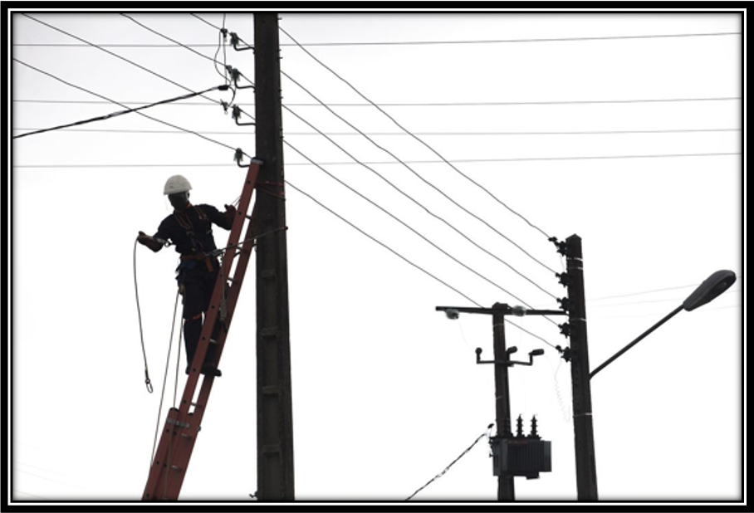
Keep away from overhead power lines
Notes:
Narration: Always keep away from overhead power lines. Touching them, directly or indirectly, can electrocute you.
You need to keep tools, ladders, vehicles, and machines away from them too.
Photo by: © World Bank

Slide 14
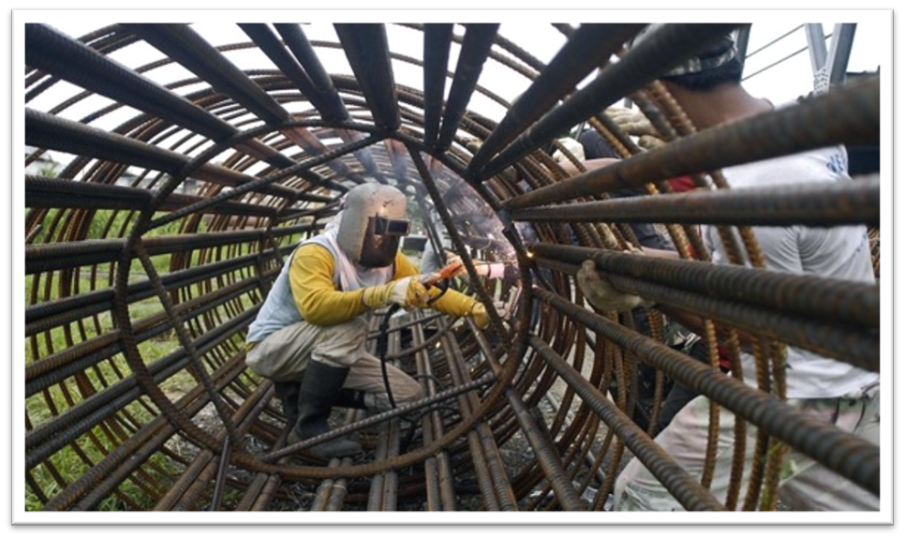
Never look at the light from a welder's torch
Notes:
Narration: Never look at the light from a welder's torch – it can damage your eyes and sight.
Photo by: © Nonie Reyes / World Bank

Slide 15
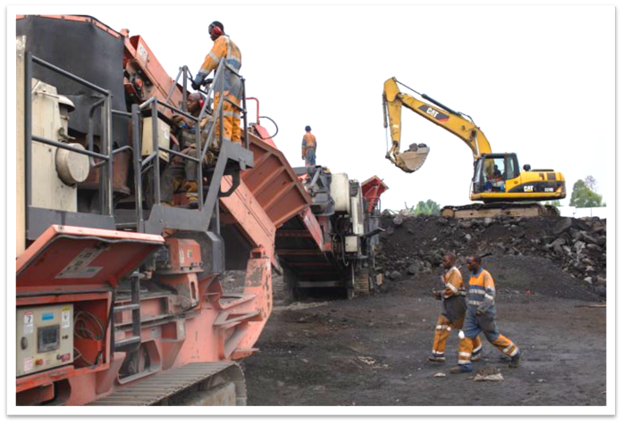
Being safe in
and around vehicles and machines
Notes:
Narration: Now we’ll talk about being safe in and around vehicles and machines, which often cause accidents by running people over or crushing them.
Photo by: © World Bank. Further permission required for reuse.

Slide 16
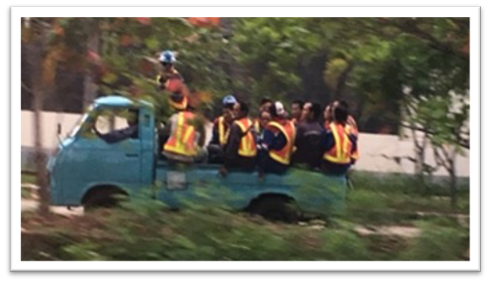
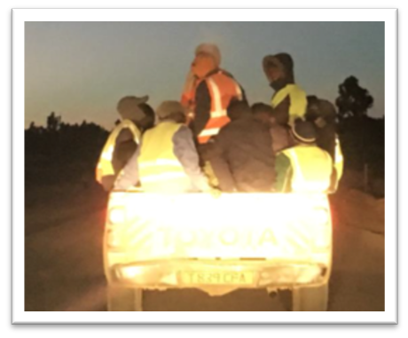
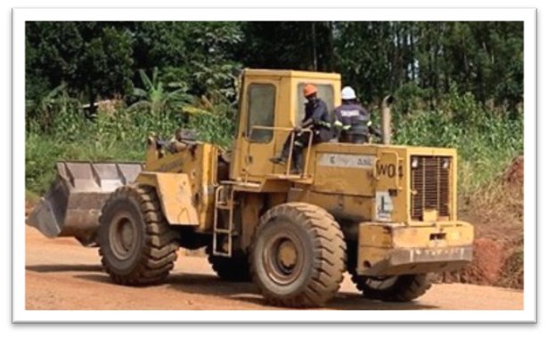
Trucks and machines easily tip over - nothing to protect you
Notes:
Narration: Unsafe worker transport sadly kills workers every year.
Don’t get into vehicles like these.
Construction vehicles and machines, like this can easily tip over – especially dumpers.
There is nothing to protect you from getting hurt.
Photo by: © Michael Hall/ World Bank

Slide 17
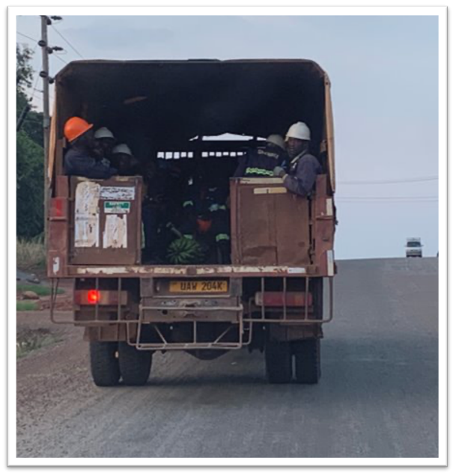
Only get in vehicle or machine with passenger seats​ ​
Fasten safety belt​
Notes:
Narration: Only get in a vehicle or machine with passenger seats.
If there is a safety belt then fasten it.
This is the sign to remind you to do so.
Photo by: © Michael Hall/ World Bank
Image by: Sign: ISO 7010 https://en.wikipedia.org/wiki/ISO_7010 In public domain.

Slide 18
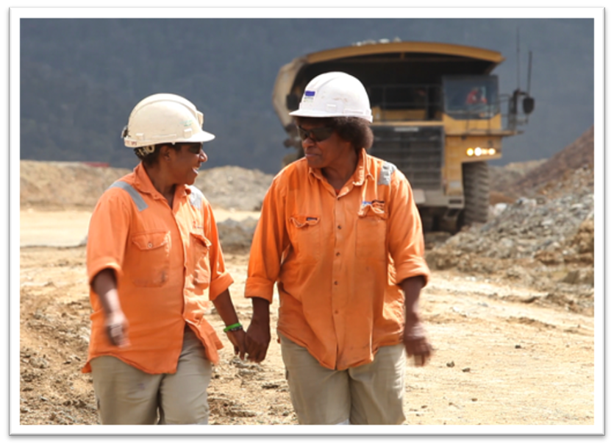
Stay on pedestrian routes
Keep out of haul roads and traffic routes
Notes:
Narration: When walking on site stay on the pedestrian routes - this keeps people on foot away from vehicles and machines.
Keep out of haul roads and traffic routes and keep them clear.
Photo by: © World Bank. Further permission required for reuse.

Slide 19
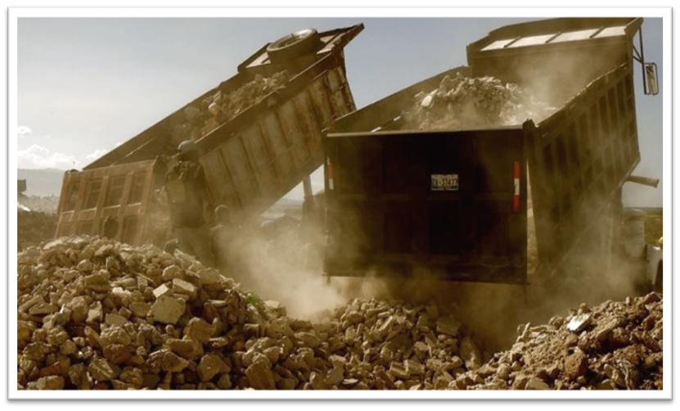
Keep out the way of vehicles and machine.
Drivers cannot see well when they are:
Loading or unloading
Lifting
Turning
Reversing
Notes:
Narration: Keep out of the way of vehicles and machines – especially when they are loading, unloading and lifting.
And when they’re turning or reversing - drivers cannot see you when they are reversing.
Listen for reversing alarms and flashing beacons if there are any.
Never sit or rest next to a vehicle or machine – workers have been killed from doing this when the driver started up again and hadn’t seen them. Photo by: © Romel Simon / World Bank

Slide 20
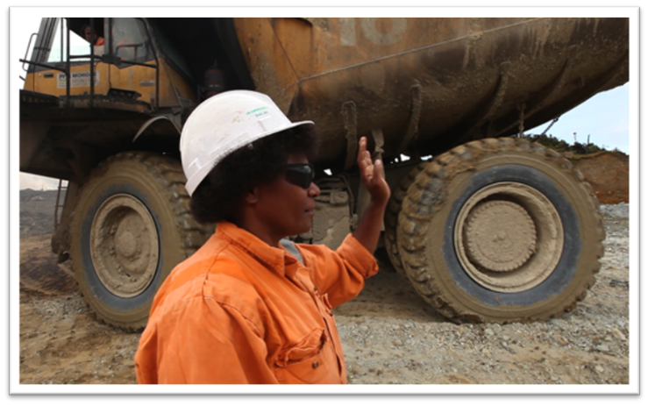
Follow the directions of people controlling traffic and machines
If you need to approach a vehicle or machine, wait until driver has seen and acknowledged you and stopped
Notes:
Narration: Always follow the directions of people in charge of controlling traffic and machines - they will tell you when and where to move to keep safe.
If you need to approach a vehicle or machine, wait until the driver has seen and acknowledged you and stopped before you get close.
Photo by: © World Bank. Further permission required for reuse.

Slide 21
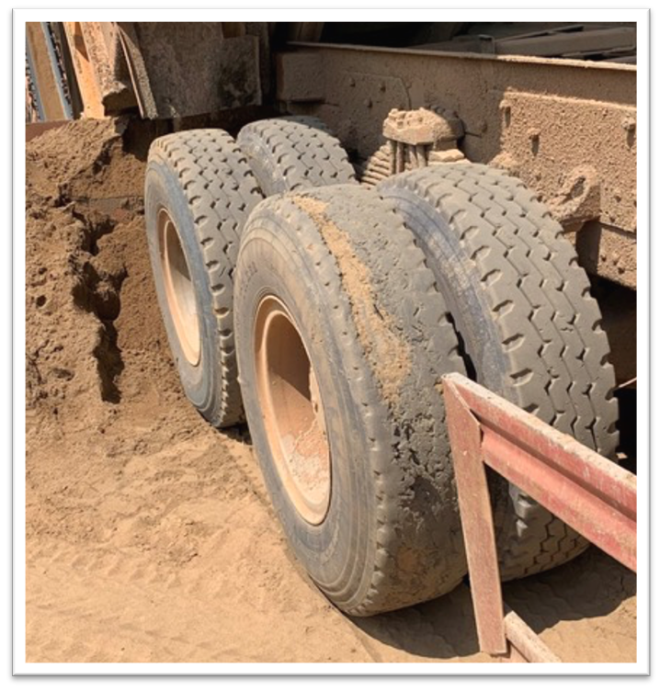
Tell Supervisor about vehicles:
Parked outside parking areas
Left running with no one in them
Driven too fast
Flat or worn tires
Notes:
Narration: Vehicles and machines are more likely to have an accident and injure people if they are being driven badly or are not in good condition.
If you see any unsafe vehicles or machines, tell your Supervisor.
This would be things like: - being parked outside the proper parking area
being left running with no one in them
being driven too fast or
flat or worn tires, broken windshields or no lights.
Photo by: © Michael Hall/ World Bank

Slide 22
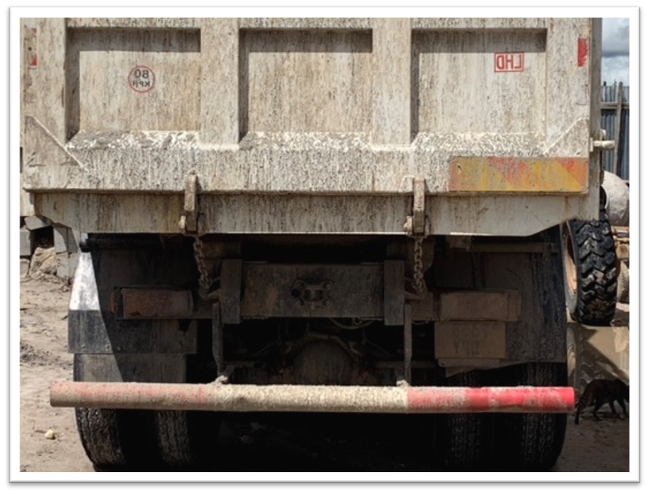
Lights not working
Flashing beacons not working
Reversing alarms not working
Notes:
Narration: - lights not working
Flashing beacons not working or
Reversing alarms not working.
Photo by: © Michael Hall/ World Bank

Slide 23
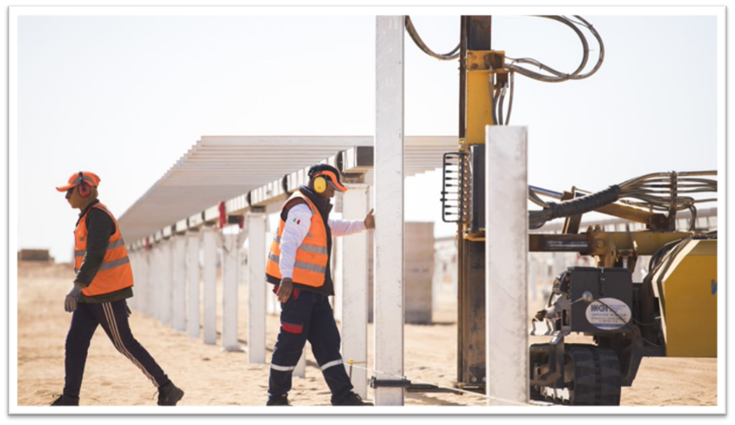
Minimizing noise
Notes:
Narration: Now we’ll explore minimizing noise.
If you are exposed to loud noise often it can permanently damage your hearing and even make you deaf.
If you need to shout to talk to someone two paces away from you then the noise is probably loud enough to cause damage.
Noise can also disturb the local community and wildlife so needs to be kept to a minimum.
Photo by: © World Bank. Further permission required for reuse.

Slide 24
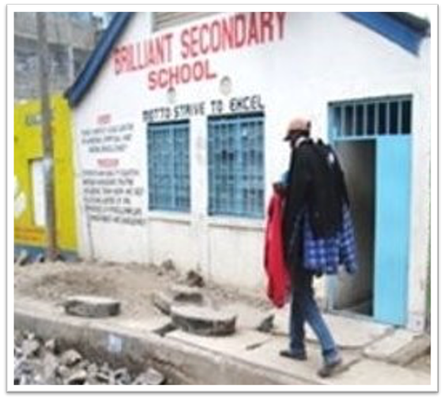
Work only at the times your Supervisor tells you
Do noisy activities away from other workers and local community
Don’t shout
Notes:
Narration: There are things you can do to keep noise levels low:
work only at the times your Supervisor tells you otherwise you might be disturbing the local community, like the local school
try to do noisy activities away from other workers and the local community and
don’t shout.
Photo by: © Michael Hall/ World Bank. Further permission required for reuse.

Slide 25
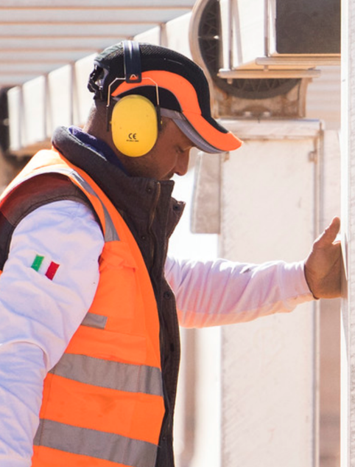
Wear ear plugs or ear defenders
Tell Supervisor or Health and Safety Specialist if you hear ringing in ears after being in noisy place
Notes:
Narration: To protect your hearing if you are doing a noisy job or working in a noisy environment, wear ear plugs or ear defenders.
Tell your Supervisor or the Health and Safety Specialist if you hear ringing in your ears after being in a noisy place – this means the noise was too high.
Image by: Sign: ISO 7010 https://en.wikipedia.org/wiki/ISO_7010 In public domain
Photo by: © World Bank. Further permission required for reuse.

Slide 26
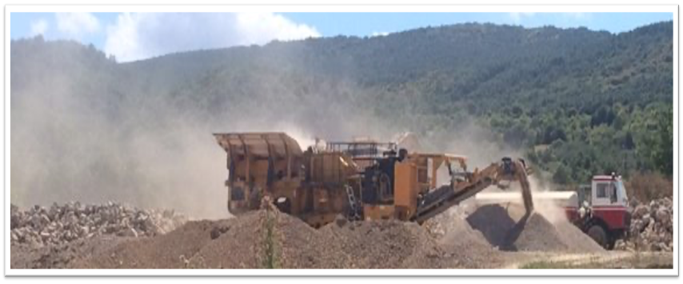
Keeping the air clean and dust-free
Notes:
Narration: Next we’ll cover keeping the air clean and dust-free.
Air pollution, including dust, needs to be minimized as it can damage people’s lungs and cause disease.
And it can affect workers and the local community.
Dust can damage their crops and wildlife.
Air pollutants can build up inside buildings so you need to be especially careful when working indoors.
Here are some things you can do to minimize air pollution on site.
Photo by: © Michael Hall/ World Bank

Slide 27
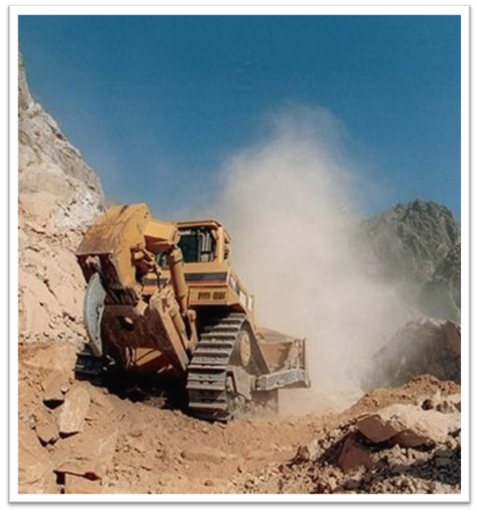
Think if there is a less dusty way
Do dusty work away from other workers and local community
Tell Supervisor if you see too much dust
Notes:
Narration: If the activity you are doing is dusty, think if there is a less dusty way to do it, like using a blocksplitter instead of a stone saw.
Try to do it away from other workers and the local community.
Tell your Supervisor if you see to much dust on site, like the dust coming off this machine.
Photo by: © Gennadiy Ratushenko / World Bank

Slide 28
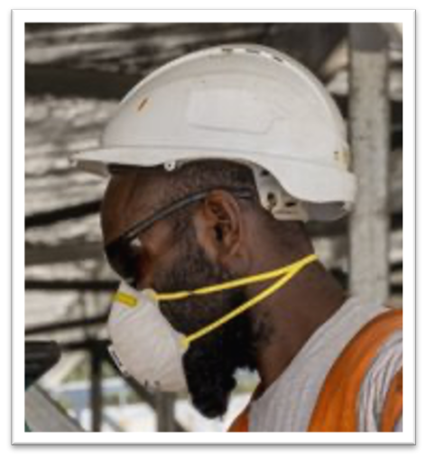
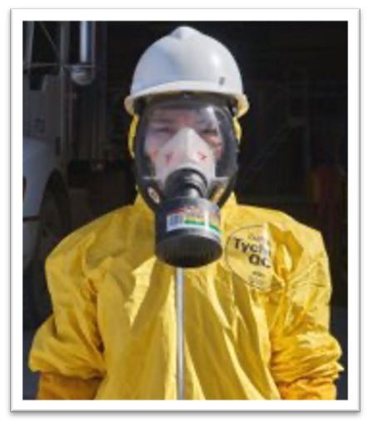
Wear a dust mask or respirator
Tell Supervisor or Health and Safety Specialist if you have breathing difficulties or coughing
Notes:
Narration: If you are doing a dusty job or working in an environment with dust or fumes wear a dust mask or a respirator.
Tell your Supervisor or the Health and Safety Specialist if you have breathing difficulties or are coughing.
Image by: Sign: ISO 7010 https://en.wikipedia.org/wiki/ISO_7010 In public domain
Photos by: 1. Respirator: © World Bank. Further permission required for reuse.
2. Dust mask: © World Bank. Further permission required for reuse.

Slide 29
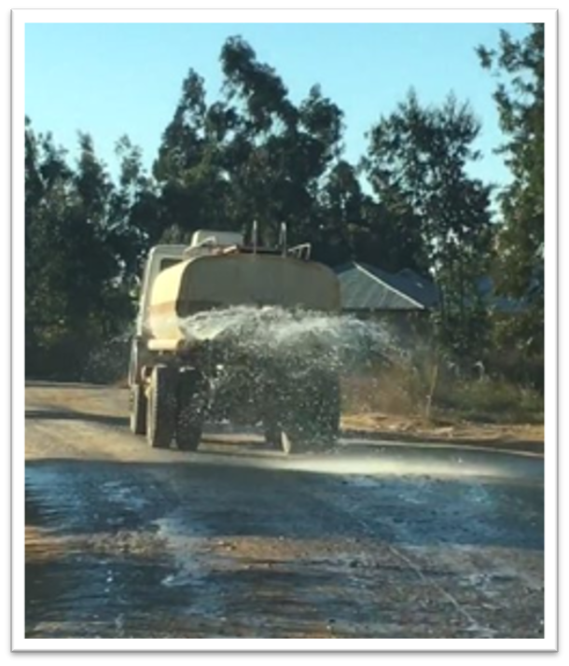
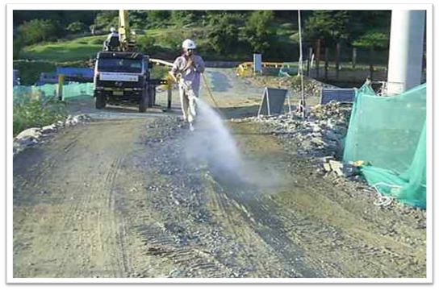
Keep areas of tarmac/ concrete and haul roads clean
Damp down dust with fine spray water
Notes:
Narration: Keep haul roads and other areas surfaced with tarmac or concrete clean of mud.
Damp down dust anywhere on site with a fine spray of water.
Use as little water as possible and turn off taps when you've finished to save water.
Photos by: 1. Haul route: © Dohwa Engineering Co Ltd / World Bank
2. Bowser: © Michael Hall/ World Bank

Slide 30
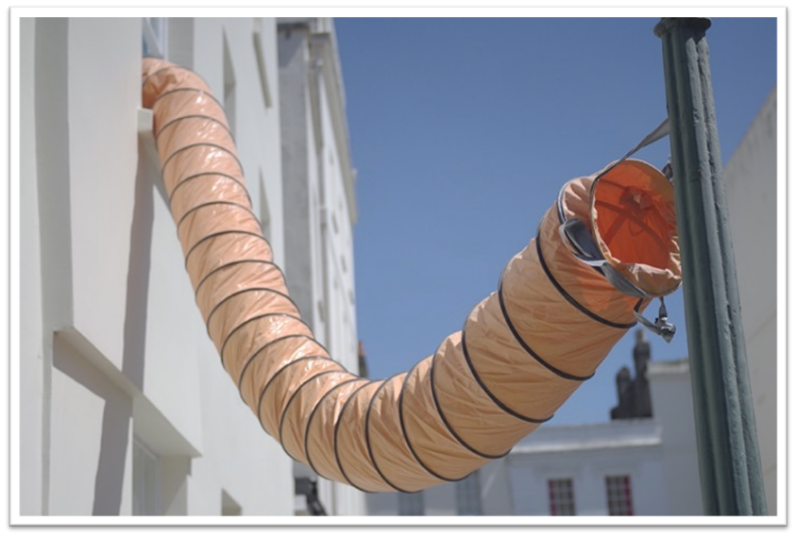
Don't stand or work next to exhausts If feel unwell, stop work and see First Aider
Notes:
Narration: Don't stand or work next to exhausts from vehicles, machines or ventilation systems, like this one.
If you feel unwell, such as having a headache or feeling dizzy.
It could be caused by fumes.
Stop work, tell your Supervisor and see a First Aider.
Photo by: Shutterstock.com.

Slide 31
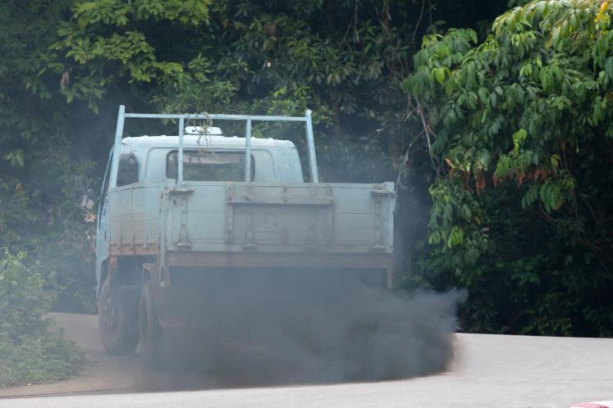
Tell your Supervisor if black smoke comes from exhausts
Notes:
Narration: Tell your Supervisor if you see black smoke from exhausts, for instance this smoky truck.
Photo by: Shutterstock.com.

Slide 32
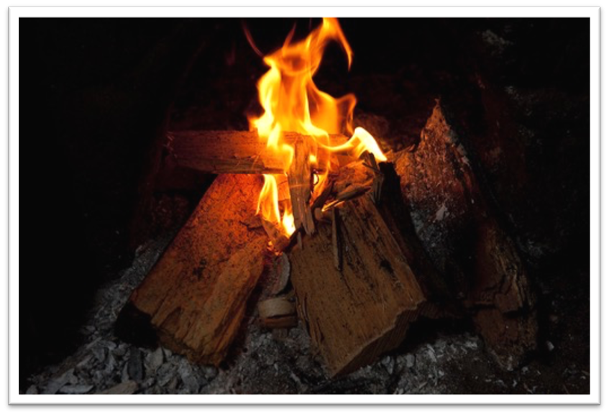
​ Do not have fires
Notes:
Narration: Do not have fires on site.
Photo by: © Arne Hoel / World Bank

Slide 33
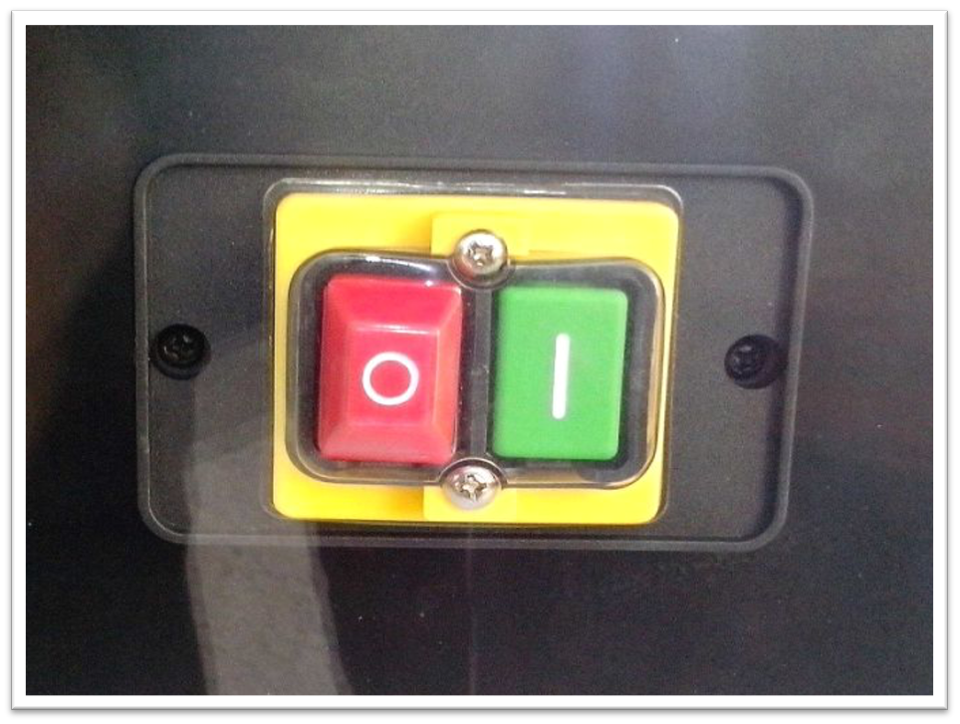
​Switch off lights, tools and machines when not using them​
Notes:
Narration: Switch off tools, machines, and lights, when you’re not using them.
Photo by: Pixnio. Creative Commons CC0, https://pixnio.com/objects/electronics-devices/on-and-off-buttons

Slide 34
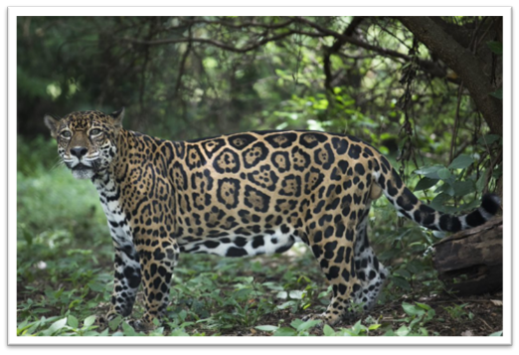
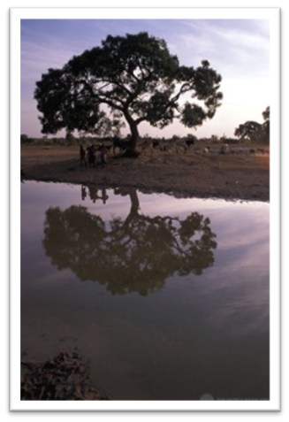
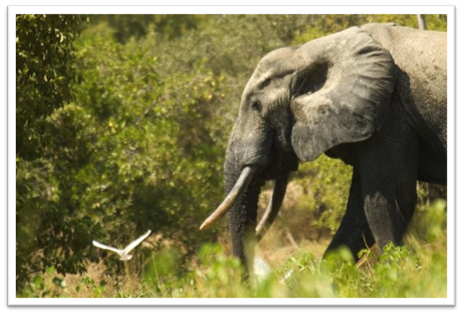
Looking after wildlife
Notes:
Narration: Now we’ll find out about looking after wildlife.
Construction sites need to have measures in place to protect wildlife.
It’s important to look after nature as we depend on it for food and water and it has as much right to be here as we do.
Photo by: 1. Elephant: © Arne Hoel / World Bank
2. Jaguar: © World Bank
3. River & tree: © Curt Carnemark / World Bank

Slide 35
Cut only trees, shrubs and plants that you are told to cut
Do not cut trees, shrubs or plants for firewood
Notes:
Narration: When clearing a site at the beginning of construction, cut only the trees, shrubs and plants that you have been told to cut by your Supervisor – everything else needs to be left in place.
Do not cut down trees, shrubs or plants for firewood.
Photo by: © Dohwa Engineering Co Ltd / World Bank

Slide 36
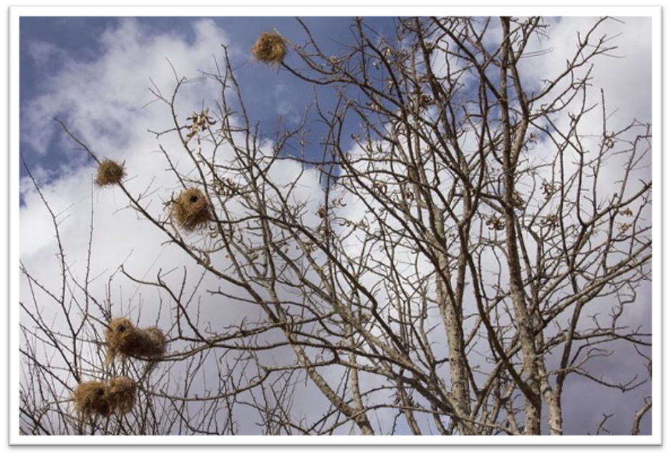
Do not cut trees, shrubs and plants if bird nests or animals are present
Notes:
Narration: Do not cut trees, shrubs and plants if birds are nesting or animals are present.
Stop work and tell your Supervisor if you find any nests, like these, or animals.
Photo by: © Flore de Preneuf / World Bank

Slide 37
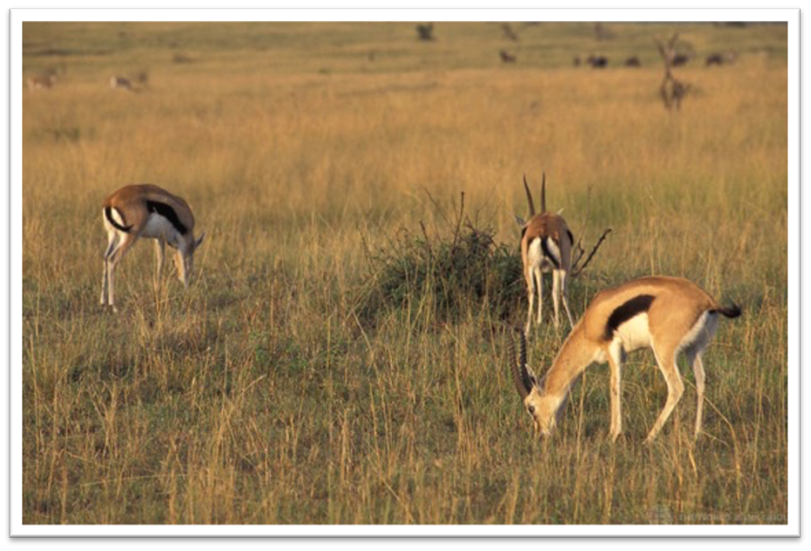
Leave wildlife alone
Do not hunt or keep animals
Notes:
Narration: Leave all wildlife alone and do not hunt or keep animals on site.
Photo by: © Curt Carnemark / World Bank

Slide 38
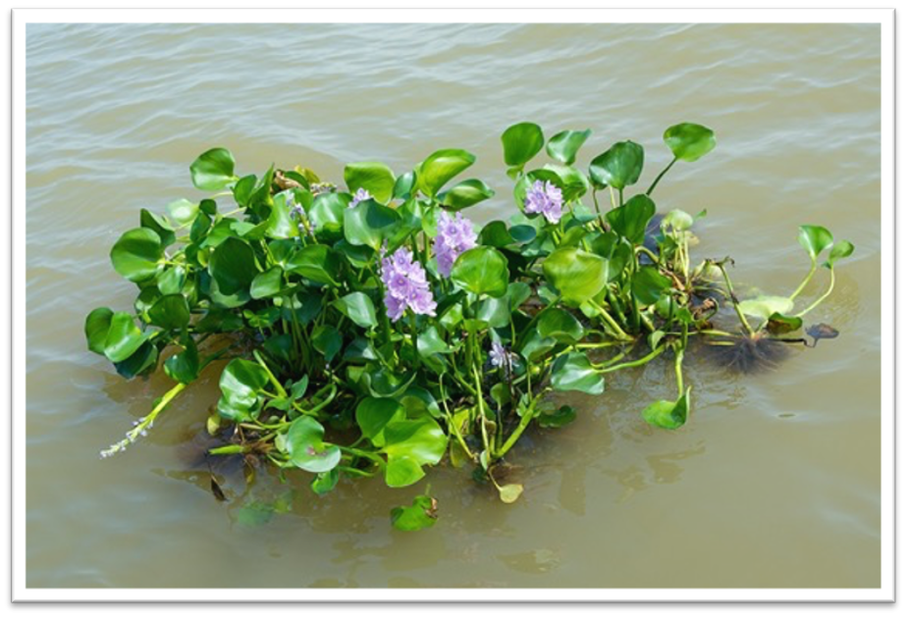
Be careful not to spread alien invasive plants and animals ​
Notes:
Narration: Some plants and animals are alien to the local area and bad for the native wildlife.
If invasive plants and animals are already present on site, they can be spread during construction.
Your Supervisor will tell you if there are any of these and what you need to do to stop them spreading.
Photo by: Shutterstock.com.

Slide 39
Notes:
Narration: We’ll finish this module with five key things for you to remember.
Image by: © World Bank

Slide 40
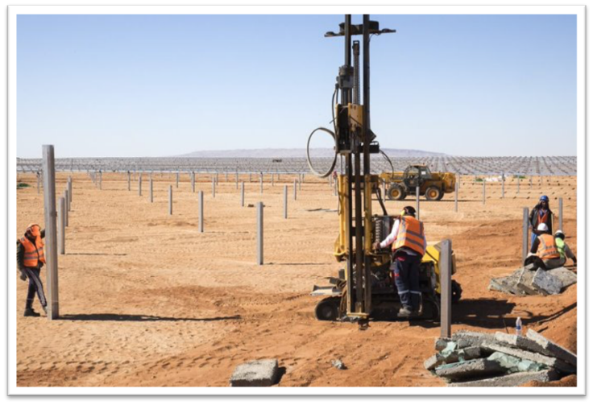
Look out for hazards
Keep site clean and tidy
Avoid dangerous areas and activities
Minimize noise, dust and fumes
Look after wildlife
Notes:
Narration:
Always look out for hazards
Keep site clean and tidy
Avoid dangerous areas and activities
Minimize noise, dust and fumes and
Look after wildlife
Now that you know some good ways to avoid hazards and risks, we’ll explore how you can stay healthy on site in Module 4.
Photo by: © World Bank

Slide 41
Copyright
© 2022 International Bank for Reconstruction and Development / The World Bank
1818 H Street NW
Washington DC 20433
Telephone: 202-473-1000
Internet: www.worldbank.org
This work is a product of the staff of The World Bank with external contributions. The findings, interpretations, and conclusions expressed in this work do not necessarily reflect the views of The World Bank, its Board of Executive Directors, or the governments they represent.
The World Bank does not guarantee the accuracy, completeness, or currency of the data included in this work and does not assume responsibility for any errors, omissions, or discrepancies in the information, or liability with respect to the use of or failure to use the information, methods, processes, or conclusions set forth. The boundaries, colors, denominations, and other information shown on any map in this work do not imply any judgment on the part of The World Bank concerning the legal status of any territory or the endorsement or acceptance of such boundaries.
Nothing herein shall constitute or be construed or considered to be a limitation upon or waiver of the privileges and immunities of The World Bank, all of which are specifically reserved.
Rights and Permissions
The material in this work is subject to copyright. Because The World Bank encourages dissemination of its knowledge, this work may be reproduced, in whole or in part, for noncommercial purposes as long as full attribution to this work is given.
Any queries on rights and licenses, including subsidiary rights, should be addressed to World Bank Publications, The World Bank Group, 1818 H Street NW, Washington, DC 20433, USA; fax: 202-522-2625; e-mail: pubrights@worldbank.org.

