Slide 1
MODULE 2
Before you start work
For copyright details see last slide of this PowerPoint presentation
Notes:
Narration: Welcome to Module 2: Before you start work.
This module explains the things that you need before you can begin work on a construction site.
Image by: © World Bank

Slide 2
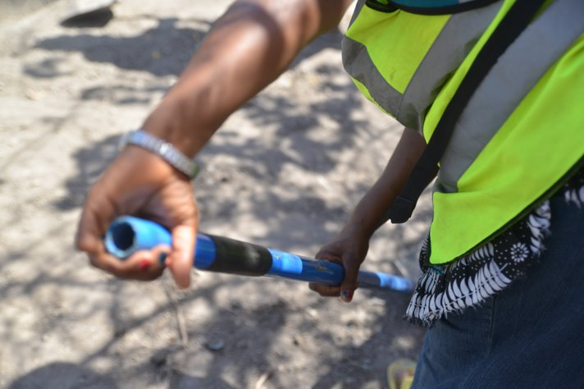
Know your rights and responsibilities
Wear Personal Protective Equipment PPE
Understand signs
Know who to ask
Raise improvements and concerns
Notes:
Narration: By the end of this module you will:
know your rights and responsibilities
be able to wear the right Personal Protective Equipment
understand what the signs on site mean
know who to ask about any queries you have and
be able to raise improvements and concerns.
Photo by: © Tom Perry / World Bank

Slide 3
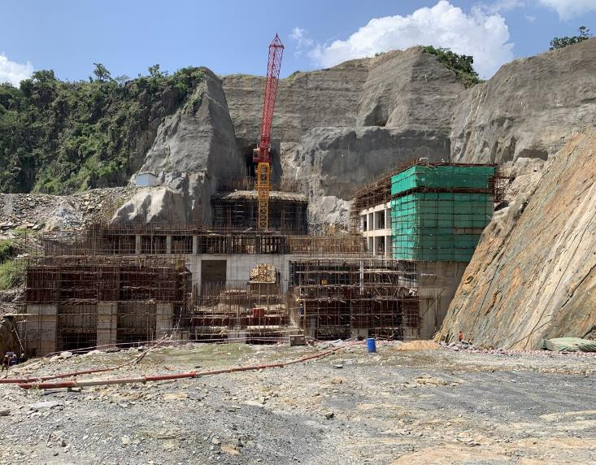
Before you
start work
Notes:
Narration: Let’s begin with the things that you should be given before you start work.
Photo by: © Michael Hall / World Bank

Slide 4
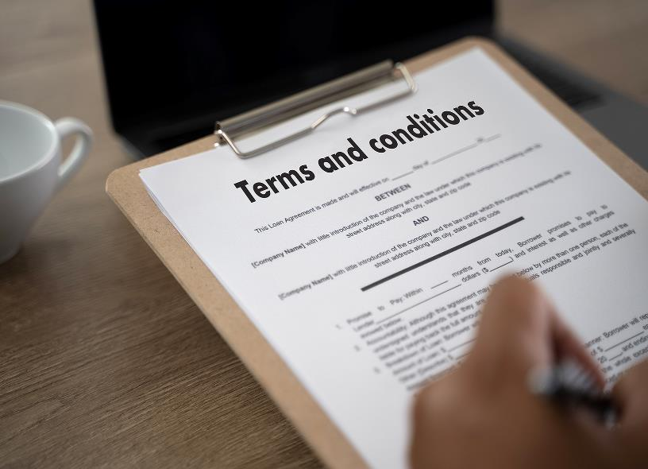
Terms and conditions
Wages
Working hours
Overtime
Workplace rules
Holidays
Benefits
Your rights
Notes:
Narration: You need to be provided with the terms and conditions of your job including:
Wages
Working hours
Overtime
Workplace rules
Holidays including religious holidays
Benefits and
Your rights - for example, to compensation you might be eligible for if you are injured at work.
The conditions of your job should be written in your language and understandable to you.
You need to read your terms and conditions and get answers to anything you are unclear about.
Photo by: Shutterstock.com.

Slide 5
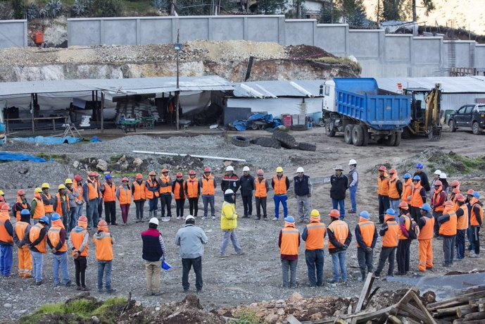
Briefing on every task
Notes:
Narration: You must be given a briefing before you begin every task to tell you how to do it.
Photo by: © World Bank. Further permission required for reuse.

Slide 6
A circle with a red line is bad practice - something you must not do
Notes:
Narration: In this general induction, wherever you see a circle with a red line through it on a photo, it is showing bad practice – something you should not do.
Image by: © World Bank.

Slide 7
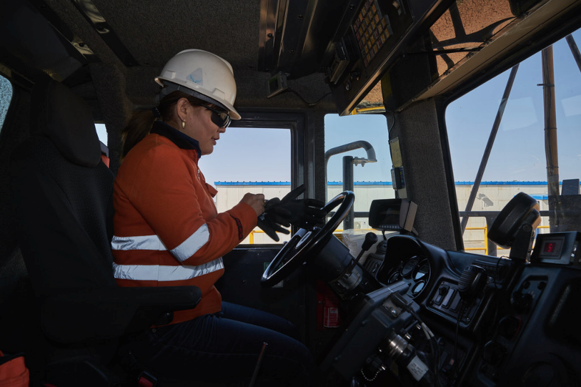
Some tasks must only be done by people with special training - driving
Notes:
Narration: Some tasks on site must only be done by people who have had special training on how to do them safely.
For example, you must have a special license to drive any vehicle or machine like a truck or an excavator.
Photo by: © World Bank. Further permission required for reuse.

Slide 8
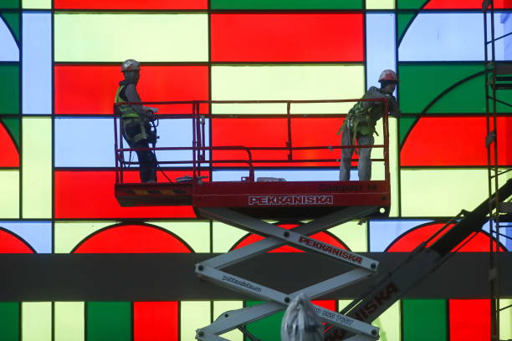
Don’t use a mobile elevated working platform unless you are specially trained
Notes:
Narration: Or to use a mobile elevated working platform.
Photo by: © World Bank

Slide 9
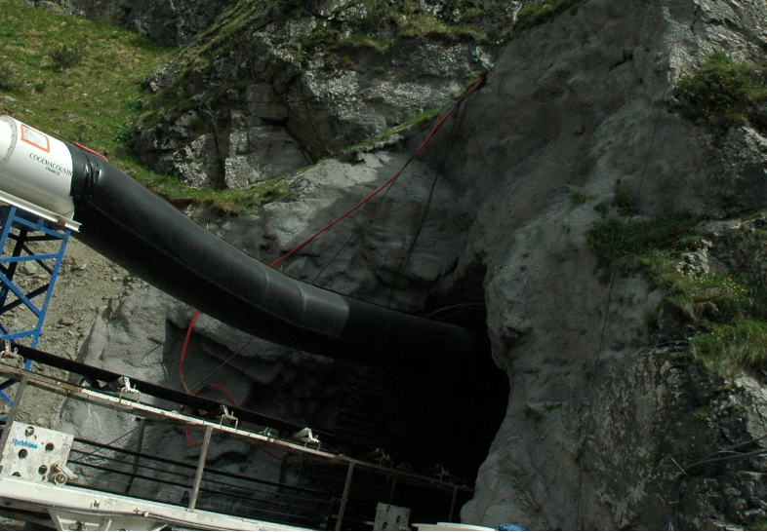
Or do not work in a confined space unless you have special training
9
Notes:
Narration: Or to work in a confined space like a tunnel.
Do not do these tasks unless you have been properly trained.
Photo by: © Jack Mozingo / World Bank

Slide 10
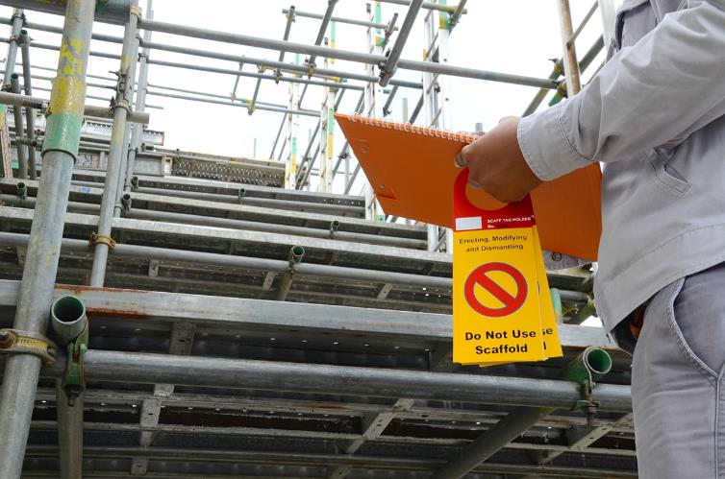
Certain activities need a Permit to Work Do not do these activities until there is a Permit to Work
Notes:
Narration: Certain activities, including working in a confined space, working at height, permit to dig etc. need a “Permit to Work” before they can start.
These activities are higher risk so the Supervisor has to check everything is safe and ready first.
Do not do these activities until you know there is a Permit to Work in place and it has been explained to you.
For example, there will be a “Permit to Dig” issued before you can start excavating and a Scafftag put on scaffolding to tell you it is safe to go up.
Photo by: Shutterstock.com.

Slide 11
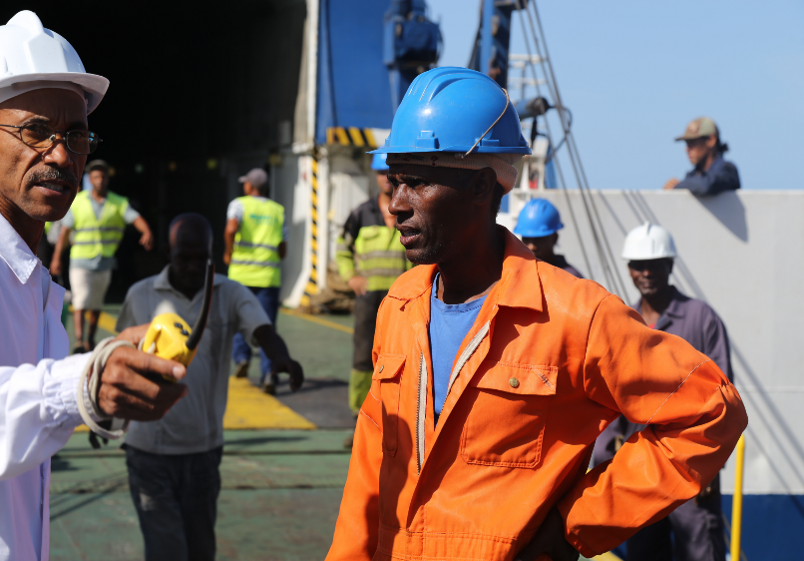
Each day:
Go through Security
Check in with Supervisor
Only do tasks given to you by Supervisor
Notes:
Narration: When you get to site each day, go through Security – bring your construction identity card if you have one.
Check in with your Supervisor who will tell you what you'll be doing.
Only do tasks given to you by your Supervisor – don’t do a task that someone else has been asked to do.
Photo by: © World Bank. Further permission required for reuse.

Slide 12
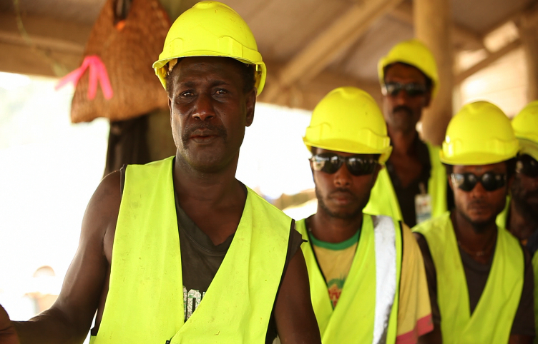
Who is responsible?
Notes:
Narration: Now we’ll find out who is responsible for safety, health and the environment on site.
Photo by: © World Bank. Further permission required for reuse.

Slide 13
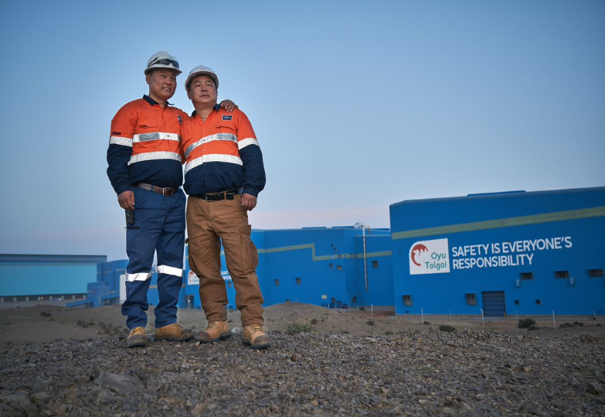
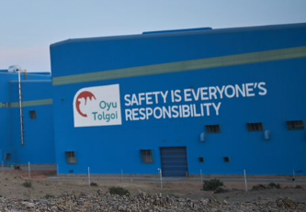
It is Your job to look after safety, health, environment Supervisor must provide safe way for you to work Site managers are responsible
Notes:
Narration: It’s an essential part of your job to look after your safety, your health and the environment.
It’s also the responsibility of everyone on site to play their part.
Your Supervisor is responsible for providing you with a safe way to work that minimizes risks.
And it's your responsibility to follow it.
Site managers are also responsible for making sure the site is safe and not damaging the environment.
Photo by: © World Bank. Further permission required for reuse.

Slide 14
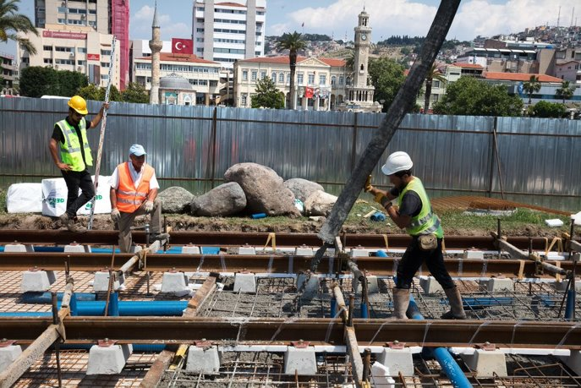
Respect reasonable work instructions
Carry out duties competently and carefully
Follow safety, health and environmental
requirements
Notes:
Narration: You can help if you:
- respect reasonable work instructions
- carry out your duties competently and carefully and
- follow the safety, health and environmental requirements.
Photo by: © World Bank

Slide 15
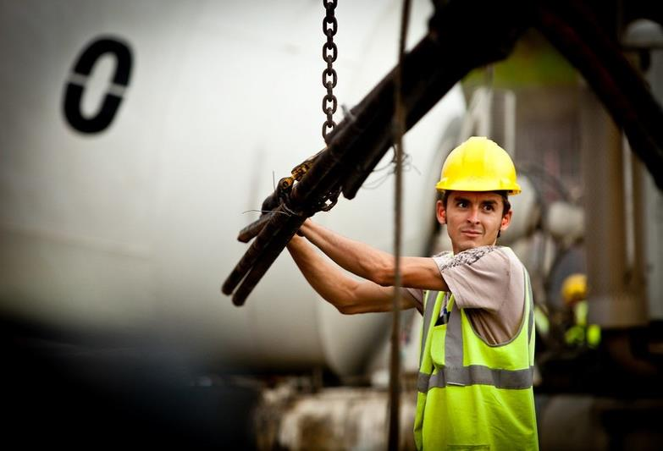
If you break rules there will be serious consequences – losing your job, getting injured or killed
Notes:
Narration: These rules are there to protect you and others.
If you break them there could be serious consequences for you – losing your job, getting injured or even killed.
Photo by: © Gerardo Pesantez / World Bank. Further permission required for reuse.

Slide 16
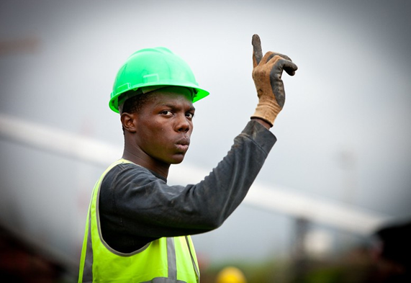
If you’re unsure ask…
Supervisor or
Health and Safety Specialist or
Environmental Specialist
Notes:
Narration: If you’re unsure about anything, ask your Supervisor or talk to the Health and Safety Specialist or the Environmental Specialist.
Photo by: © Gerardo Pesantez / World Bank. Further permission required for reuse.

Slide 17
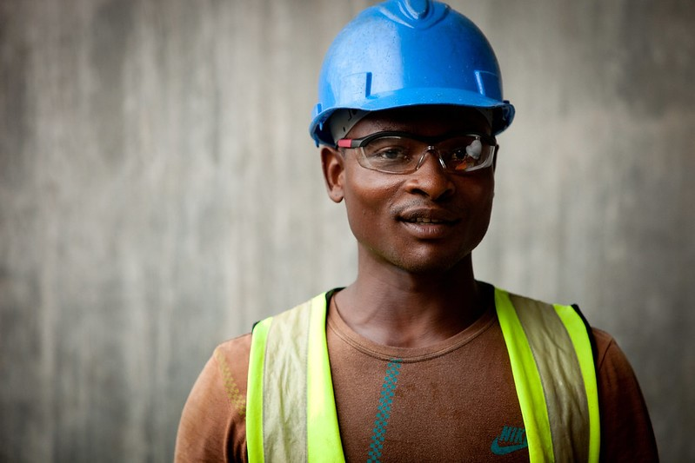
Wearing Personal Protective Equipment PPE
Notes:
Narration: Next we’ll look at Personal Protective Equipment which is also known as PPE.
It is what you need to wear to protect yourself from injuries.
But remember that the PPE is the last resort for protecting you.
You always need to follow safe ways of working as well, to avoid having an accident.
Photo by: © Gerardo Pesantez / World Bank. Further permission required for reuse.

Slide 18
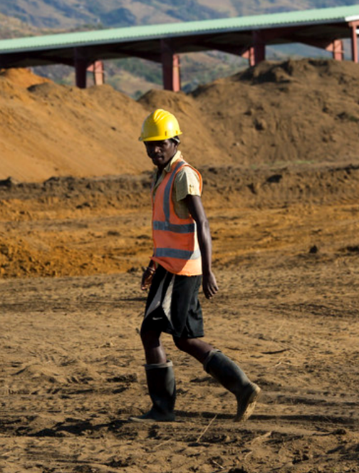
Always wear:
Hard Hat
High Visibility Vest
Safety Boots
Notes:
Narration: You should be given all the Personal Protective Equipment that you need.
You do not need to pay for it or provide your own.
And it is your responsibility to wear it.
Always wear: - a hard hat – this will reduce the risk of your head getting injured if something falls on you - a high visibility vest – so that you can be seen easily to reduce the risk of getting run over or crushed by a vehicle or machine - safety boots – these are stronger than normal boots and will protect your feet from injuries if you stand on something sharp like a nail, or if something falls on your feet.
You should also be given the right PPE for the weather:
- to keep you warm if it’s cold - cool if it’s hot and - dry if it’s wet.
Note to trainer: To make the training more interactive, BEFORE this slide, ask the workers: “What three items of PPE must you always wear on site?”
Images by: ISO 7010 https://en.wikipedia.org/wiki/ISO_7010 In the public domain.
Photo by: © World Bank. Further permission required for reuse.

Slide 19
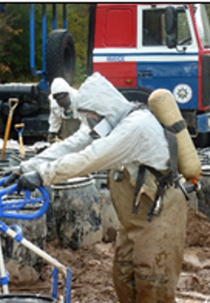
Some tasks need extra PPE Ask how to use it Do not do any task until you have PPE
Notes:
Narration: For some tasks you will need to wear extra PPE, like gloves, googles, noise protection or dust masks.
And your Supervisor should tell you what you need.
Make sure you are taught how to use it properly.
If you don’t use it the right way, it won’t protect you.
Do not do the task until you have the PPE that is needed.
Image by: ISO 7010 https://en.wikipedia.org/wiki/ISO_7010 In the public domain.
Photo by: © World Bank

Slide 20
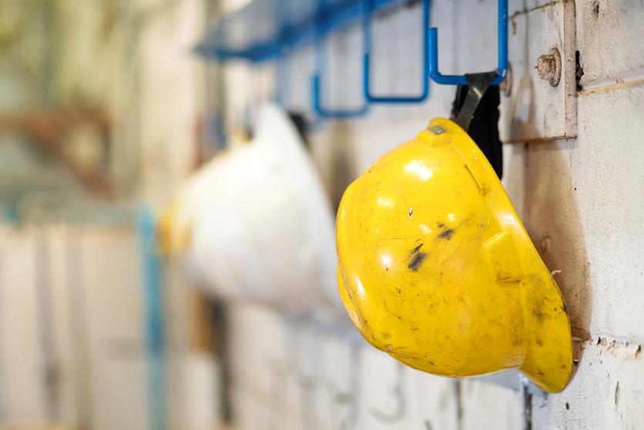
Keep PPE clean
Store it carefully
If it’s worn or damaged, get new PPE
Notes:
Narration: Keep your PPE clean and store it carefully.
When it’s worn out, time expiredor if it gets damaged get new PPE.
Don’t wear it because it might not work properly.
For instance, if you drop your hard hat, you need to get a new one.
Photo by: Shutterstock.com
​

Slide 21
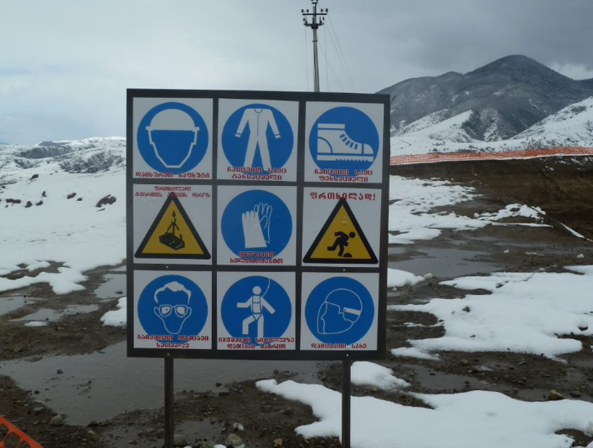
What do the signs mean?
Notes:
Narration: In this section we’ll explore the signs you’ll see on site.
What do the signs mean?
They give you information to help keep you safe - without using words, just using pictures.
It is your job to know what the signs mean: if you are unsure, ask your supervisor
Photo by: © Jack Mozingo / World Bank

Slide 22
Circle with a red line - must not do
Do not walk or stand here
Notes:
Narration: Here’s what some of the signs mean.
A circle with a red line through it is something you must not do.
For example, this one means do not walk or stand here.
Image by: ISO 7010 https://en.wikipedia.org/wiki/ISO_7010 In the public domain.

Slide 23
Blue circle - must do
Wear a hard hat
Notes:
Narration: A blue circle is something you must do.
This one means you must wear a hard hat.
Image by: ISO 7010 https://en.wikipedia.org/wiki/ISO_7010 In the public domain.

Slide 24
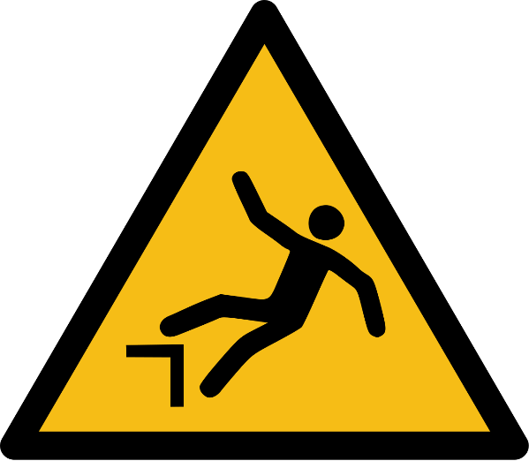
Yellow triangle - hazard careful
Risk of falling
Notes:
Narration: A yellow triangle is a hazard you need to be careful of.
This one is warning you that there is a risk of falling.
Image by: ISO 7010 https://en.wikipedia.org/wiki/ISO_7010 In the public domain.

Slide 25
Green square or rectangle - keep you safe
First aid
Notes:
Narration: A green square or rectangle is for something that will help keep you safe.
For example, this is the sign for first aid.
Image by: ISO 7010 https://en.wikipedia.org/wiki/ISO_7010 In the public domain.

Slide 26
Red square - fire safety
Fire extinguisher
Notes:
Narration: A red square is for fire safety and this one shows where the fire extinguishers are kept.
If you are not sure what a sign means then ask your Supervisor.
Image by: ISO 7010 https://en.wikipedia.org/wiki/ISO_7010 In the public domain.

Slide 27
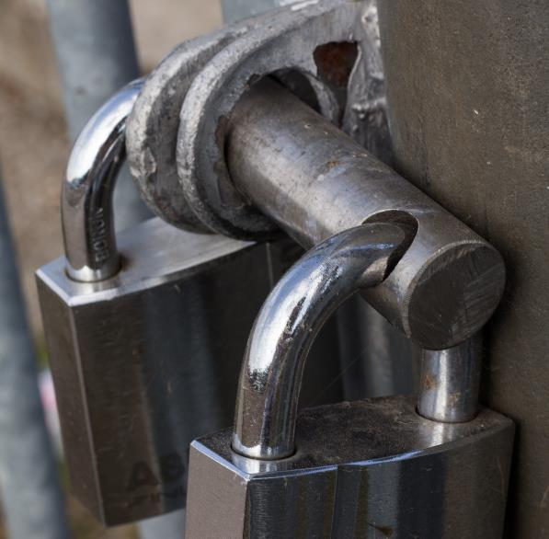
Keeping site secure
Notes:
Narration: Here we’ll look at keeping the site secure.
Everything on site needs to be kept secure from theft and waste: buildings, vehicles, machines, fuel, oil, chemicals and materials.
If things are stolen or misused people can be injured, the environment polluted and money wasted.
Photo by: Pxhere, Creative Commons by zero, https://pxhere.com/en/photo/484356

Slide 28
Keep site locked
Notes:
Narration: Keep the site locked up to make it more difficult for thieves to take things.
Photo by: Dids on Pexels, https://www.pexels.com/photo/gray-keys-1405724/

Slide 29
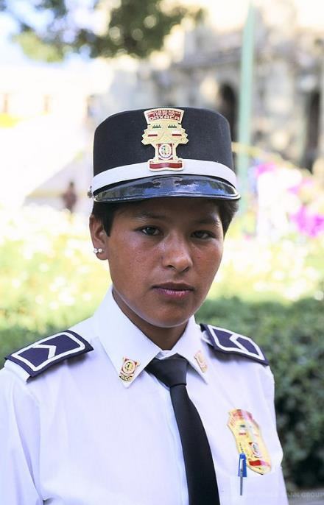
Security workers will only use force if essential to protect workers and site
Force must be proportional to incident - never violent
Body searches rarely done, and always by someone of the same sex
Notes:
Narration: Security workers may be on site and it’s their job to protect the site.
They have strict rules to follow about how they respond to events.
For example, they should only use force if it is essential to protect workers and the site.
It must be proportional to the incident.
Force can mean getting in someone’s way or physically restraining them.
It should never be violent.
Body searches should only be done rarely and by someone of the same sex as you.
Photo by: © Curt Carnemark / World Bank. Further permission required for reuse.
​

Slide 30
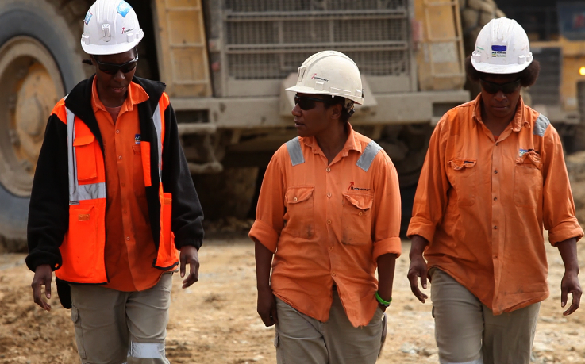
Improvements and
concerns
Notes:
Narration: Next we’ll look at how you can raise improvements and concerns.
If you have any concerns about the way work is being done or think that it could be improved then it’s important that you raise these issues.
You might prevent an accident or damage to the environment – or even save someone’s life.
Photo by: © World Bank. Further permission required for reuse.

Slide 31
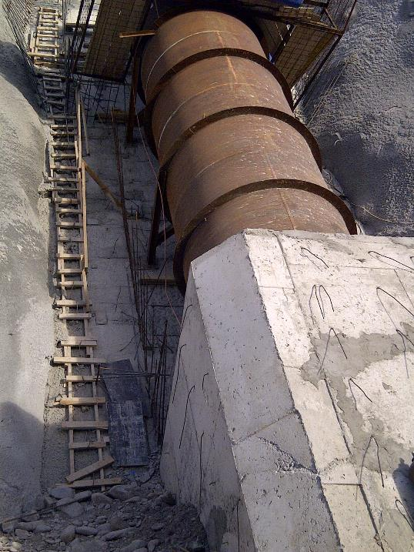
Report anything not safe, not healthy or damaging the environment
Remove yourself from a work situation if it’s danger to your life or health
Notes:
Narration: Always report anything you see on site that is not safe, not healthy or damaging the environment.
In this training we are talking about many measures that should be in place - if they are not in then you need to raise it.
You can also remove yourself from a work situation which you believe presents a likely and serious danger to your life or health – or other people’s - like this ladder that is unsafe because it is broken and at the wrong angle.
Note to trainer: To make the training more interactive, at the beginning of this slide, ask the workers: “What do you think you should do if you see anything that is unsafe or polluting?”
Photo by: © Jack Mozingo/ World Bank

Slide 32
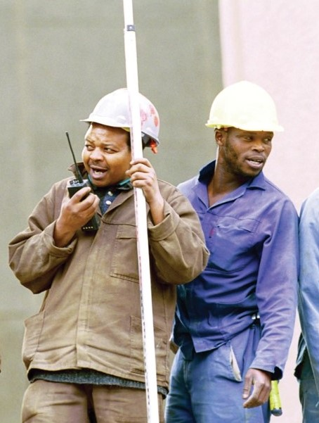
Tell Supervisor or
Health and Safety Specialist or
Environmental Specialist
Grievance system
32
Notes:
Narration: Tell your Supervisor or the Health and Safety Specialist or the Environmental Specialist.
Most sites will have a system for you to raise issues which will be explained to you.
This might be a grievance system.
Photo by: © World Bank. Further permission required for reuse.

Slide 33
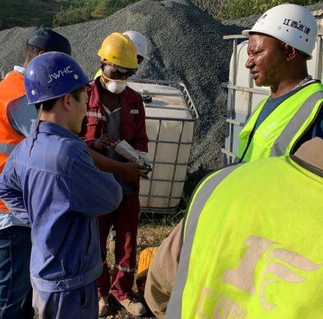
You should not be blamed – no consequences for you
Do not go back until fixed
If not dealt with, speak to site manager or the worker organization representative
Notes:
Narration: You should not be blamed for raising concerns and there should be no consequences for you – for instance you should not lose your job.
And you do not need to go back to that task until the problem has been fixed.
If your concern is not dealt with then you can speak to the site manager or the worker organization representative if there is one.
Photo by: © Michael Hall / World Bank. Further permission required for reuse.

Slide 34
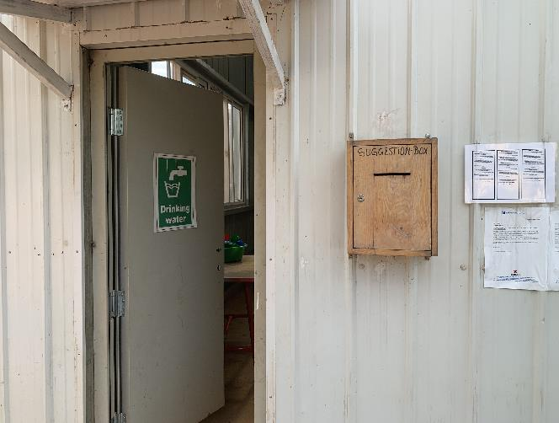
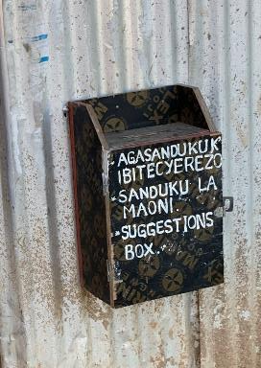
Make suggestions about safer working, or better ways to protect environment
Suggestion box
Notes:
Narration: You can also make suggestions if you think of a safer way to do a job or a better way to protect the environment or the community.
There might be a suggestion box, like these, where you can write your idea on a piece of paper and put it in the box.
It's up to you if you write your name on it – you can remain anonymous if you like.
Photo by: © Michael Hall / World Bank

Slide 35
Notes:
Narration: Now we’ll finish this module with five key things for you to remember.
Image by: © World Bank

Slide 36
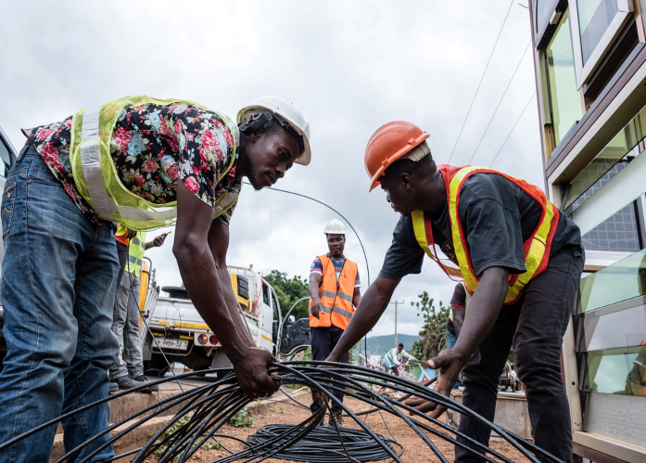
Follow instructions
Wear Personal Protective Equipment PPE
Only do tasks you are trained to do
Report concerns about safety, or environment – stop work until fixed
If you are unsure ask
Notes:
Narration:
Follow instructions from the training and briefings you are given
Wear the right Personal Protective Equipment PPE
Only do tasks that you have been trained to do – don't do tasks that need specialist training until you have had that training
Report concerns about your safety or other people’s safety or the environment – stop work until it has been fixed
5. If you are unsure about anything ask:
- Your Supervisor or
the Health and Safety Specialist or
the Environmental Specialist.
Now that you know what you need before you start work, let’s take a look at how you can avoid hazards and risks in Module 3.
Photo by: © World Bank. Further permission required for reuse.

Slide 37
Copyright
© 2022 International Bank for Reconstruction and Development / The World Bank
1818 H Street NW
Washington DC 20433
Telephone: 202-473-1000
Internet: www.worldbank.org
This work is a product of the staff of The World Bank with external contributions. The findings, interpretations, and conclusions expressed in this work do not necessarily reflect the views of The World Bank, its Board of Executive Directors, or the governments they represent.
The World Bank does not guarantee the accuracy, completeness, or currency of the data included in this work and does not assume responsibility for any errors, omissions, or discrepancies in the information, or liability with respect to the use of or failure to use the information, methods, processes, or conclusions set forth. The boundaries, colors, denominations, and other information shown on any map in this work do not imply any judgment on the part of The World Bank concerning the legal status of any territory or the endorsement or acceptance of such boundaries.
Nothing herein shall constitute or be construed or considered to be a limitation upon or waiver of the privileges and immunities of The World Bank, all of which are specifically reserved.
Rights and Permissions
The material in this work is subject to copyright. Because The World Bank encourages dissemination of its knowledge, this work may be reproduced, in whole or in part, for noncommercial purposes as long as full attribution to this work is given.
Any queries on rights and licenses, including subsidiary rights, should be addressed to World Bank Publications, The World Bank Group, 1818 H Street NW, Washington, DC 20433, USA; fax: 202-522-2625; e-mail: pubrights@worldbank.org.

