Slide 1
MODULE 17
Working over or near water
For copyright details see last slide of this PowerPoint presentation
Notes:
Narration: Welcome to Module 17 Working over or near water.
When we talk about water we mean working over or near a wetland, marshland, stream, river, pond, lake or the sea, for example if you are working on a bridge.
There may also be water on site in settlement ponds and excavations can fill up with water too.
This module does not cover working IN water, for example on boats or floating vessels. You need special training before you can do that.
Image by: © World Bank

Slide 2
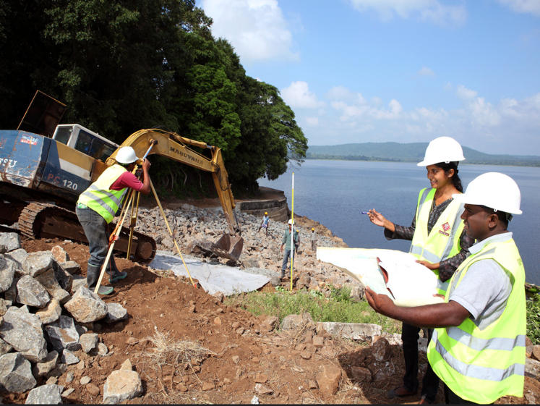
Identify hazards and risks of working over or near water
Recognize what is in place to keep you safe
Prevent falling in
Help if you fall in
Keep water pollution-free
Notes:
Narration: By the end of this module you will be able to:
identify the hazards and risks of working over or near water
recognize what should be in place to keep you and others safe
prevent yourself from falling in
help yourself and others if they fall in and
keep the water clean.
Photo by: © Lakshman Nadaraja/World Bank. Further permission required for reuse.

Slide 3
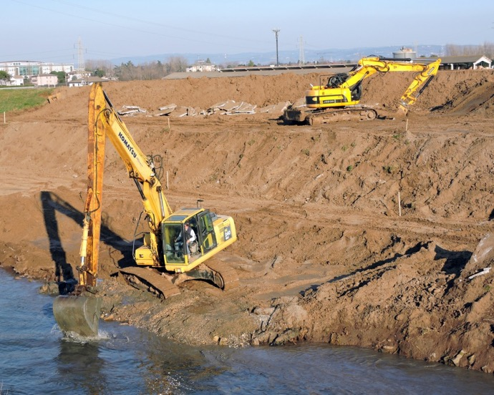
Hazards and risks of working over or near water
3
Notes:
Narration: Let’s begin by explaining the hazards and risks of working over or near water.
Photo by: Pxhere, Creative Commons CC0, https://pxhere.com/en/photo/756840 ​

Slide 4
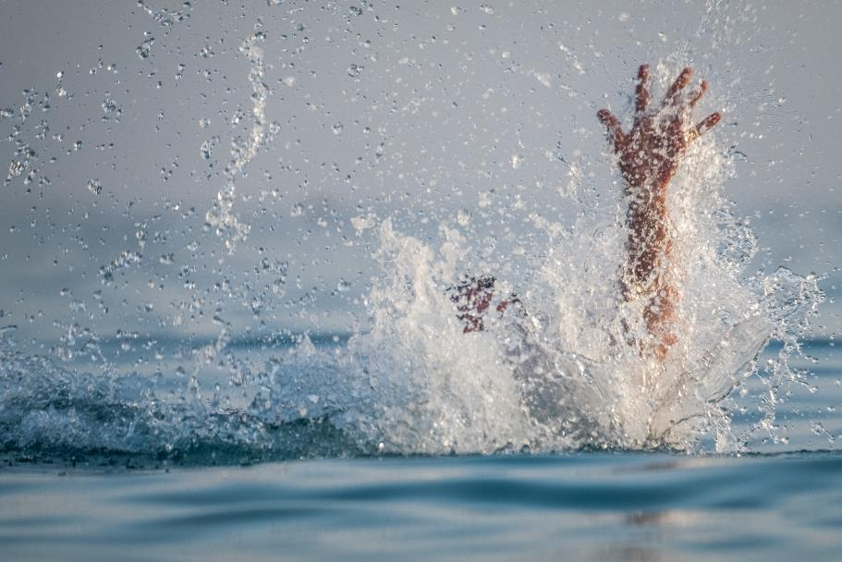
Drowning
Die of cold
Injuries
4
Notes:
Narration: People can drown from falling into water – even if it’s not that deep.
If the water is cold, they can become very ill, or even die, from the cold.
There may also be obstructions under the water that can injure people or animals in the water that bite.
Photo by: Shutterstock.com

Slide 5
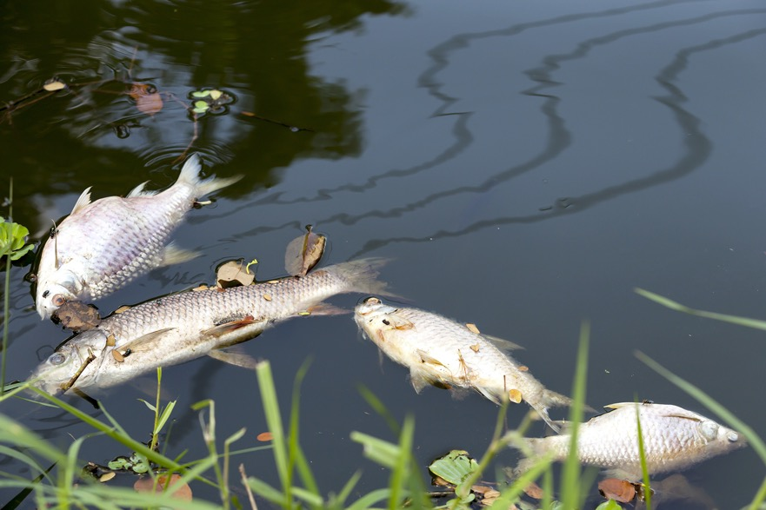
Water pollution
5
Notes:
Narration: Some substances used on site can pollute water, like wet cement and fuels.
We need to prevent them getting into water to keep it clean for everyone on site and the local community to use.
Water pollution can also kill wildlife so we need to keep it clean to protect plants, animals and fish.
Photo by: Shutterstock.com

Slide 6
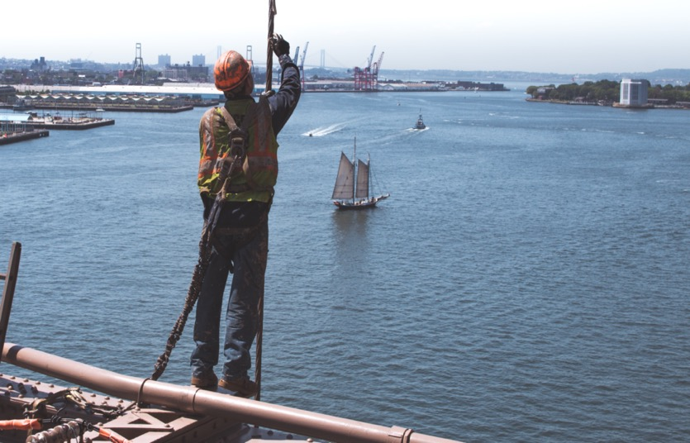
Preventing people falling in
6
Notes:
Narration: Now we’ll look at how to keep people safe by preventing them from falling in, like this worker who is wearing a harness and lanyard and is clipped on securely.
Photo by: ​ Lennard Stoellger on Stocksnap, Creative Commons CC0, https://stocksnap.io/photo/construction-worker-26F4EL6HIG ​​

Slide 7
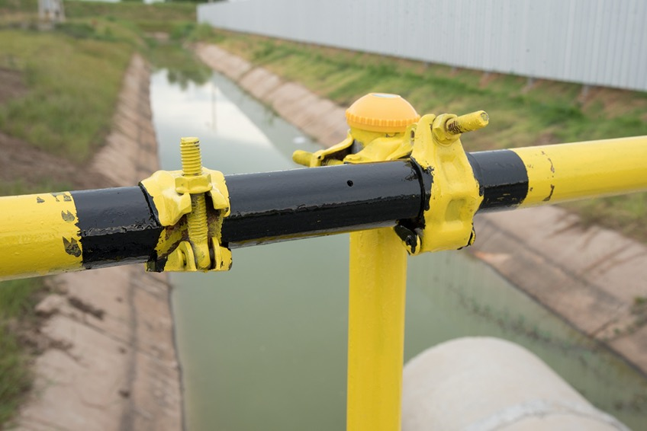
Follow rules for working at height
7
Notes:
Narration: When you’re working over water, follow all the rules for working at height in Module 15.
This includes things like making sure that any floor openings are covered or surrounded by guard rails and that there are barriers at the edge of drops over water, like this one.
Photo by: Shutterstock.com

Slide 8
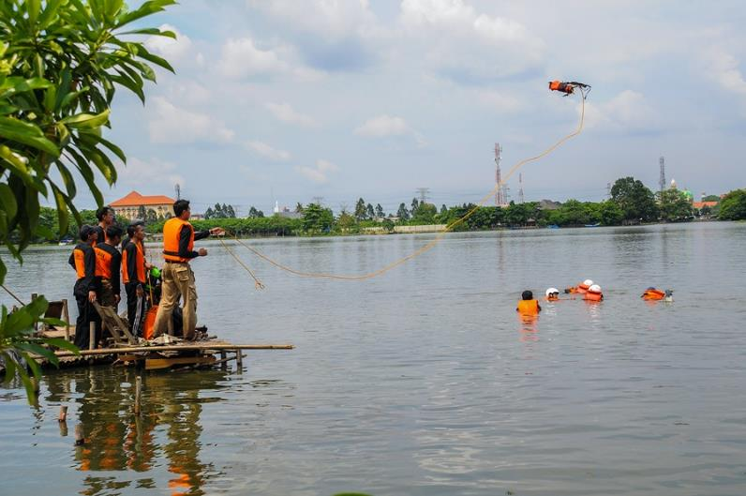
Protecting people if they fall in
Photo: Fajrul Islam / Shutterstock.com
8
Notes:
Narration: Next let’s see how to protect people if they fall in.
Here’s what you need to do to be prepared and stay safe.
Photo by: Fajrul Islam / Shutterstock.com. Further permission required for reuse.
​

Slide 9
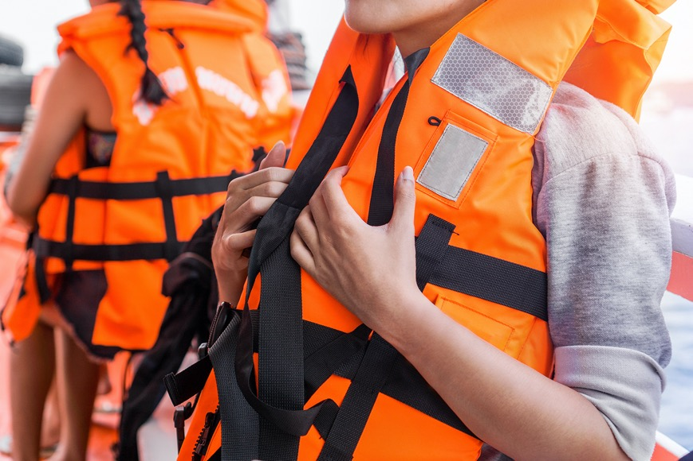
Wear life jacket or vest or personal flotation device
9
Notes:
Narration: Wear a life jacket or vest also known as a personal flotation device which will keep you afloat if you fall in the water.
If you are also wearing a harness and lanyard, make sure it fits and will work properly with the life jacket on too.
Note to trainer: To make the training more interactive, at the beginning of this slide, ask the workers: “What do you need to wear when working over or near water?” The answer is a life jacket or vest.
Photo by: Shutterstock.com

Slide 10
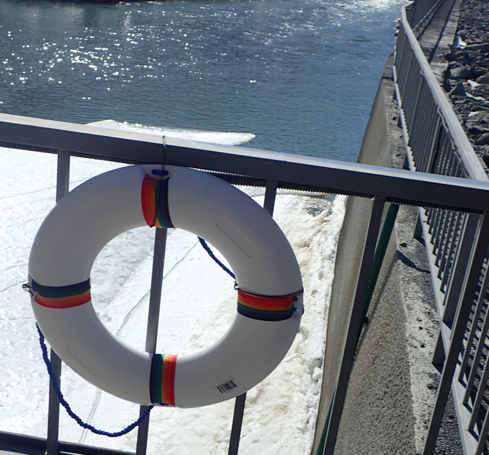
Throw rope or line and ring buoy or life ring
10
Notes:
Narration: Check there is a throw rope or line, a ring buoy or life ring close by.
If someone falls in, throw the rope or ring to them.
The buoy will help keep them afloat and then you can pull them out.
Photo by: © Jack Mozingo/ World Bank
​

Slide 11
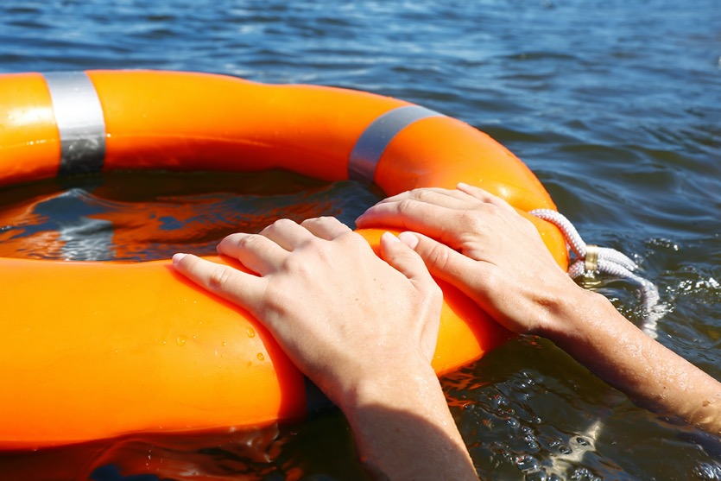
If you fall in, lie on your back
Stay calm and relaxed
11
Notes:
Narration: If you fall in, lie on your back so it is easier to breathe.
Your life jacket will keep you afloat – or hold onto a ring buoy.
Try to stay calm and relaxed to save your energy.
Photo by: Shutterstock.com
​

Slide 12
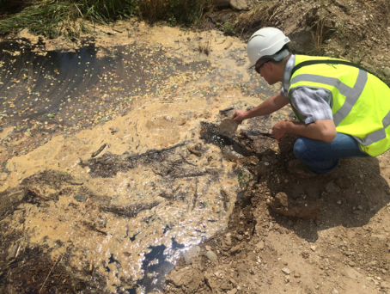
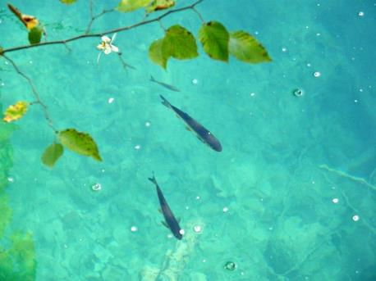
Keeping water clean
12
Notes:
Narration: Here we’ll find out how to keep water clean.
It’s important to work carefully over or near water to make sure that nothing gets in that could pollute it like this water – on the left - which is contaminated with bitumen and runoff from a concrete batching plant.
We want all water resources to stay clean and healthy like this water on the right.
Photos by: :​ 1. Polluted water: © Michael Hall/ World Bank. Further permission required for reuse.
2. Clean water: Pxhere, Creative Commons CC0, https://pxhere.com/en/photo/990795

Slide 13
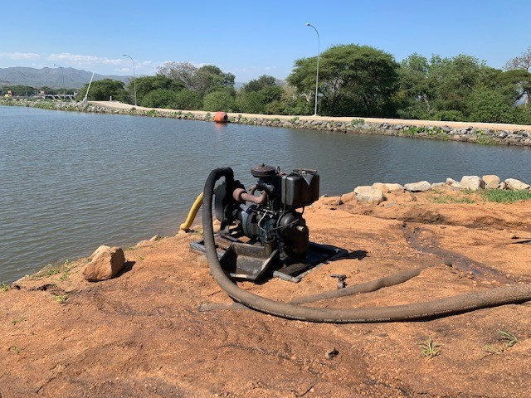
Keep everything at least 10 paces away from water Do not tip anything into water or on the ground
13
Notes:
Narration: Keep everything at least 10 paces away from the water so that if anything accidentally spills or leaks it wont go in and cause pollution.
You can see this pump is much to close to the water’s edge.
Only move materials and tools nearer while you are using them.
Do not tip anything on the ground or into the water – it will pollute the water.
Photo by: © Michael Hall/ World Bank.

Slide 14
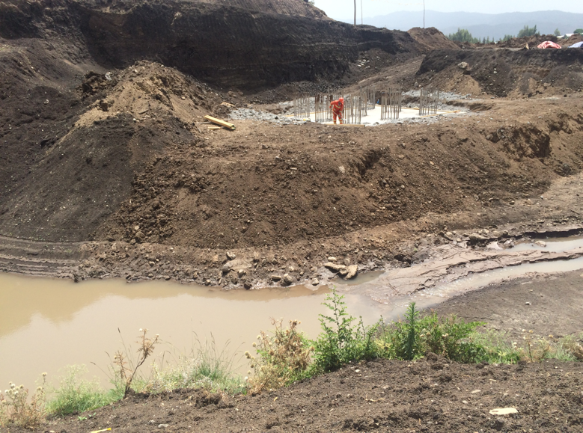
When clearing vegetation leave a strip of vegetation between stripped area and the water
14
Notes:
Narration: When clearing vegetation leave a strip of vegetation between the bare area and the water.
This acts a barrier to catch any potential pollution.
You can see here that all the vegetation on the far riverbank has been removed.
There is nothing to stop the bare soil getting washed away into the river.
Photo by: © Michael Hall/ World Bank.

Slide 15
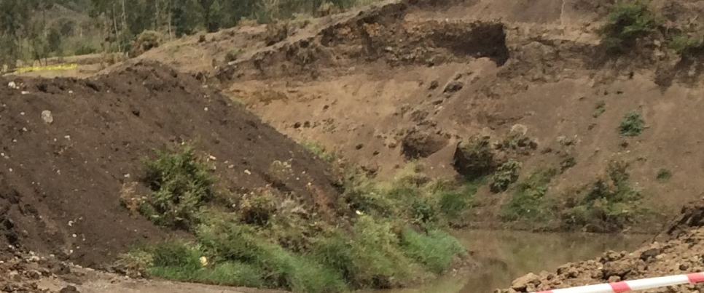
When clearing vegetation leave a strip of vegetation between the stripped area and water
15
Notes:
Narration: Here a strip of vegetation has been left in place between the stripped soil and the river – this will catch any soil or pollution and protect the river.
Photo by: © Michael Hall/ World Bank.
​

Slide 16
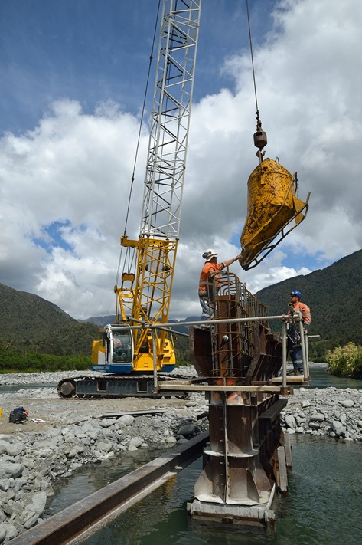
Contain concrete
Avoid moving containers of concrete over water
Check ends of pump hose are secured
16
Notes:
Narration: When concreting over or near water contain all the concrete so that none gets into the water.
Avoid moving containers of wet concrete over water – if you have to then make sure the container is fully sealed, like the one in this photo, so that concrete doesn’t spill out.
Check the ends of the pump hose are secure so that they don’t fall off letting concrete into the water.​
Photo by: Shutterstock.com

Slide 17
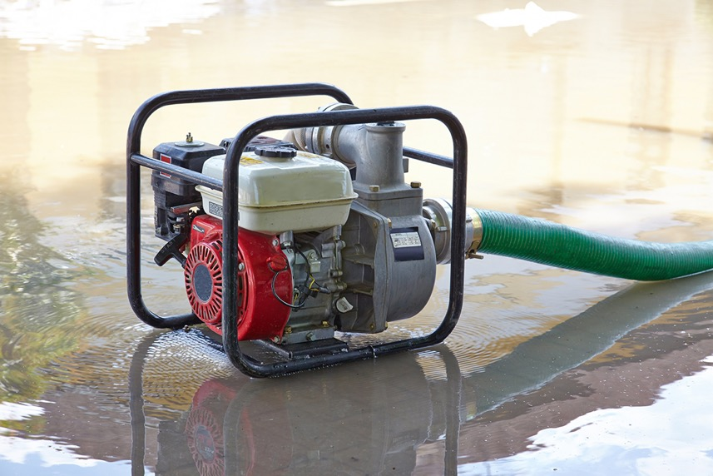
Take water only from the places your Supervisor tells you too
17
Notes:
Narration: When getting water to use on site, take water only from the places your Supervisor tells you.
Taking it from the wrong place can cause water supplies to dry up so that there is none left for the community or wildlife.
Photo by: Shutterstock.com

Slide 18
18
Notes:
Narration: Now we’ll finish this module with four key things to remember.
Image by: © World Bank

Slide 19
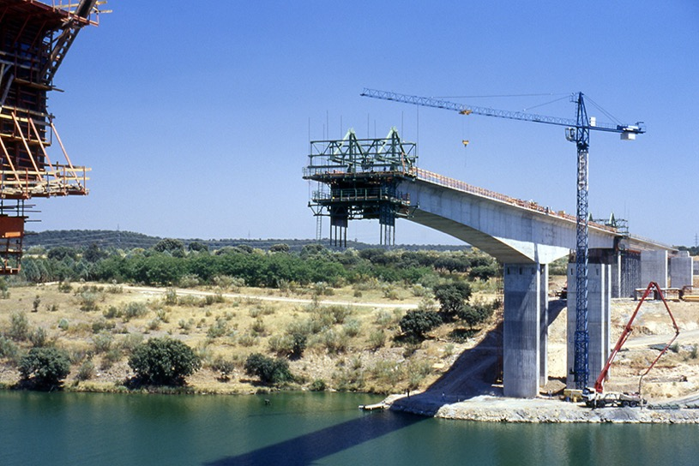
1. Follow rules for working at height
2. Wear life jacket or vest or personal flotation device
3. Have throw line, rope, ring buoy or life ring available to rescue
4. Don’t put any pollutants in or near water
19
Notes:
Narration: 1. Follow all the rules for working at height when you are working above or next to water
2. Wear a life jacket or vest also known as a personal flotation device
3. Make sure there is a throw line, rope, ring buoy or life ring to rescue anyone who falls in
4. Don’t put any pollutants in or near water – like concrete, fuel, oil, chemicals or dirty water.
Now you have completed the third set of modules on what you need to do when carrying out specific activities.
And you have finished all 17 modules of this general induction training – well done!
Photo by: Shutterstock.com

Slide 20
Copyright
© 2022 International Bank for Reconstruction and Development / The World Bank
1818 H Street NW
Washington DC 20433
Telephone: 202-473-1000
Internet: www.worldbank.org
This work is a product of the staff of The World Bank with external contributions. The findings, interpretations, and conclusions expressed in this work do not necessarily reflect the views of The World Bank, its Board of Executive Directors, or the governments they represent.
The World Bank does not guarantee the accuracy, completeness, or currency of the data included in this work and does not assume responsibility for any errors, omissions, or discrepancies in the information, or liability with respect to the use of or failure to use the information, methods, processes, or conclusions set forth. The boundaries, colors, denominations, and other information shown on any map in this work do not imply any judgment on the part of The World Bank concerning the legal status of any territory or the endorsement or acceptance of such boundaries.
Nothing herein shall constitute or be construed or considered to be a limitation upon or waiver of the privileges and immunities of The World Bank, all of which are specifically reserved.
Rights and Permissions
The material in this work is subject to copyright. Because The World Bank encourages dissemination of its knowledge, this work may be reproduced, in whole or in part, for noncommercial purposes as long as full attribution to this work is given.
Any queries on rights and licenses, including subsidiary rights, should be addressed to World Bank Publications, The World Bank Group, 1818 H Street NW, Washington, DC 20433, USA; fax: 202-522-2625; e-mail: pubrights@worldbank.org.

