Slide 1
MODULE 16
Working on or next to a road
For copyright details see last slide of this PowerPoint presentation
Notes:
Narration: Welcome to Module 16 Working on or next to a road.
​
Image by: © World Bank

Slide 2
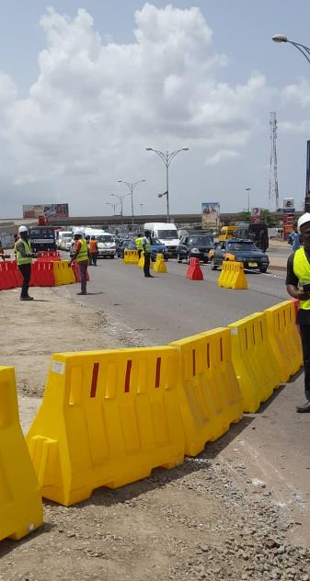
Identify hazards and risks of working on or next to a road
Recognize what is in place to keep everyone safe
Prevent you from being hit by vehicle
Protect other workers and the community
Notes:
Narration: By the end of this module you will be able to:
identify the hazards and risks of working on or next to a road
recognize what should be in place to keep you and others safe
prevent yourself from being hit by a vehicle and
protect other workers and the community.
Photo by: With kind permission of GAMA (Greater Accra Metropolitan Area) Project of the Ministry of Sanitation and Water Resources, Ghana. Further permission required for reuse.

Slide 3
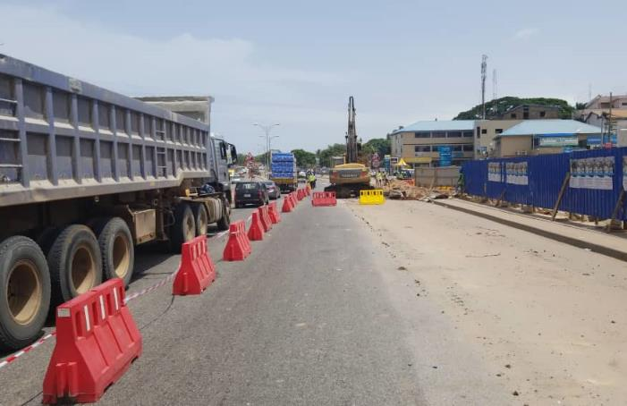
Hazards and risks of working on or next to a road
Notes:
Narration: Let’s begin by explaining the hazards and risks of working on or next to a road.
Photo by: With kind permission of GAMA (Greater Accra Metropolitan Area) Project of the Ministry of Sanitation and Water Resources, Ghana.

Slide 4
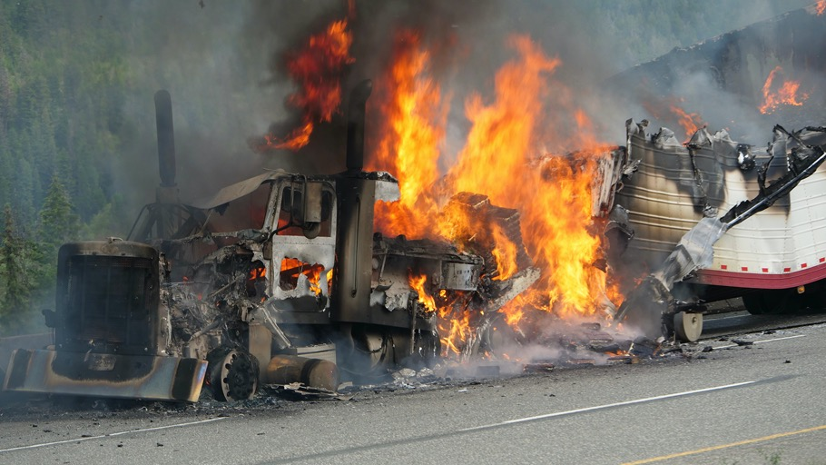
Workers, road users, members of the community die or get injured by construction on roads
4
Notes:
Narration: Too often workers, road users and members of the community passing by die or get injured in traffic accidents caused by badly done construction work.
There are also many people who can be affected by the disruption of construction work on or next to roads – the local community on foot, cyclists and even livestock, particularly when passing and crossing roadworks.
Photo by: Shutterstock.com

Slide 5
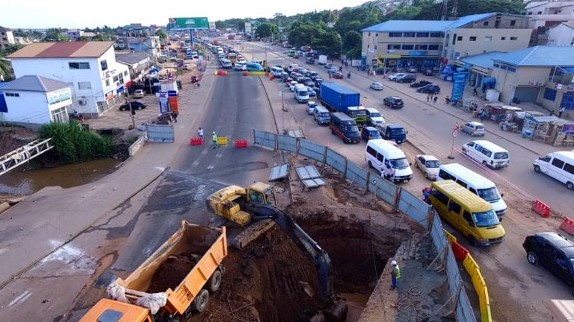
Working on or next to a road
Notes:
Narration: Now we’ll look at how you can stay safe when you are working on or next to a road.
Photo by: With kind permission of GAMA (Greater Accra Metropolitan Area) Project of the Ministry of Sanitation and Water Resources, Ghana.

Slide 6
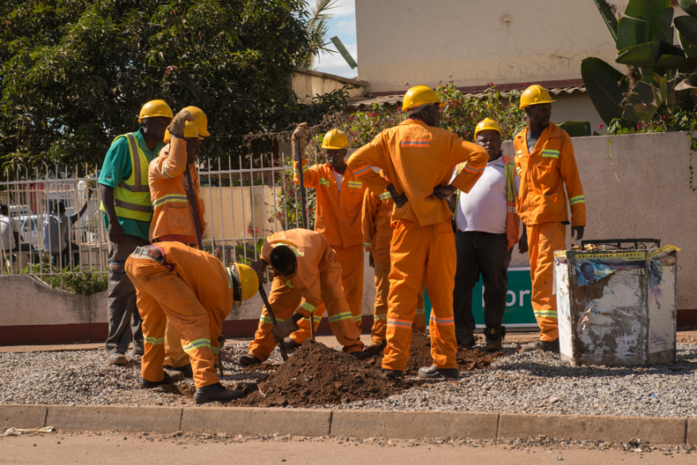
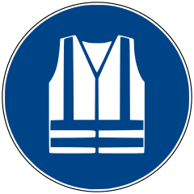
Wear high visibility clothes
Notes:
Narration: It’s best to wear high visibility long-sleeved tops and trousers or pants like the workers in this photo to make it easier for drivers to see you.
Image by: https://en.wikipedia.org/wiki/ISO_7010, public domain
Photo by: : © World Bank. Further permission required for reuse.

Slide 7
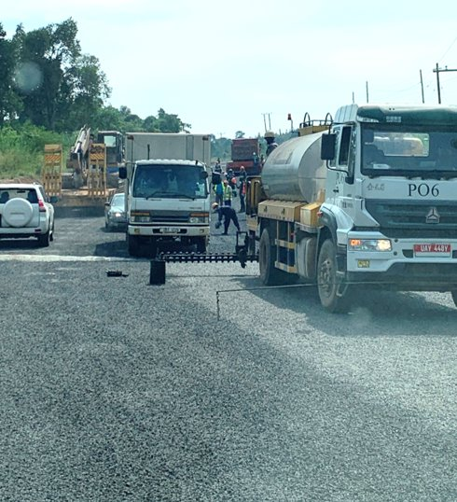
Don’t work on both sides of road
7
Notes:
Narration: Working on both sides of the road at the same time is dangerous when there is traffic going past.
So don’t work on both sides unless the road has been closed to traffic.
Photo by: © Michael Hall/ World Bank

Slide 8
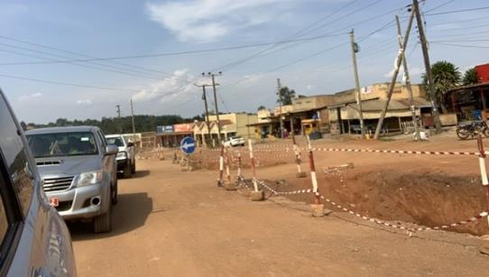
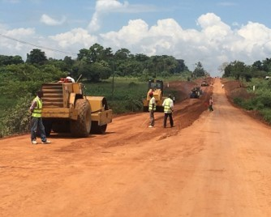
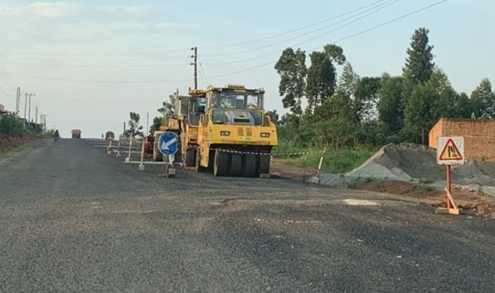
Work only on one half of the road
8
Notes:
Narration: If the road is open to traffic, only work on one half of the road at a time, like in these photos, so that the other half is kept clear for traffic and people to get past safely.
Don’t let road traffic through the works.
Photo by:​ © Michael Hall/ World Bank. Further permission required for reuse.

Slide 9
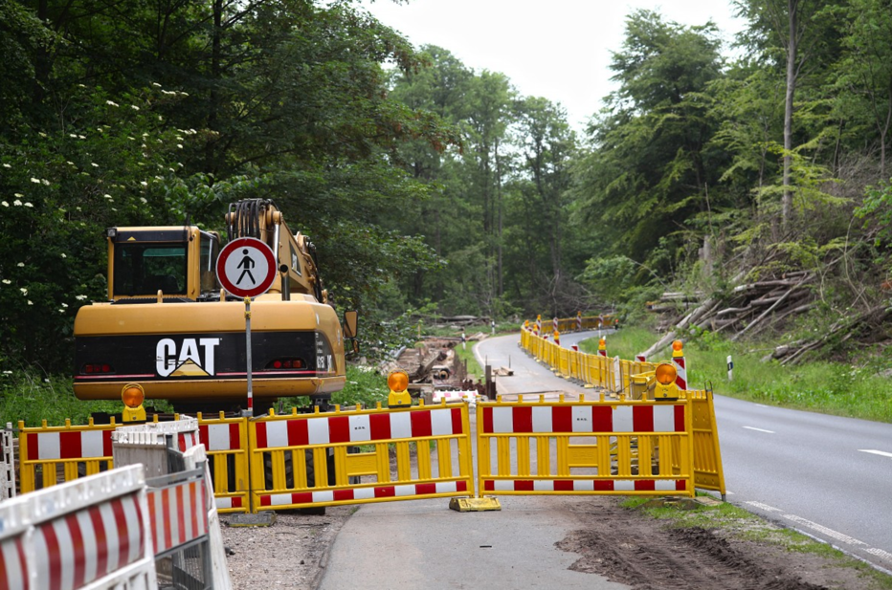
Make sure the working area is clearly visible
9
Notes:
Narration: Make sure that the working area is clearly visible to oncoming traffic.
Remember it may be approaching at high speed so drivers need to be able to see the roadworks very easily from some distance away.
This worksite is a good example as it’s clearly visible and all materials are within the fenced area.
And remember to leave the worksite well-lit and with visible barriers at the end of shift so it is safe when no one is there working.
Photo by:​ Pxhere, Creative Commons CC0, https://pxhere.com/en/photo/678433

Slide 10
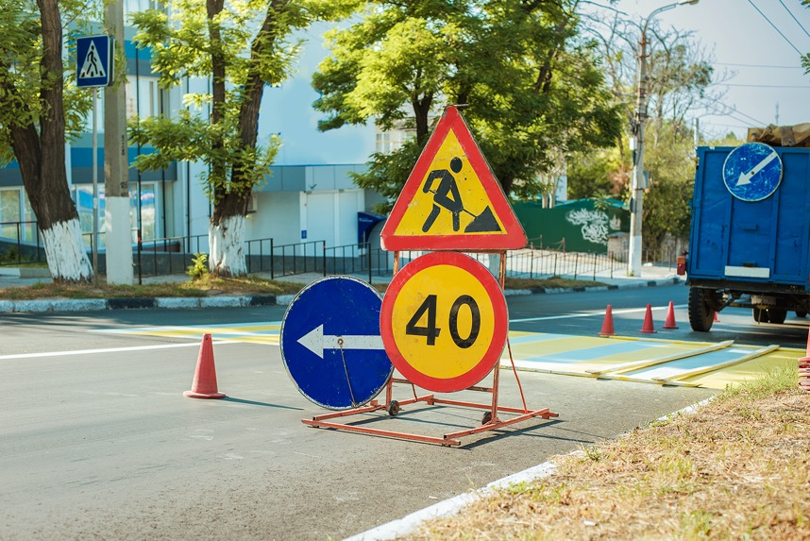
Keep signs in place and clean
10
Notes:
Narration: There will also be signs to give road users advance warning of the works, the speed limit and showing drivers and people passing by where to go if part of the road or footway is closed and there is a diversion, for instance this arrow pointing left.
Make sure all the signs stay in place and if they get dirty, clean them so that they can still be seen.
Photo by:​ Shutterstock.com

Slide 11
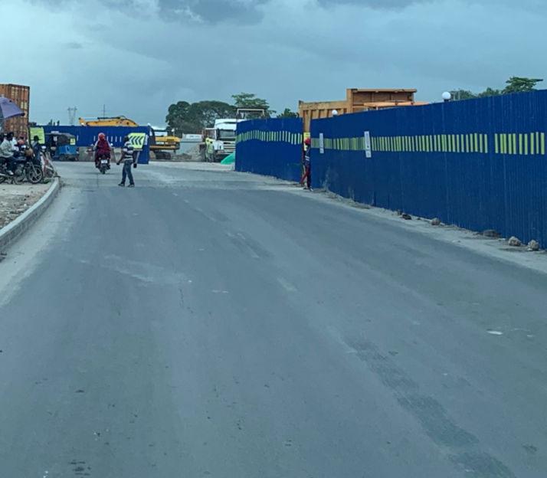
Stay inside barriers
11
Notes:
Narration: There should be protective barriers, traffic cones or barrels marking out the area that it is safe for you to work in.
Always stay inside this area – it is there to protect you from traffic and getting runover.
And make sure that materials, like stockpiles of soil or stone, are kept inside barriers too so that road users don’t crash into them.​
​
Note to trainer: To make the training more interactive, at the beginning of this slide, ask the workers: “What are the barriers for next to road works?”. The answer is “To keep you and the vehicles away from each other to stop accidents”. ​
​
Photo by:​ © Michael Hall/ World Bank

Slide 12
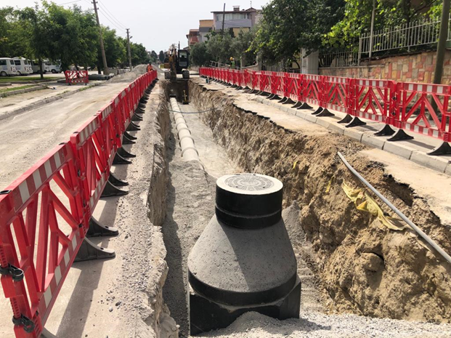
Keep barriers in place
12
Notes:
Narration: The barriers also keep members of the community away from traffic and out of the work area.
There should be barriers along temporary footpaths for the community to protect them.
Keep the barriers in place at all times.
Photo by:​ © Canan Yildiz/ World Bank

Slide 13
Use lights in dark or bad weather - Not dazzling
Photo: Mahathir Mohd Yasin / Shutterstock.com
Notes:
Narration: When working in the dark or bad weather, turn the lights on so that the roadworks are clearly visible to oncoming traffic.
This includes temporary construction lights by the side of the road, on construction vehicles and machines and on warning signs and barriers.
Make sure the lights are not dazzling you, other workers or passing road users – lights that shine too brightly or at the wrong angle can dazzle people and cause accidents.
Photo by:​ Mahathir Mohd Yasin / Shutterstock.com. Further permission required for reuse.
​

Slide 14
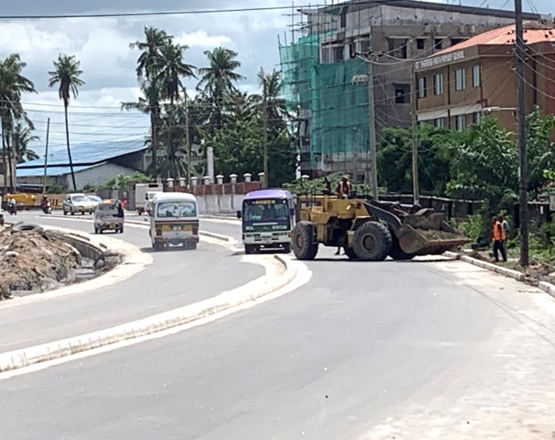
Need someone to warn and direct traffic
14
Notes:
Narration: There should be someone directing traffic, especially when construction vehicles or machines are moving in the road like here.
The bus has had to pull out onto the other side of the road to get past the excavator which is not safe.
There should have been someone directing it to stop while the excavator moved.
Photo by:​ © Michael Hall/ World Bank

Slide 15
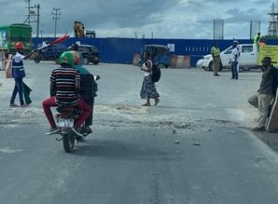
Do not direct traffic unless you have special training
15
Notes:
Narration: And here the flag person has told the motorbike to stop so the person can cross the road safely.
Do not direct traffic unless you have been given special training to make sure you do it in a way that’s safe.
Photo by:​ © Michael Hall/ World Bank. Further permission required for reuse.
​

Slide 16
16
Notes:
Narration: We’ll finish this module with four key things to remember.
Image by: © World Bank

Slide 17
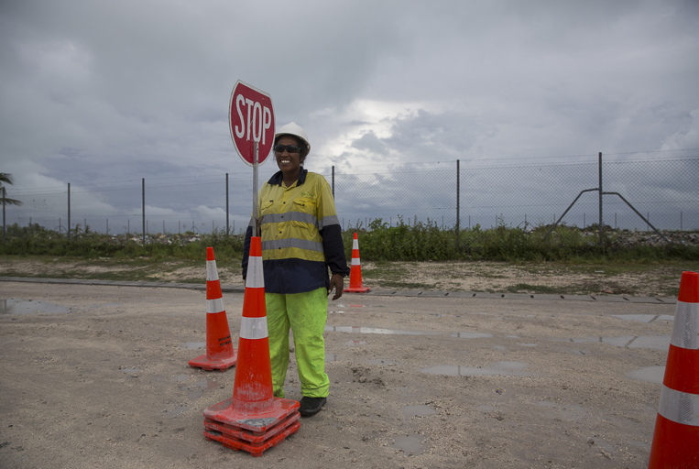
1. Wear high visibility clothes
2. Make sure works can be seen easily by road users
3. Stay inside barriers
4. Keep road and footway clear
17
Notes:
Narration: 1. Wear high visibility clothes
2. Make sure the works can be seen easily by road users – including at night and in bad weather
3. Stay inside the barriers around the work area
4. Keep the road clear for road users and the footway clear of construction materials for the community.
Now that you know more about how to work on or next to a road safely you’ll find out the right way to work near or over water in Module 17.
Photo by:​ © Conor Ashleigh/ World Bank. Further permission required for reuse.

Slide 18
Copyright
© 2022 International Bank for Reconstruction and Development / The World Bank
1818 H Street NW
Washington DC 20433
Telephone: 202-473-1000
Internet: www.worldbank.org
This work is a product of the staff of The World Bank with external contributions. The findings, interpretations, and conclusions expressed in this work do not necessarily reflect the views of The World Bank, its Board of Executive Directors, or the governments they represent.
The World Bank does not guarantee the accuracy, completeness, or currency of the data included in this work and does not assume responsibility for any errors, omissions, or discrepancies in the information, or liability with respect to the use of or failure to use the information, methods, processes, or conclusions set forth. The boundaries, colors, denominations, and other information shown on any map in this work do not imply any judgment on the part of The World Bank concerning the legal status of any territory or the endorsement or acceptance of such boundaries.
Nothing herein shall constitute or be construed or considered to be a limitation upon or waiver of the privileges and immunities of The World Bank, all of which are specifically reserved.
Rights and Permissions
The material in this work is subject to copyright. Because The World Bank encourages dissemination of its knowledge, this work may be reproduced, in whole or in part, for noncommercial purposes as long as full attribution to this work is given.
Any queries on rights and licenses, including subsidiary rights, should be addressed to World Bank Publications, The World Bank Group, 1818 H Street NW, Washington, DC 20433, USA; fax: 202-522-2625; e-mail: pubrights@worldbank.org.

