Slide 1
MODULE 15
Working at height
For copyright details see last slide of this PowerPoint presentation
Notes:
Narration: Welcome to Module 15 Working at height.
Working at height means any place you could fall from including from a ladder or scaffolding as well as into a hole in the ground or the floor.
Image by: © World Bank

Slide 2
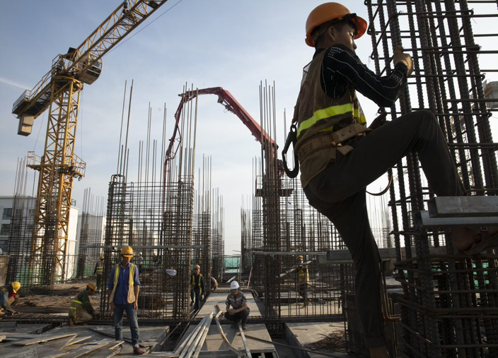
Hazards and risks working at height
Recognize safe set up for work at height
Prevent from falling
Handle materials and tools safely
Protect people below
2
Notes:
Narration: By the end of this module you will be able to:
identify the hazards and risks of working at height
recognize how work at height should be set up to keep you and others safe
prevent yourself from falling
handle materials and tools safely when working at height and
protect people below you.
Photo by: ​© World Bank. Further permission required for reuse.

Slide 3
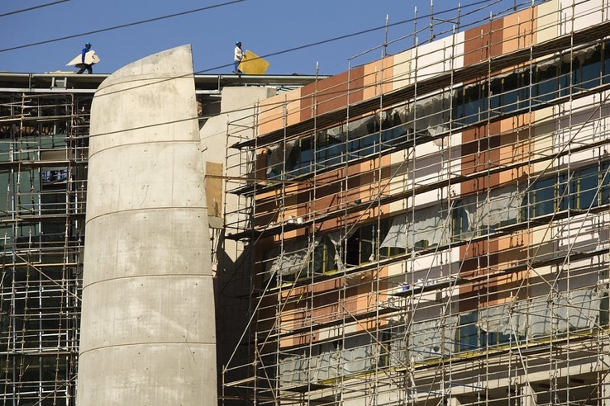
Hazards and risks of working at height
3
Notes:
Narration: Let’s begin by explaining the hazards and risks of working at height.
Photo by: © John Hogg / World Bank

Slide 4
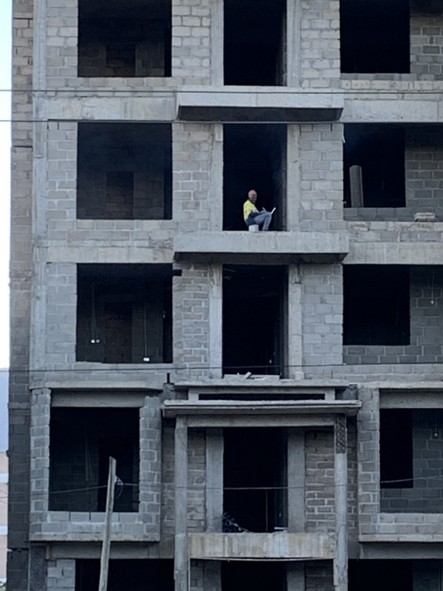
One of biggest causes of injuries and deaths
4
Notes:
Narration: One of the biggest causes of injuries and deaths on construction sites is falling from height.
This worker could easily fall – there is nothing on the edge to prevent them from falling.
Materials and tools can also cause injuries if they fall onto people below.
Photo by: © Michael Hall / World Bank

Slide 5
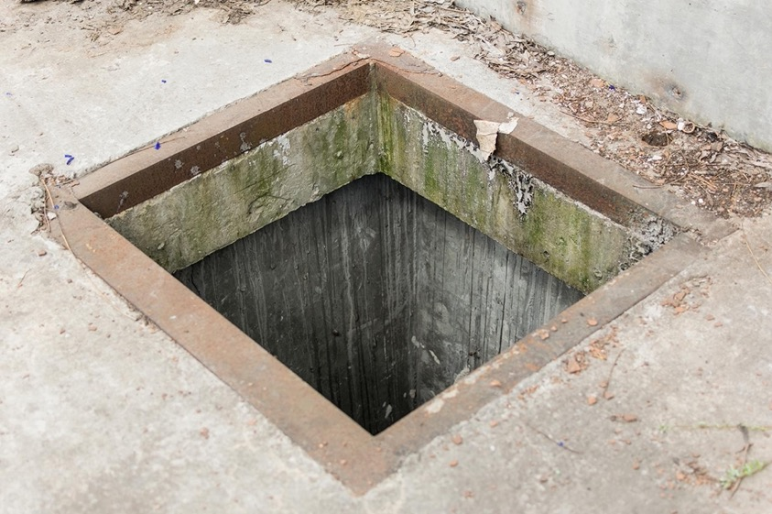
Hole that someone could fall into
5
Notes:
Narration: And here’s a hole in the floor that someone could easily fall into and seriously hurt themselves.
Photo by: Shutterstock.com
​

Slide 6
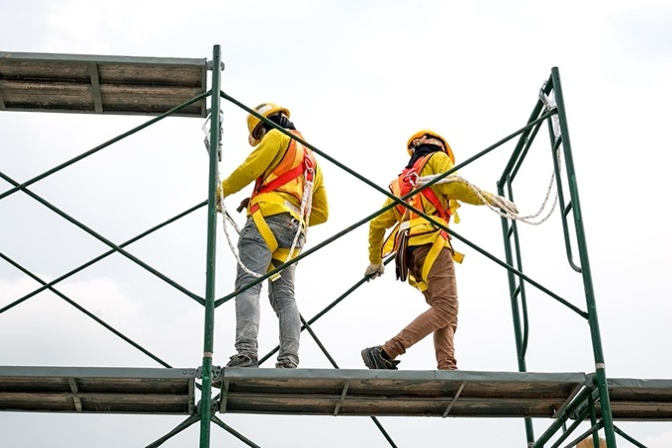
Prevent people from falling
6
Notes:
Narration: Now we’ll look at simple things that you can do to prevent yourself and others from falling.
Photo by: Shutterstock.com. Further permission required for reuse.

Slide 7
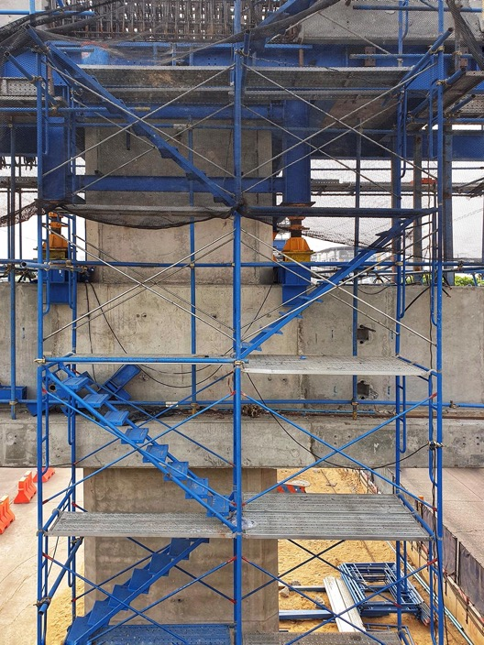
Use stairs or secure ladders
7
Notes:
Narration: Use safe access like stairs or secure ladders to get up and down from heights, and to move from place to place.
Never jump or climb up or down.
Photo by: Shutterstock.com

Slide 8
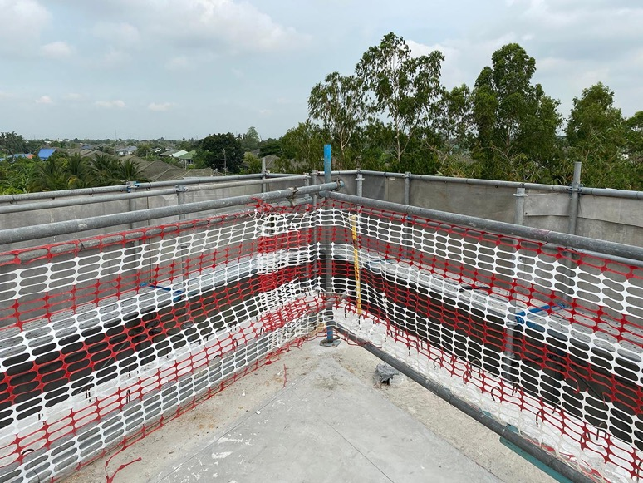
Keep barrier anywhere people could fall
8
Notes:
Narration: A barrier like this with guard rails, should be in place anywhere you could fall from – stairs, platforms, scaffolding, floor openings, ramps, or above machines.
The guard-rails are to stop you falling over the edge and the toe boards are to prevent tools and materials falling off and hitting someone below.
Another option for a hole in the floor is to cover it with a cover strong enough to support the weight of anything that may be put on it or people that may stand on it.
Photo by: Shutterstock.com

Slide 9
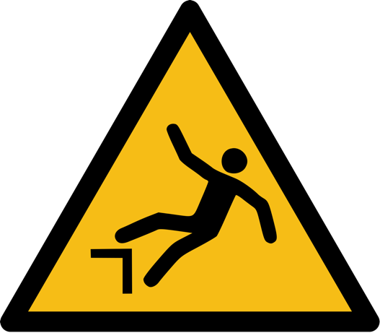
Warning signs
9
Notes:
Narration: Watch out for areas that are marked off or signs to warn you of places you could fall from.
This yellow triangle sign let's you know that there is a risk of falling so you need to take extra care.
Image by: https://en.wikipedia.org/wiki/ISO_7010, public domain

Slide 10
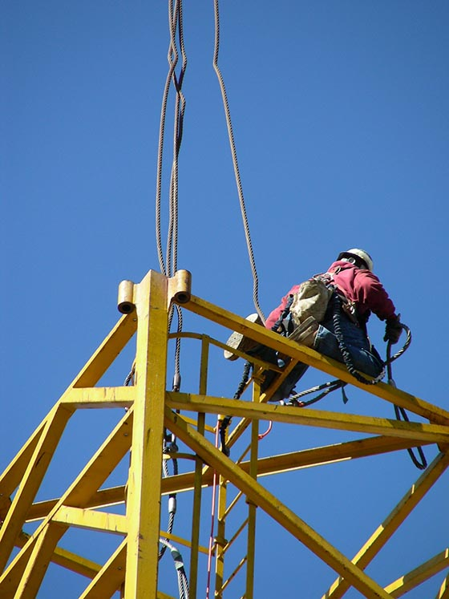
When working near an edge, face the edge on your knees
10
Notes:
Narration: When working near an edge, face the edge and work on your knees – you are much less likely to fall from this position.
Photo by: Shutterstock.com.

Slide 11
Don’t work at height in windy or wet weather or lightning
11
Notes:
Narration: Don’t work at height in windy or wet weather or when there is lightning.
The weather could cause you to fall and lighting will strike the tallest object, which could be where you are working.
Photos by: 1. Wind: dimitrisvetsikas1969 on Pixabay, https://pixabay.com/photos/palm-trees-wind-windy-weather-4293013
2. Rain: Ron Lach on Pexels, https://www.pexels.com/photo/light-art-water-space-9166301
3. Lighting: Pixabay, https://pixabay.com/photos/lightning-clouds-storm-silhouette-768801
​

Slide 12
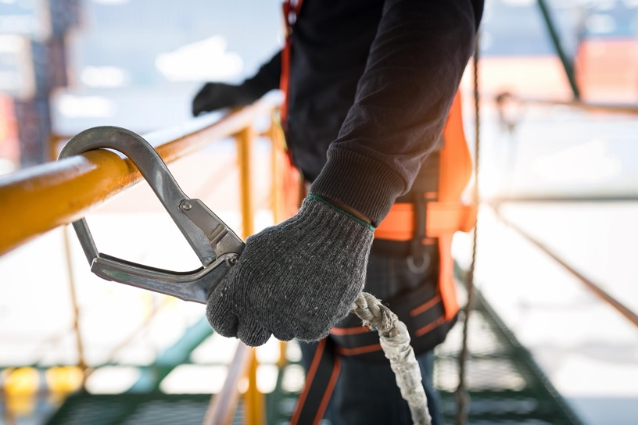
Protecting people if they fall
12
Notes:
Narration: Next let’s see how you should be protected just in case you do fall.
This could save your life.
Photo by: Shutterstock.com
​

Slide 13
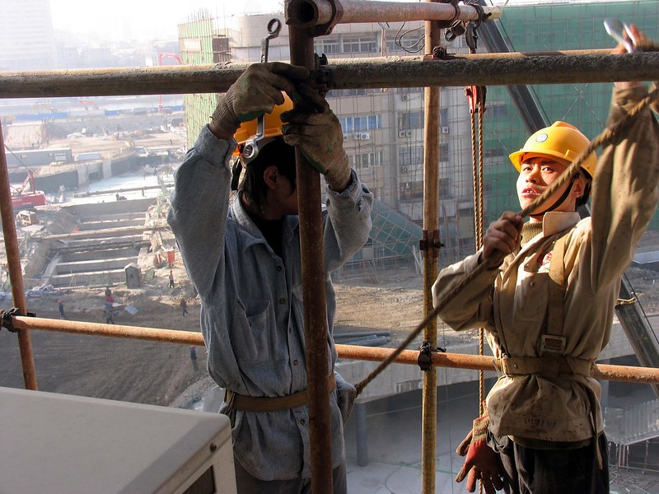
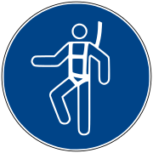
Wear a harness and lanyard Trained how to use it
13
Notes:
Narration: Wear a harness with a shock-absorbing lanyard.
This sign reminds you that you must wear a safety harness.
Check it before you put it on and if the harness or attachments are damaged, get another one.
Make sure you have been trained how to use it properly.
Note to trainers: To make the training more interactive, at the beginning of this slide, ask the workers: “What do you need to wear when working at height?” The answer is a harness and lanyard.
Photo by: © ang Aijun / World Bank. Further permission required for reuse.
Image by: https://en.wikipedia.org/wiki/ISO_7010, public domain

Slide 14
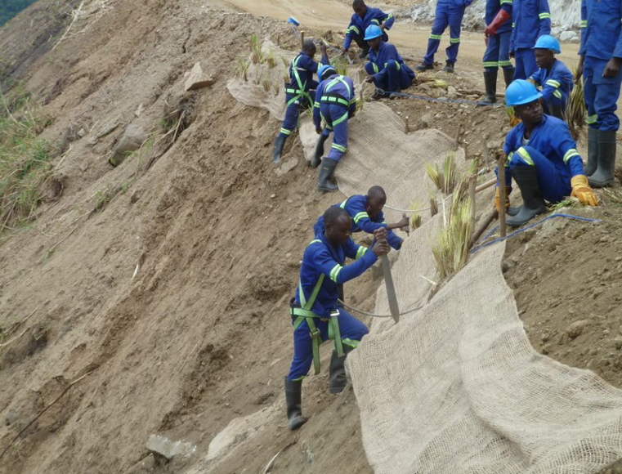
Know where to secure the clip
14
Notes:
Narration: And you know where it is secure to clip onto and where it isn’t.
Photo by: © Jack Mozingo / World Bank. Further permission required for reuse.

Slide 15
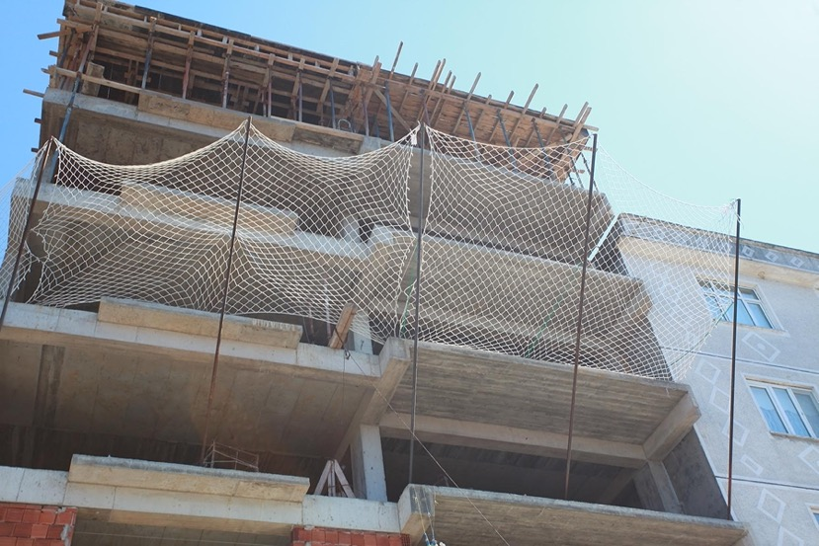
Use
Safety nets or
Fall-arrest mats
directly under where you are working
15
Notes:
Narration: Sometimes there may be other ways than a harness to protect workers from injury if they fall.
There might be safety nets or fall-arrest mats.
If there are fall-arrest mats check they are positioned directly under where you are working.
Don’t forget that harnesses, nets and mats cushion your fall so that you are not seriously injured but they wont stop you from falling so you still need to be careful.
Photo by: Shutterstock.com
​

Slide 16
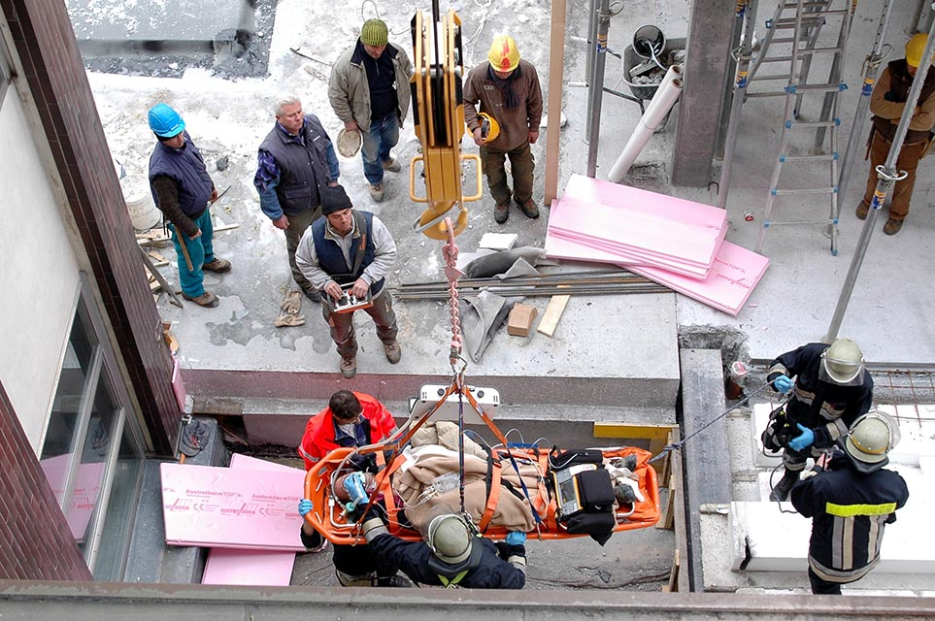
If someone falls, call for help straight away
Photo: faboi / Shutterstock.com
16
Notes:
Narration: If someone falls call for help to rescue them straight away.
There should be a Rescue Plan for rescuing workers if they fall from height.
And people on site who have been specially trained to rescue people from falls.
They are better placed to help than you are.
Moving someone who has fallen can easily make their injuries worse.
Photo by: faboi / Shutterstock.com. Further permission required for reuse.

Slide 17
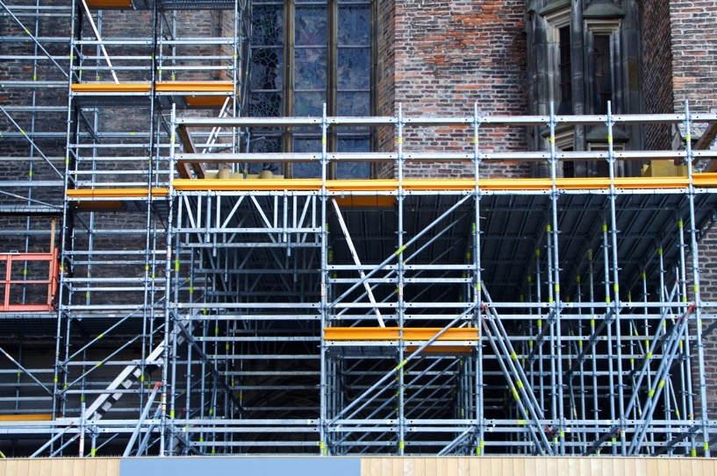
Using scaffolding
17
Notes:
Narration: In this section we’ll find out how to use scaffolding safely.
Photo by: Pixhere, Creative Commons CC0, https://pxhere.com/en/photo/493273

Slide 18
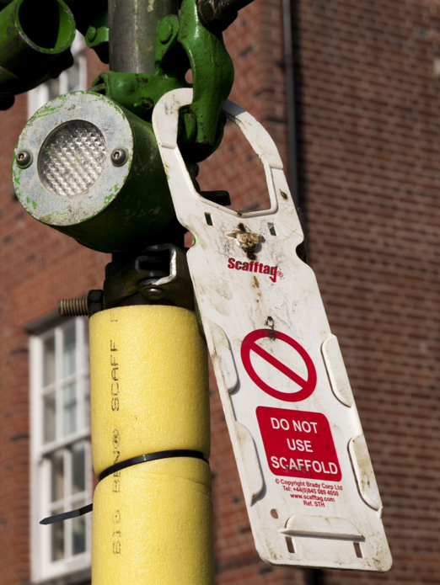
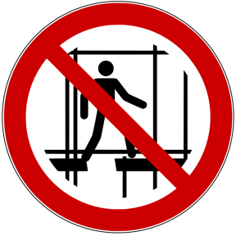
Don’t put up, alter or take down scaffolding unless you have special training Only go up scaffolding when the green label says it is safe
Photo: faboi / Shutterstock.com
18
Notes:
Narration: Don’t put up, alter or take down scaffolding unless you have had special training.
This sign and this tag tell you that the scaffolding is incomplete and you must not go up it.
Only go up scaffolding when there is a label on the entrance to the scaffold, saying it has been approved for use.
Check the label to make sure it has been inspected within the last week.
Photo by: 1. Sign: https://en.wikipedia.org/wiki/ISO_7010, public domain
2: Scafftag: faboi / Shutterstock.com

Slide 19
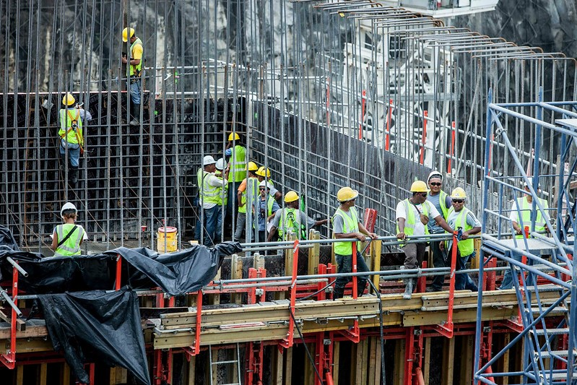
Secure walkways and work platforms – use boards
19
Notes:
Narration: Scaffolding should have a secure walkway, like in this photo, and work platforms of boards or safety decking so that you can stand, walk and work safely.
Photo by: © Gerardo Pesantez / World Bank. Further permission required for reuse.

Slide 20
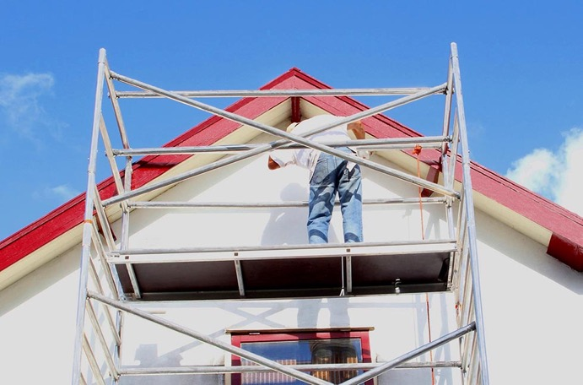
Using a mobile access tower
Photo: Barry Barnes / Shutterstock.com
20
Notes:
Narration: Now let’s explore how to use a mobile access tower safely.
A mobile access tower is scaffolding that is specially designed to be moved from one place to another.
Photo by: Barry Barnes/ Shutterstock.com
​

Slide 21
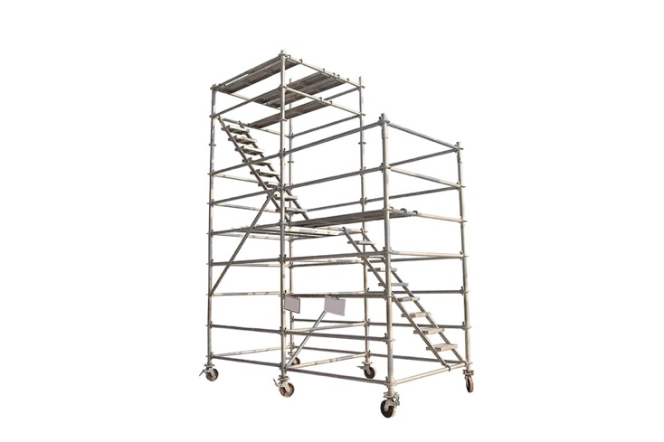
Don’t put up, alter or take down a mobile access tower unless you are specially trained Use only on stable, even ground Lock the wheels Never move it with people and materials on Push it from the base
21
Notes:
Narration: Don’t put up, alter or take down a mobile access tower unless you have had special training.
Only use it on stable even ground. Always lock the wheels.
If the wheels don’t lock, don’t use it – it needs to be repaired first. Never move it with people and materials on it and push it from the base.
Photo by: Shutterstock.com

Slide 22
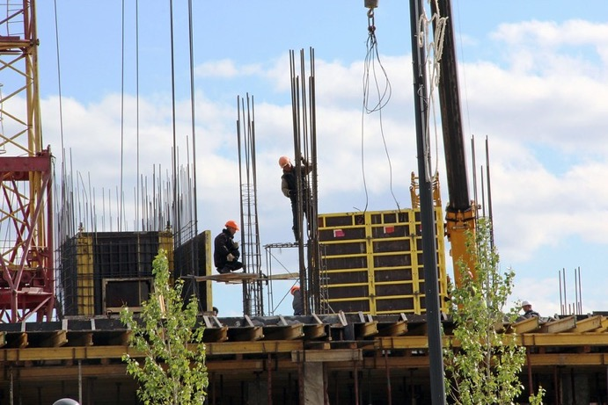
Moving tools, materials and waste up and down
22
Notes:
Narration: Here we’ll explain how to move tools, materials and waste up and down safely.
They can cause injuries if they fall and hit someone.
Photo by: © Shynar Jetpissova / World Bank

Slide 23
Never throw anything up or down Use a tool belt or tool lanyard
23
Notes:
Narration: Never throw anything up to someone above you or down to someone below you. Wear a tool belt or tool lanyard to take tools up and down - to leave your hands free to hold on.
Photo by: Shutterstock.com

Slide 24
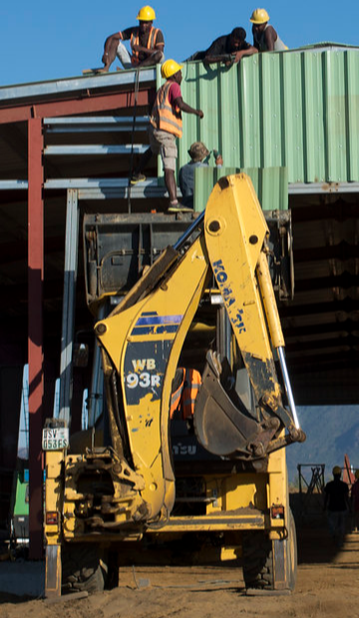
Unsafe lifting
24
Notes:
Narration: These workers are using a machine to get panels up to the roof.
This is unsafe as the machine is not designed to do this so the workers or the panels could easily fall.
Photo by: © World Bank. Further permission required for reuse.

Slide 25
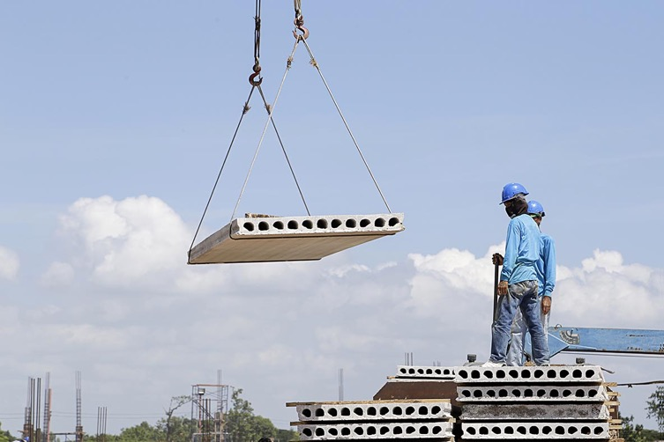
Get someone to use lifting equipment to move materials up Only specially trained people
25
Notes:
Narration: Get someone to use proper lifting equipment to move materials up safely from the ground. Only specially trained people should lift loads with hoists and lifting equipment.
Photo by: Shutterstock.com

Slide 26
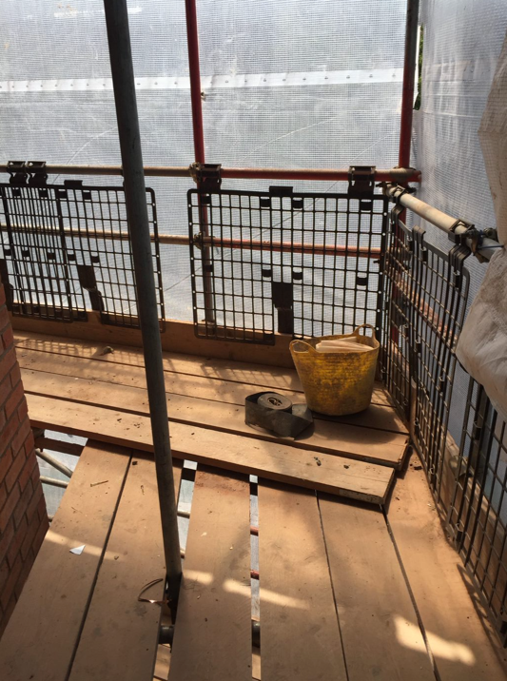
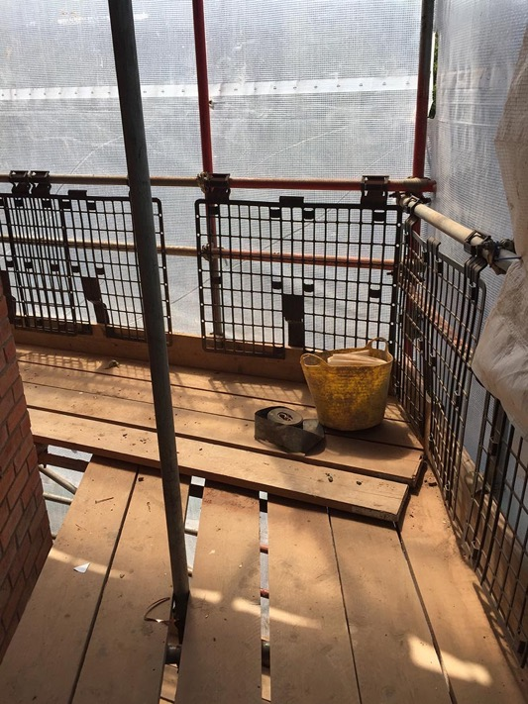
If materials are stored on scaffold:
Stack them so stable
Use guards or netting to prevent falling
26
Notes:
Narration: It’s best not to store materials at height – only the ones you need to use at the time.
If materials need to be stored, stack them so they are stable and cannot fall. Put guards or netting - like these brick guards - on the edge so materials cannot fall off and injure someone.
Photo by: Shutterstock.com
​

Slide 27
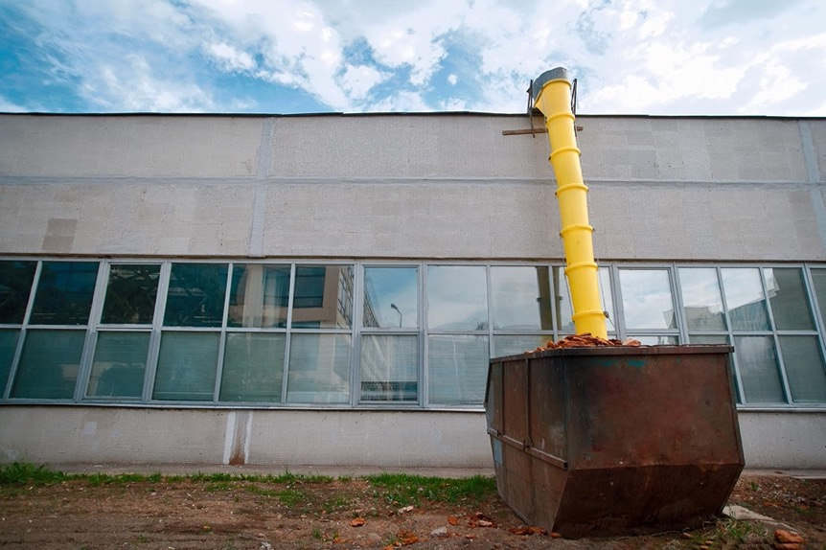
Chute to move waste down
27
Notes:
Narration: Use a chute to move waste down to the ground.
Photo by: Shutterstock.com

Slide 28
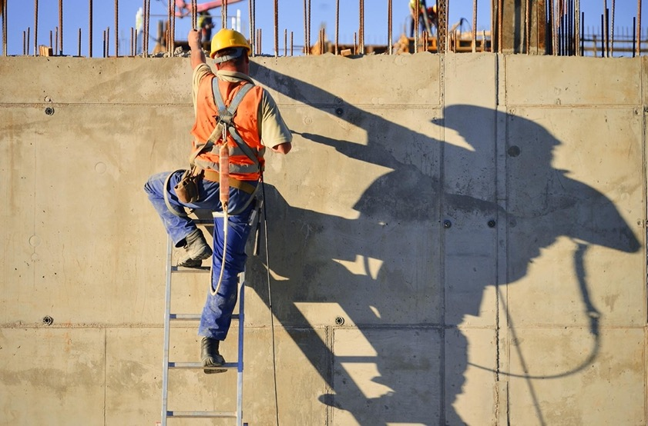
Using ladders
28
Notes:
Narration: Next let’s look at using ladders.
Many workers fall from ladders and injure themselves.
This can be prevented by doing the following things.
Photo by: Shutterstock.com

Slide 29
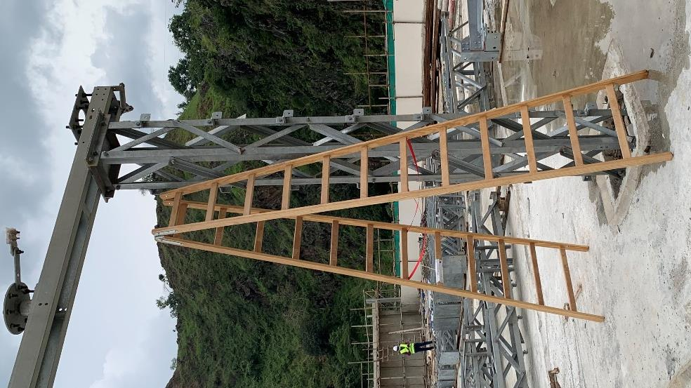
Use a manufactured ladder if there is one – preferably metal
29
Notes:
Narration: Use a manufactured metal ladder if there is one.
Photo by: © Michael Hall / World Bank

Slide 30
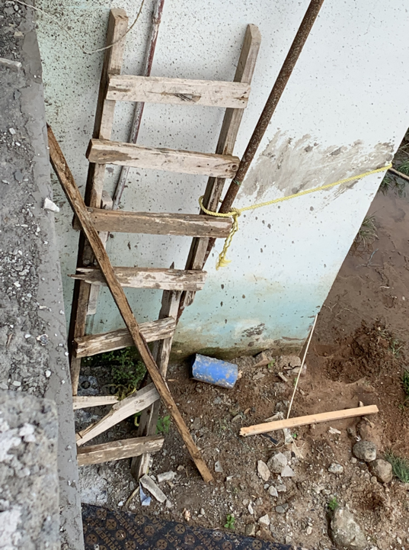
Check ladders for damage before use Do not use a broken ladder
30
Notes:
Narration: Always check ladders for damage before you use them. Do not use a ladder if: - it is broken – this ladder is not safe because it has a broken rung.
Note to trainer: To make the training more interactive, at the beginning of this slide, ask the workers: “What must you always do before you use a ladder?” The answer is check it is not broken.
Photo by: © Michael Hall / World Bank

Slide 31
Do not use a ladder if it is too short
Ladder should extend 1 meter higher than the top
31
Notes:
Narration: Also do not use it if it is too short – it should extend at least 1 meter higher than where the top of the ladder will land - like the one here.
Photo by: Shutterstock.com

Slide 32
Firm, level, stable surface Correct angle
32
Notes:
Narration: Put the ladder on a firm level, stable surface. This one is not.
And it is at too steep an angle and therefore more likely to fall over.
Photo by: © Jack Mozingo/ World Bank

Slide 33
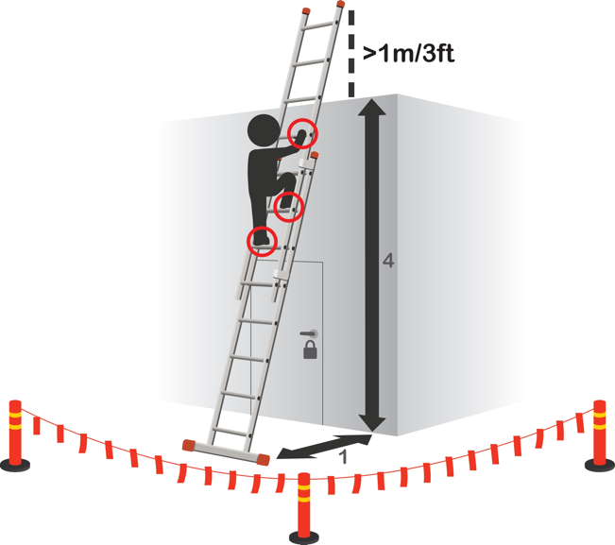
Correct angle: One out four up
33
Notes:
Narration: It should be at an angle of one out four up, like this.
This is the same as a 75 degree angle from the ground.
Image by: Shutterstock.com

Slide 34
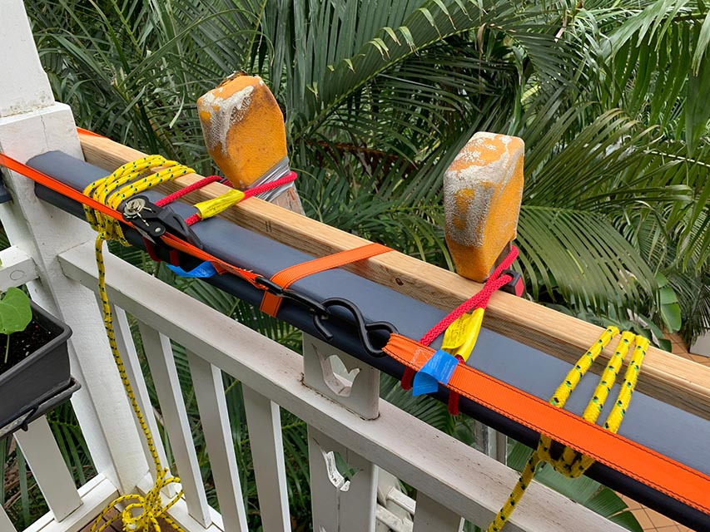
Tie ladder
34
Notes:
Narration: Tie the ladder to the structure you are working on so it cannot move.
If this is impossible, fix a ladder stablilizer to the top.
Photo by: Shutterstock.com

Slide 35
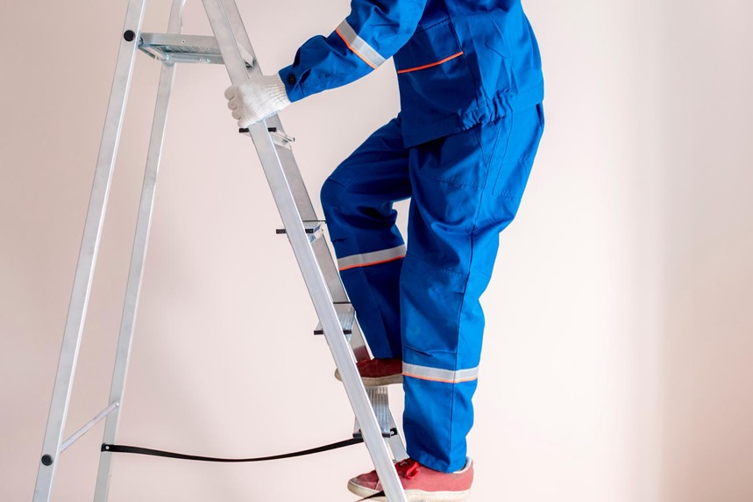
3 points of contact
35
Notes:
Narration: Make sure there is only 1 person on the ladder at a time.
Always have 3 points of contact with the ladder – two feet and a hand or two hands and one foot.
Photo by: Shutterstock.com

Slide 36
Don’t over-reach Don’t work on the top 3 rungs
36
Notes:
Narration: Don’t over-reach.
And don’t work on the top 3 rungs of a ladder – this makes the ladder unstable and increases the chance of you falling off.
Image by: osuosuosu on Pixabay, https://pixabay.com/illustrations/ladder-over-reach-about-reach-510578
​

Slide 37
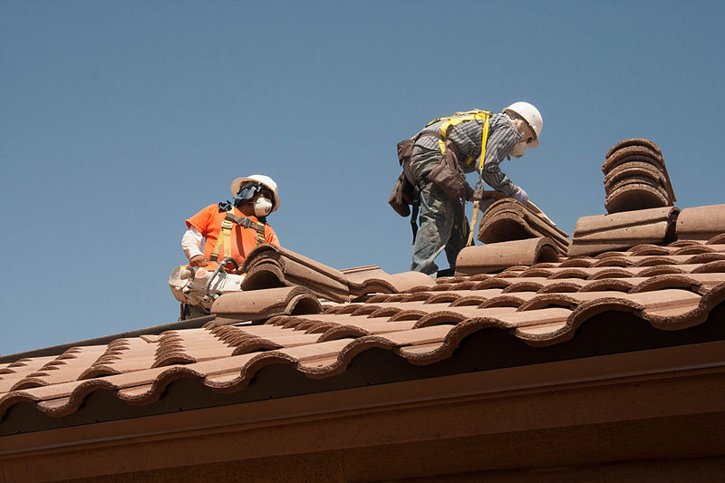
Working on a roof
37
Notes:
Narration: Here we’ll see how you can work safely on a roof.
Roofs can be dangerous as workers can fall through them or easily slip off and injure themselves.
Photo by: Wikimedia Commons, National Institute for Occupational Safety and Health, USA https://commons.wikimedia.org/wiki/File:Roofing_workers_fall_prevention_(9253637735).jpg
​

Slide 38
Don’t stand on the roof
38
Notes:
Narration: When working on a roof or above a ceiling always assume it is fragile - don’t stand on the roof or ceiling.
This sign reminds you that it is fragile.
Image by: Wikipedia, Creative Commons CC0, https://en.wikipedia.org/wiki/File:ISO_7010_W036_warning;_fragile_roof.svg, public domain ​

Slide 39
Stay on working platform
39
Notes:
Narration: Where there is a safe working platform, stay on the platform.
Photo by: Shutterstock.com

Slide 40
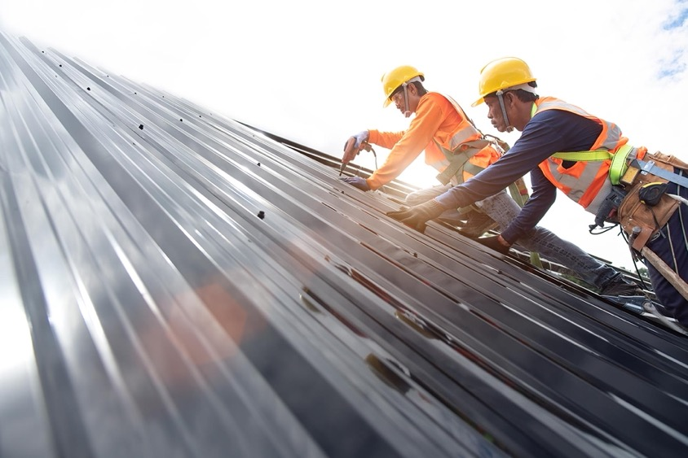
Wear harness and lanyard clipped to secure anchor point
40
Notes:
Narration: And if there is not a working platform, wear a harness and lanyard and be clipped on to a secure anchor point.
This may be scaffolding or a track or cable fixed to the roof.
Photo by: Shutterstock.com. Further permission required for reuse.

Slide 41
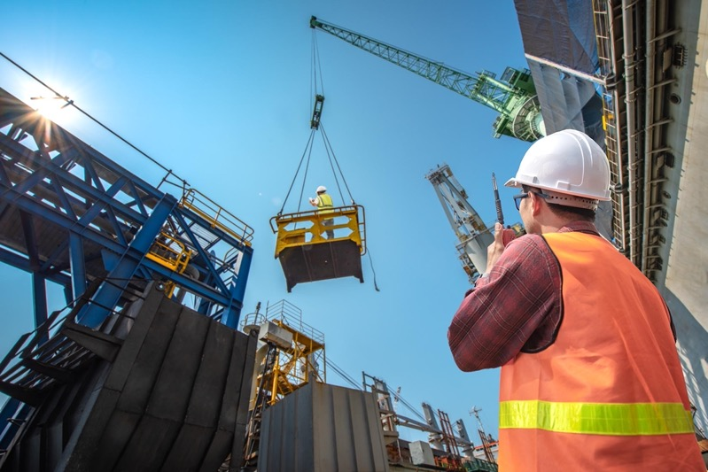
Protecting people below
41
Notes:
Narration: Now let’s find out how to protect people below from being hit by tools or materials that accidentally fall.
There could be fellow workers or members of the community underneath the work who could get injured.
Photo by: Shutterstock.com. Further permission required for reuse.
​

Slide 42
Keep people out of area below with fencing and signs
42
Notes:
Narration: Keep people out of the area below where you are working with fencing, like in this image, and signs like this one.
If the area is a community space, like a footpath, it will need to be closed and an alternative footpath set up for the community to use safely.
Image by:​ 1. Icon of person on ladder: Shutterstock.com
2. Sign: https://en.wikipedia.org/wiki/File:ISO_7010_W035.svg, public domain
​

Slide 43
43
Notes:
Narration: Now we’ll finish this module with four key things to remember.
Image by: © World Bank

Slide 44
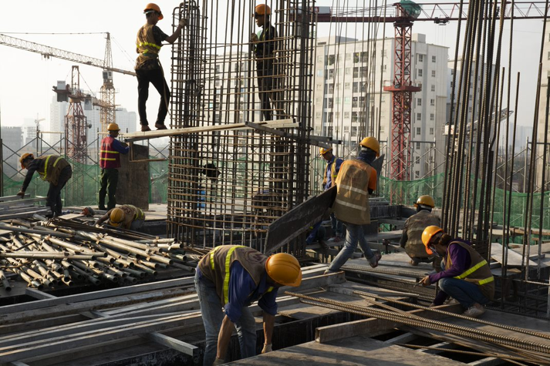
Check barriers are anywhere where you could fall
Use stairs or secure ladders
Wear harness and clip lanyard onto secure point
Keep people out of the area below
44
Notes:
Narration:
Check there are barriers at the edge of anywhere you or materials could fall from
Use stairs or secure ladders to get up and down
Wear your harness and clip your lanyard on a secure point
Keep people out of the area below you.
Now that you know how to work at height safely, we’ll explore what you need to do to work safely on or next to a road in Module 16.
Photo by: © World Bank. Further permission required for reuse.

Slide 45
Copyright
© 2022 International Bank for Reconstruction and Development / The World Bank
1818 H Street NW
Washington DC 20433
Telephone: 202-473-1000
Internet: www.worldbank.org
This work is a product of the staff of The World Bank with external contributions. The findings, interpretations, and conclusions expressed in this work do not necessarily reflect the views of The World Bank, its Board of Executive Directors, or the governments they represent.
The World Bank does not guarantee the accuracy, completeness, or currency of the data included in this work and does not assume responsibility for any errors, omissions, or discrepancies in the information, or liability with respect to the use of or failure to use the information, methods, processes, or conclusions set forth. The boundaries, colors, denominations, and other information shown on any map in this work do not imply any judgment on the part of The World Bank concerning the legal status of any territory or the endorsement or acceptance of such boundaries.
Nothing herein shall constitute or be construed or considered to be a limitation upon or waiver of the privileges and immunities of The World Bank, all of which are specifically reserved.
Rights and Permissions
The material in this work is subject to copyright. Because The World Bank encourages dissemination of its knowledge, this work may be reproduced, in whole or in part, for noncommercial purposes as long as full attribution to this work is given.
Any queries on rights and licenses, including subsidiary rights, should be addressed to World Bank Publications, The World Bank Group, 1818 H Street NW, Washington, DC 20433, USA; fax: 202-522-2625; e-mail: pubrights@worldbank.org.

