Slide 1
MODULE 14
Working in excavations and earthworks
For copyright details see last slide of this PowerPoint presentation
Notes:
Narration: Welcome to Module 14 Working in excavations and earthworks.
Image by: © World Bank

Slide 2
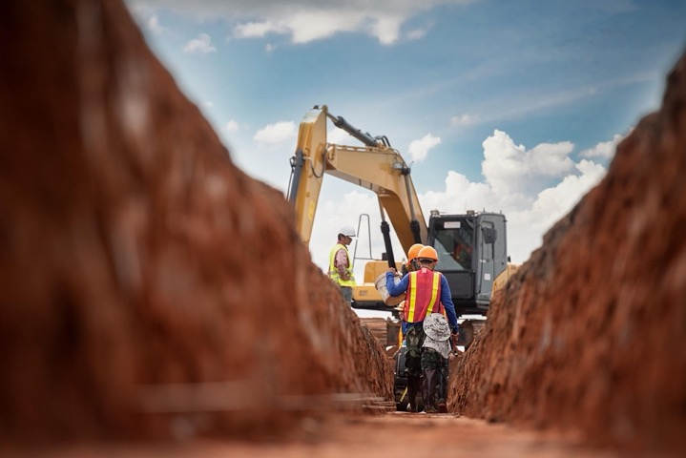
Hazards and risks of excavations and earthworks
Report things found when digging
Recognize good set up for excavations and earthworks
Work in excavations and earthworks safely and look after environment
2
Notes:
Narration: By the end of this module you will be able to:
identify the hazards and risks of working in excavations and earthworks
report things you find when digging
recognize how excavations and earthworks should be set up to keep you and others safe and
work in excavations and earthworks safely and in a way that looks after the environment.
Photo by: Shutterstock.com. Further permission required for reuse.

Slide 3
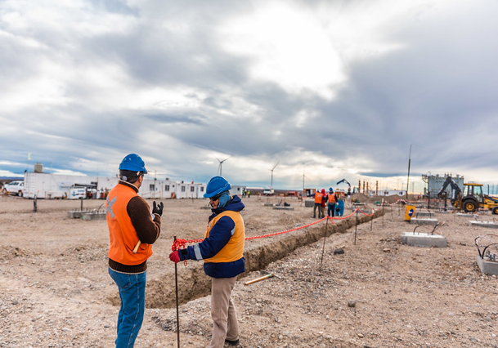
Hazards and risks of working in excavations and earthworks
3
Notes:
Narration: Let’s begin by explaining the hazards and risks of working in excavations and earthworks.
Photo by: © Juan Ignacio Coda/ World Bank. Further permission required for reuse.
​

Slide 4
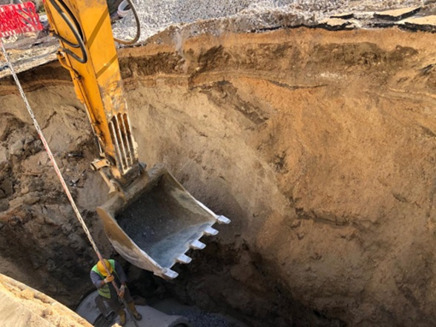
People killed or seriously injured in excavations:
Sides collapse
People, vehicles or materials fall in
Buried pipes and cables hit
Excavation floods and people drown
Earthworks unstable and collapse
4
Notes:
Narration: People are killed or seriously injured in excavations, like ditches and trenches – this might be people working on site or members of the community. It can happen because - the sides of the excavation collapse in and bury people - people, vehicles or materials fall in - buried pipes and cables are hit and broken or - the excavation floods and people drown.
See in this photo how close the excavator bucket is to the worker. If it were much closer, they would be crushed and injured. Earthworks can be unstable, especially if they are too steep and can collapse burying people.
Digging and bare soil often create dust which is not healthy to breathe in and can cause problems for the local community offsite.
Photo by: © Canan Yildiz / World Bank

Slide 5
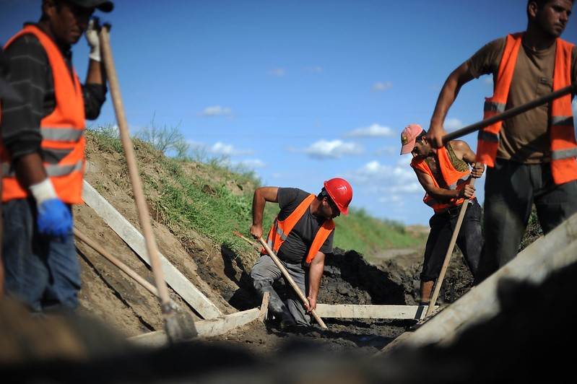
Digging
5
Notes:
Narration: Now we’ll explore the things you need to do when digging on site.
Photo by: © Allison Kwesell / World Bank. Further permission required for reuse.

Slide 6
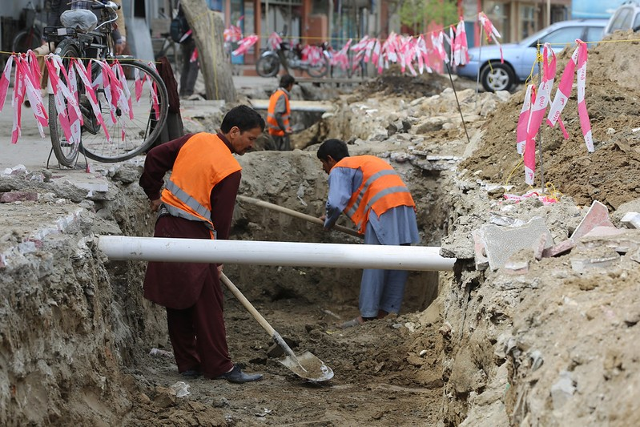
Your Supervisor should tell you if there are buried pipes or cables Dig very carefully using hand tools only
6
Notes:
Narration: Make sure your Supervisor tells you if there are any buried pipes or cables and they should be marked.
These might be gas, water, sewage or oil pipes, or electricity or fiber-optic cables - they can injure you if you cut into them.
If there are any, then dig very carefully using only hand tools.
Here’s an example of a pipe remaining in place as the workers carefully dig around it.
Sometimes buried pipes or cables may have colored tape on top of them to show that there is something below.
Photo by: © ABBAS Farzami / Rumi Consultancy/ World Bank . Further permission required for reuse.

Slide 7
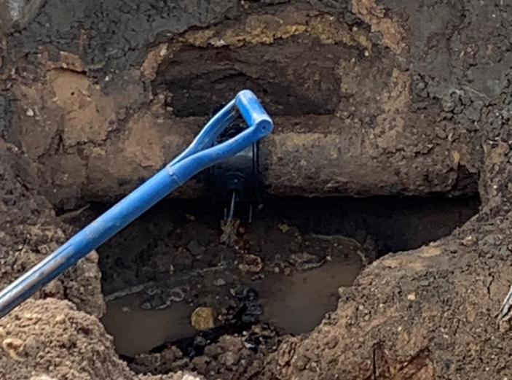
If you accidentally damage a buried pipe or cable, stop and tell your Supervisor
7
Notes:
Narration: Buried pipes or cables can be accidentally damaged when you dig. Signs of this can be bad smells, or water or oil seeping into the excavation.
Here you can see a sewage pipe has been broken by digging and foul water is leaking into the excavation.
Stop work and tell your Supervisor if this happens. It will need to be repaired.
Photo by: © Michael Hall / World Bank

Slide 8
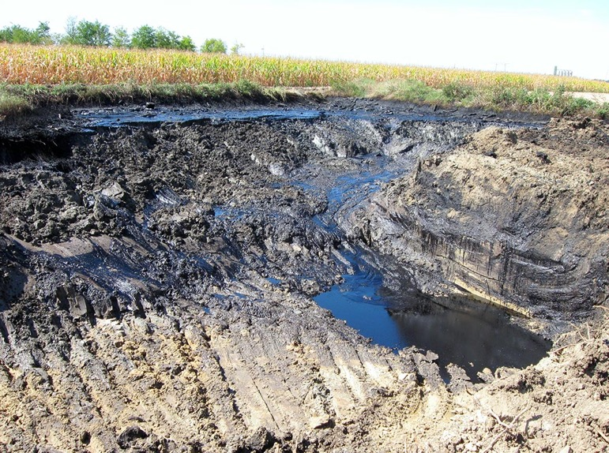
Look for:
Changes in soil color or texture
Strange smells
8
Notes:
Narration: When you’re digging, look for: - Changes in soil color or texture and - Strange smells. These could be signs that the ground has been polluted in the past and might contain hazardous substances that are harmful to you or the environment.
Here you can see the soil is black and oily because of buried oil pollution.
Special measures will need to be put in place before you carry on digging, including special training and extra Personal Protective Equipment PPE.
Photo by: Shutterstock.com

Slide 9
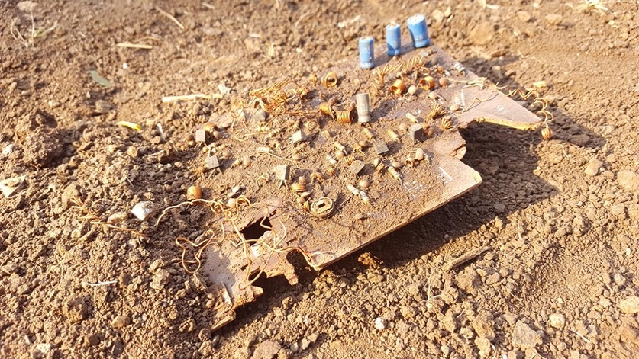
Buried rubbish, drums or tanks
9
Notes:
Narration: Also watch out for
Buried rubbish, like this electronic waste which will contain hazardous substances.
You might also come across old drums or tanks.
Photo by: Shutterstock.com

Slide 10
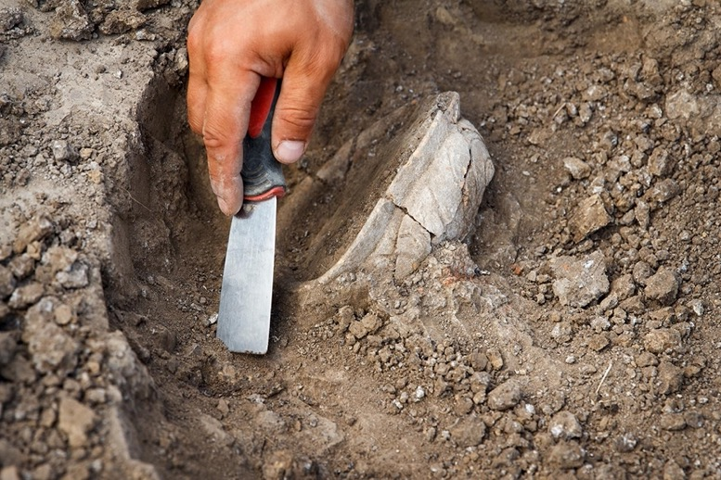
Jewelry, coins, bones, fossils, pottery
Old buildings or structures Stop work and tell your Supervisor if you spot these
10
Notes:
Narration: Watch out for
jewelry, coins, bones, fossils and pottery, such as this ancient pot
And remains of old buildings or structures.
These might be important cultural heritage objects that need to be investigated by a specialist before you carry on.
Leave the objects where they are, stop work and tell your Supervisor.
Photo by: Shutterstock.com
​

Slide 11
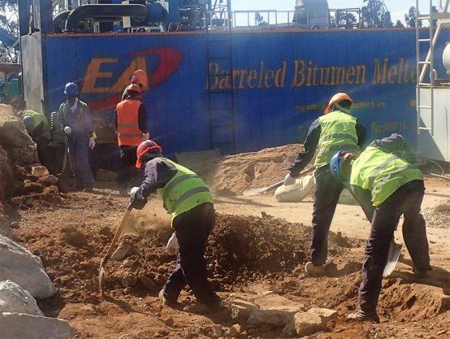
Setting up excavations
11
Notes:
Narration: Next let’s find out how excavations need to be set up so you know what to look out for to stay safe.
Photo by: © Michael Hall / World Bank. Further permission required for reuse.

Slide 12
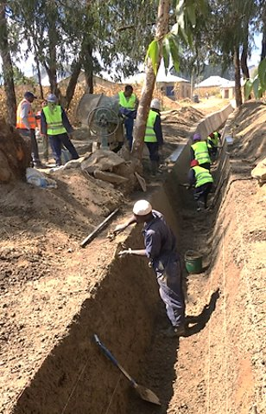
Excavation walls:
Not too steep or supported by props Do not get in - ask your Supervisor first
12
Notes:
Narration: Excavation walls must not be vertical because it’s unsafe – the only exception is in solid rock, then the sides are strong enough to be vertical. Excavation walls should be graded so they are not too steep.
Here you can see that the sides are sloping which makes the walls much more stable. Alternatively, the sides of the excavation can be supported by shoring with wooden or metal props.
If the excavation is not like this, do not get in and tell your Supervisor.
Note to trainer: To make the training more interactive, at the beginning of this slide, ask the workers: “Do you think this excavation is safe to work in?” The answer is “yes”. Ask them “why? What makes this excavation safe?” The answer is in the narration.
Photo by: © Michael Hall / World Bank. Further permission required for reuse.
​

Slide 13
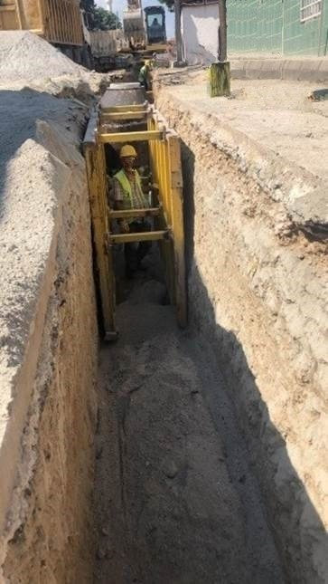
If excavation needs supporting
Put in (and take out) supports from ground level or supported ground
Make sure wooden supports are not damaged or rotten
Check supports are secure and the props tight
13
Notes:
Narration: If the excavation needs supporting with props like in this photo - Only put in (and take out) the supports from ground level or supported ground - If using wooden supports, make sure they are not damaged or rotten as they won’t be strong enough - Check supports are secure and the props are tight.
If the supports are loose or move, do not get in the excavation and tell your Supervisor.
Photo by: © Canan Yildiz / World Bank

Slide 14
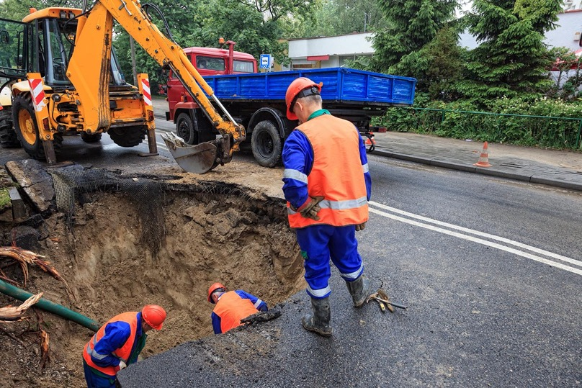
Working in excavations
14
Notes:
Narration: In this section we’ll look at how to work safely in excavations.
Photo by: Shutterstock.com. Further permission required for reuse.

Slide 15
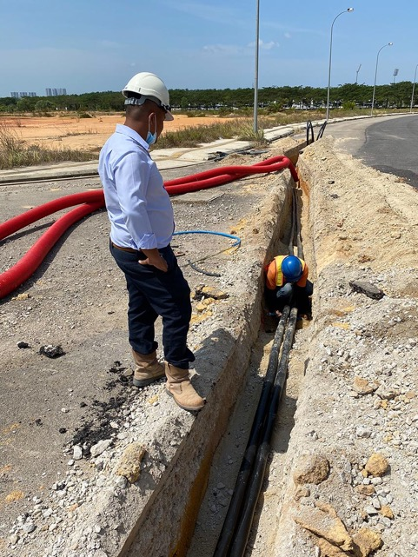
Ask Supervisor if excavation has been checked before you get in Person at ground level observing
15
Notes:
Narration: Ask your Supervisor if the excavation has been checked before you get into it.
An excavation should be inspected several times a day, particularly after it's rained, to make sure it’s still safe.
And there should always be a person at ground level observing all work in excavations – that’s what the worker here is doing.
Photo by: Shutterstock.com. Further permission required for reuse.

Slide 16
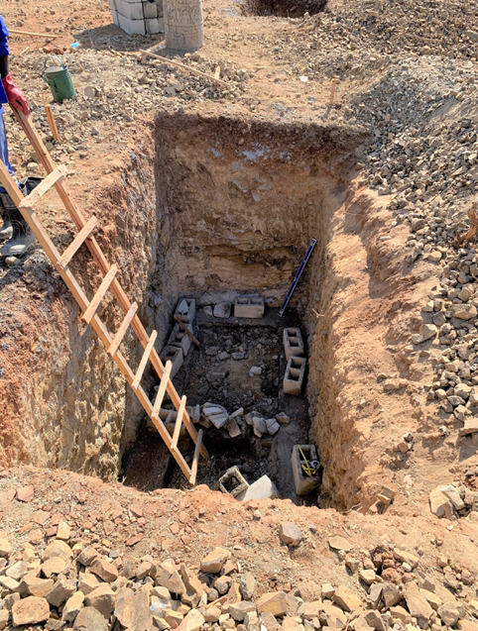
Before you get in, check you can get out quickly and safely:
Gentle slope or
Stairs or
Secured ladder
16
Notes:
Narration: Before you get in, check you can get in and out of excavations quickly and safely via:
- a gentle slope or - stairs or - a secured ladder.
Photo by: © Michael Hall / World Bank

Slide 17
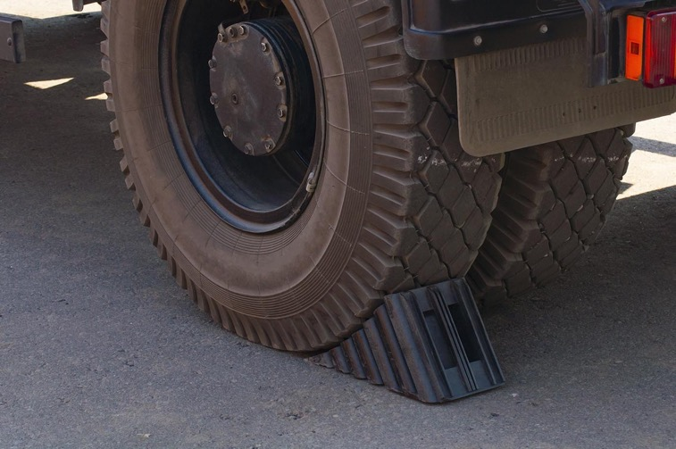
Keep soil and materials at least two paces from edge of excavation Keep vehicles and machines away from edge of excavations Put stop-blocks under wheels
17
Notes:
Narration: The edges of excavations are fragile. Putting things close to the edges can cause the excavation to collapse on top of workers.
To stop this from happening:
Keep soil and materials at least two paces from the edge
Make sure vehicles and machines are kept away from the edge
And put stop-blocks like these under the wheels of dumpers and tipping trucks, to stop them accidentally falling into the excavation on top of workers.
Photo by: Shutterstock.com

Slide 18
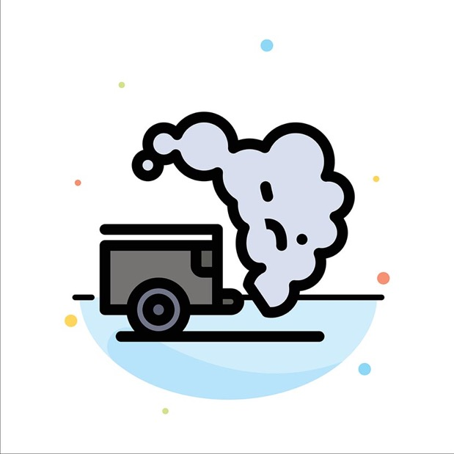
If using a tool or machine in an excavation on fuel or gas, use for little time and turn off when not using If you feel dizzy in excavation, get out straight away and get other people out
18
Notes:
Narration: If you’re using a tool or machine in an excavation that runs on fuel or gas, use it for as little time as possible and turn it off when you are not using it.
The fumes can affect your health.
If you feel dizzy in an excavation, get out straight away and get other people out too.
Gases can build up inside poorly ventilated excavations and make you and other workers seriously ill – or even cause death.
Stop work and tell your Supervisor.
In deep excavations there should be gas monitoring alarms – ask your Supervisor or the Health and Safety Specialist about this.
Image by:​ Shutterstock.com

Slide 19
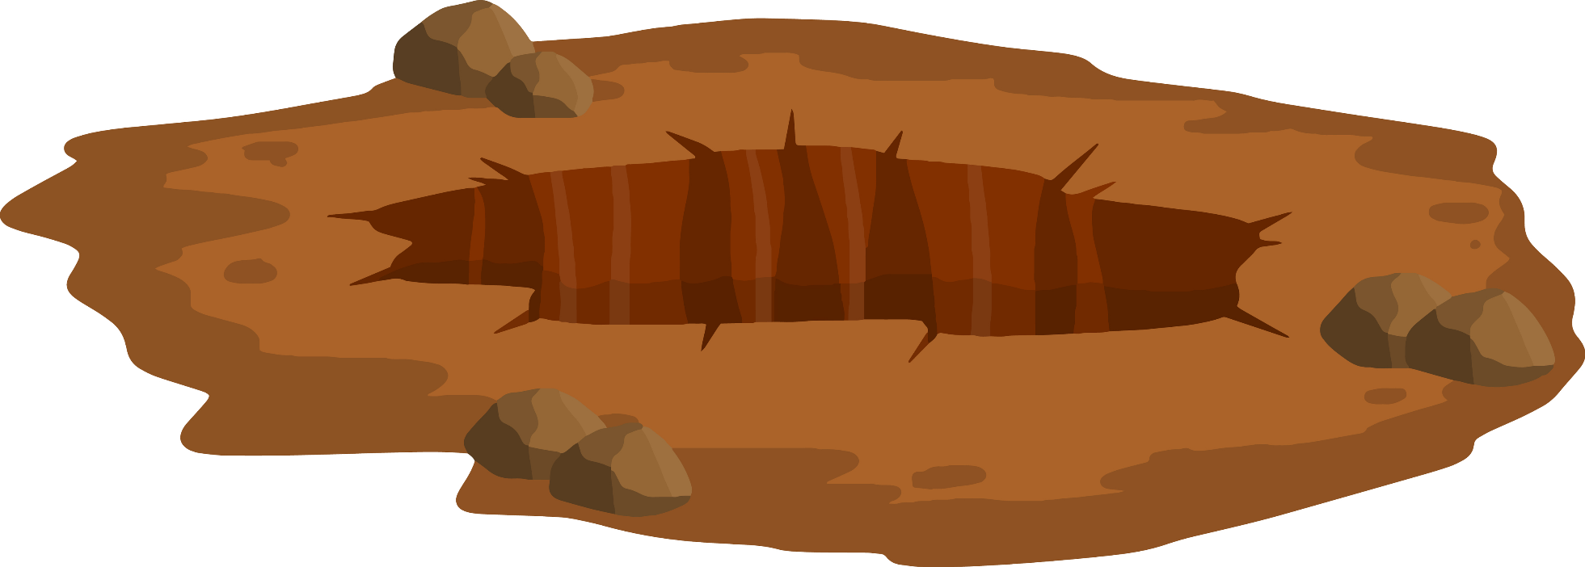
Get out if cracks appear or there is movement at the edge
19
Notes:
Narration: You must also get out of an excavation if you notice cracks appearing or soil moving.
This might be a sign that it is going to collapse.
Get everyone else out too and tell your Supervisor.
Image by:​ Shutterstock.com

Slide 20
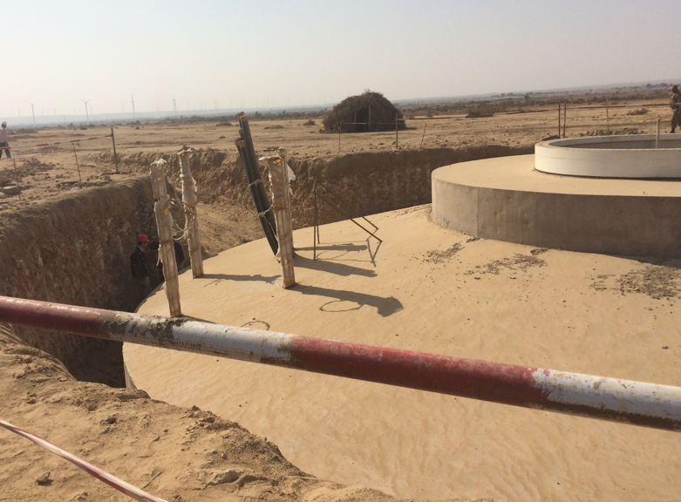
Keep a barrier, fence or guard rails around excavations
20
Notes:
Narration: Put a barrier, fence or guard rails around excavations at all times to stop vehicles, materials and people falling in.
You can see the red and white barrier around this excavation.
Photo by: © Jack Mozingo / World Bank

Slide 21
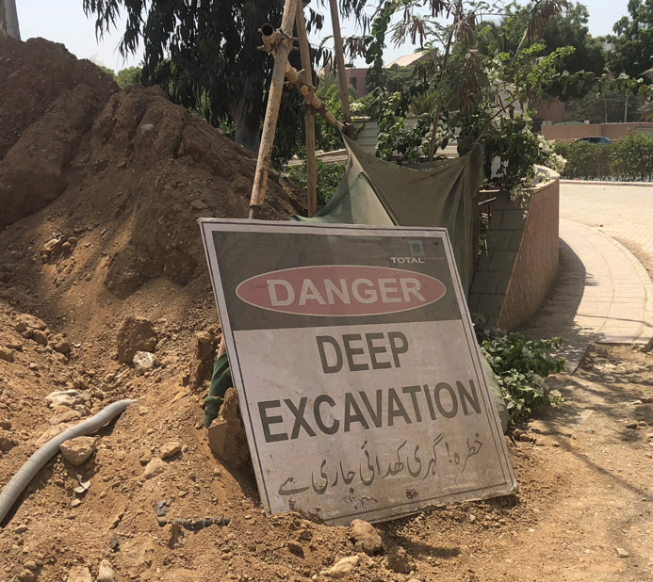
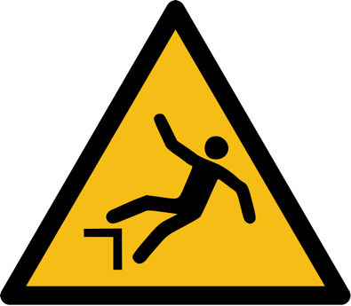
Put warning signs and lights around excavations
21
Notes:
Narration: Put up warning signs – like these – to tell people that there is a hole in the ground so they don’t fall in.
Make sure the excavation can be seen easily, especially by the community.
Put up lights for when it’s dark so everyone can find their way safely.
Photo by: © Jack Mozingo / World Bank
Image by: https://en.wikipedia.org/wiki/ISO_7010, public domain.

Slide 22
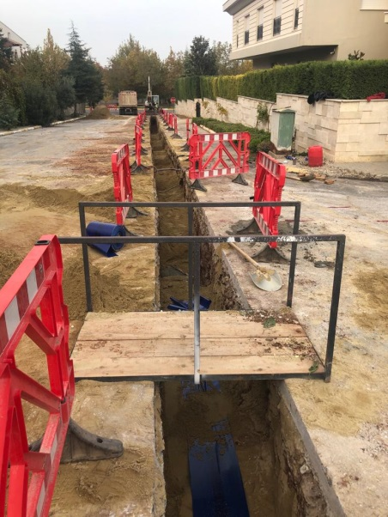
Bridges and gangways across access should have guardrails and toe boards
22
Notes:
Narration: When access is needed across excavations put bridges and gangways across, with guardrails and toe boards.
Here’s an example which allows the community to get across the trench to their homes on the right.
Photo by: © Canan Yildiz / World Bank

Slide 23
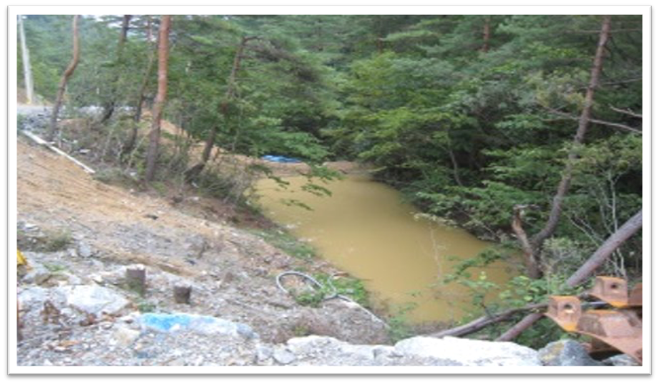
Dealing with water
Notes:
Narration: Next we’ll look at dealing with water in excavations and earthworks.
Excavations can fill up with rainwater or groundwater. Workers and members of the community have drowned in this water when they accidentally fell into excavations.
Rainwater that falls on earthworks can wash away valuable soil that is needed for growing crops.
Water can also cause problems by flooding the site or running through the local community, damaging their homes and businesses.
And silty water can contaminate drinking water and pollute rivers, lakes and the sea even killing wildlife, like fish.
Photo by: © Dohwa Engineering Co Ltd / World Bank

Slide 24
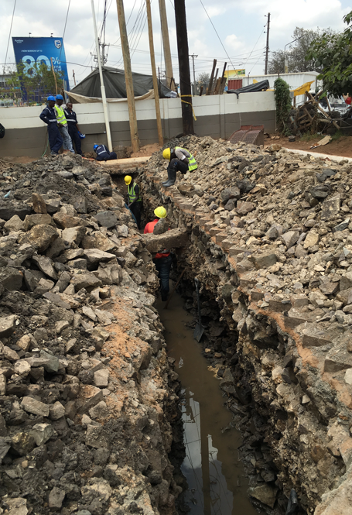
Do not get into an excavation if it contains water
Water needs to be pumped out
24
Notes:
Narration: Do not get into an excavation if it contains water.
The water needs to be pumped out before anyone gets in.
Photo by: © Michael Hall / World Bank

Slide 25
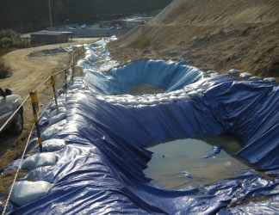
Pump into settlement tank or pond
Discharge only clear water to ground
Water should soak into the ground, not run over ground
Never pump silty water into wetlands, marshlands, streams, rivers, lakes, ponds or the sea
25
Notes:
Narration: Pump the water into a settlement tank or pond, like this one, provided it is not already full.
Leave it for some time to allow the silt to sink to the bottom.
Then pump out only clear water and let it soak into the ground.
Always make sure it is soaking in, not running across the ground’s surface.
Never pump silty water into wetlands, marshlands, streams, rivers, lakes, ponds or the sea.
It’s quicker and easier to stop water from getting into excavations - slope the ground next to the excavation so that rainwater drains away.
Photo by: © Dohwa Engineering Co Ltd / World Bank

Slide 26
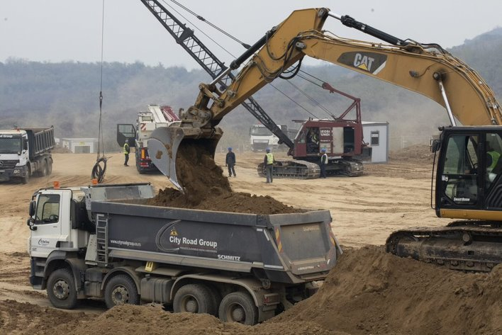
Working on earthworks
26
Notes:
Narration: Now let’s see how you can stay safe and protect the environment when working on earthworks like stockpiles, cuttings and embankments.
Photo by: © World Bank

Slide 27
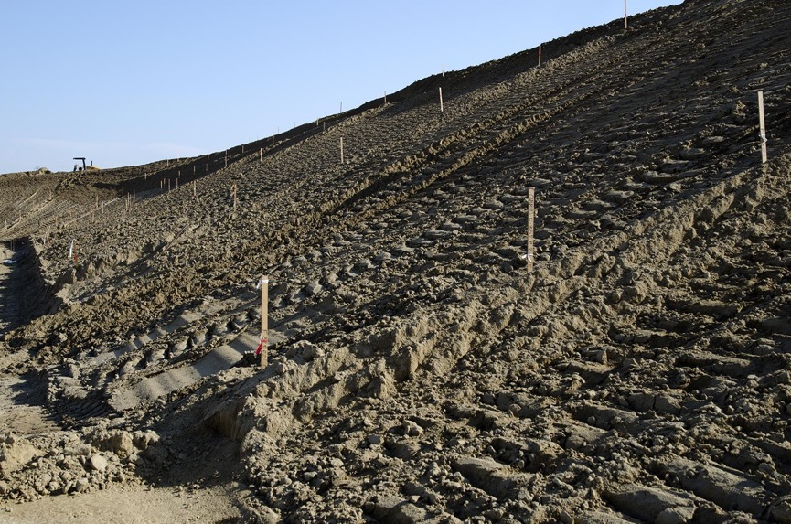
Slopes gentle - not too steep
27
Notes:
Narration: If slopes are too steep they are not stable, and liable to collapse causing an accident.
So make sure slopes are gentle. If they aren’t tell your Supervisor.
Photo by: Shutterstock.com

Slide 28
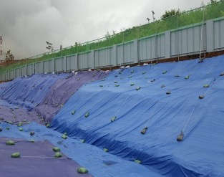
Stockpiles away from drainage ditches Stockpiles and bare earth covered
28
Notes:
Narration: Put stockpiles away from drainage ditches – the stockpile could get washed away in the rain and block the ditch.
Keep soil stockpiles and bare earth covered (or they can be grassed over) to stop them creating dust and washing away in the rain.
Here’s an example of an embankment that has been covered to protect the soil.
Photo by: © Dohwa Engineering Co Ltd / World Bank

Slide 29
Notes:
Narration: Now we’ll finish this module with 5 key things to remember.
Image by: © World Bank

Slide 30
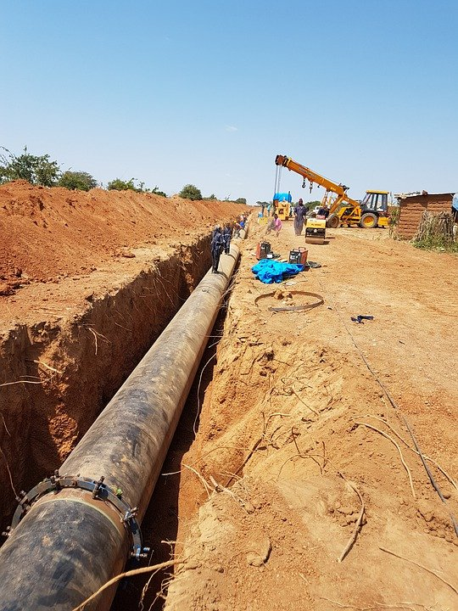
Stop work if find anything buried
Only get into an excavation if it has been inspected
Get out of excavation if dizzy, unwell, see cracks or movement
Put barriers, signs and lights around excavations
Pump water out of excavation before you get in
30
Notes:
Narration:
Stop work if you find anything buried in the ground, like pipes or cables.
Only get into an excavation if it has been inspected.
Get out of an excavation if you feel dizzy or unwell, or see cracks or movement.
Put barriers, signs and lights around excavations to stop people falling in.
Pump water out of an excavation before anyone gets in.
Now that you know the right way to work in excavations and earthworks, let’s look at safe ways of working at height in Module 15.
Photo by: sanviacc88 on Pixabay, https://pixabay.com/photos/pipeline-site-excavation-dig-5467530

Slide 31
Copyright
© 2022 International Bank for Reconstruction and Development / The World Bank
1818 H Street NW
Washington DC 20433
Telephone: 202-473-1000
Internet: www.worldbank.org
This work is a product of the staff of The World Bank with external contributions. The findings, interpretations, and conclusions expressed in this work do not necessarily reflect the views of The World Bank, its Board of Executive Directors, or the governments they represent.
The World Bank does not guarantee the accuracy, completeness, or currency of the data included in this work and does not assume responsibility for any errors, omissions, or discrepancies in the information, or liability with respect to the use of or failure to use the information, methods, processes, or conclusions set forth. The boundaries, colors, denominations, and other information shown on any map in this work do not imply any judgment on the part of The World Bank concerning the legal status of any territory or the endorsement or acceptance of such boundaries.
Nothing herein shall constitute or be construed or considered to be a limitation upon or waiver of the privileges and immunities of The World Bank, all of which are specifically reserved.
Rights and Permissions
The material in this work is subject to copyright. Because The World Bank encourages dissemination of its knowledge, this work may be reproduced, in whole or in part, for noncommercial purposes as long as full attribution to this work is given.
Any queries on rights and licenses, including subsidiary rights, should be addressed to World Bank Publications, The World Bank Group, 1818 H Street NW, Washington, DC 20433, USA; fax: 202-522-2625; e-mail: pubrights@worldbank.org.

