Slide 1
MODULE 13
Using electricity and electric tools
For copyright details see last slide of this PowerPoint presentation
Notes:
Narration: Welcome to Module 13 Using electricity and electric tools.
This module covers using electrical equipment.
You must not install, maintain or repair anything electrical – such work must only be done by a qualified electrician.
Image by: © World Bank

Slide 2
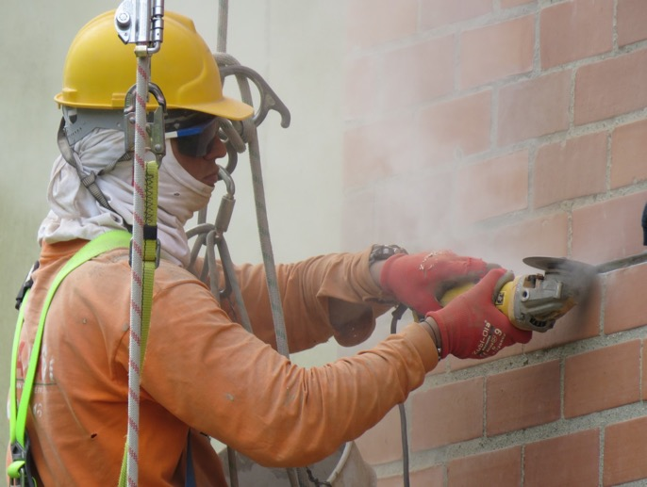
Hazards and risks from electricity and electric tools
Recognize how electricity and cables are set up
Use electric tools safely
2
Notes:
Narration: By the end of this module you will be able to:
identify the hazards and risks from using electricity and electric tools
recognize how electricity and cables should be set up to keep you and others safe and
use electric tools safely.
Photo by: Esteban Espinal on Pxhere, Creative Commons CC0, https://pxhere.com/en/photo/1603237. Further permission required for reuse.

Slide 3
Hazards and risks of using electricity and electric tools
3
Notes:
Narration: Let’s begin by looking at the hazards and risks of using electricity and electric tools.
Photo by: Shutterstock.com. Further permission required for reuse.

Slide 4
Electric shock
Breathing, heart and muscles
Severe burns
Start fires or explosions
4
Notes:
Narration: Electricity can electrocute people and this is a big cause of deaths and injuries on construction sites.
It can give you an electric shock and this can make breathing difficult and even stop the heart beating.
It can affect muscles and throw a person – this can be especially dangerous on site where it could cause a fall from height or into the path of vehicles or machines.
It can also cause severe burns.
Sparks can start fires or cause explosions if there are flammable substances present, like fuel.
Water makes electricity even more dangerous as it makes it more likely that the electricity would go through you giving you a severe shock.
This yellow triangle sign reminds you that there is an electricity hazard and you need to take extra care.
Photo by: Shutterstock.com. Further permission required for reuse.
Image by: https://en.wikipedia.org/wiki/ISO_7010, public domain.

Slide 5
Using electricity
5
Notes:
Narration: Next we’ll explain key things you need to check and do to make sure the electricity you use is safe.
Photo by: ​ Shutterstock.com

Slide 6
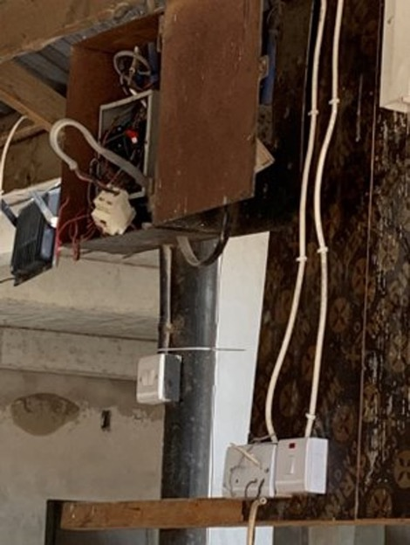
Cables must be connected into the right place by qualified electrician
6
Notes:
Narration: First let’s find out how cables need to be set up so you know what to look out for to stay safe.
Cables should have been connected into the right place by a qualified electrician.
This cable has been wired up to a light socket which is very dangerous.
Photo by: © Michael Hall / World Bank

Slide 7
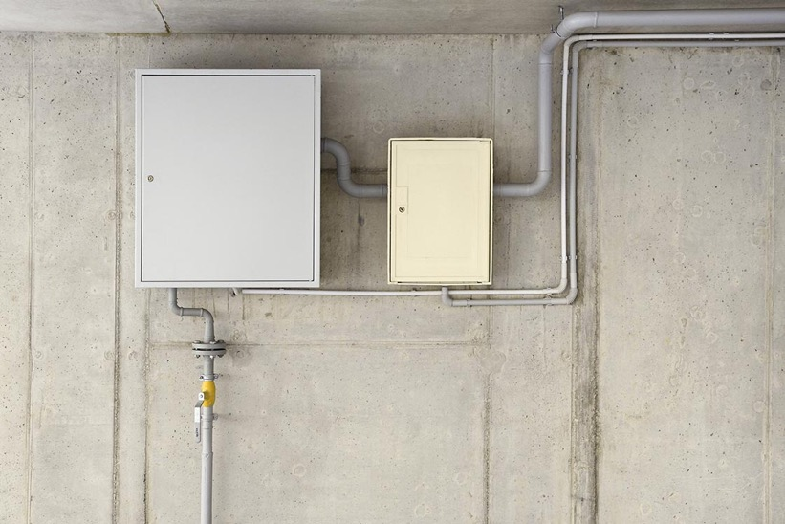
Cables connected into closed boxes
7
Notes:
Narration: Cables should have been connected to a closed electric box like this.
Photo by: Shutterstock.com

Slide 8
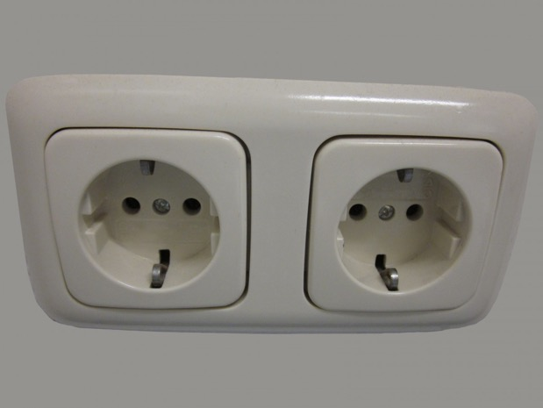
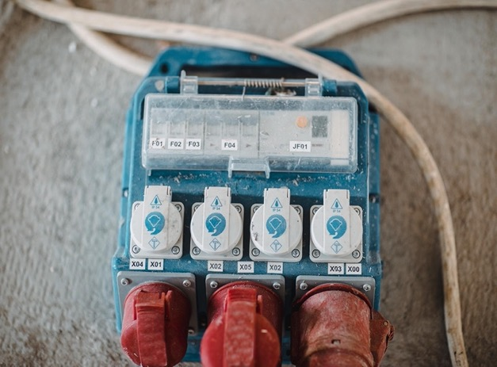
Cables connected into sockets
8
Notes:
Narration: Or a socket like these.
Do not use cables that have not been properly connected – tell your Supervisor.
Photos by: 1. Socket: Pxhere, Creative Commons CC0, https://pxhere.com/en/photo/996633
2. Industrial socket: Shutterstock.com

Slide 9
Cables shielded
9
Notes:
Narration: Only use cables that are shielded. This means that there is an outer layer of plastic covering all the internal wires, like the black shielding in this picture.
Photo by: ​Shutterstock.com

Slide 10
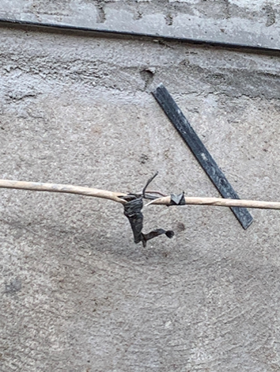
Do not use cable if damaged
10
Notes:
Narration: Don’t use a cable if it’s damaged and there are any wires showing - which could be if it is bare, cut, frayed like this one or if it has tape wrapped around it.
Photo by:​ © Michael Hall / World Bank
​

Slide 11
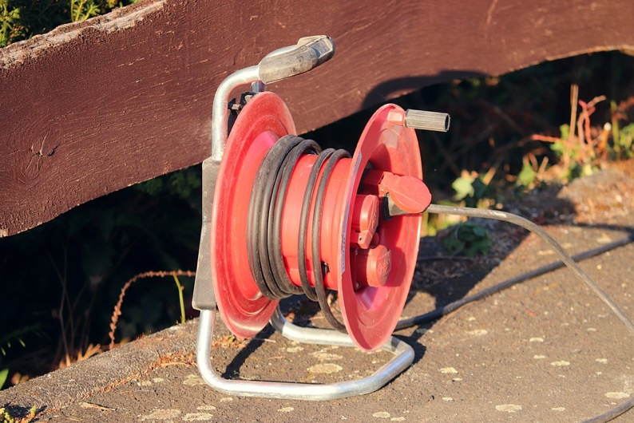
Use nearest power socket Extension cable:
don’t join cables
use one that is long enough
unwind the whole cable
11
Notes:
Narration: Use the nearest power socket so that electric equipment can be disconnected quickly in an emergency and so that there is the minimal amount of cable trailing.
Use an extension cable – don’t join cables together.
Cables should only be joined by a qualified electrician.
Only plug an extension lead into a wall socket – not into another extension lead.
Make sure the extension cable is long enough so it is not straining which would damage the cable.
Unwind the whole cable so that it does not overheat and risk causing a fire.
Photo by: manfredrichter on Pixabay, https://pixabay.com/photos/cable-reel-electrical-wires-cable-6159639/ ​

Slide 12
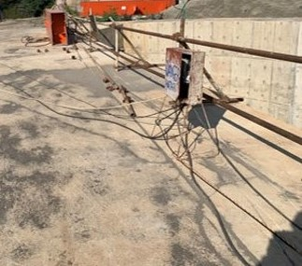
Cables must be kept out of the way
12
Notes:
Narration: Cables must be kept out of the way of people and protected from damage. If they are trailing on the ground like this.
Note to trainer: To make the training more interactive, at the beginning of this slide, ask the workers: “Do you think this cable is in a safe place?” The answer is “no”. Ask them “where should they be?” The answer is in the narration.
Photo by: © Michael Hall / World Bank

Slide 13
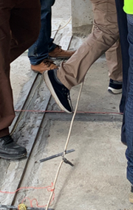
Hang cables up above head height over doorways and walkways
13
Notes:
Narration: Then people can trip over them like in this photo and get injured or even receive an electric shock.
Hang them up above head height and over doorways and walkways.
Photo by: © Michael Hall / World Bank
​

Slide 14
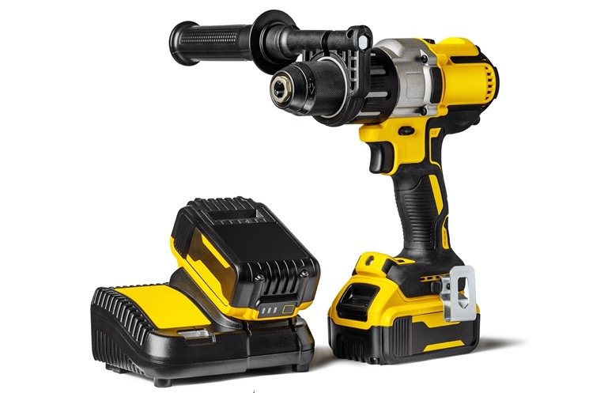
Batteries
Don’t use a damaged battery or one that has been dropped
Never tamper with them
Unplug chargers and remove battery once charged
Store battery proper place
Do not allow battery to heat up
14
Notes:
Narration: If tools are powered by batteries: - don’t use a battery that has been dropped or is damaged - never tamper with a battery - unplug battery chargers and remove the battery once it’s charged - store the battery in the proper place – somewhere cool and dry
- do not allow the battery to heat up, for example by leaving it in the sun or by a heater – it may explode.
Photo by: ​ Shutterstock.com

Slide 15
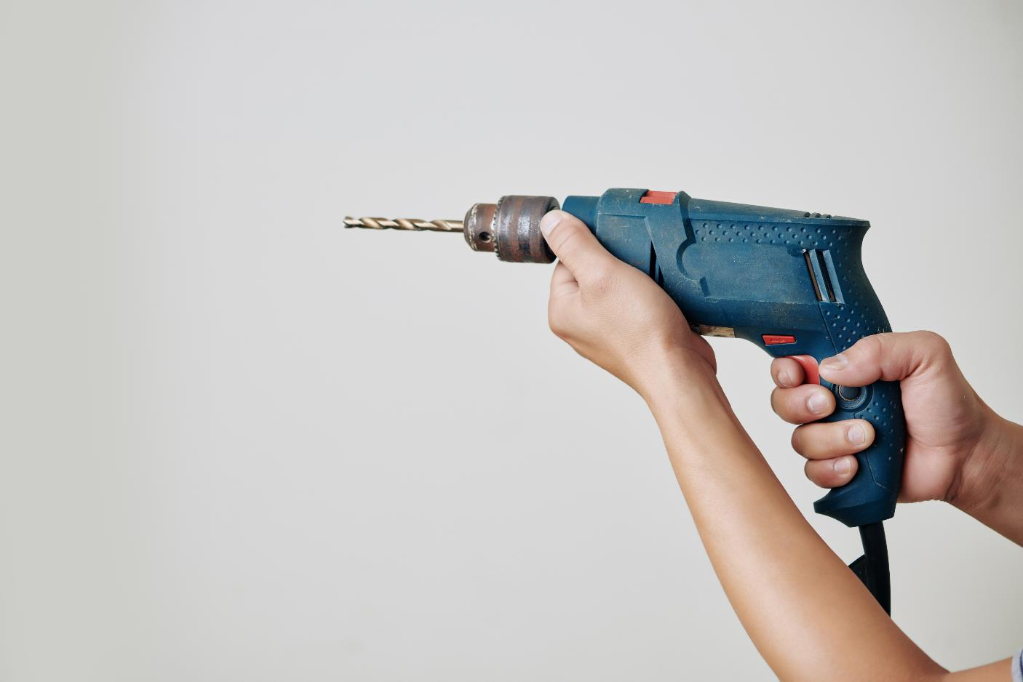
Using electric tools
15
Notes:
Narration: Now let’s find out how to use electric tools safely.
Photo by: Shutterstock.com

Slide 16
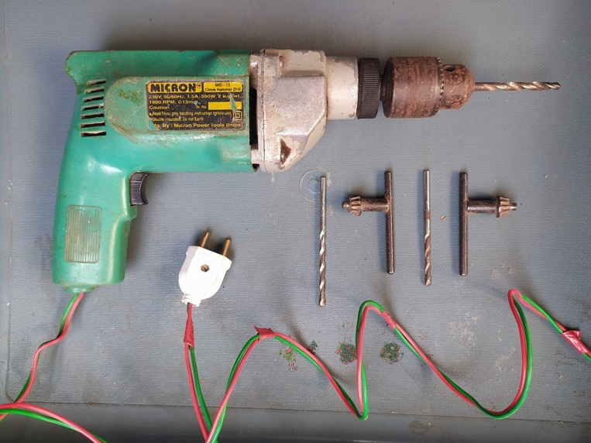
Check tool before use:
Not damaged
Inspected recently
Cable shielded
Cable secure in tool and plug
16
Notes:
Narration: Check every tool before you use it and only use it if it: - is not damaged - if it has cracks or pieces missing from the casing it may be dangerous. Check any screws are tight.
make sure it has been inspected recently – there should be a tag on the tool showing the date it was inspected
check the cable is shielded – you should not use this tool as the cable is not shielded and you can see the bare red and green wires
and make sure the cable fits securely into the tool and the plug and is not loose.
Photo by: Shim on Pixahive, Creative Commons CC0, https://pixahive.com/photo/an-electric-drill-machine-and-bits

Slide 17
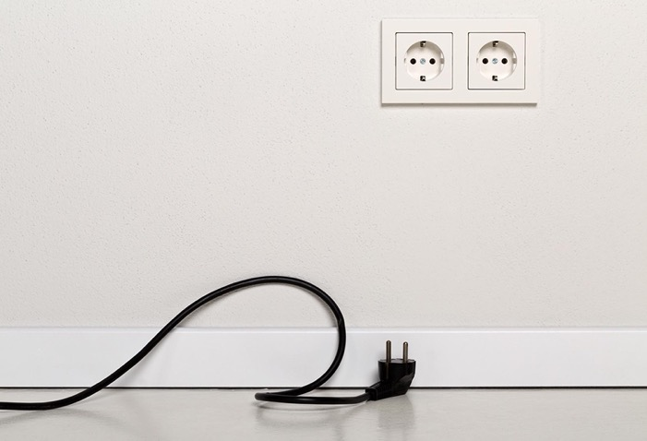
Don’t carry tools by their cable
Don’t start or stop a tool when it is under load Disconnect tool from power before adjusting and when not using
17
Notes:
Narration: Don’t’ carry tools by their cable as it can pull the cable out of the tool.
Don’t start or stop a tool when it is under load. And disconnect a tool from the power supply before you adjust it and when you are not using it.
Photo by: Shutterstock.com

Slide 18
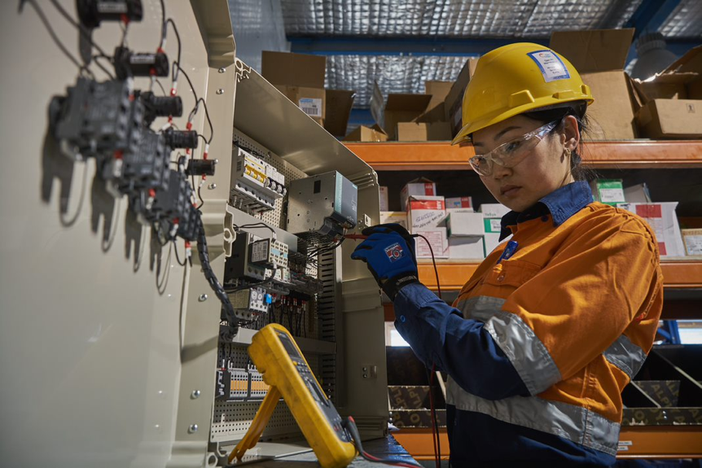
If it cuts out, switch off the power and get it checked by electrician
18
Notes:
Narration: If you are using a tool and it cuts out, switch off the power and get it checked by an electrician.
Photo by: ​ © World Bank. Further permission required for reuse.

Slide 19
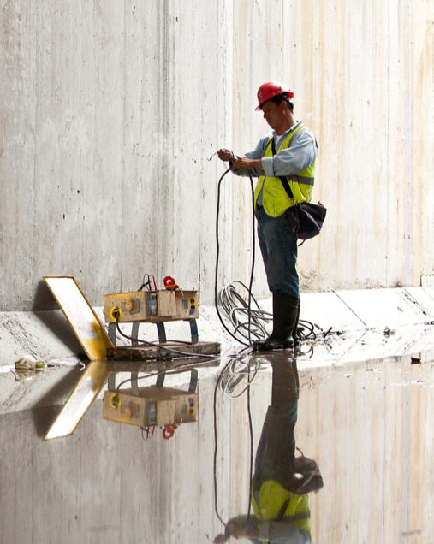
Don’t stand on damp or wet surface when using electric tools or equipment
19
Notes:
Narration: Don’t stand on a damp or wet surface when using an electric tool or equipment like this worker is – it’s not safe.
Photo by: © Gerardo Pesantez / World Bank. Further permission required for reuse.

Slide 20
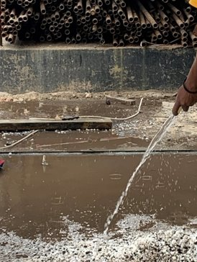
Keep anything electric away from water
20
Notes:
Narration: Keep anything electric away from water.
Here you can see water pouring onto the ground and there is an electricity cable by the wall – this is not safe and the cable should be moved.
Photo by: © Michael Hall / World Bank

Slide 21
21
Notes:
Narration: Now we’ll finish this module with four key things to remember.
Image by: © World Bank

Slide 22
Check tools, cables, plugs and sockets before use
Keep cables above head height
Keep cables and electric tools away from water
Turn off power when checking or adjusting
22
Notes:
Narration: 1. Check tools, cables, plugs and sockets before you use them – make sure they are in good condition
2. Hang cables at head height to keep them out of the way
3. Keep cables and electric tools away from water
4. Turn off the power when checking or adjusting tools.
Now that you know how to use electricity and electric tools safely, we’ll find out the right way to work in excavations and earthworks in Module 14.
Photo by: Shutterstock.com

Slide 23
Copyright
© 2022 International Bank for Reconstruction and Development / The World Bank
1818 H Street NW
Washington DC 20433
Telephone: 202-473-1000
Internet: www.worldbank.org
This work is a product of the staff of The World Bank with external contributions. The findings, interpretations, and conclusions expressed in this work do not necessarily reflect the views of The World Bank, its Board of Executive Directors, or the governments they represent.
The World Bank does not guarantee the accuracy, completeness, or currency of the data included in this work and does not assume responsibility for any errors, omissions, or discrepancies in the information, or liability with respect to the use of or failure to use the information, methods, processes, or conclusions set forth. The boundaries, colors, denominations, and other information shown on any map in this work do not imply any judgment on the part of The World Bank concerning the legal status of any territory or the endorsement or acceptance of such boundaries.
Nothing herein shall constitute or be construed or considered to be a limitation upon or waiver of the privileges and immunities of The World Bank, all of which are specifically reserved.
Rights and Permissions
The material in this work is subject to copyright. Because The World Bank encourages dissemination of its knowledge, this work may be reproduced, in whole or in part, for noncommercial purposes as long as full attribution to this work is given.
Any queries on rights and licenses, including subsidiary rights, should be addressed to World Bank Publications, The World Bank Group, 1818 H Street NW, Washington, DC 20433, USA; fax: 202-522-2625; e-mail: pubrights@worldbank.org.

