Slide 1
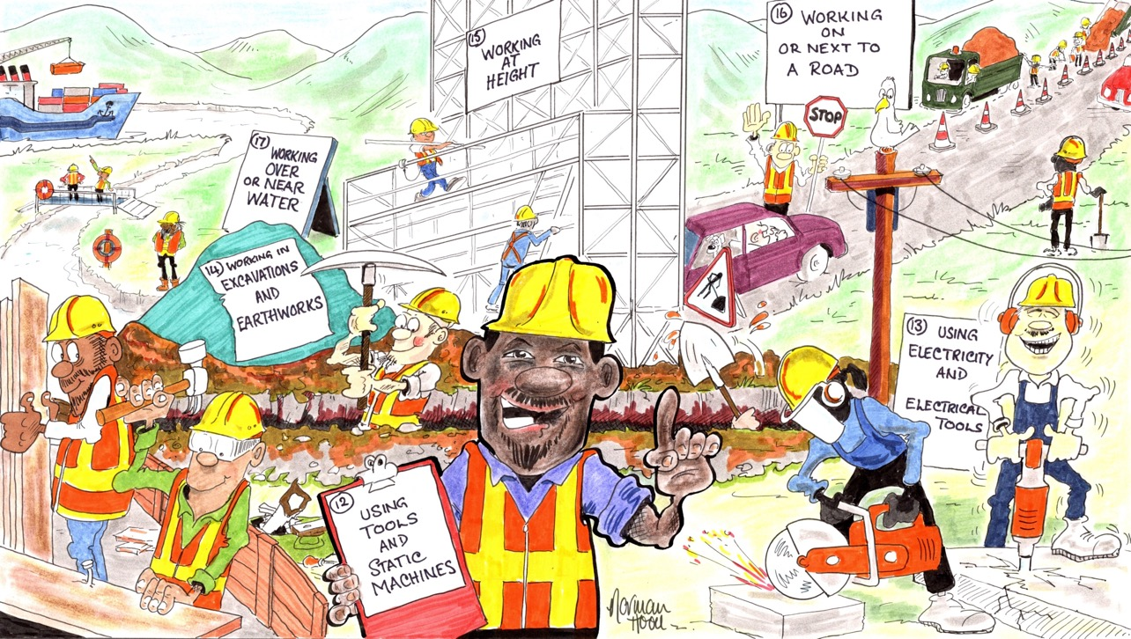
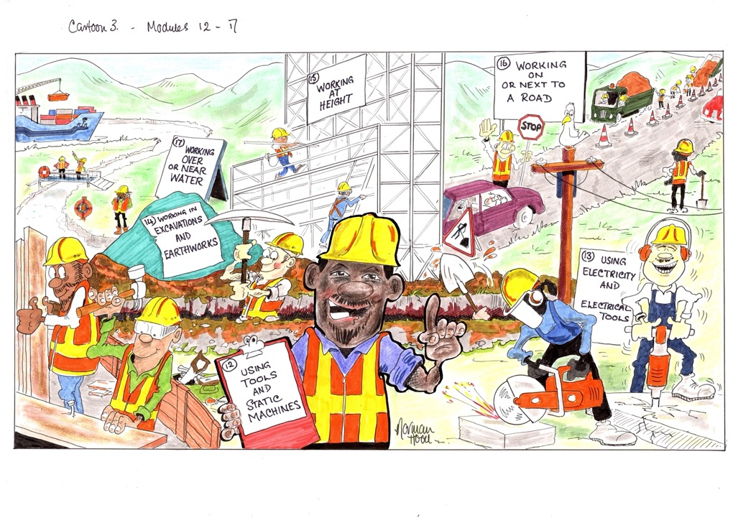
MODULES 12-17 • SPECIFIC ACTIVITIES
Notes:
Narration: Welcome to the third section of the general induction which covers what you need to do when carrying out specific activities. We’ll look at:
Using tools and static machines
Using electricity and electric tools
Working in excavations and earthworks
Working at height
Working on or next to a road and
Working over or near water.
Image by: © Norman Hood / World Bank

Slide 2
MODULE 12
Using tools and static machines
For copyright details see last slide of this PowerPoint presentation
Notes:
Narration: Let’s begin the third section with Module 12 Using tools and static machines.
A static machine is a machine that stays in one place when it is being operated, like a table saw or a crusher.
This module explains how to use hand tools, power tools and static machines safely and in a way that protects the environment.
Image by: © World Bank

Slide 3
Hazards and risks from tools and static machines
Recognize whether a tool is safe
Locate safety controls
How to use tools and static machines
3
Notes:
Narration: By the end of this module you will be able to:
identify the hazards and risks from using tools and static machines
recognize whether a tool is safe to use
locate the safety controls and
use tools and static machines in a way that is safe for you and others and protects the environment.
Photo by: Pxhere, Creative Commons CC0,​ https://pxhere.com/en/photo/749546​. Further permission required for reuse.

Slide 4
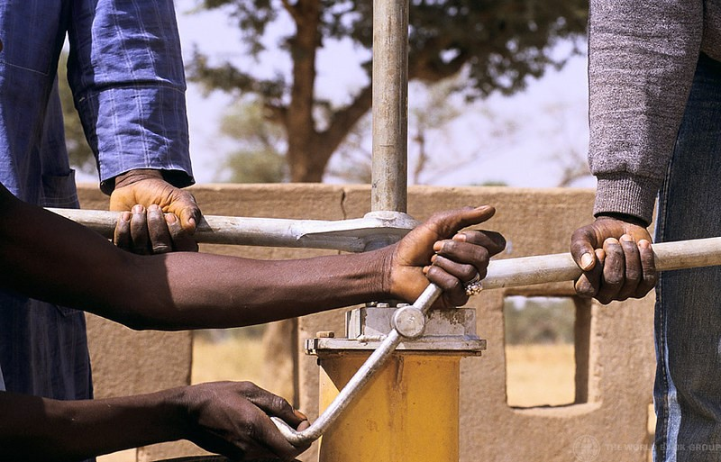
Hazards and risks of using tools and static machines
4
Notes:
Narration: Let’s begin by exploring the hazards and risks of using tools and static machines.
Photo by: © Curt Carnemark / World Bank

Slide 5
Cuts
Crushed body parts
Loss of limbs
Damage to nerves
Pollution of environment
5
Notes:
Narration: Many injuries happen on site from the incorrect use of tools and static machines.
Hazards include cuts, getting body parts stuck in machines and crushed, and damage to nerves from too much vibration.
Plus oils and fuels inside tools and machines can leak causing pollution of the environment.
Knowing the best way to use them will help to keep you and others safe and prevent pollution.
Photo by: Shutterstock.com
​

Slide 6
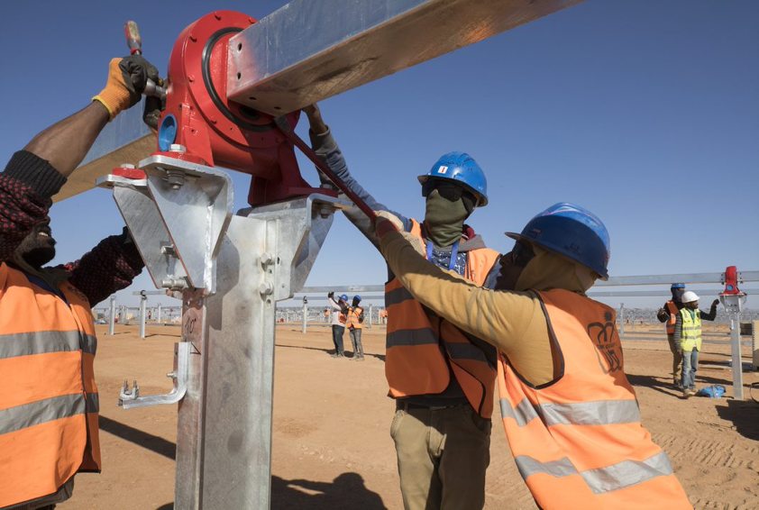
Using all types of tools and static machines
6
Notes:
Narration: Now let’s look at what you need to do when using all types of tools – that’s hand tools and also static machines.
Photo by: © World Bank

Slide 7
Extra Personal Protective Equipment - PPE
Notes:
Narration: When you are using some tools you will need to wear extra Personal Protective Equipment PPE, such as:
gloves for using a tool that could cut your hands
safety glasses, goggles or a full-face shield for a dusty job or if pieces or sparks might fly through the air and hit your face or eye, such as when cutting steel or removing old paint.
If you wear glasses, you still need to wear safety glasses or googles as well.
Images by: ISO 7010 https://en.wikipedia.org/wiki/ISO_7010, public domain
Photos by: Shutterstock.com. Further permission required for reuse.

Slide 8
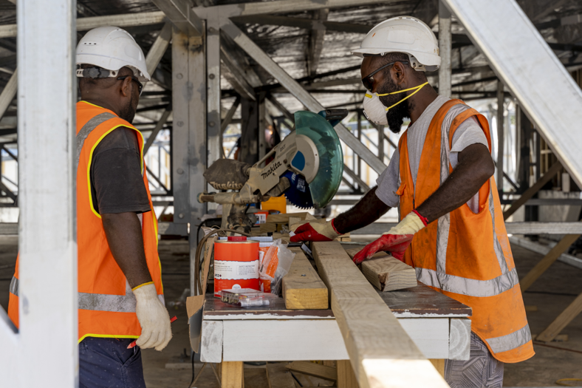
Trained on how to use each tool and machine
8
Notes:
Narration: Make sure you are fully trained on how to use each type of tool and machine safely.
They are all different and you need to have this explained to you before you begin.
Photo by: © World Bank​. Further permission required for reuse.
​

Slide 9
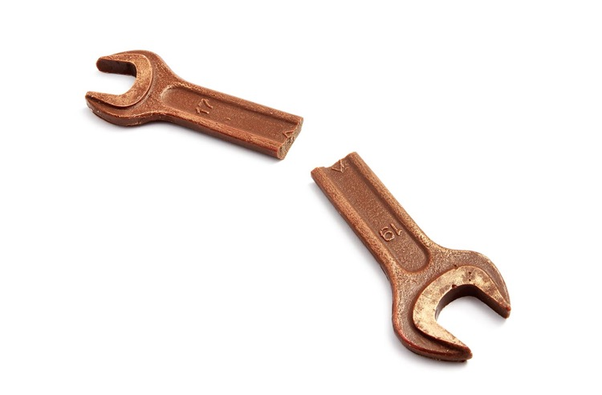
Right tool or machine for the job
Check tools and machines before each use
Do not use if they are damaged
Keep the edges of cutting tools sharp
9
Notes:
Narration: Always choose the right tool or machine for the job – do not try to make do with something that isn’t right as that's when injuries often happen. Check tools and machines every time before you use them to make sure they are not damaged – if they are, do not use them.
And don’t use a tool if the handle is split.
Don’t try to do repairs yourself, for example by using tape, as this is not strong enough.
Get damaged tools or machines repaired by a trained person.
Keep the edges of cutting tools sharp.
This means you need to use less pressure so it’s less likely to slip and cut you.
Note to trainer:
To make the training more interactive, ask the workers: “What you need to do before you use a tool or machine?” The answer is: Check tools and machines every time before you use them to make sure they are not damaged.
Photo by: Shutterstock.com

Slide 10
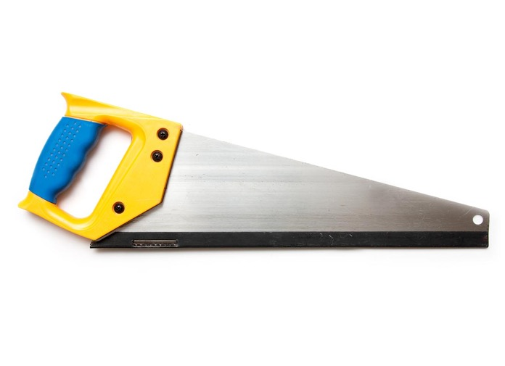
Use tools away from other people Protect sharp edges of tools when carrying or leaving in store
10
Notes:
Narration: Use tools as far away from other people as you can.
For example, cut metal away from other people and flammable materials like wood.
This is because when you cut metal, sparks can fly up and go in someone's eye or cause a fire.
Protect sharp edges of tools when you carry or store them so they cannot accidently cut you or someone else.
See how this saw has a blade guard to put on when it’s not being used.
Photo by: Shutterstock.com

Slide 11
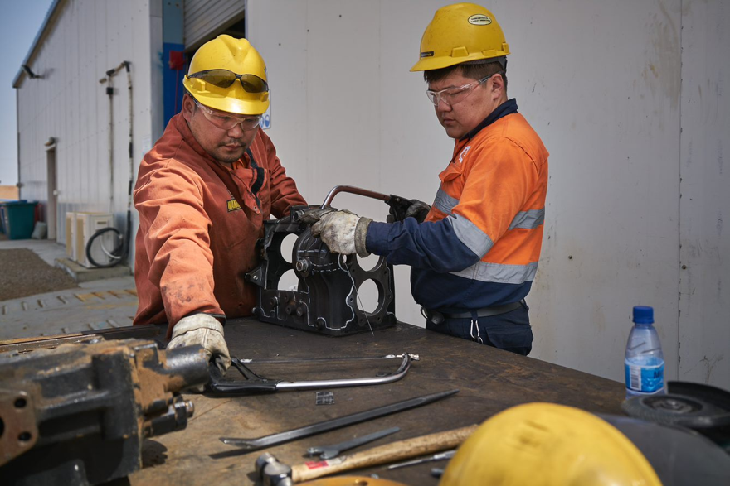
Using hand tools
11
Notes:
Narration: Next we’ll look at some of the safest ways of using hand tools.
Photo by: © World Bank. Further permission required for reuse.

Slide 12
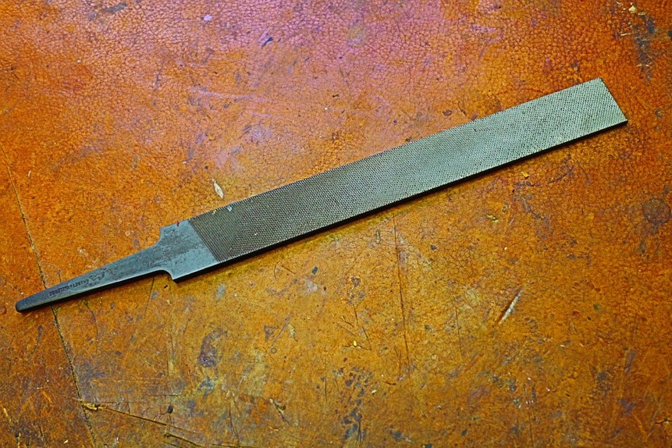
Only use tools with handles
12
Notes:
Narration: Use tools with handles – don't use a tool without a handle.
Photo by: Baohm on Pixabay, https://pixabay.com/photos/file-tool-metal-handwork-craft-534178/

Slide 13
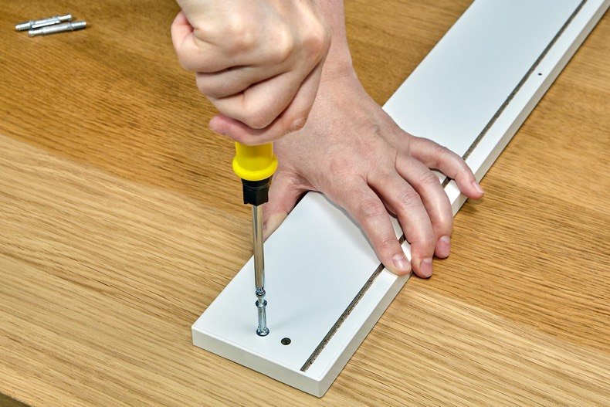
Screwdriver: Work on a hard surface Do not use as a chisel
13
Notes:
Narration: When using a screwdriver put the work on a hard surface, like the floor or a workbench.
Do not use a screwdriver on work held in your hand – it can easily puncture your skin.
Do not use a screwdriver as a chisel – the handle may fracture.
Photo by: Shutterstock.com

Slide 14
Put tools away in racks or boxes
14
Notes:
Narration: When you have finished, put tools away on racks or in boxes.
Other people can injure themselves if you leave tools lying around.
Image by: OpenClipart-Vectors on Pixabay https://pixabay.com/vectors/toolbox-green-box-grey-closed-575405/

Slide 15
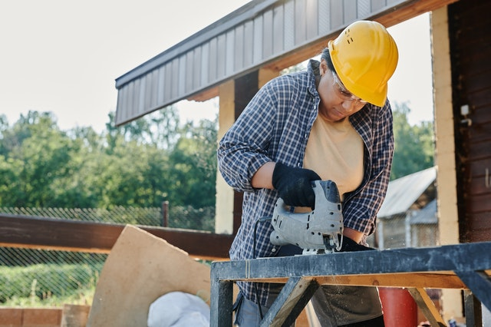
Using power tools and
static machines
15
Notes:
Narration: Here we’ll explore how to use power tools and static machines in ways that will make it safer for you and others around you.
Photo by: Mikael Blomkvist on Pexels https://www.pexels.com/photo/wood-man-people-woman-8961395/. Further permission required for reuse.

Slide 16
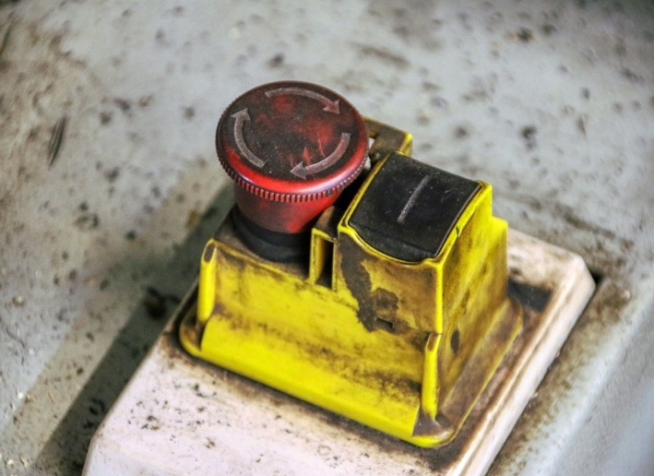
Static machines need to be level and on stable ground Know where the emergency stop/ safety cut-out button is
16
Notes:
Narration: Before you use a static machine, make sure it is on level and stable ground so that it does not tip over.
Check where the emergency stop or safety cut-out button is.
Photo by: Planet_fox on Pixabay, https://pixabay.com/photos/stud-switch-machine-begin-5239954/

Slide 17
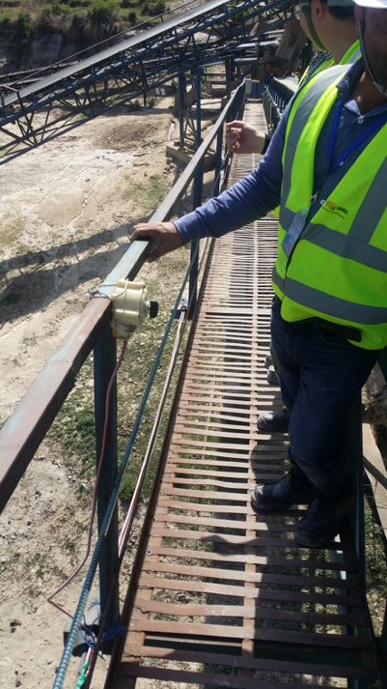
Check the emergency stop/ safety cut-out works
17
Notes:
Narration: For example, the one for this conveyor is on the handrail.
When you turn power tools and static machines on, check that the emergency stop or safety cut-out works.
If it doesn’t tell your Supervisor and do not use it until it has been repaired.
Photo by: © Jack Mozingo / World Bank. Further permission required for reuse.

Slide 18
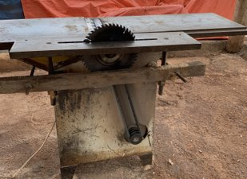
Check equipment guard is on
18
Notes:
Narration: Saws, belts, conveyors and gears should have an equipment guard so check it is in on before you start.
Here you can see that the blade does not have a guard and neither does the belt.
Both of them should have guards to prevent injuries.
Photo by: © Michael Hall / World Bank

Slide 19
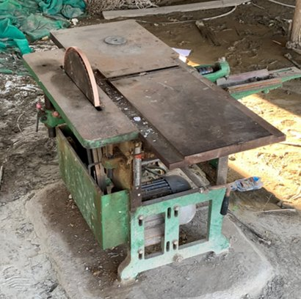
Check the equipment guard is on
19
Notes:
Narration: Like the guard on this table saw.
If there isn’t an equipment guard, tell your Supervisor and do not use it until a guard has been fitted.
Photo by: © Michael Hall / World Bank

Slide 20
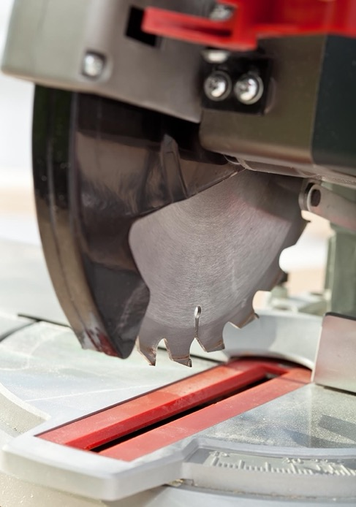
Adjust the equipment guard so there is just enough blade to do the task
20
Notes:
Narration: Adjust the equipment guard so there is just enough blade to do the task.
Photo by: Shutterstock.com

Slide 21
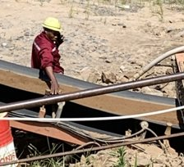
Keep your body and clothes out of tools and machines
21
Notes:
Narration: Some tools and machines have pinch points where it is possible for a person or part of their body to get trapped or crushed.
Keep all parts of your body out of tools and machines.
Here you can see the worker has his arm and hand touching the conveyor belt.
This is not safe as his arm or hand could get caught in the mechanism and seriously hurt.
And don’t wear loose fitting clothes that could get stuck in the machine and pull you in.
Photo by: © Michael Hall / World Bank. Further permission required for reuse.

Slide 22
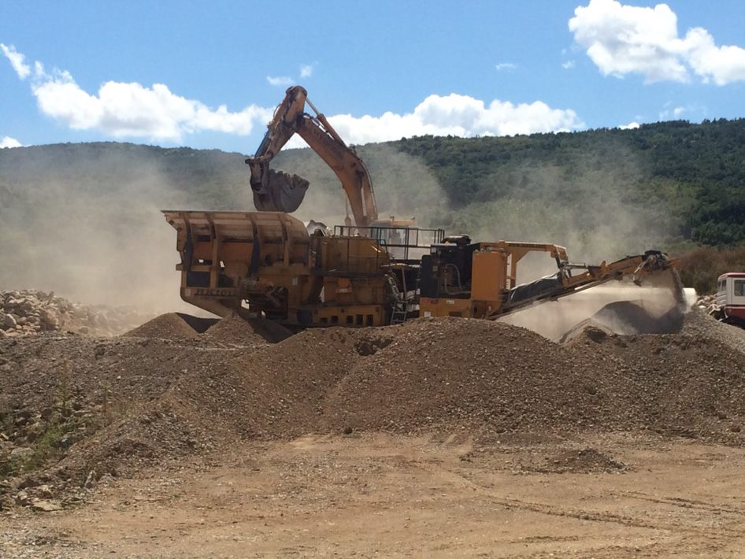
Turn off and isolate crushers before pushing rocks through
22
Notes:
Narration: For example, if you are working on a crusher, turn it off and isolate it from the power supply before you get up to push rocks through.
Never get on top of it to push rocks through when it is running.
Photo by: © Michael Hall / World Bank

Slide 23
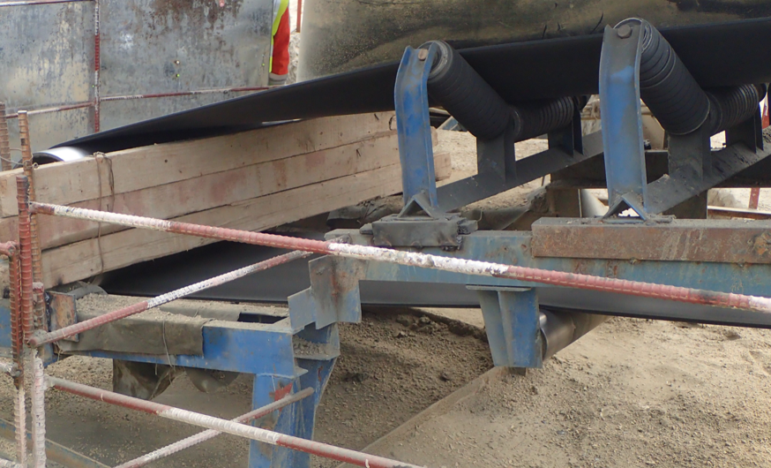
Keep doors and covers closed and barriers in place
23
Notes:
Narration: Keep the doors and covers on tools and machines closed so that people cannot get stuck or squashed.
This also reduces the noise levels to protect workers hearing and avoid disturbing the local community.
There may be barriers to keep people away from dangerous parts like the red and white one in this photo.
Note to trainer: To make the training more interactive, BEFORE this slide, ask the workers: “what should you do with doors and covers on tools and machines? The answer is: “Keep them closed”.
Photo by: © Jack Mozingo / World Bank

Slide 24
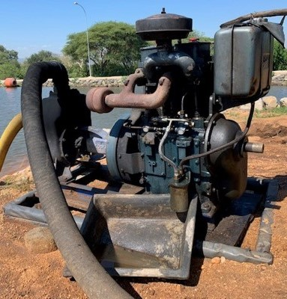
Static machines can cause pollution
24
Notes:
Narration: Static machines can leak oil or fuel into the ground causing pollution.
Here you can see that the pump is in a drip tray and another one has been added too.
This is sloping and has rainwater in it – any oil or fuel will spill out onto the ground so it will need to be checked and emptied regularly – in the way we covered in Module 8.
Photo by: © Michael Hall / World Bank

Slide 25
Top layer of oil absorbent pads
To absorb leaks and spills
Middle layer of oil absorbent granules
To absorb leaks and spills
Timber or sand bags
To hold pads in place
Bottom layer of oil absorbent pads
To absorb leaks and spills
Use oil absorbent pads under static machines, weighed down
25
Notes:
Narration: An alternative is to put a layer of oil absorbent pads under a static machine, like in this picture.
If you see a drip tray like this, check and see if the oil absorbent granules and pads are soaked with oil. If they are replace them with a layer of pads, then a layer of granules and another layer of pads – all weighed down with sandbags or timber so they don't blow away or get washed away when it rains.
Remember to put the oil-soaked pads and granules in the right hazardous waste bin.
Image by: © World Bank

Slide 26
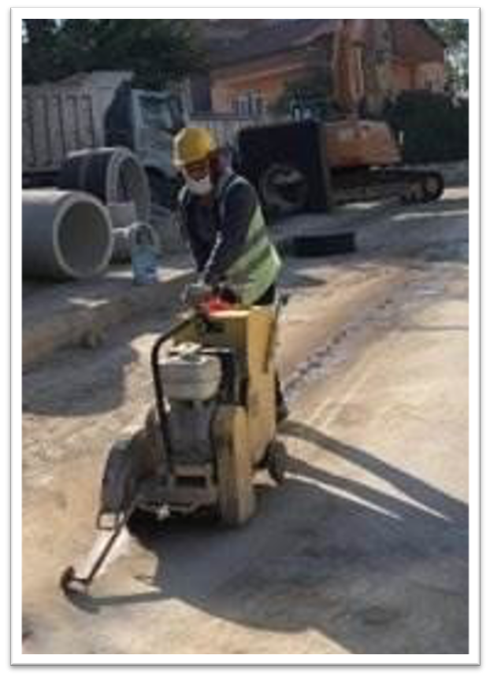
Use dust reduction system
26
Notes:
Narration: If there is a dust reduction system, switch it on and check it's working. If it isn’t tell your Supervisor.
For example, this cutter releases water as it cuts to reduce dust.
Photo by: © Canan Yildiz / World Bank

Slide 27
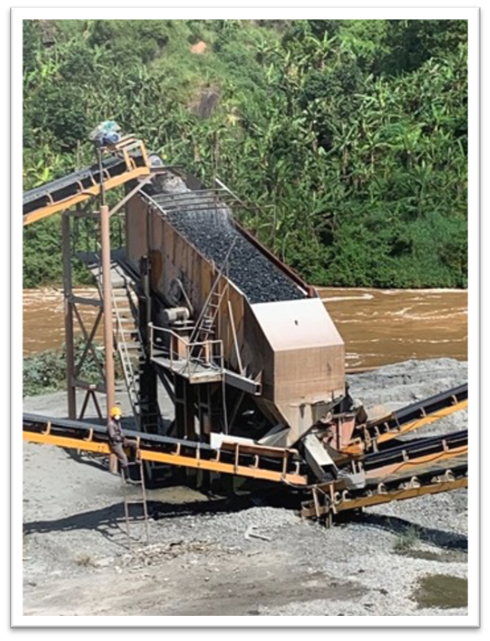
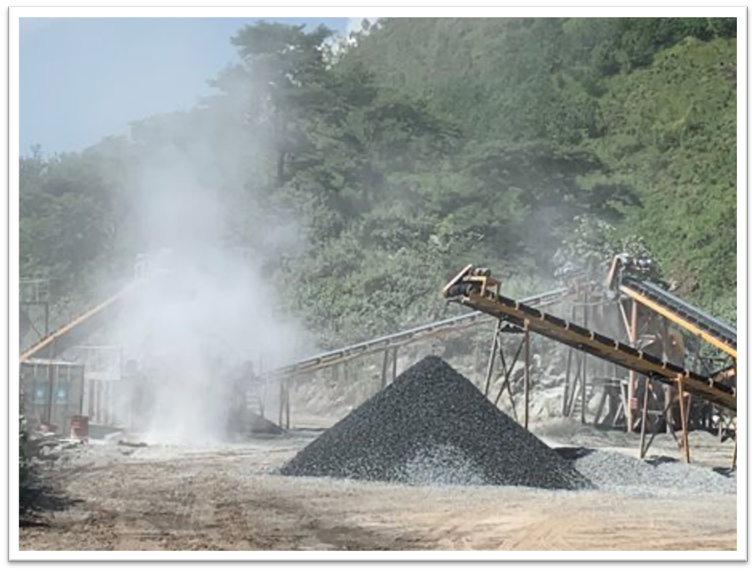
Use dust reduction system
27
Notes:
Narration: You can see this conveyor on the left is creating lots of dust because the water sprayer has not been turned on.
Here’s what it should be like on the right, with the sprayer on and, look, there’s no dust.
Note to trainer: To make the training more interactive, change “You can see this conveyor…..” into a question. Ask the workers: “What do you think is not right with this conveyor?” The answer is: It’s creating lots of dust because the water sprayer has not been turned on.
Photos by: © Michael Hall / World Bank

Slide 28
Only use tools and machines that vibrate for a limited time Keep to limits for how long you can use noisy tools
28
Notes:
Narration: There are time limits for how long you can use very noisy or vibrating tools and machines.
Because too much noise can damage your hearing and too much vibration can cause permanent damage to your hands or arms.
Only use such tools, like a concrete breaker, poker or cut-off wheel, for the allowed time.
Your Supervisor will tell you how long you can use them for, and do not use them for any longer than that.
Photo by: Shutterstock.com

Slide 29
Keep hands warm and dry with gloves
Tell Supervisor if you have changes in sensation in your hands or fingers
29
Notes:
Narration: When working with vibrating tools keep your hands warm and dry by wearing gloves.
Tell your Supervisor if you have any changes in sensation in your hands or fingers during or after working with vibrating tools.
This is feelings like tingling, numbness, stiffness, pain, swollen joints, white fingertips, loss of sensitivity, reduced grip, or painful throbbing.
Photo by: Shutterstock.com
Image by: https://en.wikipedia.org/wiki/ISO_7010, public domain

Slide 30
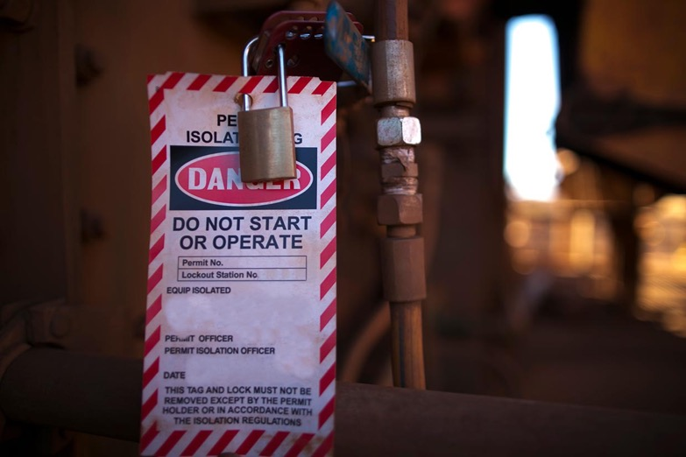
Lock out and tag out power tools and static machines that are broken or need servicing:
Disconnect from the power supply
Lock it
Label it
30
Notes:
Narration: When a power tool or static machine is broken or needs servicing, then you need to lock out and tag out to stop someone using it when it is not safe.
This means to disconnect it from the power supply, lock it and label it so that it is clear to everyone that it must not be used.
Photo by: Shutterstock.com

Slide 31
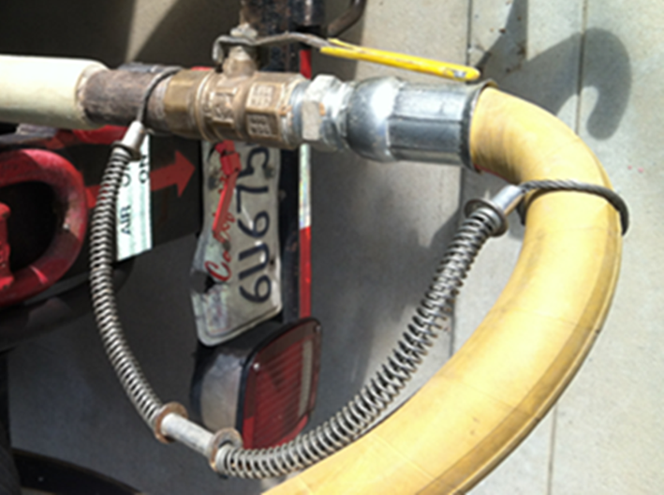
Whiplash arrestor connecting compressed air hose into compressor and equipment Never blow compressed air onto your or anyone’s body Do not use it to clean
31
Notes:
Narration: Use a whiplash arrestor, like the one in this photo, when connecting a compressed air hose into the compressor and equipment.
This will prevent the hose from injuring someone if it becomes disconnected.
Never blow compressed air onto your or anyone else's body - it can enter the bloodstream through the skin and kill you.
Do not use it to clean anything - this can damage whatever you're cleaning and particles can get stuck in your eyes, ears or skin.
Photo by: © Michael Hall / World Bank

Slide 32
32
Notes:
Narration: We’ll finish this module with four key things to remember.
Image by: © World Bank

Slide 33
Use right tool/ machine for right job, have right training
Check tools and machines before use
Wear right Personal Protective Equipment PPE
Use Safety controls
33
Notes:
Narration: 1. Use the right tool or machine for the right job and make sure you have been trained how to use it.
2. Check tools and machines before you use them - don’t use them if they are damaged.
3. Wear right the Personal Protective Equipment PPE for the type of tool or machine you are working with.
4. Use safety controls like doors, covers, and equipment guards.
Now that you know how to use tools and static machines safely, let’s see what you need to do to use electricity and electric tools safely in Module 13.
Photo by: © World Bank​. Further permission required for reuse.

Slide 34
Copyright
© 2022 International Bank for Reconstruction and Development / The World Bank
1818 H Street NW
Washington DC 20433
Telephone: 202-473-1000
Internet: www.worldbank.org
This work is a product of the staff of The World Bank with external contributions. The findings, interpretations, and conclusions expressed in this work do not necessarily reflect the views of The World Bank, its Board of Executive Directors, or the governments they represent.
The World Bank does not guarantee the accuracy, completeness, or currency of the data included in this work and does not assume responsibility for any errors, omissions, or discrepancies in the information, or liability with respect to the use of or failure to use the information, methods, processes, or conclusions set forth. The boundaries, colors, denominations, and other information shown on any map in this work do not imply any judgment on the part of The World Bank concerning the legal status of any territory or the endorsement or acceptance of such boundaries.
Nothing herein shall constitute or be construed or considered to be a limitation upon or waiver of the privileges and immunities of The World Bank, all of which are specifically reserved.
Rights and Permissions
The material in this work is subject to copyright. Because The World Bank encourages dissemination of its knowledge, this work may be reproduced, in whole or in part, for noncommercial purposes as long as full attribution to this work is given.
Any queries on rights and licenses, including subsidiary rights, should be addressed to World Bank Publications, The World Bank Group, 1818 H Street NW, Washington, DC 20433, USA; fax: 202-522-2625; e-mail: pubrights@worldbank.org.

