Slide 1
MODULE 11
Staying in worker
accommodation
For copyright details see last slide of this PowerPoint presentation
Notes:
Narration: Welcome to Module 11 Staying in worker accommodation.
This module explains what your accommodation should be like, your rights and your responsibilities to keep it safe and healthy for everyone.
Image by: © World Bank

Slide 2
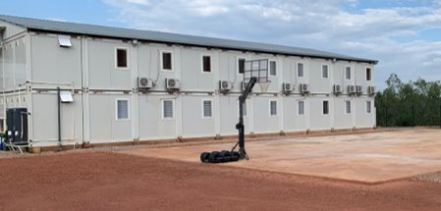
Keep safe and healthy in worker accommodation
Look after your accommodation
Know your rights
Report concerns
Notes:
Narration: By the end of this module you will be able to:
keep yourself and others safe and healthy in the worker accommodation
look after it
know your rights and
report any concerns about your accommodation.
Photo by:​ © Michael Hall / World Bank

Slide 3
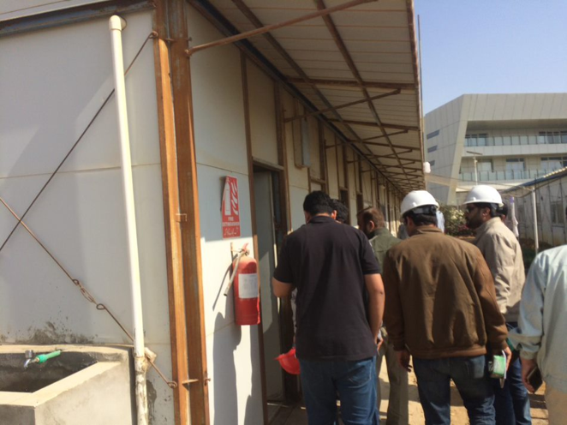
Why worker accommodation is important
3
Notes:
Narration: Let’s begin by explaining why worker accommodation is important.
Your accommodation should be set up and managed properly so that you can be comfortable and well.
Photo by:​ © Jack Mozingo / World Bank. Further permission required for reuse.
​

Slide 4
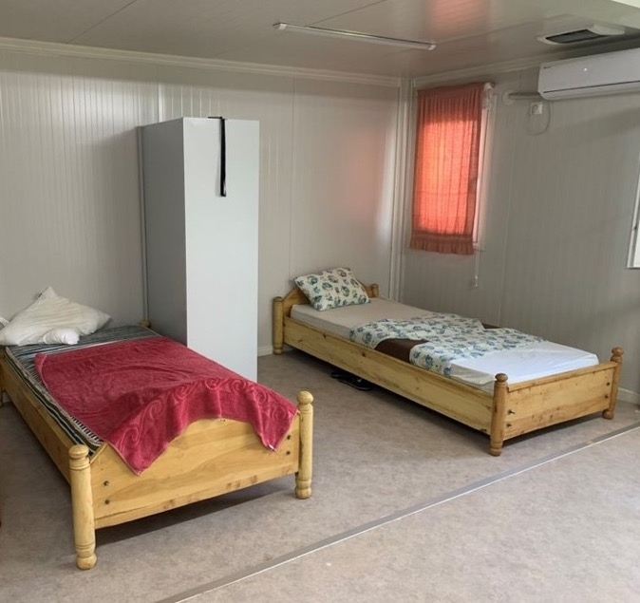
Safe and secure
Meet your basic needs
Not overcrowded
Good condition and clean
Separate bedrooms and bathrooms for men and women
4
Notes:
Narration: It should:
Be safe and secure
Meet your basic needs at least
Not be overcrowded
Be in good condition and kept clean and
Have separate bedrooms and bathrooms for men and women.
Photo by:​ © Michael Hall / World Bank

Slide 5
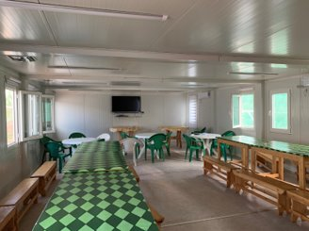
Looking after the accommodation
5
Notes:
Narration: Now we’ll see how you can help keep the facilities a good place to stay for you and everyone else.
Photo by:​ © Michael Hall / World Bank

Slide 6
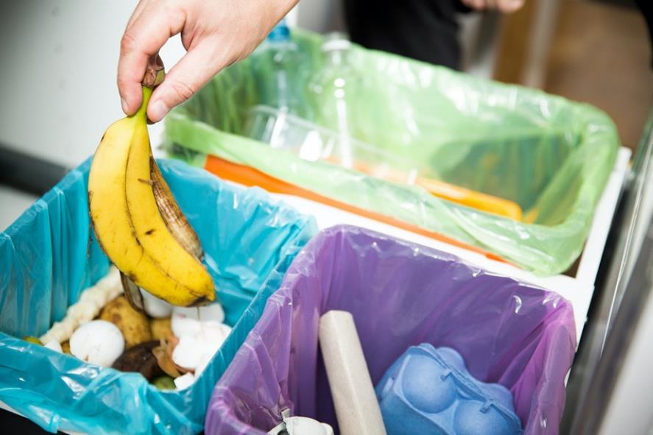
Keep it clean and tidy
Put waste in the bins
6
Notes:
Narration: Keep all areas clean and tidy - a messy room is not as safe and healthy as a tidy one.
Put waste in the bins provided.
Photo by:​ Shutterstock.com

Slide 7
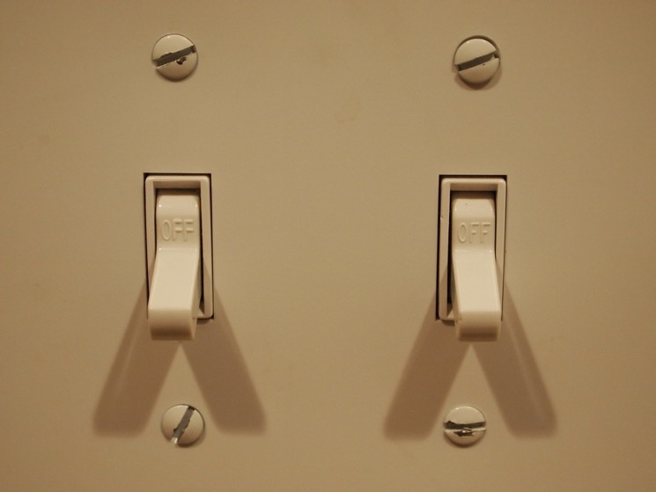
Turn off lights, heating, air conditioning, and ventilation
7
Notes:
Narration: Turn off lights, heating, air conditioning, and ventilation when you are not using them.
This is to save fuel or electricity and help combat climate change.
Photo by:​ Fried Dough, Public Domain Mark 1.0, https://wordpress.org/openverse/image/d4985711-7a23-4a47-90e1-d68e51a5ce05/?referrer=creativecommons.org

Slide 8
Be considerate
Be quiet – especially night
8
Notes:
Narration: Follow the same rules we have already covered in Module 6: Respecting yourself and others about treating people, and being treated, equally, fairly and respectfully.
Be considerate to other people staying in the accommodation.
Be quiet – especially at night so that everyone can sleep well.
Image by:​ Shutterstock.com

Slide 9
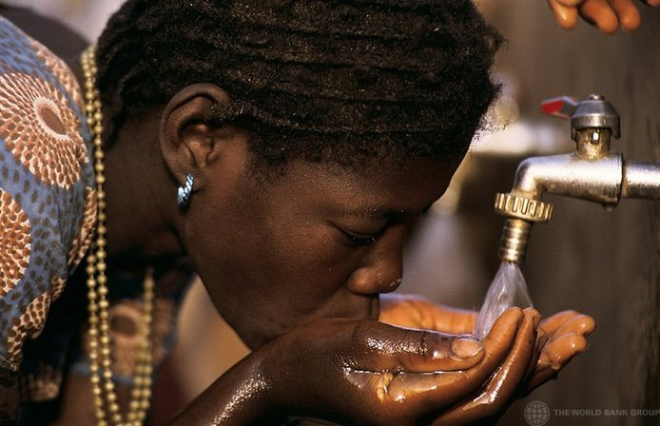
Staying safe and healthy
9
Notes:
Narration: Next we’ll explore what you need to do to stay safe and healthy which will also help to keep everyone else safe and healthy too.
Photo by:​ © Curt Carnemark/ World Bank. Further permission required for reuse.

Slide 10
If ill report to the Medical Center
10
Notes:
Narration: If you are ill, report to the medical center.
This will enable steps to be taken so that you don’t pass the illness onto anyone else in the accommodation.
Photo by:​ © Simone D. McCourtie/ World Bank. Further permission required for reuse.

Slide 11
Smoke only in smoking areas
11
Notes:
Narration: You can help prevent a fire by only smoking in proper smoking areas.
Never smoke in bed .
Image by: Shutterstock.com

Slide 12
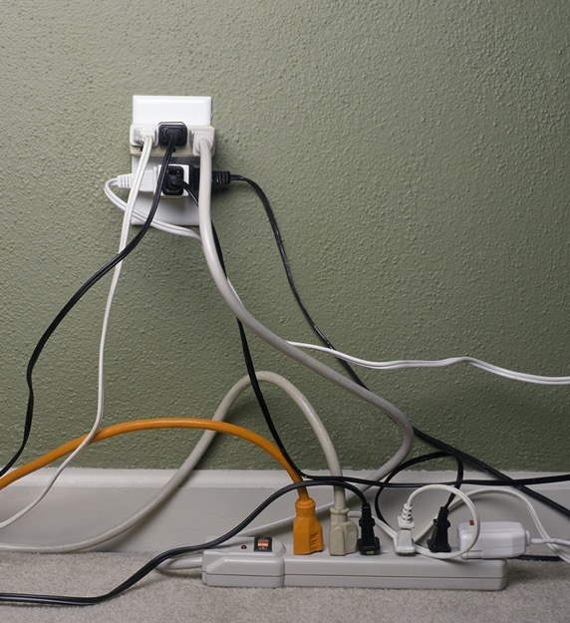
Plug electrical power strip or extension lead directly into wall socket
12
Notes:
Narration: Only plug an electrical power strip or extension lead directly into a wall socket – not into another extension lead, like this.
It can overload the electric circuit and cause a fire.
Note to trainer: To make the training more interactive, change, “Only plug an electrical extension lead …..” into a question. Ask the workers: “What’s not good about these plugs?” The answer is: in the narration
Photo by:​ Shutterstock.com

Slide 13
Know what to do and where to go in an emergency
13
Notes:
Narration: Accidents could happen in the accommodation so the things to do that we covered in Module 7: Dealing with Incidents apply in the accommodation too.
Make sure you know where to go and what to do if there is an emergency.
Images by:​ https://en.wikipedia.org/wiki/ISO_7010. public domain.

Slide 14
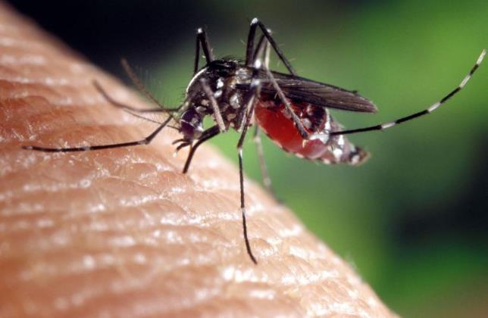
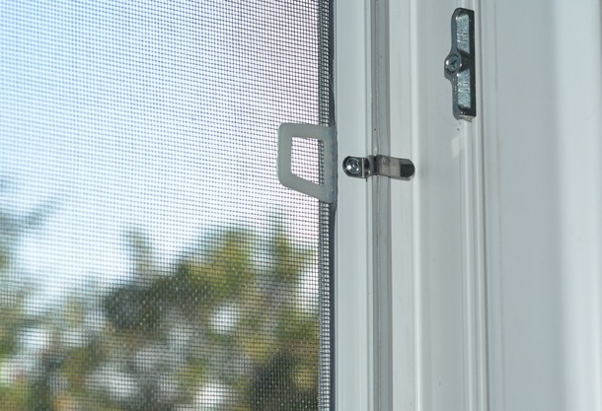
If you are in an area where insects spread diseases use:
Screens on doors and windows
Insect repellant
14
Notes:
Narration: If the accommodation is in an area where insects, like mosquitos, can spread diseases, such as malaria, you need to:
- use insect screens on doors and windows
- use insect repellant.
Photos by:​ 1. Mosquito: James Gathany, USCDCP on Pixnio, Creative Commons CC0, https://pixnio.com/fauna-animals/insects-and-bugs/mosquito/aedes-albopictus-mosquito-genus-of-the-culicine-family-of-mosquitoes
2. Mosquito screen: Shutterstock.com

Slide 15
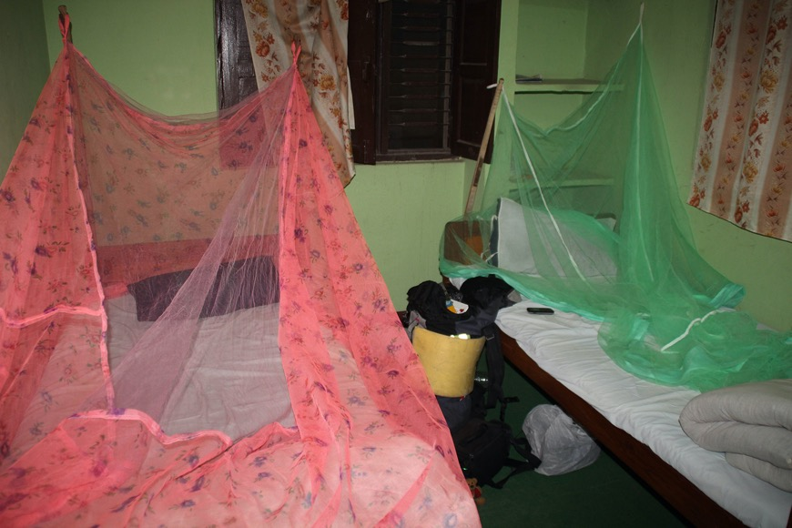
Net
Photo: Tatsiana Hendzel / Shutterstock.com
15
Notes:
Narration: And nets over your bed at night.
Photo by:​ ​Tatsiana Hendzel / Shutterstock.com

Slide 16
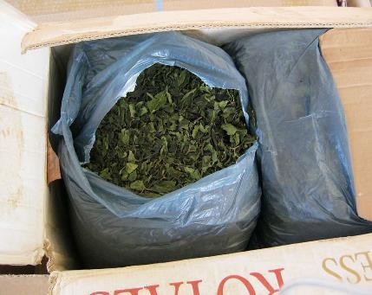
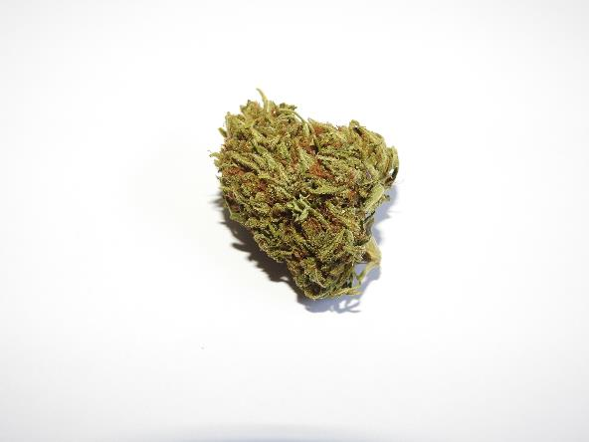
Don’t use illegal drugs and use legal drugs only in moderation
16
Notes:
Narration: Don’t use illegal drugs.
And even legal drugs have health effects so it’s best to use in moderation.
Drugs and alcohol can stay in your system for hours and affect your ability to focus and move, even the next day.
This can lead to accidents at work.
Photo by:​ 1. Syringe: RenoBeranger on Pixabay, https://pixabay.com/photos/drugs-addict-addiction-problem-2793133/
2. Khat: Public domain, https://picryl.com/media/cooperation-within-cbp-in-savannah-leads-to-largest-khat-seizure-in-agencys-18b63a
3. Cannabis: pugrawr on Pxhere, Creative Commons CC0, https://pxhere.com/en/photo/1586953
4. Beer: Adonyi Gábor on Pxhere, Creative Commons CC0, https://pxhere.com/en/photo/1606075 ​

Slide 17
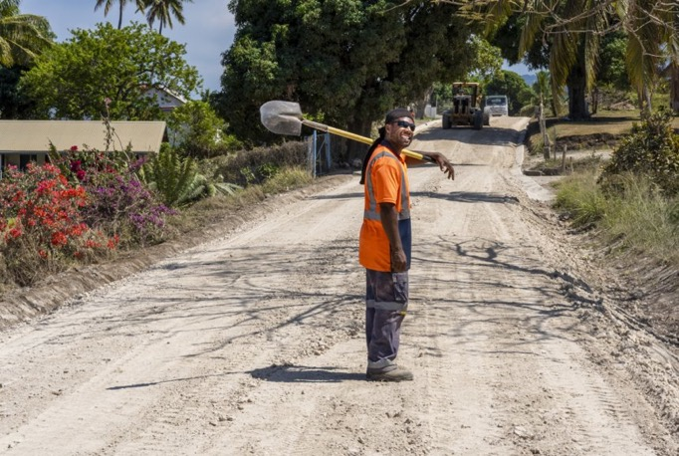
Your rights and responsibilities
17
Notes:
Narration: Now we’ll find out what your rights and responsibilities are.
You have certain rights if you are staying in worker accommodation.
Photo by:​ ​ © World Bank. Further permission required for reuse.
​

Slide 18
Accommodation rules should be fair and reasonable
If you break the rules there can be serious consequences for you
18
Notes:
Narration: You should receive a copy of the accommodation rules which should be fair, reasonable, clear and understandable to you.
If you break these rules there could be serious consequences – even losing your job and your place in the accommodation.
Photo by:​ Shutterstock.com

Slide 19
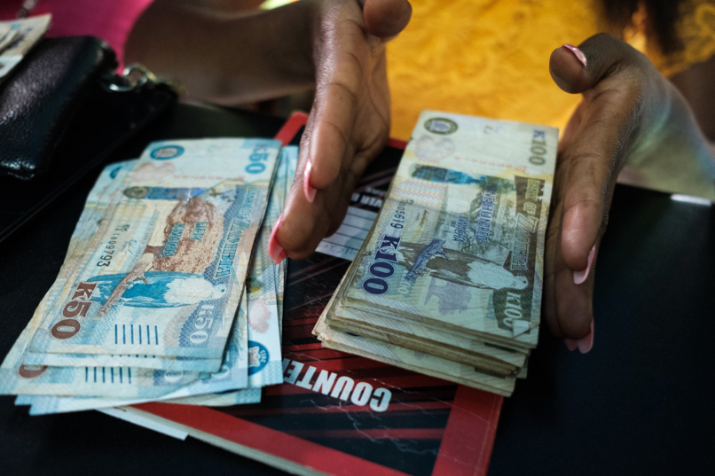
Payments for accommodation must be in your work contract or free or the same or less than the local market price
Your identify papers should never be taken
19
Notes:
Narration: Any payments for your accommodation must be stated in your work contract or be free or the same or less than the local market price.
Your identity papers should never be taken from you – no one should ask for these to secure your accommodation.
Photo by:​ © World Bank

Slide 20
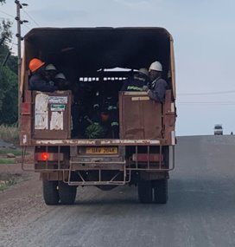
You should be free to come and go
Free transport between construction site and accommodation
Transport to and from accommodation and nearby towns or villages
20
Notes:
Narration: You should be free to come and go from your accommodation at any time – your employer cannot keep you there.
There should be free transport between the construction site and the worker accommodation.
There may also be transport to and from the accommodation and nearby towns or villages.
Photo by:​ © Michael Hall / World Bank​

Slide 21
Raise any issues or suggestions
No blame and no consequences for you
21
Notes:
Narration: If you spot anything is broken, like a ripped insect screen or a leaking tap, or have any issues about the accommodation or other workers, there should be a way for you to raise these so that they can be resolved.
It’s important that you report things.
You might prevent an accident.
Or you might have suggestions for improvements.
Speak to the manager or there should be a system for you to follow, such as a grievance mechanism.
No one should be blamed for any problems and there should not be any consequences for you or others if you raise something.
You may want to take part in a workers’ accommodation committee – or set one up if there isn’t one.
This can be a useful way to help make sure the worker accommodation is run well.
Image by: Shutterstock.com

Slide 22
22
Notes:
Narration: We’ll finish this module with three key things to remember.
Image by: © World Bank

Slide 23
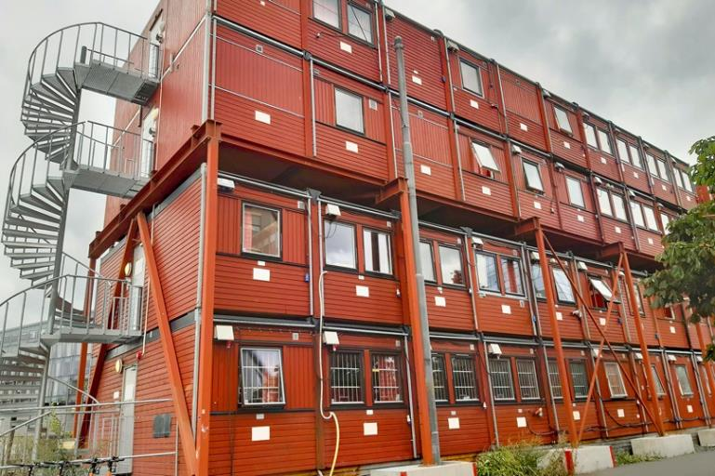
Keep it clean and tidy
Be considerate
Know your rights
23
Notes:
Narration: 1. Keep your accommodation clean and tidy
2. Be considerate and
3. Know your rights.
Now that you know how to stay safe and healthy in your worker accommodation, you have completed the second section of the general induction how to do everyday tasks – well done!
Next we’ll start the third and final section of the general induction on what you need to do when carrying out specific activities.
Photo by:​ Shutterstock.com

Slide 24
Copyright
© 2022 International Bank for Reconstruction and Development / The World Bank
1818 H Street NW
Washington DC 20433
Telephone: 202-473-1000
Internet: www.worldbank.org
This work is a product of the staff of The World Bank with external contributions. The findings, interpretations, and conclusions expressed in this work do not necessarily reflect the views of The World Bank, its Board of Executive Directors, or the governments they represent.
The World Bank does not guarantee the accuracy, completeness, or currency of the data included in this work and does not assume responsibility for any errors, omissions, or discrepancies in the information, or liability with respect to the use of or failure to use the information, methods, processes, or conclusions set forth. The boundaries, colors, denominations, and other information shown on any map in this work do not imply any judgment on the part of The World Bank concerning the legal status of any territory or the endorsement or acceptance of such boundaries.
Nothing herein shall constitute or be construed or considered to be a limitation upon or waiver of the privileges and immunities of The World Bank, all of which are specifically reserved.
Rights and Permissions
The material in this work is subject to copyright. Because The World Bank encourages dissemination of its knowledge, this work may be reproduced, in whole or in part, for noncommercial purposes as long as full attribution to this work is given.
Any queries on rights and licenses, including subsidiary rights, should be addressed to World Bank Publications, The World Bank Group, 1818 H Street NW, Washington, DC 20433, USA; fax: 202-522-2625; e-mail: pubrights@worldbank.org.

