Slide 1
MODULE 10
Lifting loads by hand
For copyright details see last slide of this PowerPoint presentation
Notes:
Narration: Welcome to Module 10: Lifting loads by hand.
This module explains what you need to know to move loads without hurting yourself.
Image by: © World Bank

Slide 2
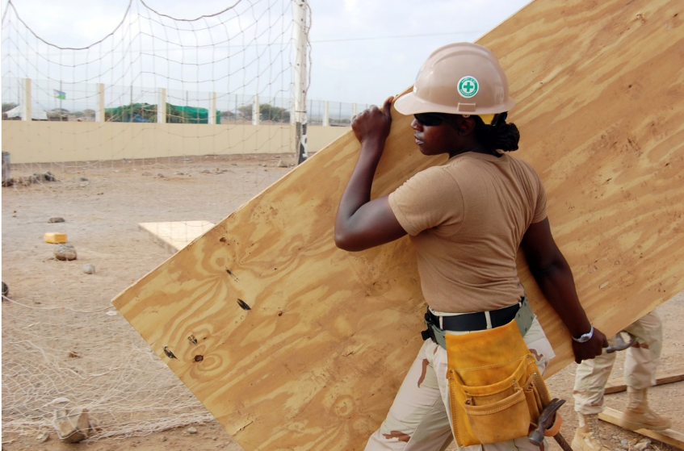
Identify hazards and risks from lifting by hand
Lift loads safely by hand
Recognize when to get help
Notes:
Narration: By the end of this module you will be able to:
identify the hazards and risks from lifting by hand
lift loads safely and
recognize when to get help with lifting.
Photo by: Pxhere, Creative Commons CC0, https://pxhere.com/en/photo/756729 Further permission required for reuse.

Slide 3
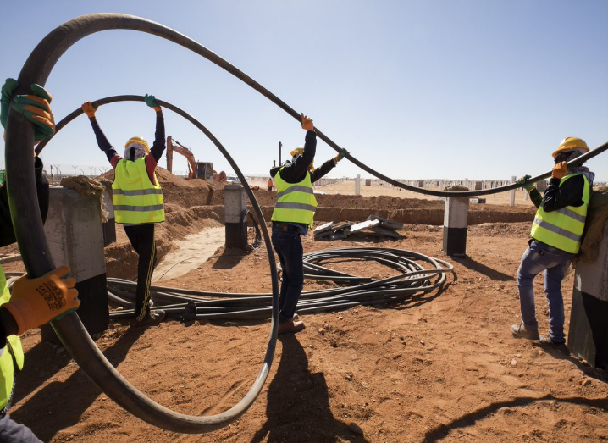
Hazards and risks of lifting by hand
3
Notes:
Narration: Let’s begin by explaining the hazards and risks of lifting by hand.
Photo by: © World Bank

Slide 4
Common cause of injury
Long-term health problems
Notes:
Narration: Moving loads is a common cause of injury at work, such damaging the back or pulling muscles.
These injuries can cause long-term health problems.
Photo by: Shutterstock.com. Further permission required for reuse.

Slide 5
Lifting by hand
Notes:
Narration: You need to know the best way to do it to stop yourself from getting hurt.
So now we’ll look at how you can do this.
Photo by: Shutterstock.com. Further permission required for reuse.

Slide 6
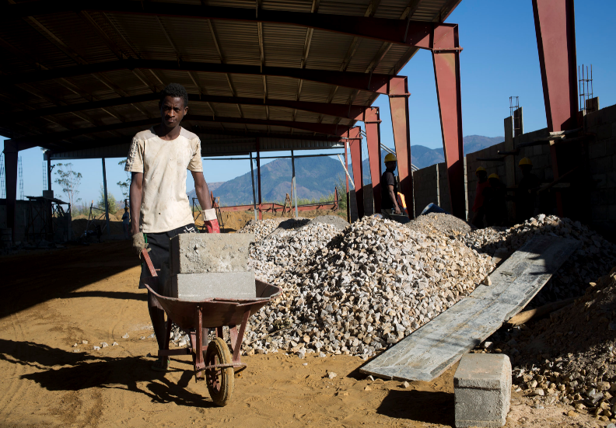
Think how going to lift load
Do not lift on your own if:
too heavy
too large
too awkward
cannot get firm grip
cannot see over or round
6
Notes:
Narration: Before you start, think about how you are going to lift the load.
For instance, is there a safer way to move it? Can you split the load into smaller loads? Or can you use a wheelbarrow? like this worker here.
Remember to check there is nothing in the way that you might slip on or trip over.
Do not lift anything on your own if it is: - too heavy - too large - too awkward - you cannot get a firm grip on it or - you cannot see over or round it.
Note to trainer: To make the training more interactive, BEFORE this slide, ask the workers: “What do you think you should do before you lift something? The answer is: given in the narration.
Photo by: © World Bank. Further permission required for reuse.

Slide 7
Get another worker to help
If several people are lifting, choose one person to call instructions
7
Notes:
Narration: If this is the case, get another worker to help. If several people are lifting, choose one person to call the instructions – this means that everyone can hear and is clear on what to do.
Photo by: Shutterstock.com. Further permission required for reuse.

Slide 8
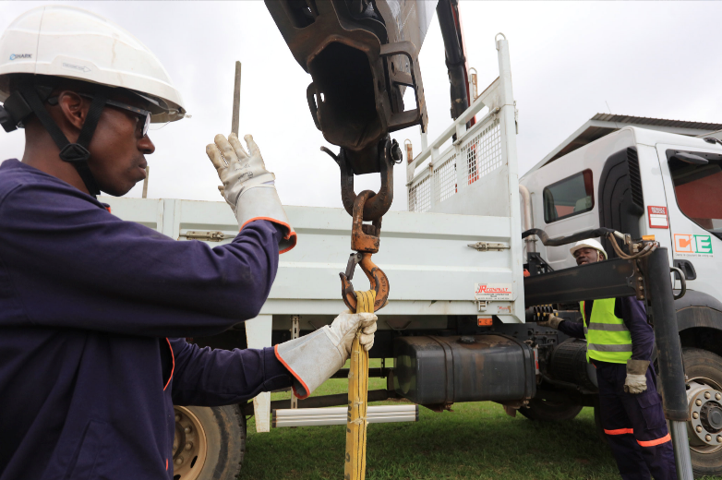
Don’t use lifting equipment unless you have had special training
8
Notes:
Narration: Or ask your Supervisor if lifting equipment can be used instead.
Don’t use lifting equipment unless you have had special training.
Photo by: © World Bank. Further permission required for reuse.

Slide 9
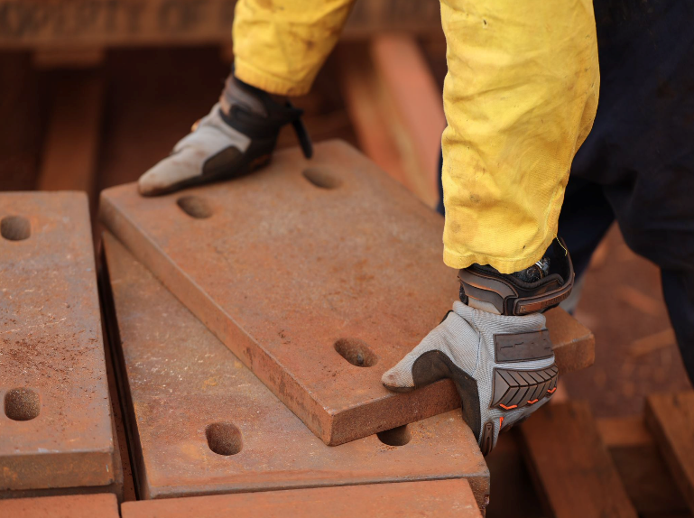
Wear gloves
Notes:
Narration: Wear gloves to avoid cuts and scratches.
Photo by: Shutterstock.com
Image by: https://en.wikipedia.org/wiki/ISO_7010, public domain

Slide 10
Bend knees, not back
Move smoothly and slowly
Keep load close to body
Avoid twisting
10
Notes:
Narration: Don’t lift like the person on the right is doing.
Do it like the person on the left. - bend your knees, not your back - move smoothly and slowly - keep the load close to your body and
avoid twisting.
Image by: Shutterstock.com

Slide 11
Notes:
Narration: Now we’ll finish this module with three key things to remember.
Image by: © World Bank
​

Slide 12
Think how you will lift the load
Get help if it’s unsafe to lift on your own
Bend your knees and move smoothly
12
Notes:
Narration: 1. Think ahead how you will lift a load
2. Get help if it’s unsafe to lift on your own
3. Bend your knees and move smoothly.
Now that you know how to safely lift loads by hand, we’ll explain what you need to do to keep worker accommodation safe and healthy in Module 11.
Photo by: Shutterstock.com. Further permission required for reuse.
​

Slide 13
Copyright
© 2022 International Bank for Reconstruction and Development / The World Bank
1818 H Street NW
Washington DC 20433
Telephone: 202-473-1000
Internet: www.worldbank.org
This work is a product of the staff of The World Bank with external contributions. The findings, interpretations, and conclusions expressed in this work do not necessarily reflect the views of The World Bank, its Board of Executive Directors, or the governments they represent.
The World Bank does not guarantee the accuracy, completeness, or currency of the data included in this work and does not assume responsibility for any errors, omissions, or discrepancies in the information, or liability with respect to the use of or failure to use the information, methods, processes, or conclusions set forth. The boundaries, colors, denominations, and other information shown on any map in this work do not imply any judgment on the part of The World Bank concerning the legal status of any territory or the endorsement or acceptance of such boundaries.
Nothing herein shall constitute or be construed or considered to be a limitation upon or waiver of the privileges and immunities of The World Bank, all of which are specifically reserved.
Rights and Permissions
The material in this work is subject to copyright. Because The World Bank encourages dissemination of its knowledge, this work may be reproduced, in whole or in part, for noncommercial purposes as long as full attribution to this work is given.
Any queries on rights and licenses, including subsidiary rights, should be addressed to World Bank Publications, The World Bank Group, 1818 H Street NW, Washington, DC 20433, USA; fax: 202-522-2625; e-mail: pubrights@worldbank.org.

