Slide 1
For copyright details see last slide of this PowerPoint presentation
Notes:
Narration: Welcome to the General Induction for Construction Workers: Safety, Health and the Environment.
It’s been produced by the World Bank and the Korea Green Growth Trust Fund to …
Photos by: © World Bank. Further permission required for reuse.

Slide 2
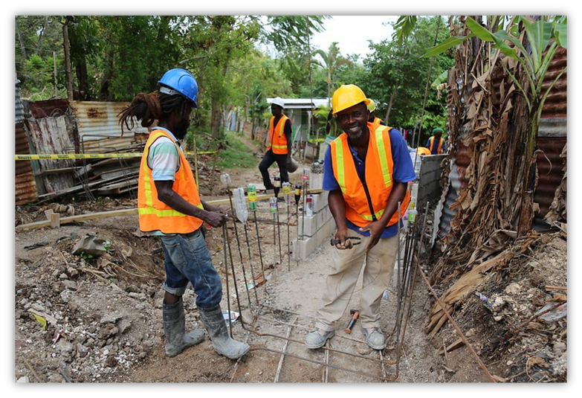
Keep yourself and others safe and healthy
Protect the environment
Know your rights and responsibilities
Notes:
Narration: …. explain what construction workers, like you, can do to keep yourself and others safe, healthy and protect the environment.
You will also find out about your rights, responsibilities and what you can do to help​.
Photo by: © Mariana Kaipper Ceratti / World Bank. Further permission required for reuse.

Slide 3
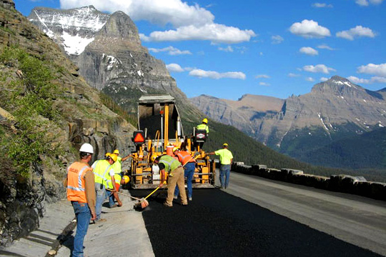
Section 1
Modules 1 – 6: Essential things to do
Section 2
Modules 7 – 11: Everyday tasks
Section 3
Modules 12 – 17: Specific activities
3
Notes:
Narration: There are 17 modules in this training, which is split into three sections:
- The first section covers the essential things you need to do on site and how to behave at work.
- The second section talks about how to do everyday tasks.
- And the third section deals with what you need to do when carrying out specific activities.
Now that you have an overview of what's coming up ….
Photo by: Wikimedia, https://commons.wikimedia.org/wiki/File: Going-to-the-Sun_Road,_construction_crew_paving_around_milepost_33.jpg, In public domain

Slide 4
MODULES 1-6 • ESSENTIAL THINGS TO DO
Notes:
Narration: … let’s begin the first section. It covers the essential things you need to do on site and how to behave at work.
We’ll look at:
- Why safety, health and the environment matter
Things you need before you start work
Avoiding hazards and risks on site
Staying healthy
Keeping the community safe and
Respecting yourself and others.
Cartoon by: © Norman Hood. / World Bank

Slide 5
MODULE 1
Why safety, health and the environment matter
Notes:
Narration: Let’s start with Module 1 Why safety, health and the environment matter.
Image by: © World Bank

Slide 6
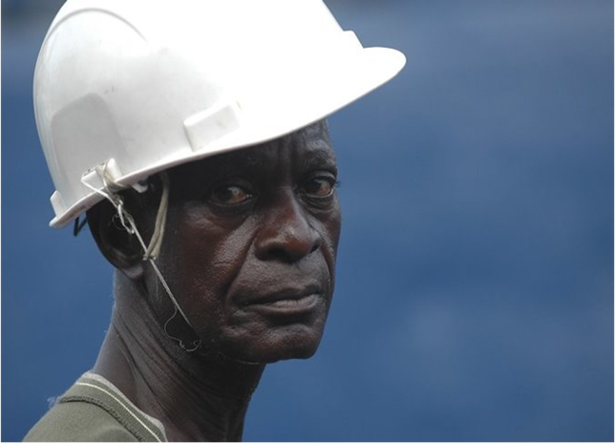
Why safety and health matter
6
Notes:
Narration: First, we’ll look at why safety and health matter.
Photo by: © Jonathan Ernst/ World Bank. Further permission required for reuse.

Slide 7
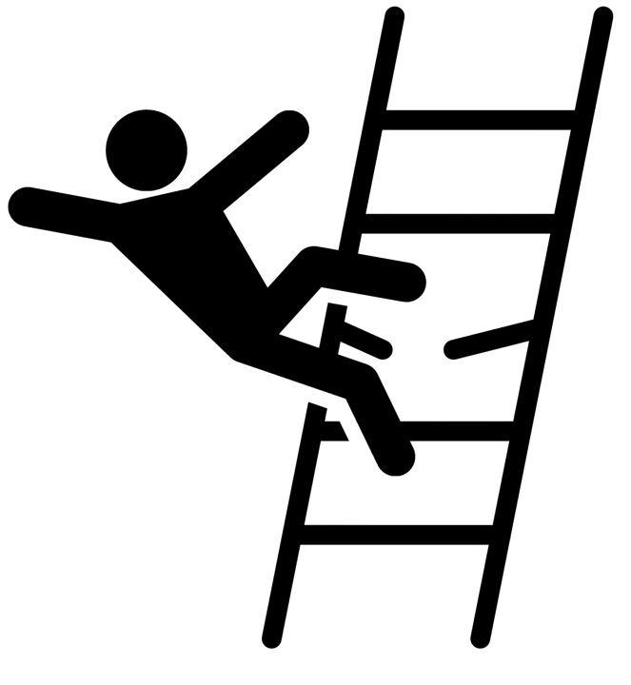
60,000 construction workers die each year
Main causes:
Falls
Being hit by vehicles
Being crushed by things falling
Getting stuck in tools or machines
Slipping or tripping over
Electrocution
7
Notes:
Narration: In the construction industry worldwide 60,000 construction workers die each year.
Some of the main causes of death are:
- Falls
- Being hit by vehicles
- Being crushed by things falling
- Getting stuck in tools or machines
- Slipping or tripping over and
- Electrocution.
Note to trainer: To make the training more interactive, before you show this slide, ask the workers: “How many construction workers do you think die worldwide every year?”
Data sources: Death figures: International Labor Organization, Safety + Health for all, key facts and figures 2016-2020
Causes of death: https://www.constructionweekonline.com/training/255830-top-10-causes-of-construction-deaths-and-how-to-prevent-site-accidents
Image by: Shutterstock.com.

Slide 8
Every day 1 million workers have accident that may leave them seriously injured
Notes:
Narration: Also every day worldwide, 1 million workers have an accident that leaves them injured – sometimes seriously injured.
Data sources: International Labor Organization, Safety + Health for all, key facts and figures 2016-2020
Photo by: Shutterstock.com.

Slide 9
Stephen’s story
Video: Institution of Engineers Tanzania with Contractors Registration Board Tanzania, Occupational Safety and Health Authority, United Kingdom Government Department for International Development and Engineers Against Poverty
Notes:
Narration: Next we’ll hear from a worker, Stephen about how an accident on site affected him.
Instruction to trainer: Click arrow to play video.
Video by: With kind permission from the Institution of Engineers Tanzania (IET) https://iet.or.tz/, extract from Usalama, Afya na Umasikini / Safety, Health & Poverty Part 1. Further permission required for reuse. https://www.youtube.com/watch?v=1mCYzqw8ZYE

Slide 10
Tango’s family
Video: Institution of Engineers Tanzania with Contractors Registration Board Tanzania, Occupational Safety and Health Authority, United Kingdom Government Department for International Development and Engineers Against Poverty
Notes:
Narration: Workplace accidents and diseases also have a severe impact on worker’s families. Find out how by listening to Tango’s story.
Instruction to trainer: Click arrow to play video.
Video by: With kind permission from the Institution of Engineers Tanzania (IET) https://iet.or.tz/, extract from Usalama, Afya na Umasikini / Safety, Health & Poverty Part 1. Further permission required for reuse.
https://www.youtube.com/watch?v=1mCYzqw8ZYE

Slide 11
Workers can get diseases
Cancer or breathing diseases
Notes:
Narration: Workers can get also diseases from an unhealthy workplace. This includes:
cancer or breathing diseases from exposure to hazardous substances like chemicals, dust or fumes
Photo by: Shutterstock.com

Slide 12
Damage to muscles or bones
Hearing loss from too much loud noise
Notes:
Narration: - damage to muscles or bones from repetitive movement or over-straining and
hearing loss from too much loud noise.
Photo by: Shutterstock.com. Further permission required for reuse.

Slide 13
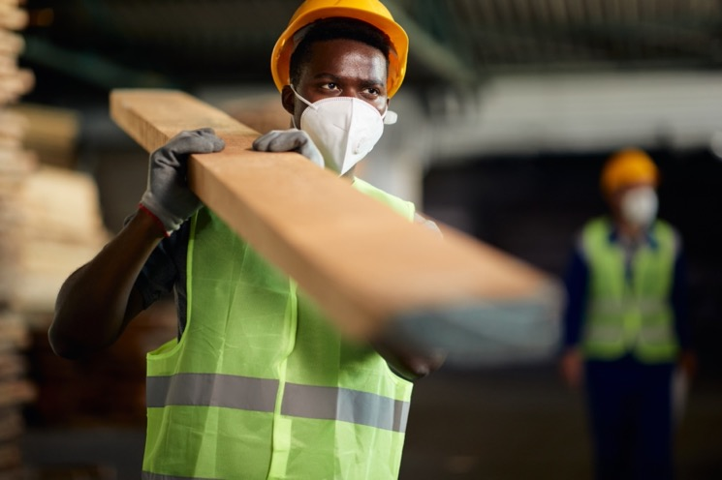
You need to be provided with:
Safe ways of working
Safe equipment
Limited exposure to hazards
You should be safe on site - everyone should go home safely
Notes:
Narration: There is some good news: most work-related deaths, injuries and diseases can be prevented.
You need to be provided with:
safe ways of working
safe equipment and
limited exposure to hazards like noise, dust and hazardous substances.
You should be safe on site and everyone should go home safely at the end of each day.
Image source: Shutterstock.com. Further permission required for reuse.

Slide 14
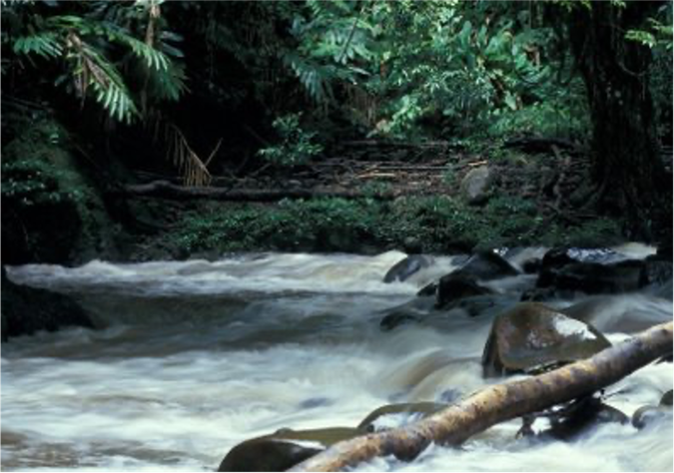
Why the environment matters
14
Notes:
Narration: Next let’s look at reasons why the environment matters.​
​
Photo by: © Curt Carnemark / World Bank

Slide 15
We rely on the natural environment for:
Air
Water
Food
Natural resources
Nature is special and sacred
Notes:
Narration: We rely totally on the natural environment to survive: the air we breathe and the water we drink, cook and wash with.
The food we eat from the land, rivers and seas.
We use natural resources, like timber and rock, to make things.
And many people feel nature is special or sacred.
Photo by: © John Hogg / World Bank

Slide 16
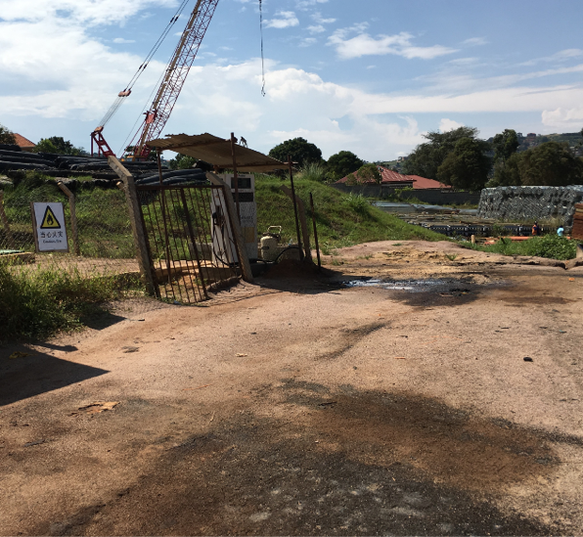
Construction can:
Damage nature and wildlife
Cause soil pollution
Notes:
Narration: Sadly the environment is being harmed by human activities.
And the construction industry contributes to this.
It can:
damage nature and wildlife
cause pollution, like this oil spill – oils and chemicals can pollute soil and water. And …
Note to trainer: To make the training more interactive, at the beginning of this slide, ask the workers: “What impacts do you think construction has on the environment?”.
Sources of statistics: Energy - https://globalabc.org/sites/default/files/inline-files/2020%20Buildings%20GSR_FULL%20REPORT.pdf
Water - https://www.researchgate.net/publication/322315967_Impacts_of_booming_concrete_production_on_water_resources_worldwide
Photo by: © Michael Hall / World Bank

Slide 17
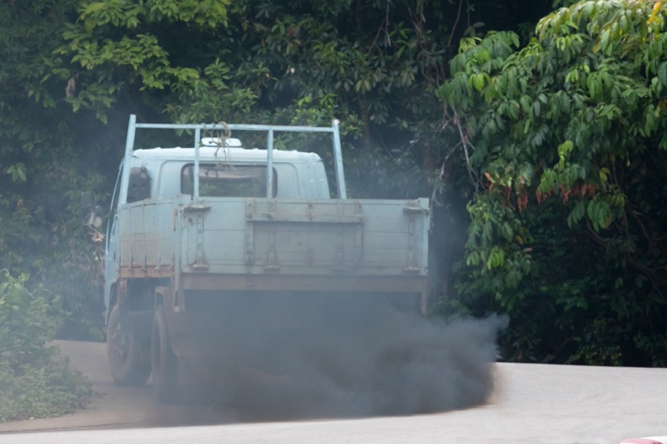
Cause air pollution and add to climate change
Notes:
Narration: Pollution like the fumes from this truck also pollute the air. This adds to climate change which is altering the weather and making droughts, storms, floods and fires more common.
Photo by: Shutterstock.com

Slide 18
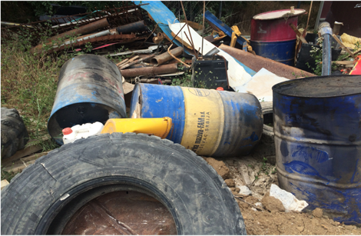
Use up limited natural resources
Creates waste
18
Notes:
Narration: The construction industry also
- uses limited natural resources like metals, fuel and water and
- creates waste, like this waste dumped here.
We need to find better ways to work to stop this damage and restore the natural environment.
There isn’t another planet, so we need to look after this one.
Photo by: © Michael Hall / World Bank

Slide 19
Be efficient with materials
Protect wildlife and restore nature
Stop polluting air, water and soil
Notes:
Narration: There are lots of things that people working on construction sites can do to reduce the environmental impact.
We can:
Be efficient with materials like fuel and timber to use fewer natural resources
Protect wildlife and restore nature areas, for example by planting trees
Stop polluting the air, water and soil, for instance by storing chemicals properly like this.
Photo by: © Michael Hall / World Bank

Slide 20
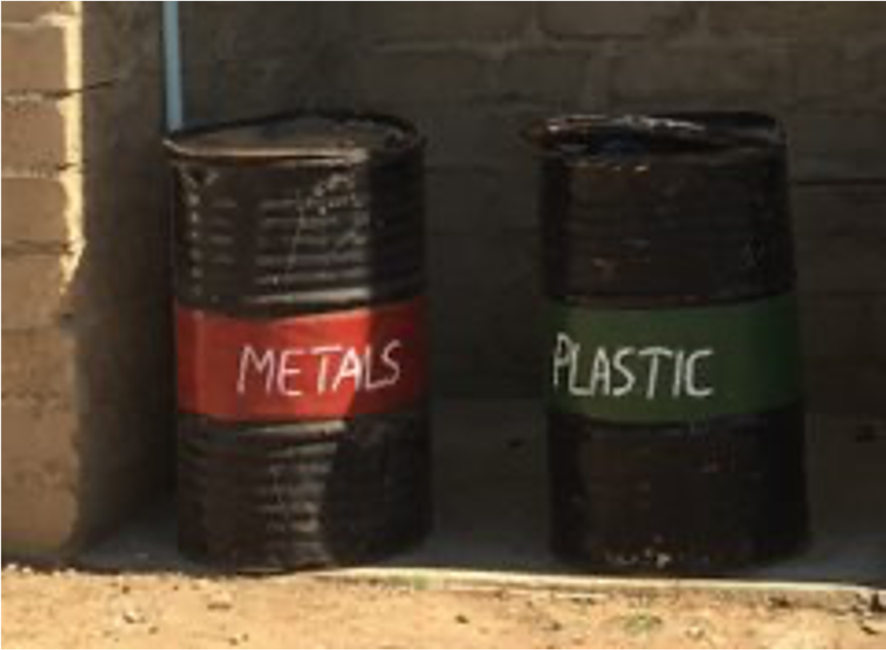
Avoid waste
Recycle
Notes:
Narration: And avoid producing waste and recycle more, using bins like these.
Photo by: © Michael Hall / World Bank

Slide 21
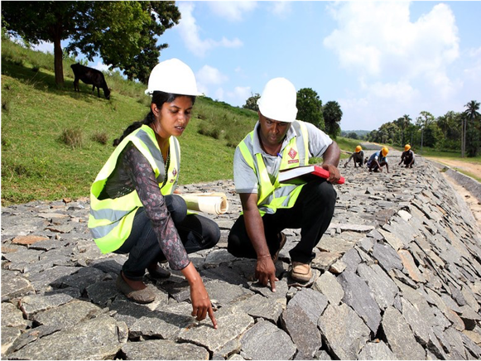
More reasons why safety, health and the environment matter
21
Notes:
Narration: There are a few more reasons why safety, health and the environment matter.
Photo by: © Lakshman Nadaraja/ World Bank. Further permission required for reuse.

Slide 22
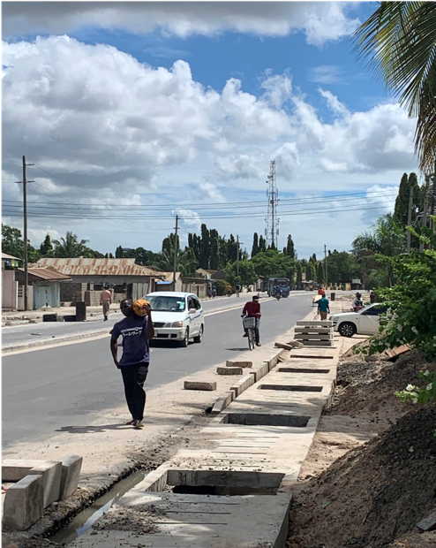
Protect the community
Accidents kill or injure members of the community
Work can damage their property, land or crops
Work can pollute their air, water or soil
Notes:
Narration: We also need to protect the community.
This includes people living and working near the site or road users passing by. They can all be affected by:
Unsafe work that causes accidents that kill or injure members of the community
Damage to their property, land or crops
Pollution of air, water or soil.
Photo by: © Michael Hall / World Bank. Further permission required for reuse.

Slide 23
Protect the community
Work can disturbance or interfere with business
Unacceptable behavior by workers can result in complaints
Notes:
Narration: - Disturbance and
- unacceptable behavior from people working on site can result in distress to the community and complaints, and could stop the project (which means you will not be paid).
Photo by: © Michael Hall / World Bank. Further permission required for reuse.

Slide 24
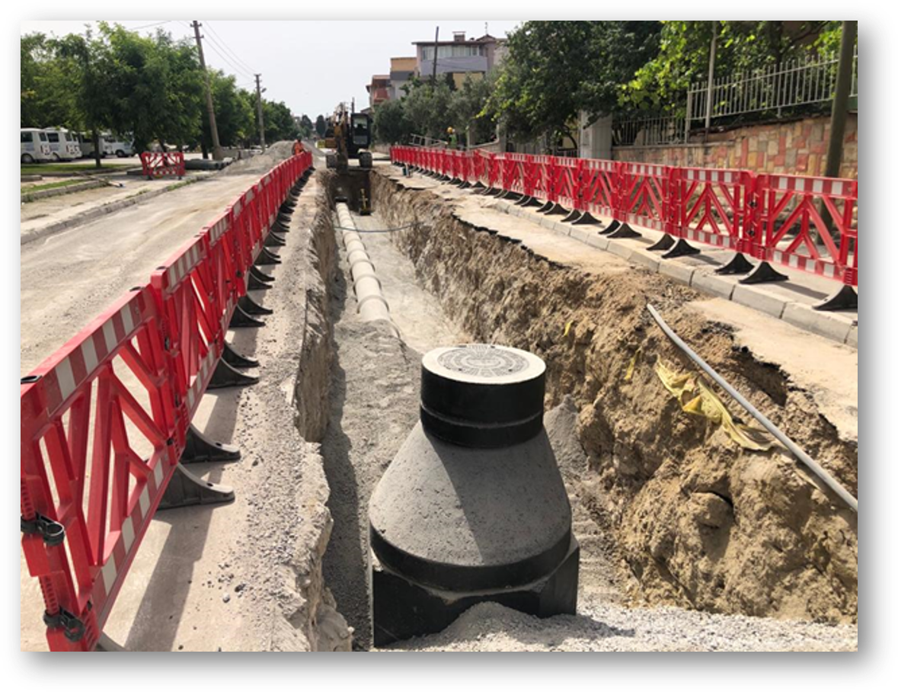
Protect the community
Protect the community from accidents
Notes:
Narration: Construction projects need to look after the community.
It’s simple to do.
For example, we can protect them from accidents by putting up barriers like these to keep people out of the work area.
Photo by: © Canan Yildiz / World Bank

Slide 25
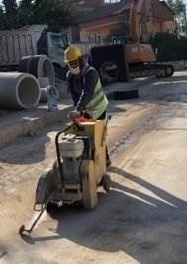
Protect the community
Stop polluting
Notes:
Narration: And we can stop polluting the air by using water to prevent dust as this worker is doing.
Photo by: © Canan Yildiz / World Bank

Slide 26
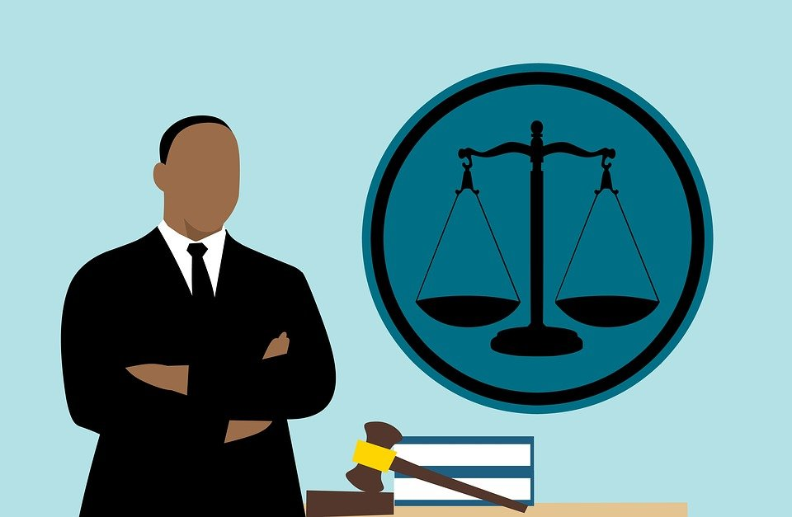
The Law
Follow the rules
Notes:
Narration: Another thing we need to do is to obey the law.
Unsafe workplaces and pollution are illegal and those guilty may be fined or even go to jail.
Image by: Mohamed Hassan on Pixabay. https://pixabay.com/illustrations/lawyer-judge-african-cartoon-man-3819044/

Slide 27
To keep work opportunities
Work responsibly
Notes:
Narration: Also, by working responsibly, you will help ensure that projects continue to be invested in, providing work for you and your community in the future.
Organizations that pay for construction projects, like the World Bank, want to make sure that their money is spent in a way that protects workers, the community and the environment.
Photo by: © Albes Fusha/ World Bank. Further permission required for reuse.

Slide 28
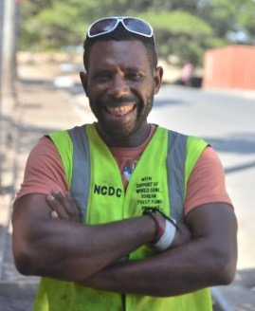
What you can do to help
28
Notes:
Narration: Finally let’s look at what you can do to help.
What you do at work on construction sites really matters.
Photo by: © Tom Perry/ World Bank. Further permission required for reuse.

Slide 29
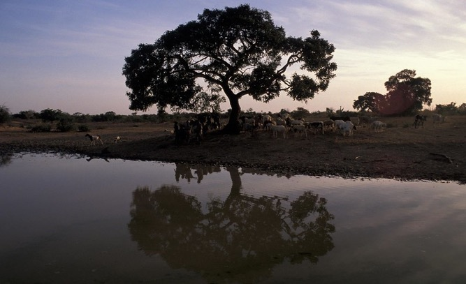
Follow the good practice in this training
29
Notes:
Narration: You can make a positive difference by following the good practice in this training.
All these things are easy to do.
You might need to change a few habits, but you’ll soon get the hang of it.
Your actions will help make sure everyone goes home safely every day, that everyone stays healthy and the environment is protected from damage.
Now we’ll move onto Module 2 about things you need to know before you start work.
Photos by: : 1. Worker: Shutterstock.com. Further permission required for reuse.
2. Tree and river: © Curt Carnemark / World Bank

Slide 30
Copyright
© 2022 International Bank for Reconstruction and Development / The World Bank
1818 H Street NW
Washington DC 20433
Telephone: 202-473-1000
Internet: www.worldbank.org
This work is a product of the staff of The World Bank with external contributions. The findings, interpretations, and conclusions expressed in this work do not necessarily reflect the views of The World Bank, its Board of Executive Directors, or the governments they represent.
The World Bank does not guarantee the accuracy, completeness, or currency of the data included in this work and does not assume responsibility for any errors, omissions, or discrepancies in the information, or liability with respect to the use of or failure to use the information, methods, processes, or conclusions set forth. The boundaries, colors, denominations, and other information shown on any map in this work do not imply any judgment on the part of The World Bank concerning the legal status of any territory or the endorsement or acceptance of such boundaries.
Nothing herein shall constitute or be construed or considered to be a limitation upon or waiver of the privileges and immunities of The World Bank, all of which are specifically reserved.
Rights and Permissions
The material in this work is subject to copyright. Because The World Bank encourages dissemination of its knowledge, this work may be reproduced, in whole or in part, for noncommercial purposes as long as full attribution to this work is given.
Any queries on rights and licenses, including subsidiary rights, should be addressed to World Bank Publications, The World Bank Group, 1818 H Street NW, Washington, DC 20433, USA; fax: 202-522-2625; e-mail: pubrights@worldbank.org.

